Slide 1
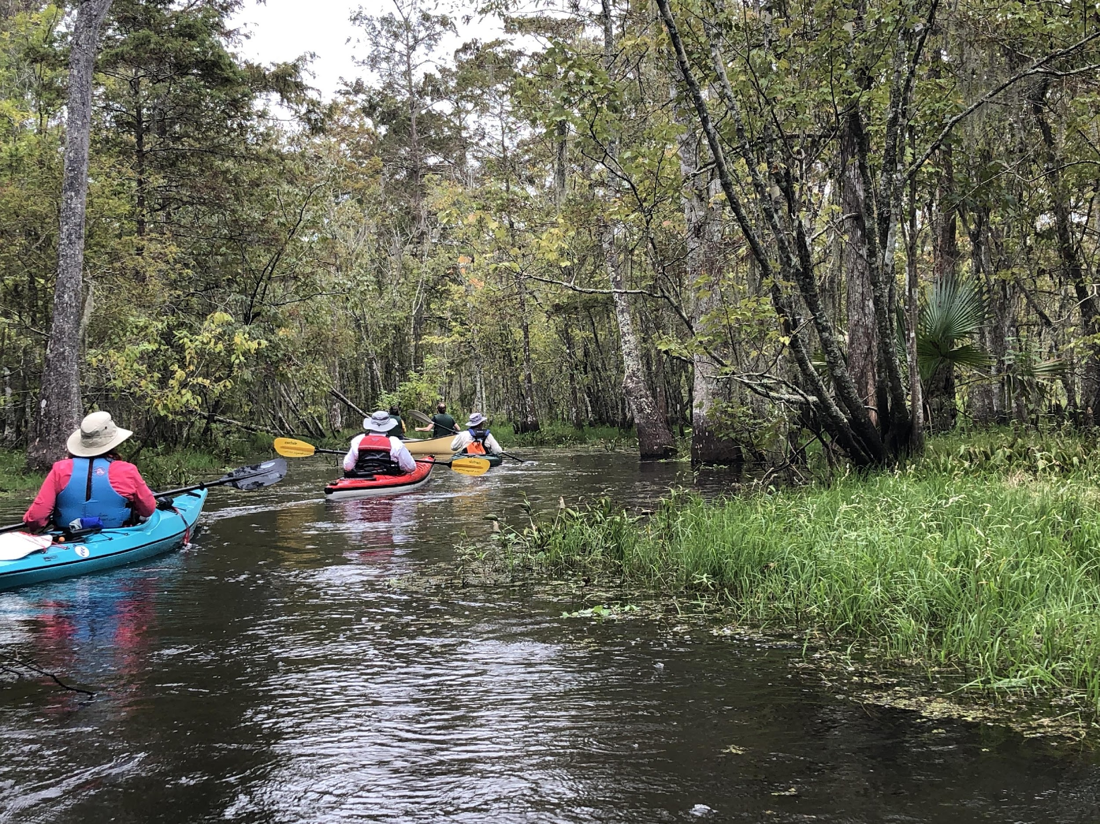
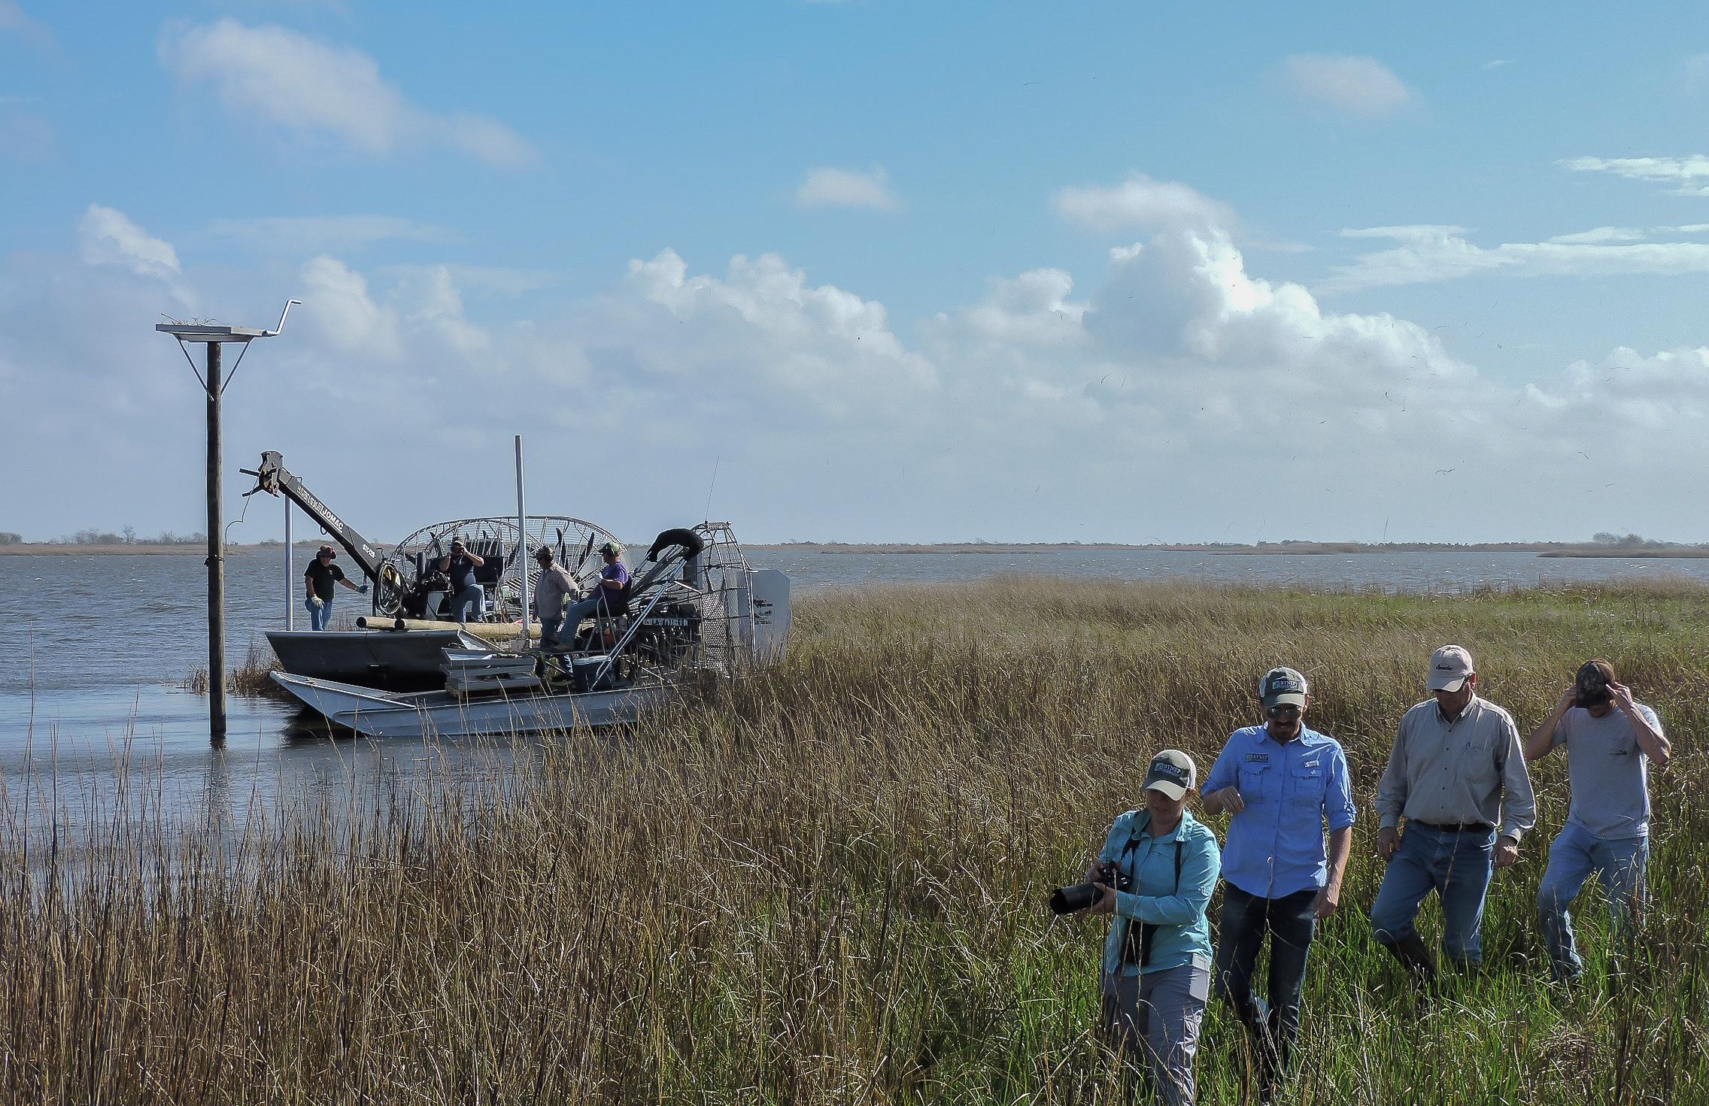
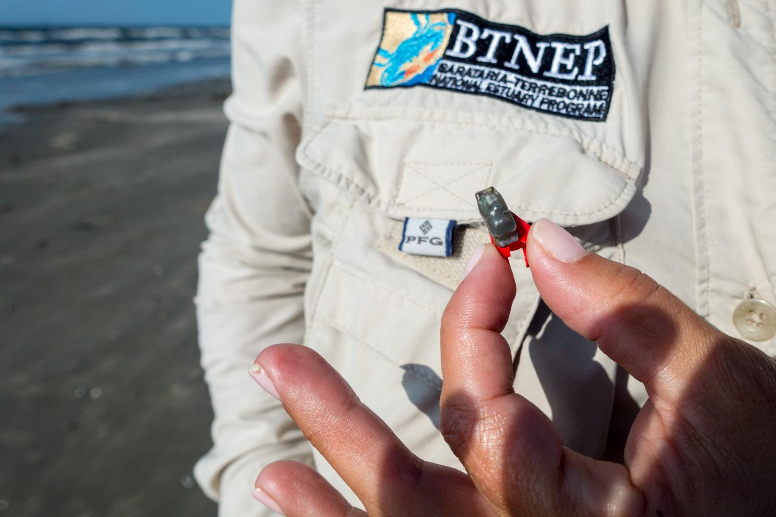
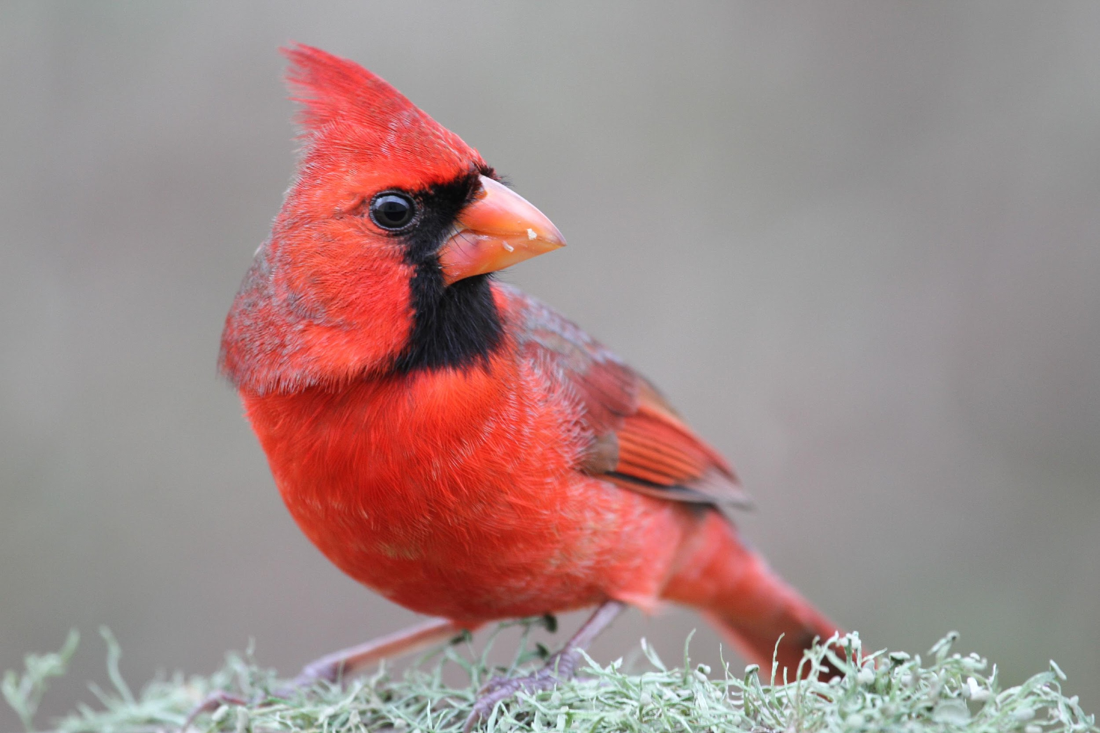
Barataria-Terrebonne National Estuary Program
Management Conference Meeting #97
Director’s Report | November 4, 2021

Slide 2
BTNEP Moves Forward…
Post-COVID, Post-Ida

Slide 3
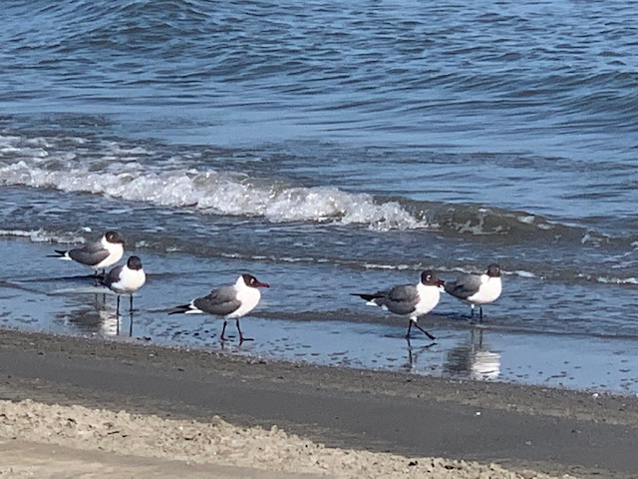
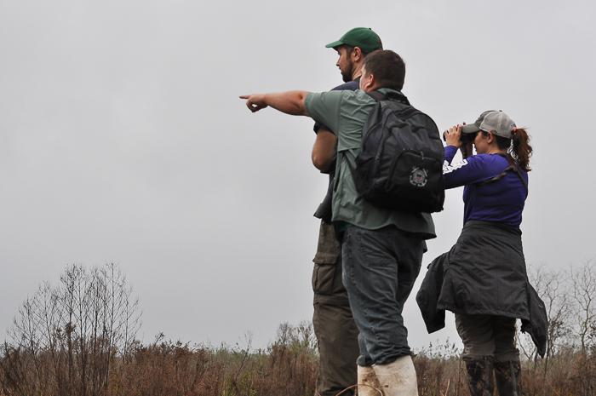
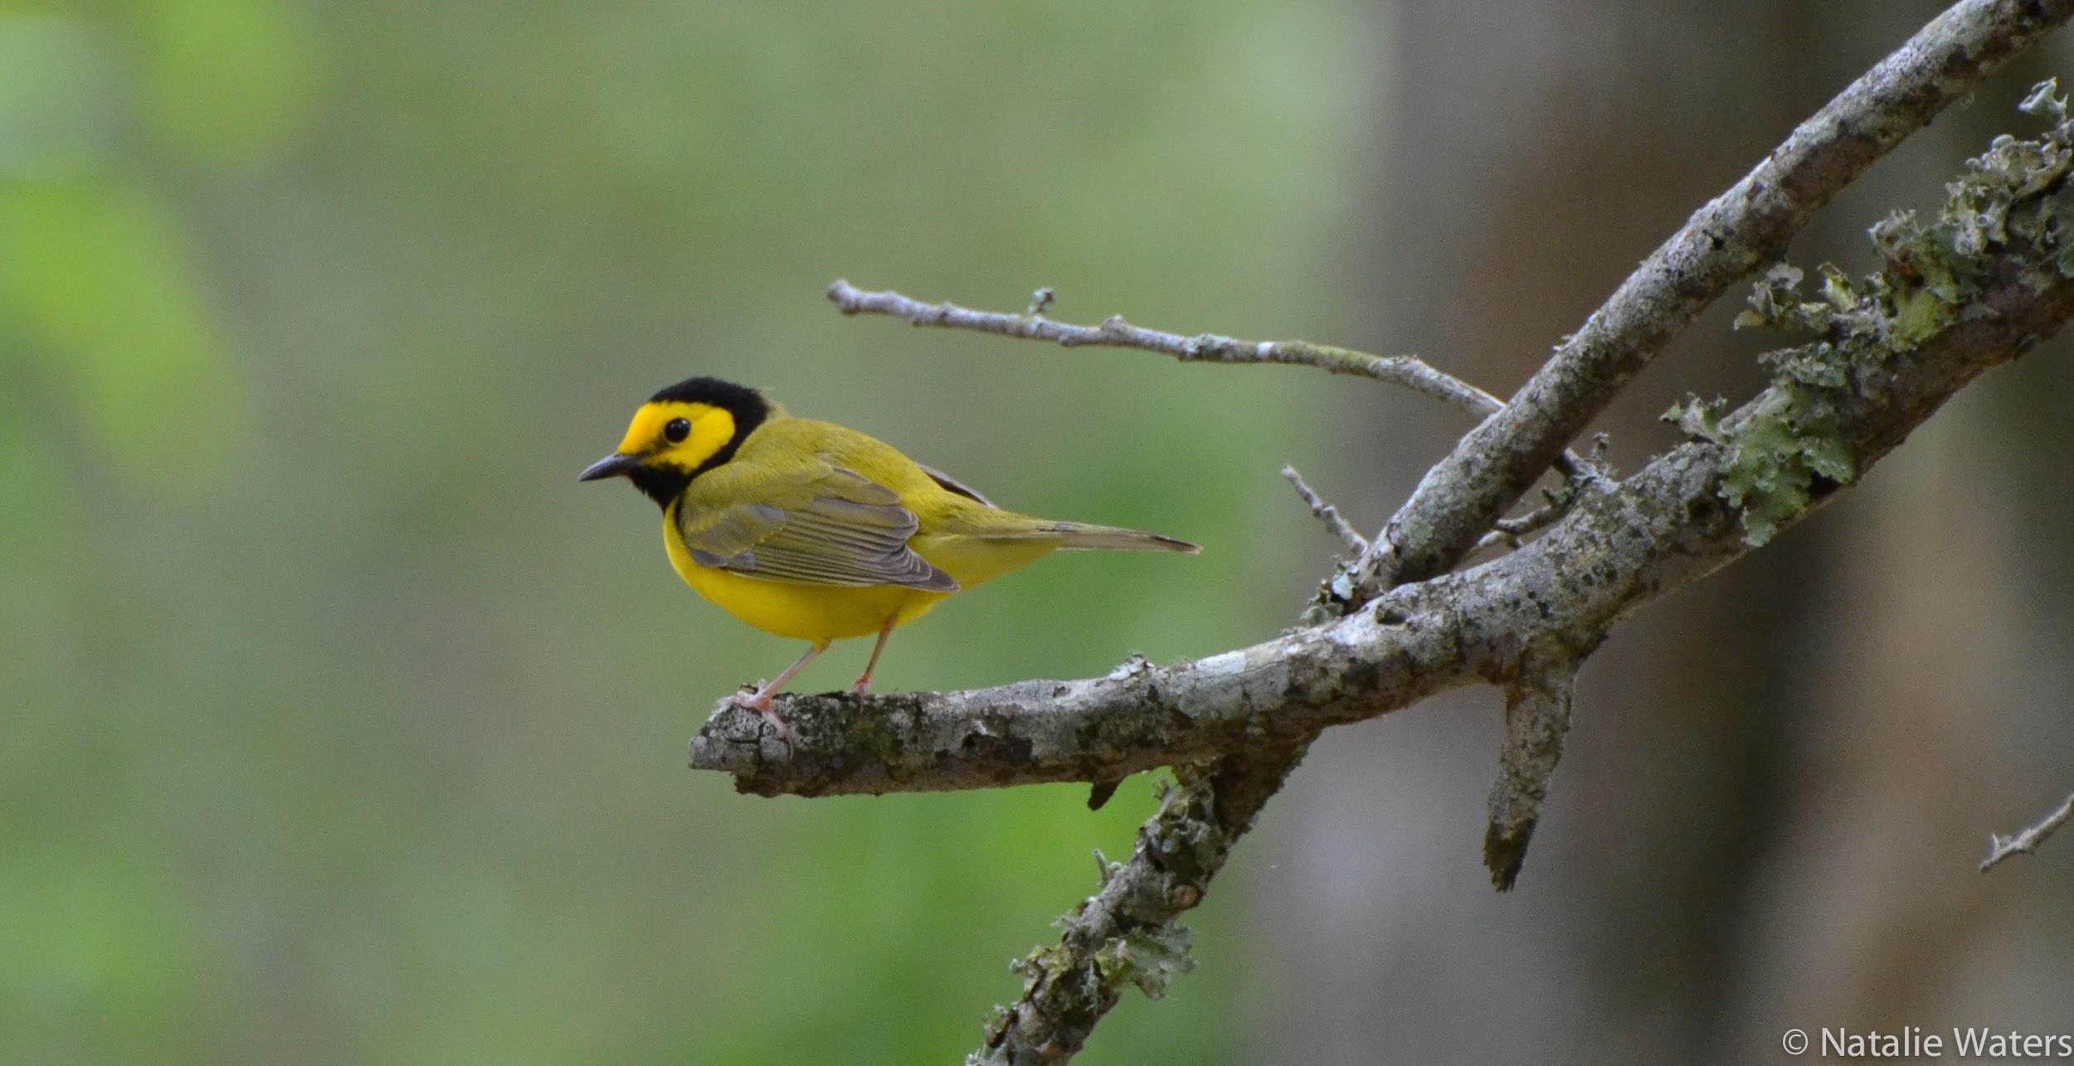
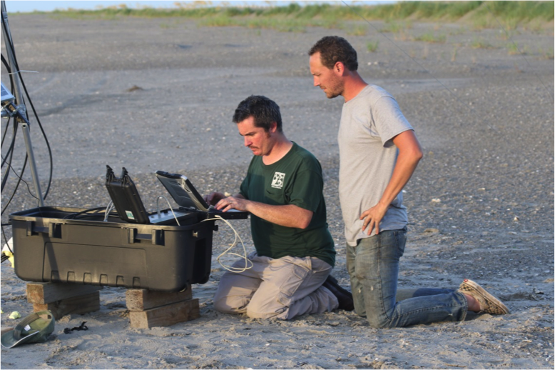
RECENT HIGHLIGHTS & ACTIVITIES
EPA accepts workplan and authorizes a new contract, effective October 2, 2021
Water Quality — monitoring in the Bayou Lafourche and Bayou Folse watersheds and Wetland Assimilation Project with Nicholls State University
Director’s Report | November 4, 2021

Slide 4
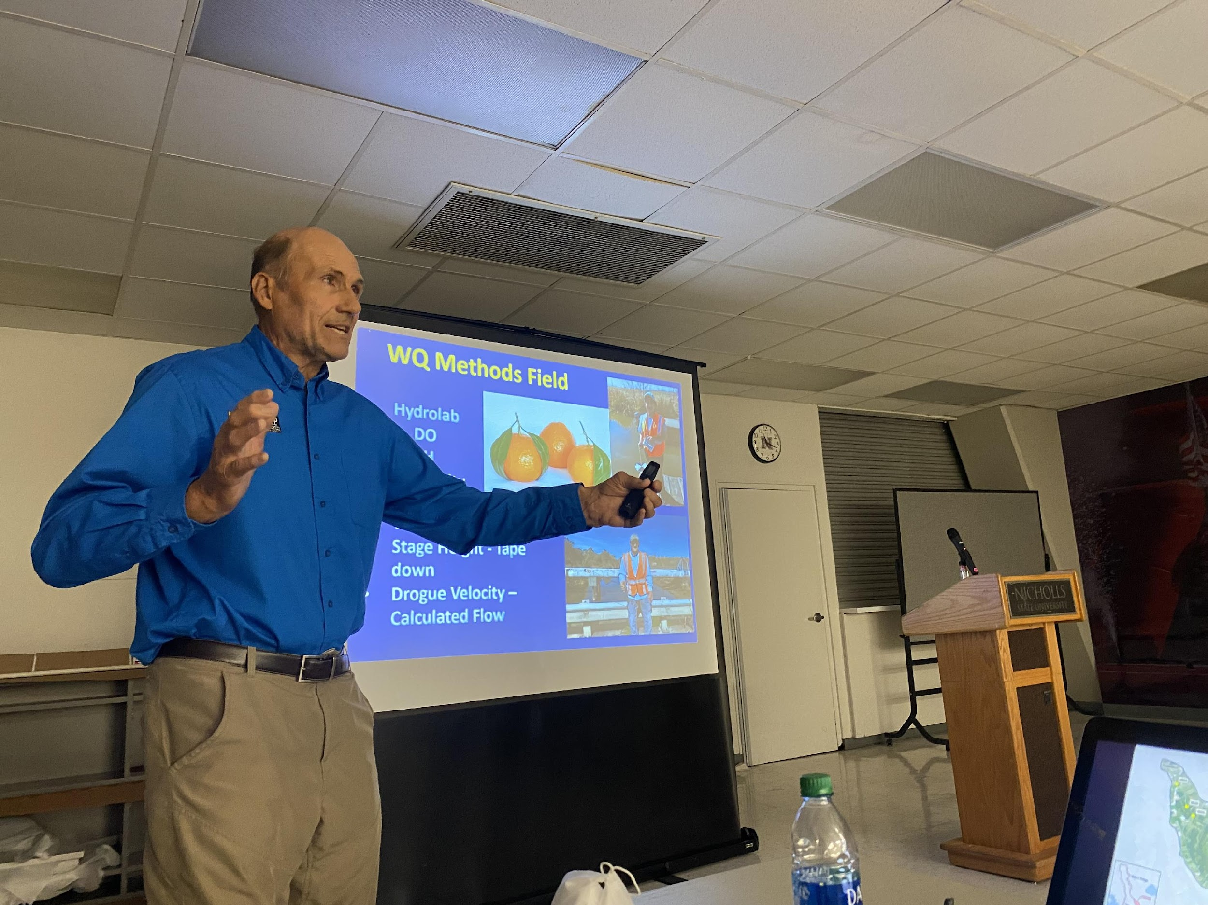

Slide 5
RECENT HIGHLIGHTS & ACTIVITIES
EPA accepts workplan and authorizes a new contract, effective October 2, 2021
Water Quality — monitoring in the Bayou Lafourche and Bayou Folse watersheds and Wetland Assimilation Project with Nicholls State University
Ongoing work and expansion (and repairs) at Plant Production facility at the Nicholls State University farm
Director’s Report | November 4, 2021

Slide 6
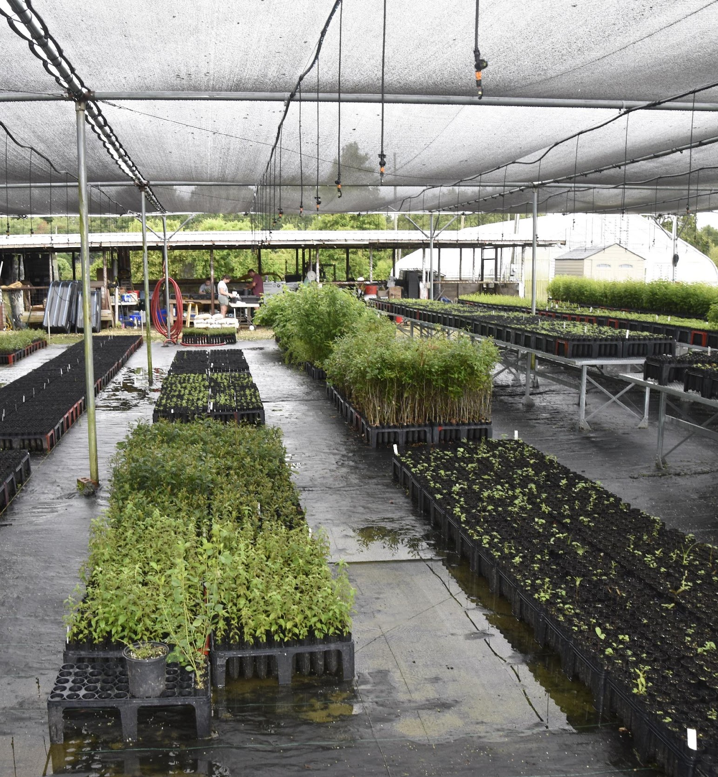
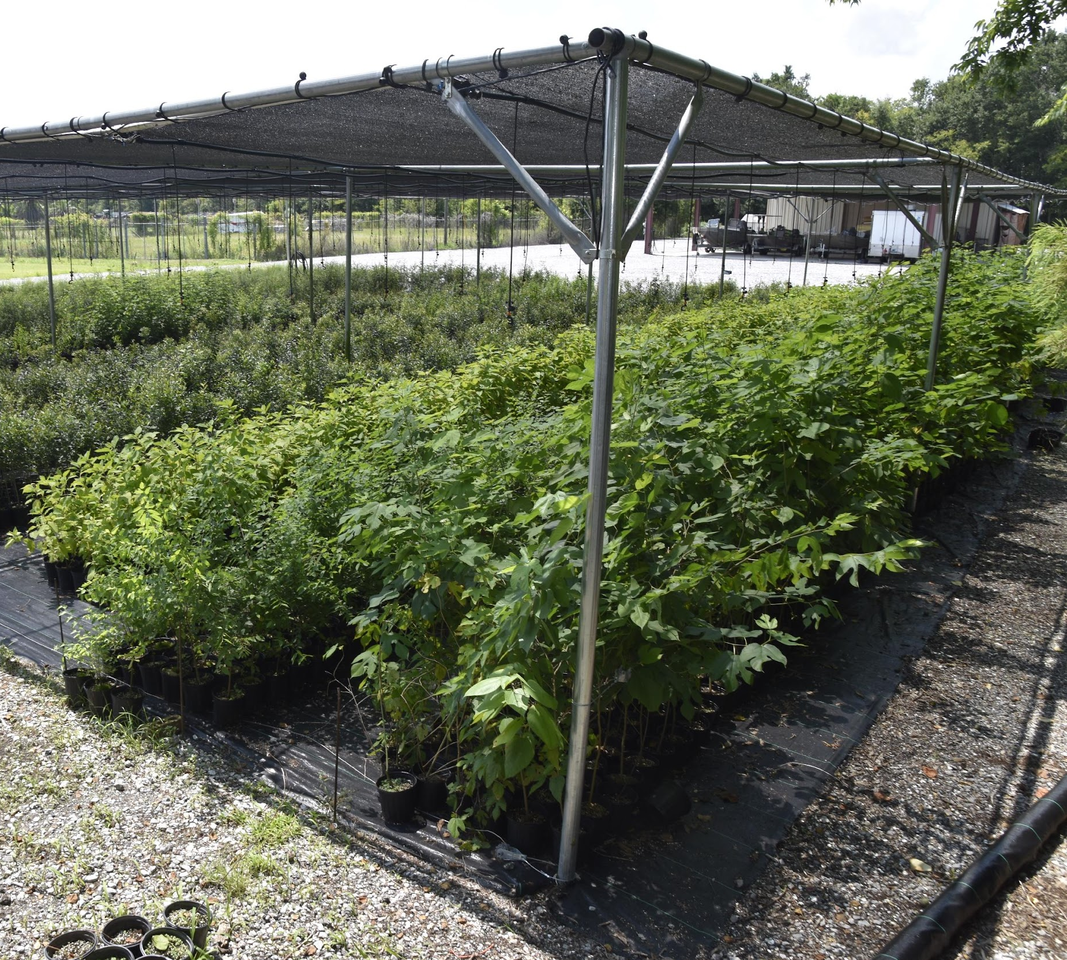

Slide 7
RECENT HIGHLIGHTS & ACTIVITIES
EPA accepts workplan and authorizes a new contract, effective October 2, 2021
Water Quality — monitoring in the Bayou Lafourche and Bayou Folse watersheds and Wetland Assimilation Project with Nicholls State University
Ongoing work and expansion (and repairs) at Plant Production facility at the Nicholls State University farm
Resiliency Education & Outreach
Director’s Report | November 4, 2021

Slide 8
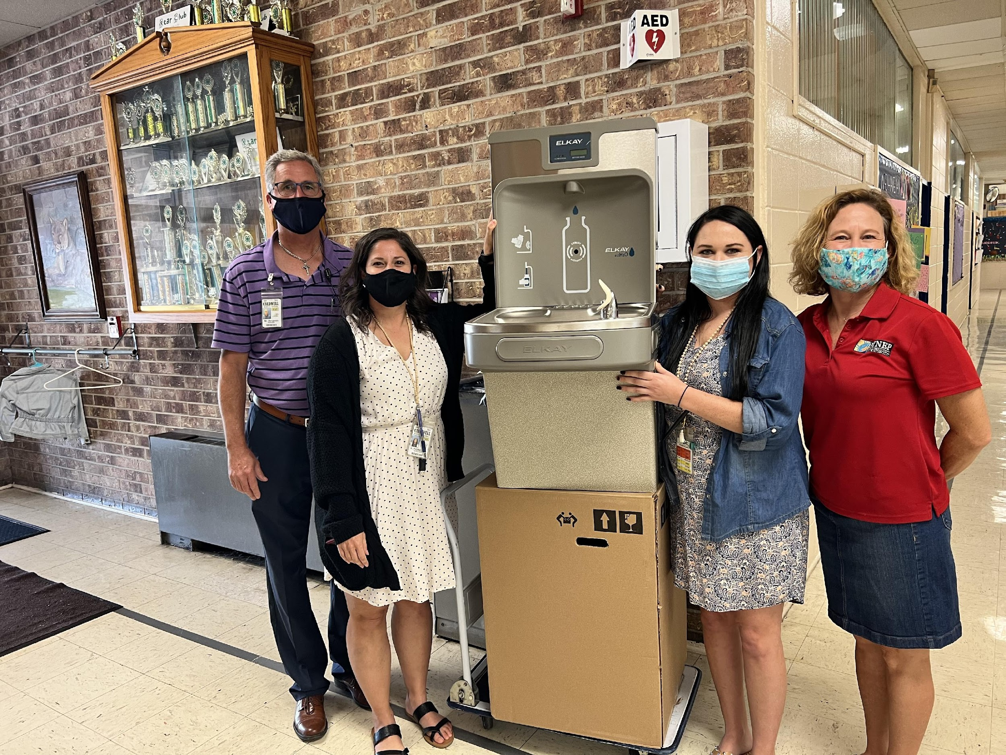
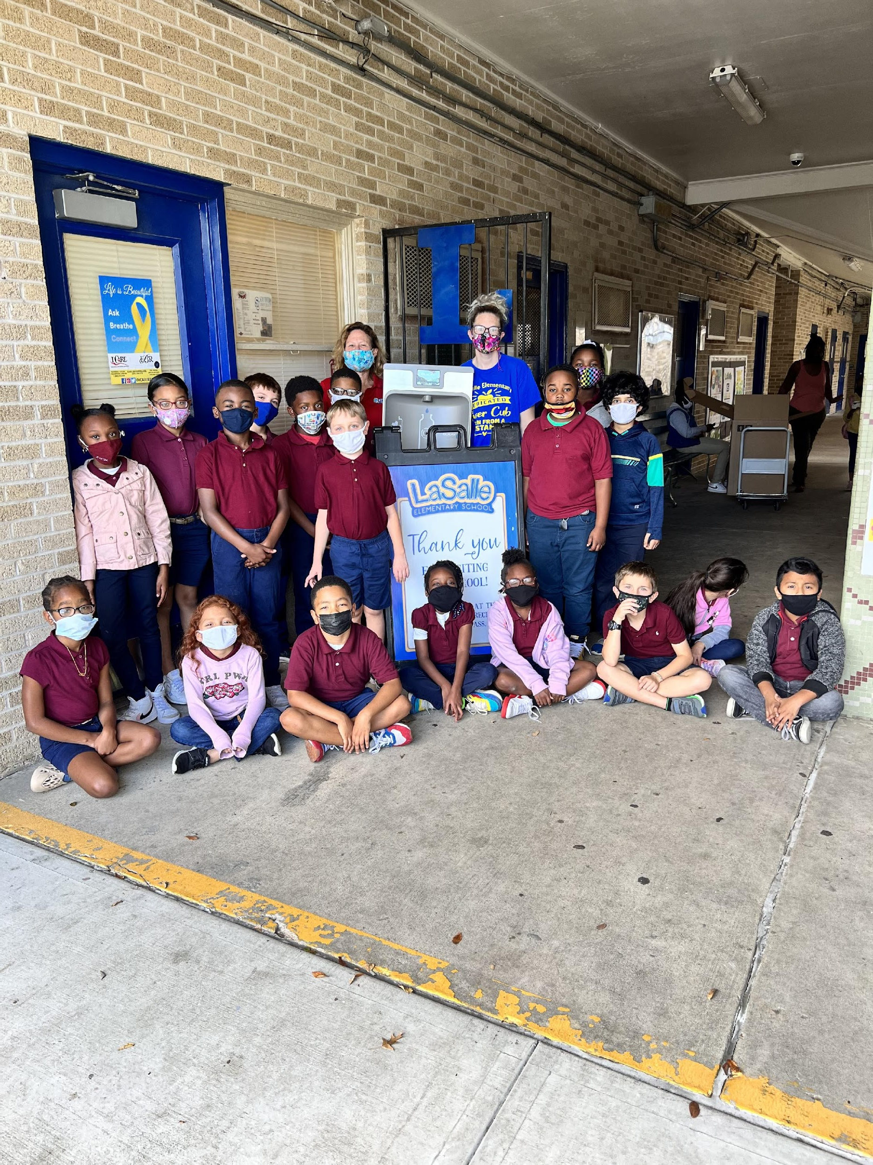
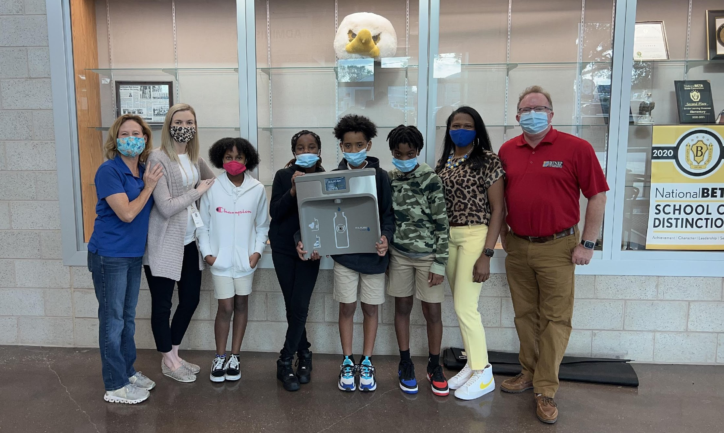

Slide 9
RECENT HIGHLIGHTS & ACTIVITIES
EPA accepts workplan and authorizes a new contract, effective October 2, 2021
Water Quality — monitoring in the Bayou Lafourche and Bayou Folse watersheds and Wetland Assimilation Project with Nicholls State University
Ongoing work and expansion (and repairs) at Plant Production facility at the Nicholls State University farm
Resiliency Education & Outreach
Habitat – Pollinator Gardens
Director’s Report | November 4, 2021

Slide 10
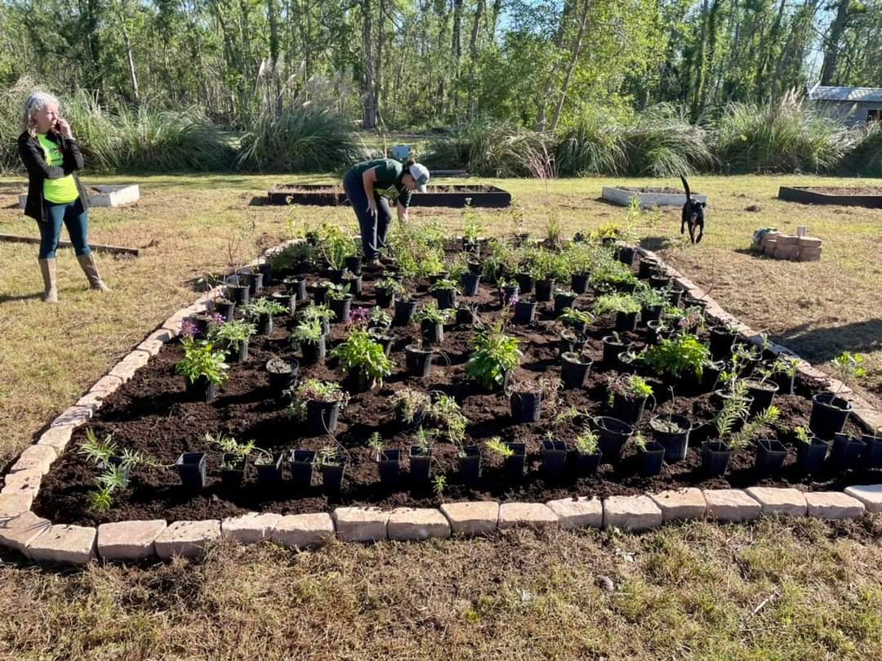
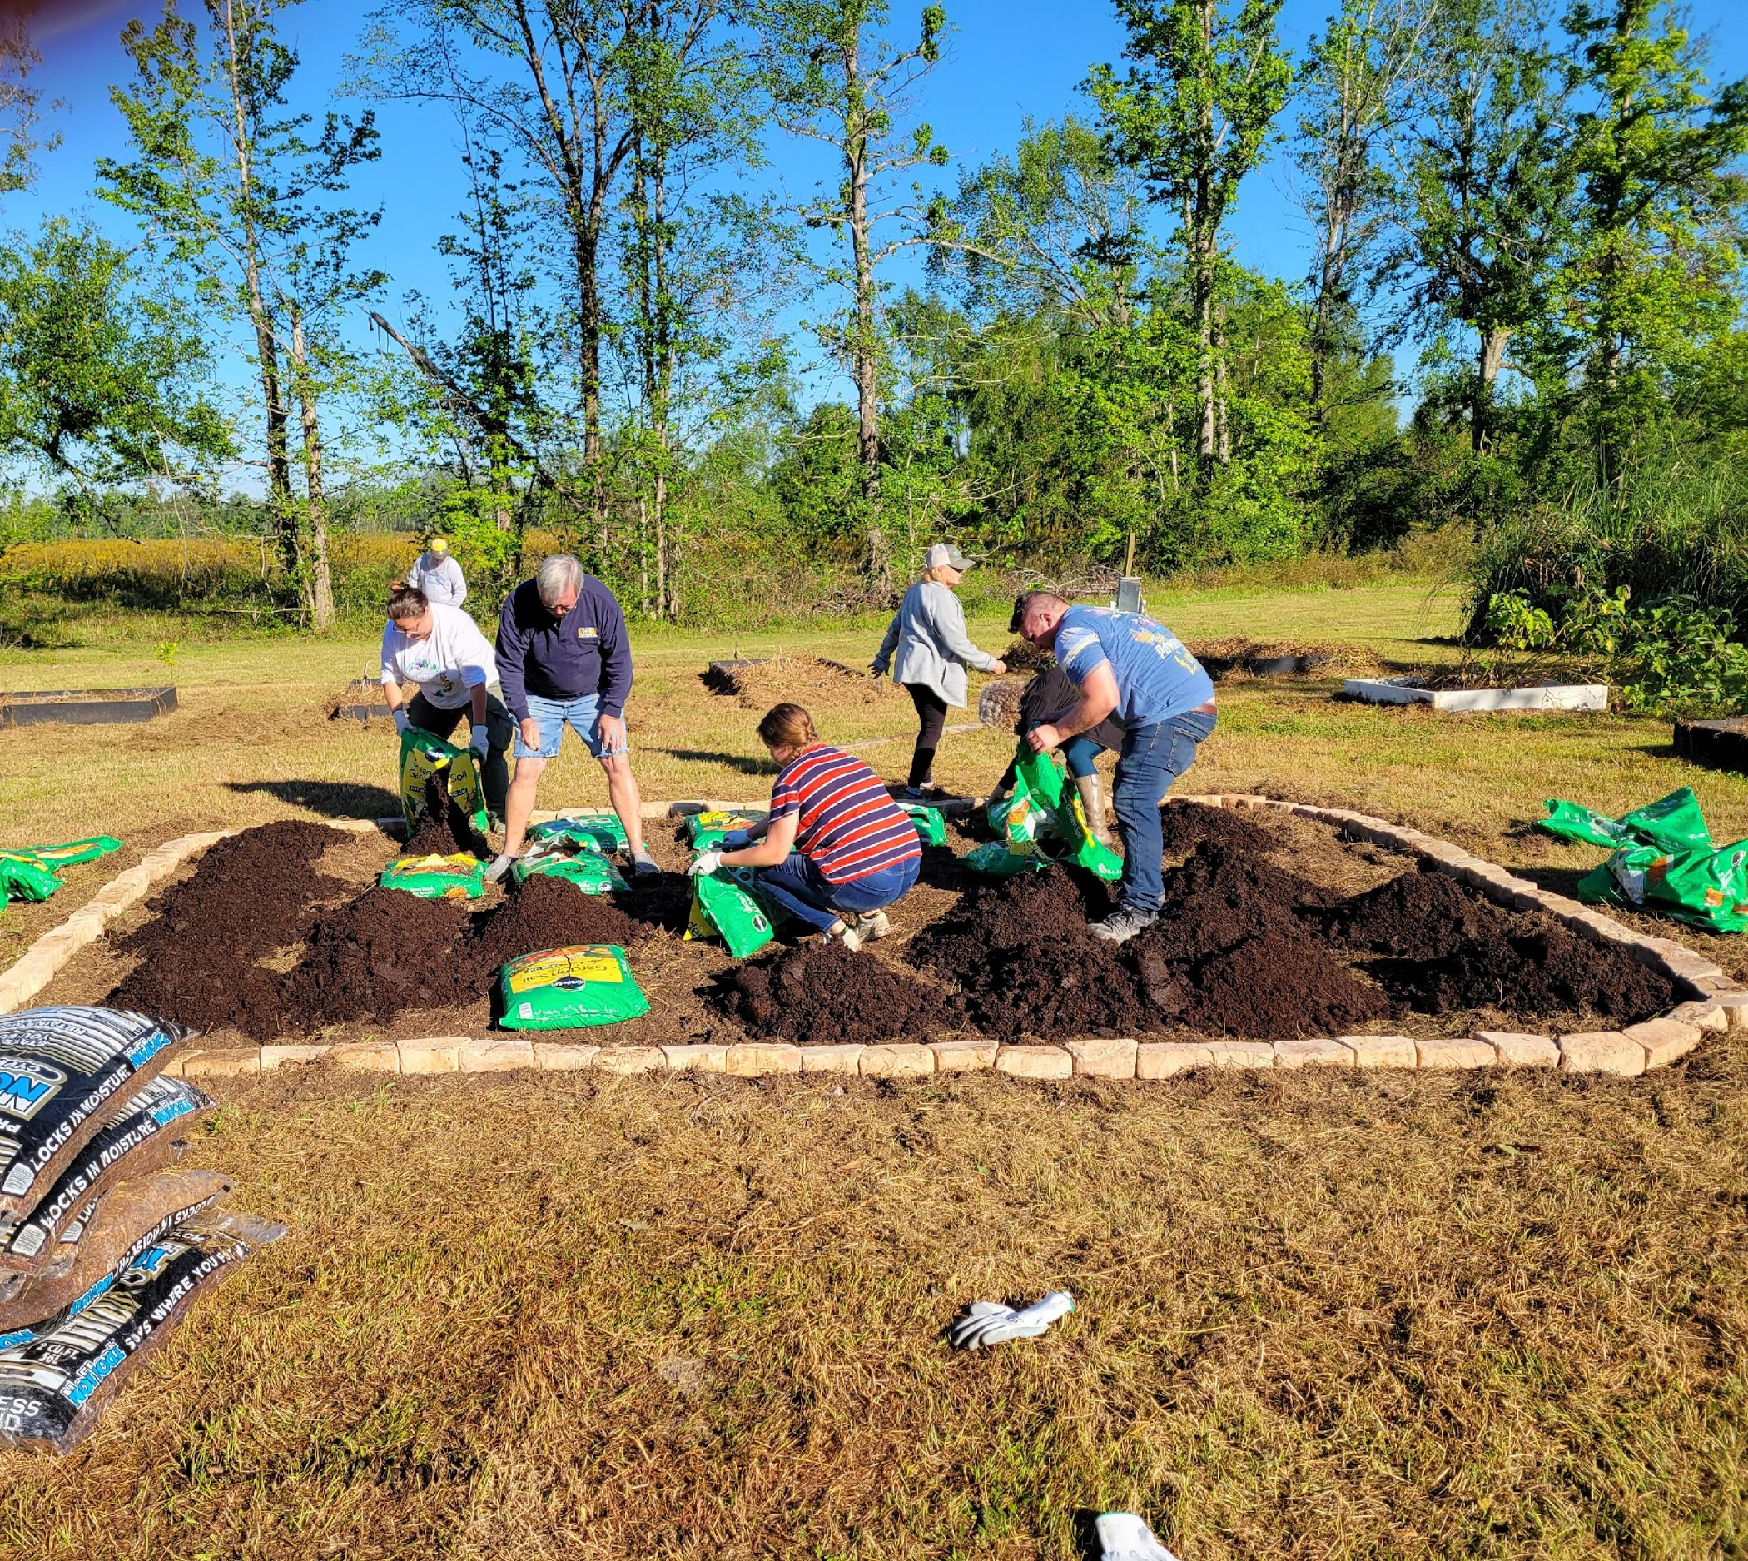
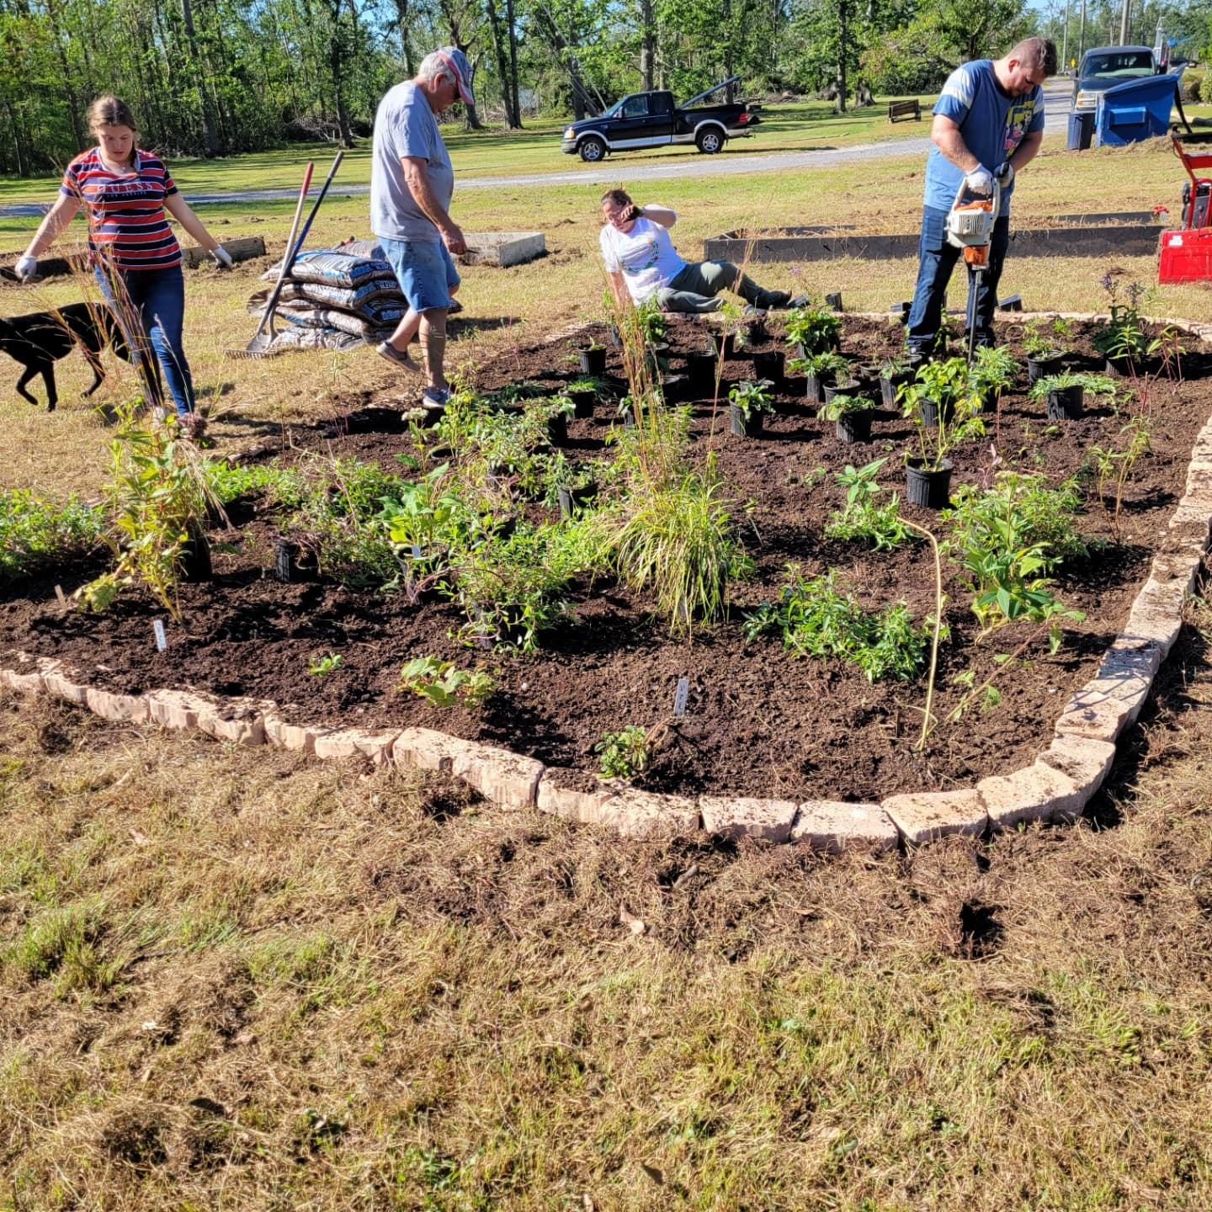

Slide 11
NEAR TERM PRIORITIES
Repair and Expansion of Native Plant Production
Contracts on projects approved in 2021 Work Plan
Project Action Teams solicit and select projects to be funded in 2022 Work Plan
Prepare for a return to large scale volunteer events
Personnel
Director’s Report | November 4, 2021

Slide 12
T. Bradley Keith
BTNEP Director
985. | November 4, 2021

