Slide 1
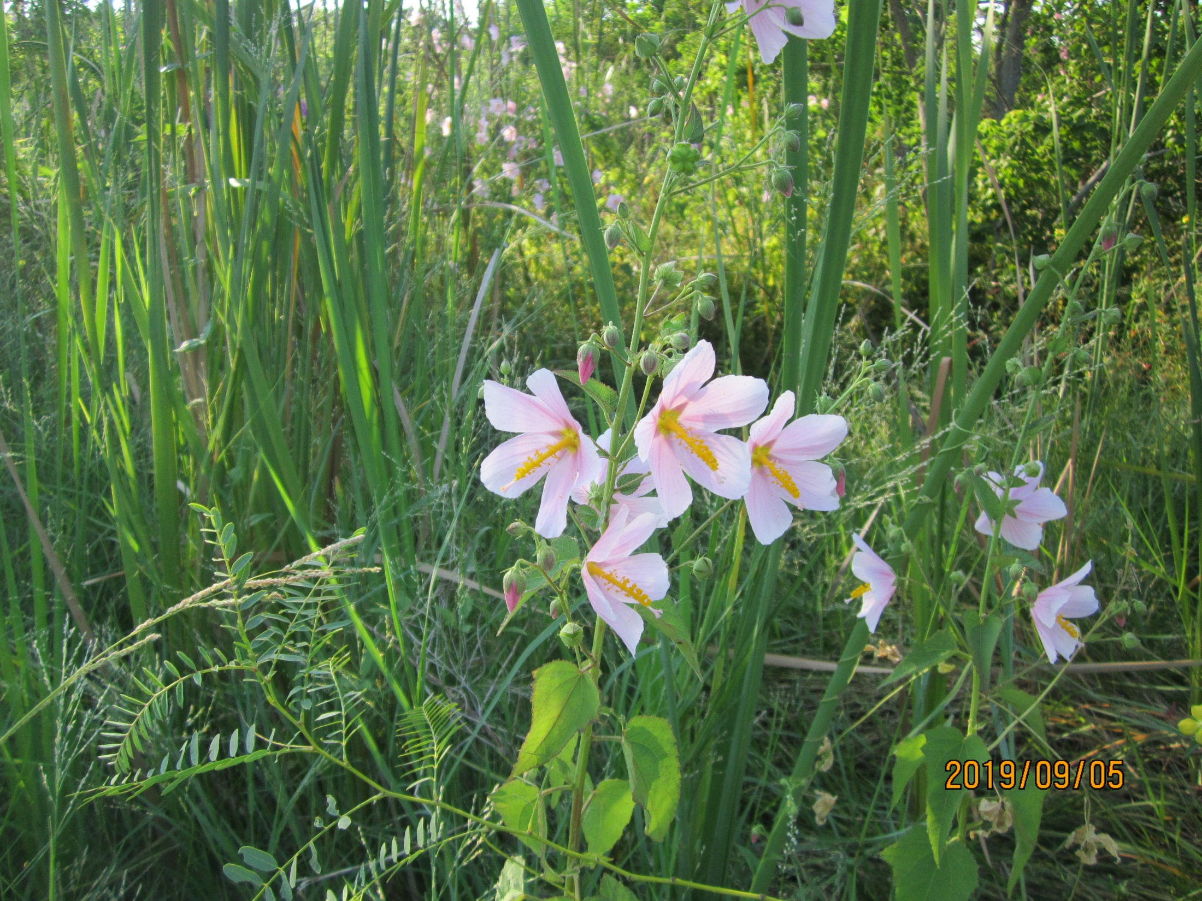
Grand Isle State Park Chinese Tallow Removal
December 2017 to December 2019
Baker Botanical Consulting, LLC.

Slide 2
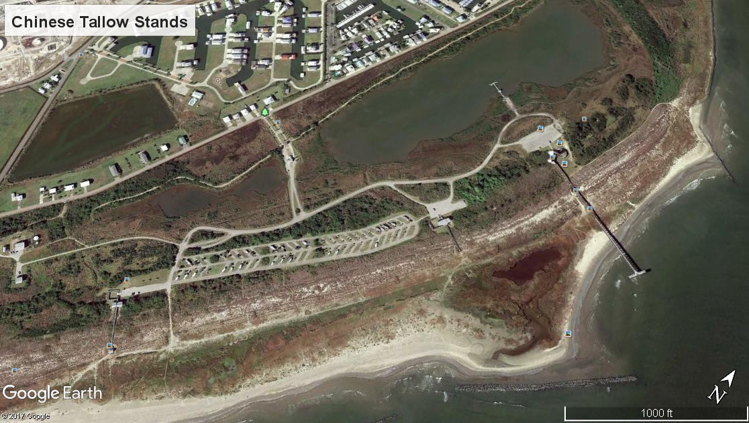
D
C
B
A

Slide 3
Photo Locations.
Arrows indicate direction of photograph.
Telephone pole Tallow
5
15
12
14
11
9
10
5
8
21
4
13
1
7
6
16
19
18
17
3
2
20

Slide 4
Photo point reference numbers showing changes over time.
Points 1, 2, and 3 are Block B.
Points 4 – 12 are Block C. Points 8,9, and 10 are the pass through, Signs, Hydrant. Point 11 is at the speed bump.
Points 13 – 15 are Block D.
Points 16 – 20 are Block A.

Slide 6
Chinese Tallow by size class by Block (n=7519).

Slide 7
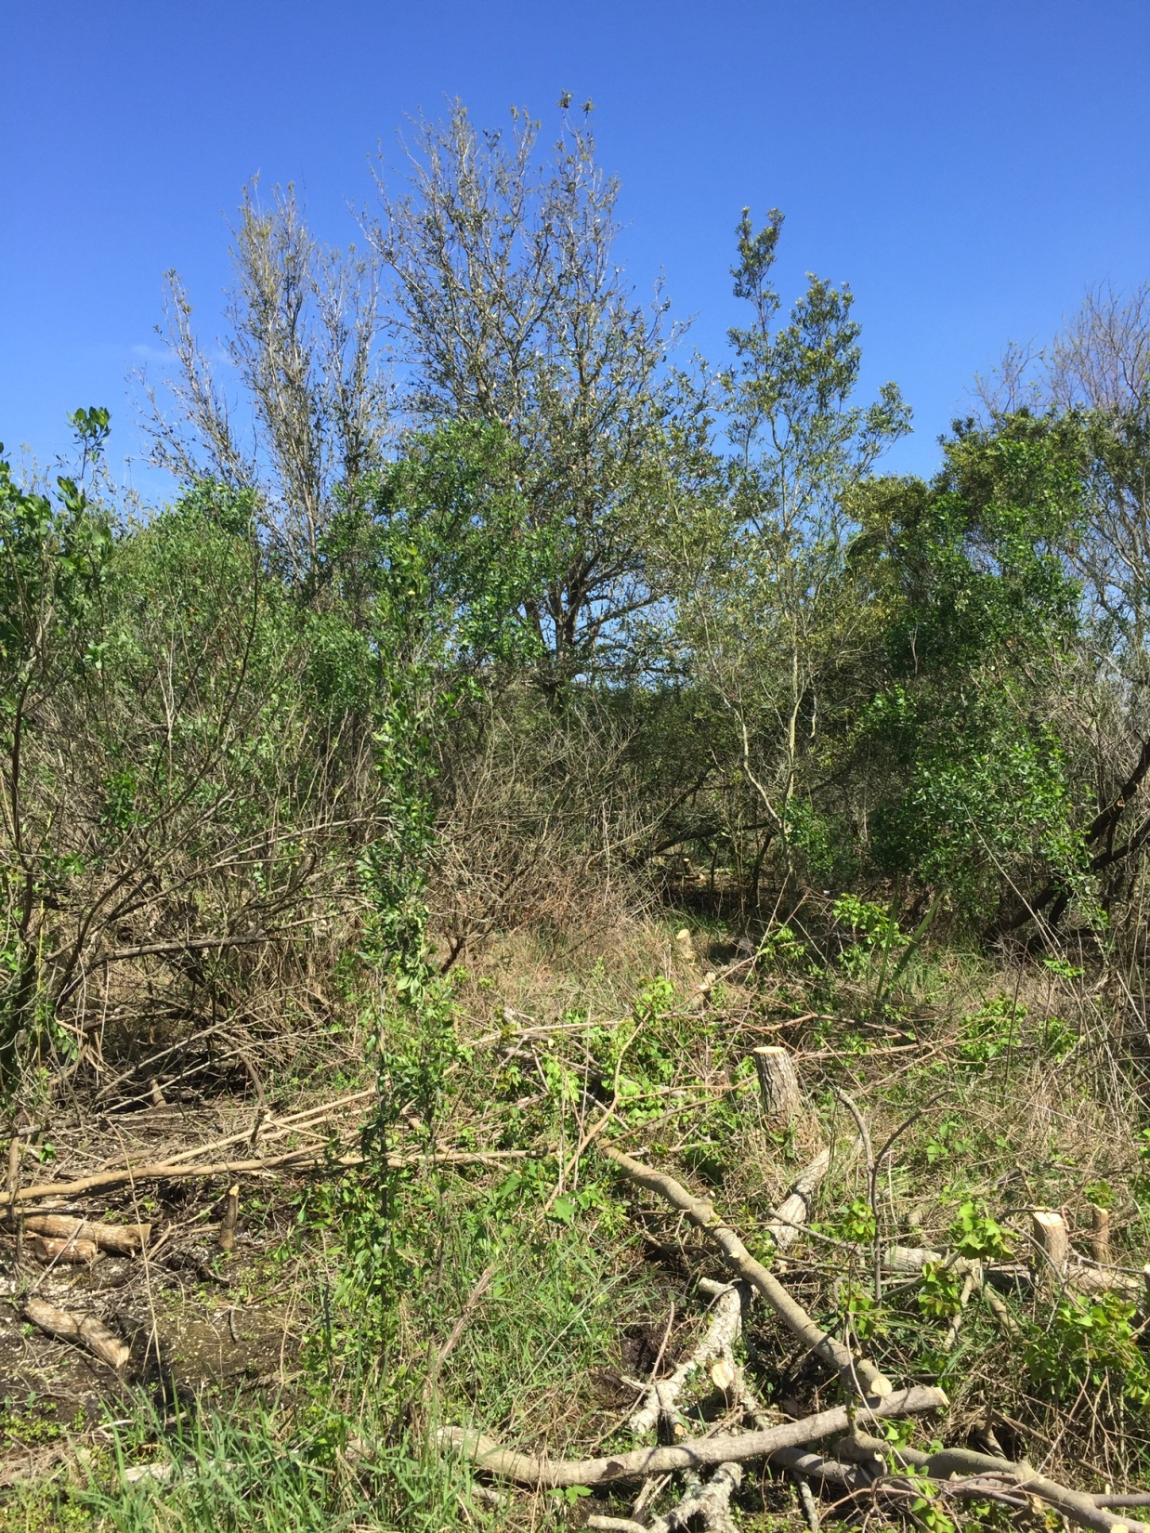
1.Block B. > 300 Chinese Tallow stems cut in picture frame.
03/16/2018

Slide 8
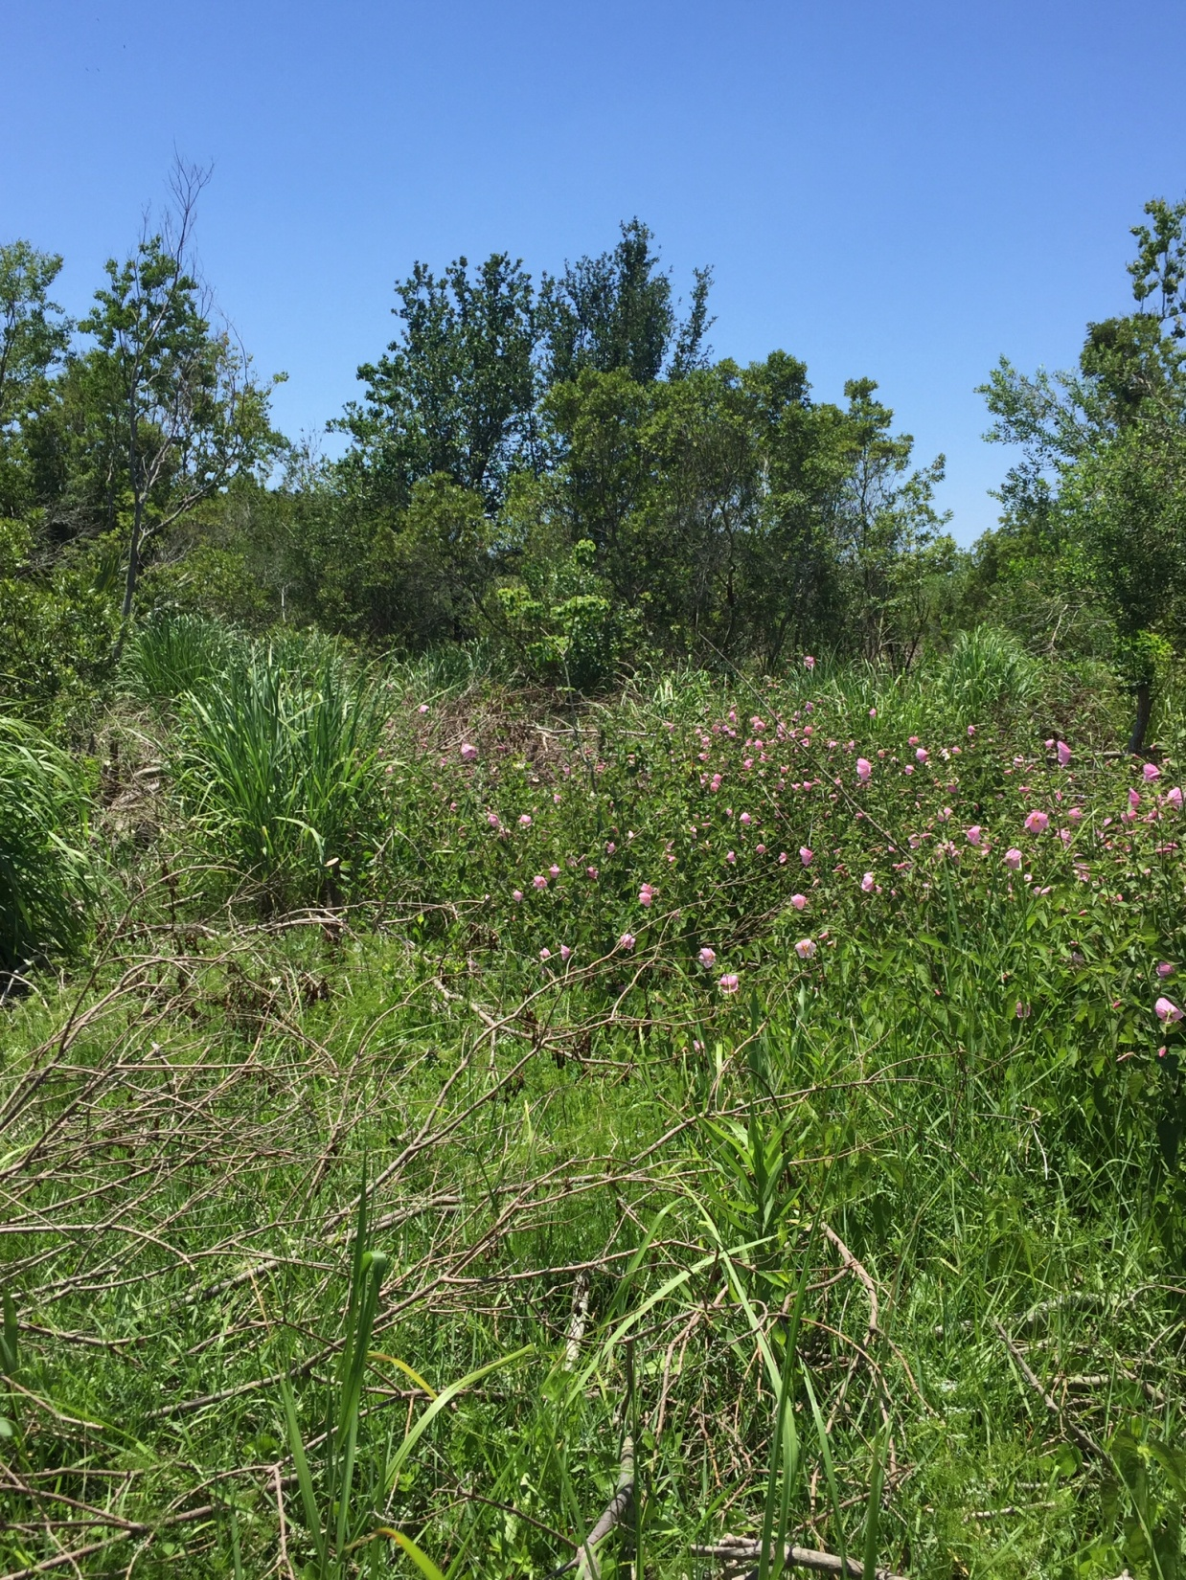
05/07/2018

Slide 9
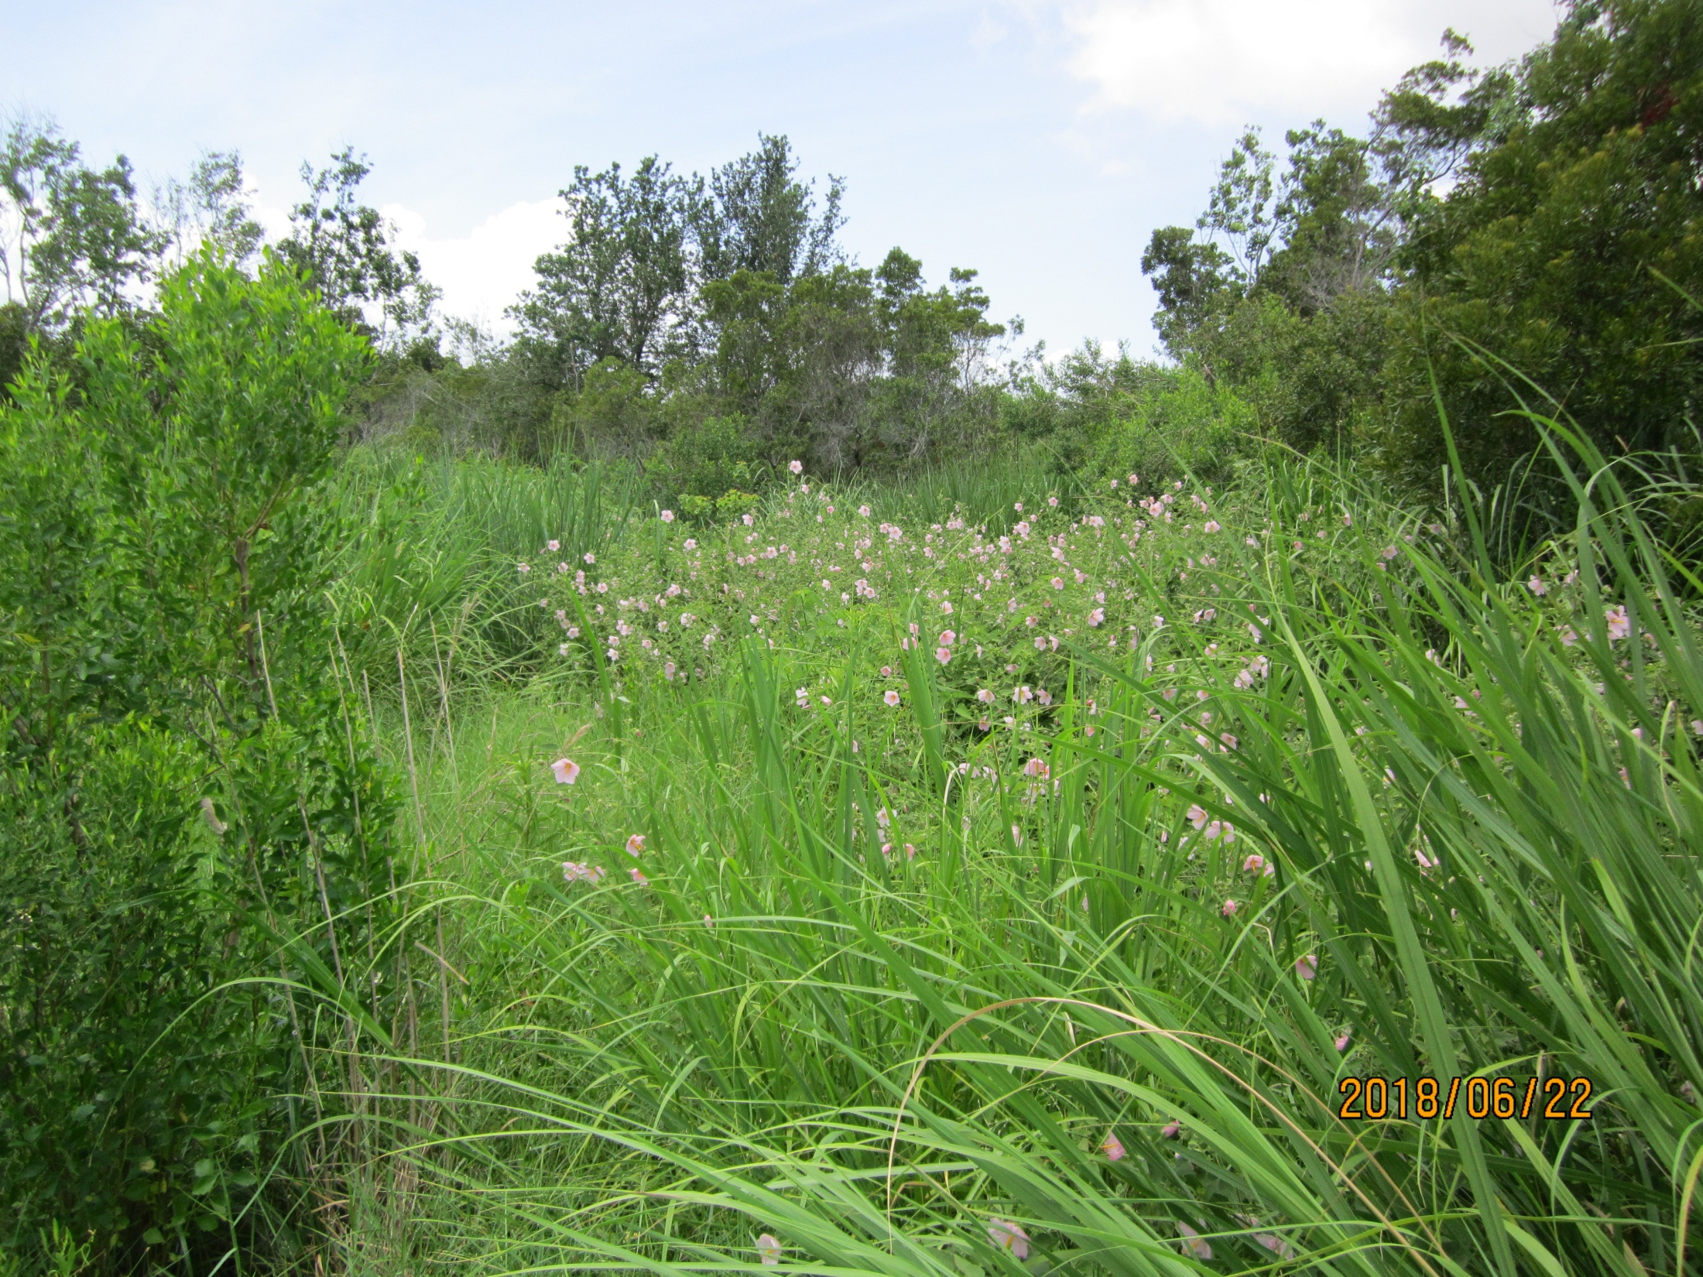

Slide 10
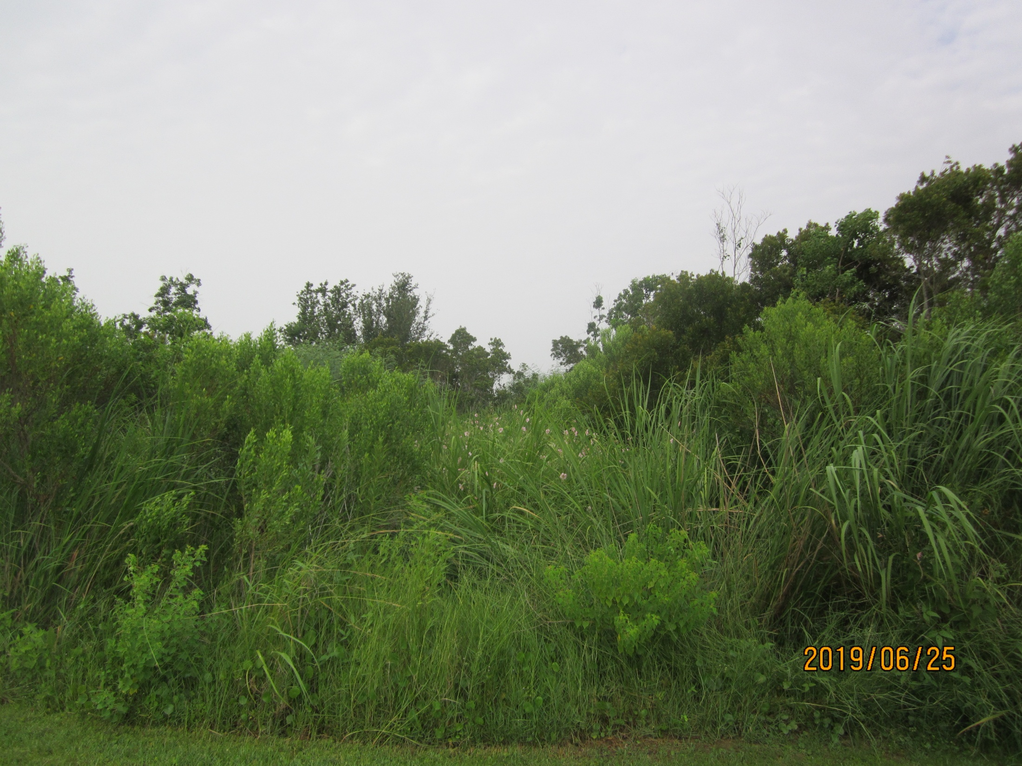

Slide 11
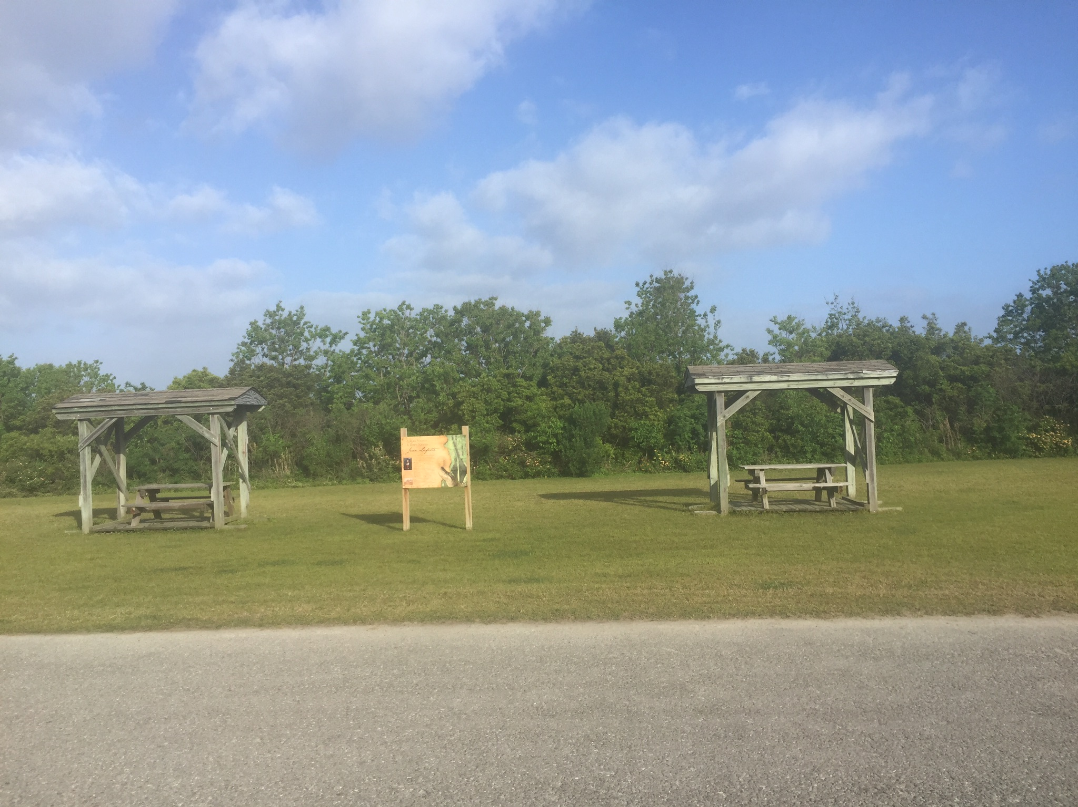
03/28/2019

Slide 12
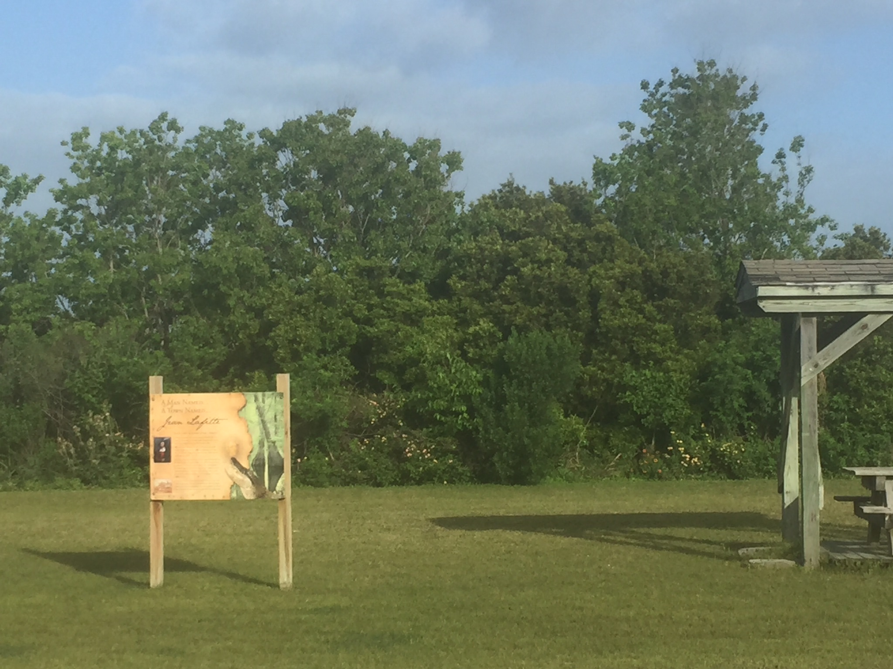
Tallow
Tallow
Wax Myrtle
Wax Myrtle

Slide 13
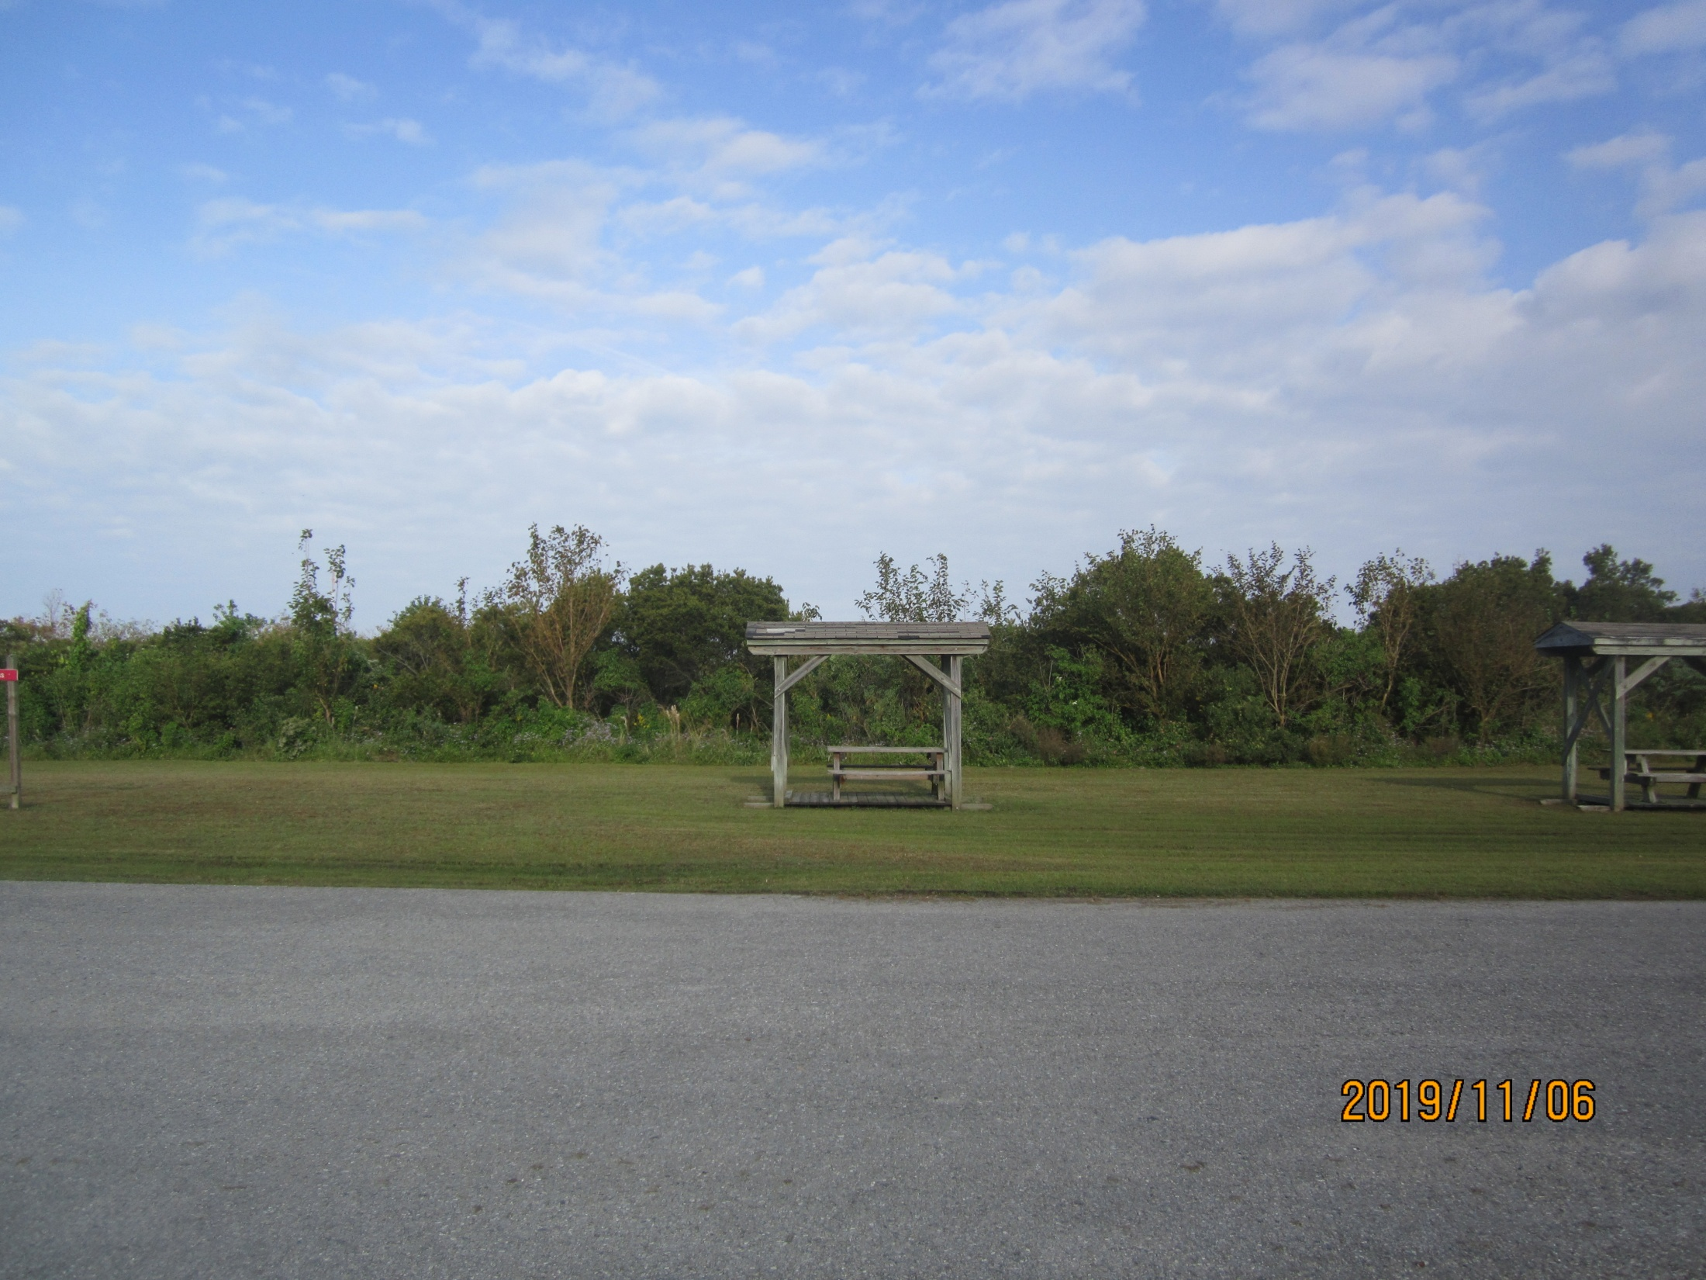
2. Preexisting Red Mulberry are now freed from the canopy cover of Chinese Tallow.

Slide 14
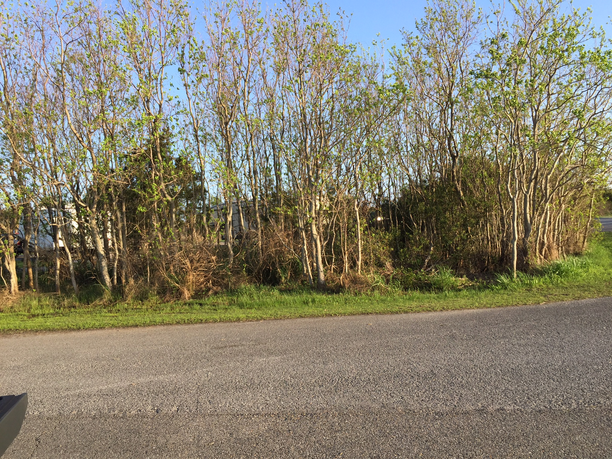
5. The dump station facing south towards campground. Over 250 trees were cut out of a 20 X 40 meter area.
03/01/2018

Slide 15
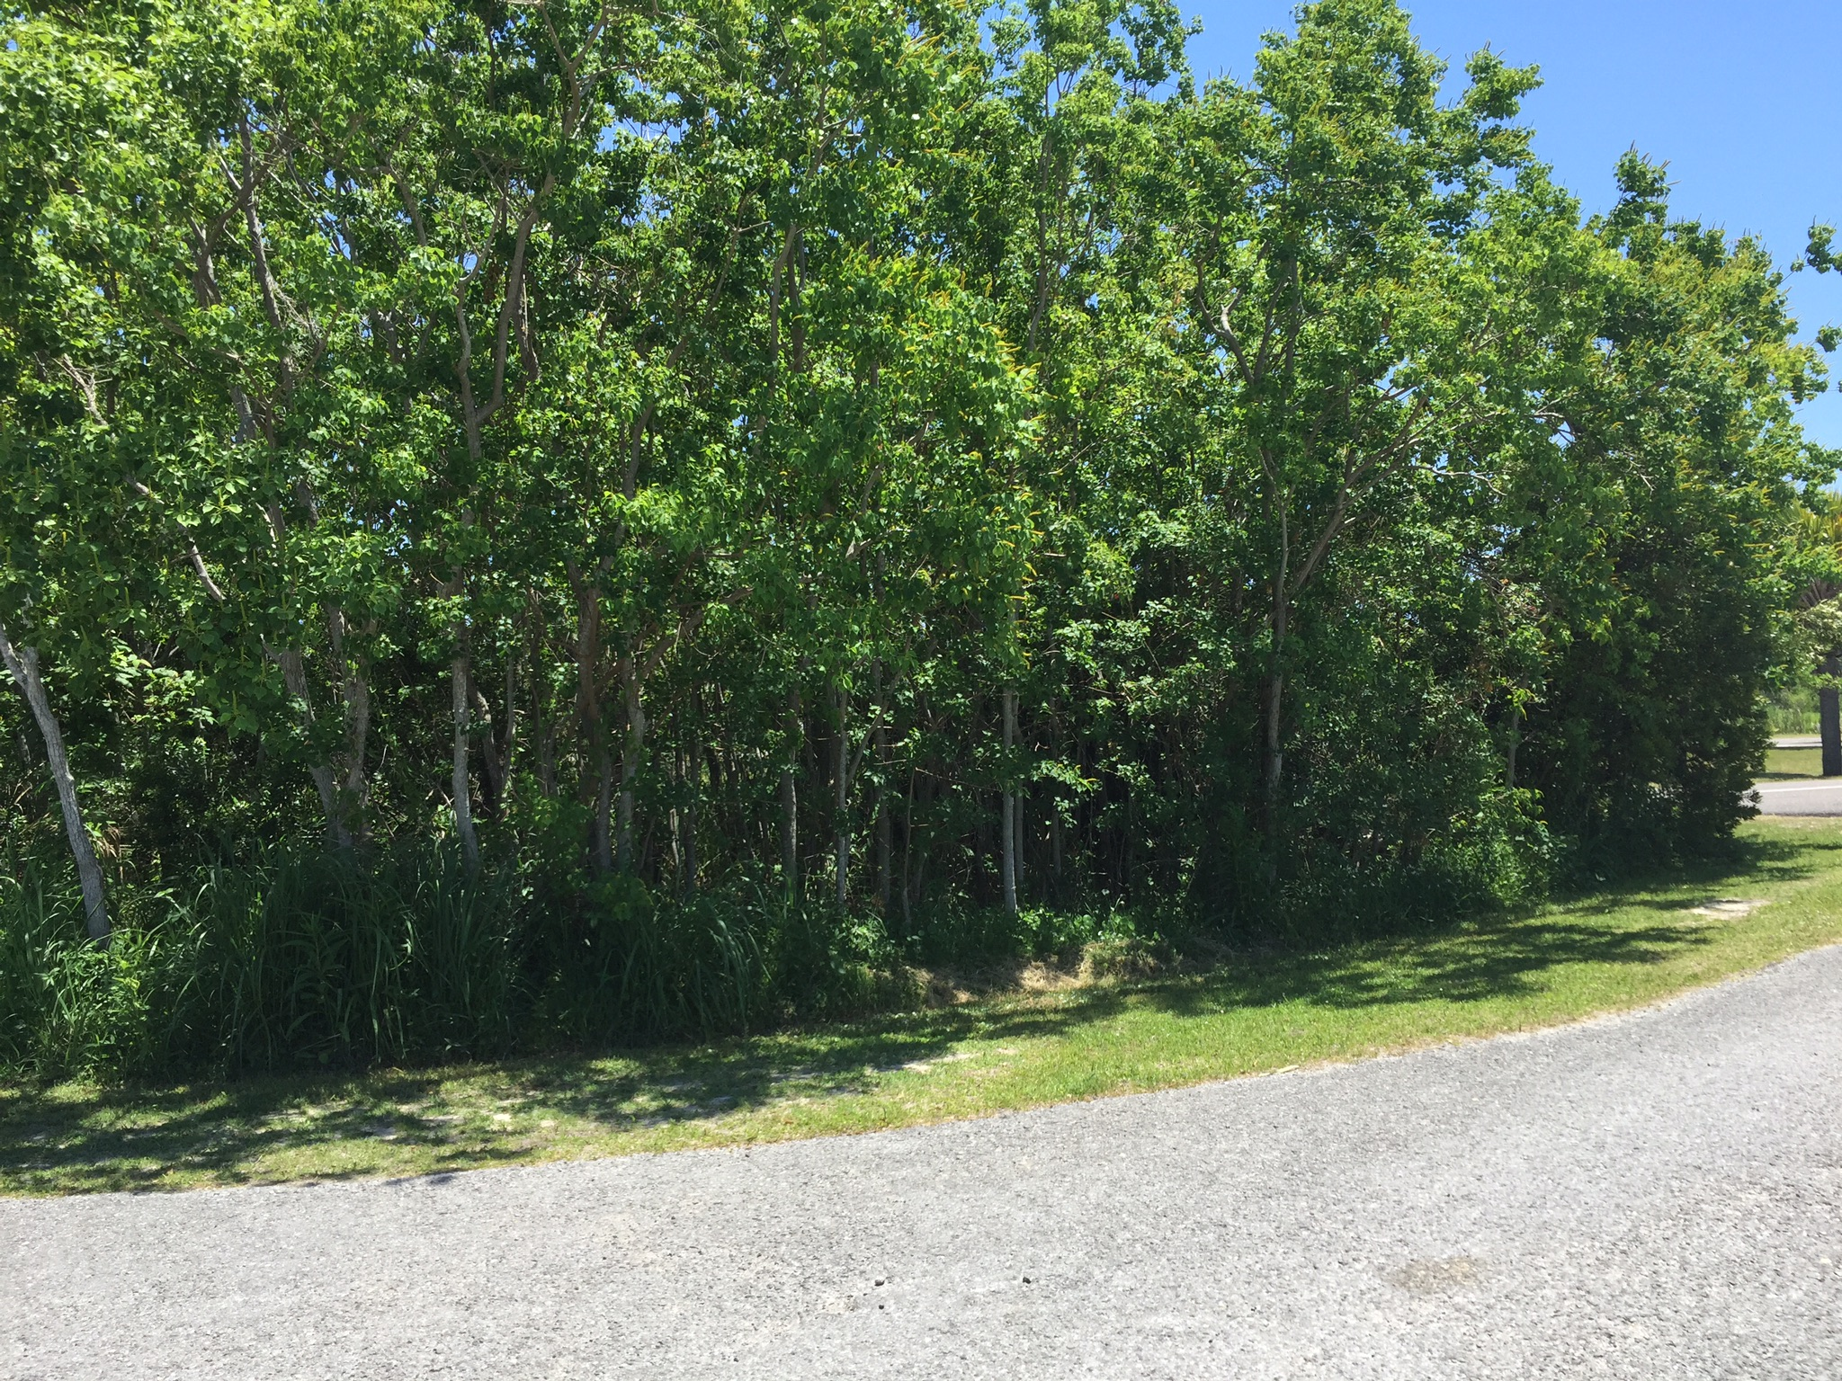
05/07/2018

Slide 16
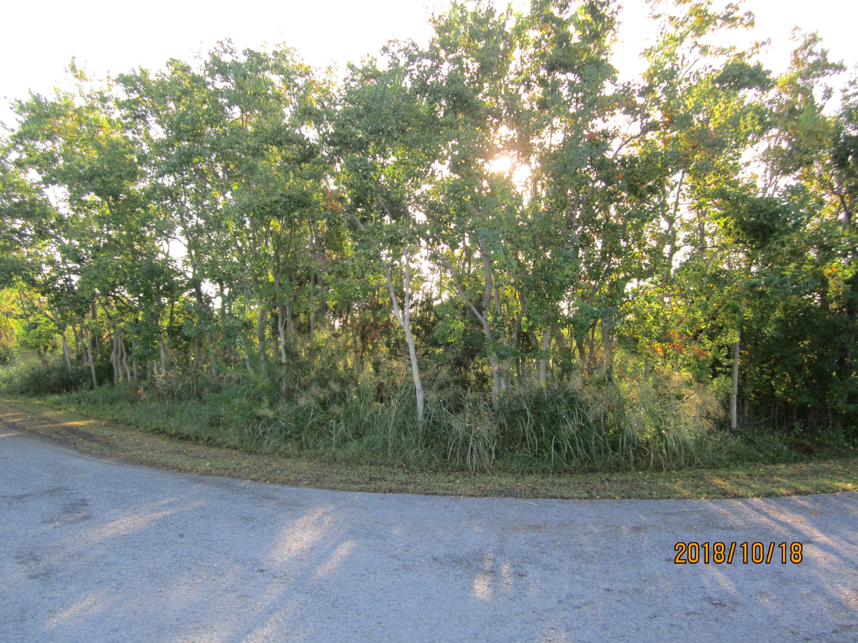

Slide 17
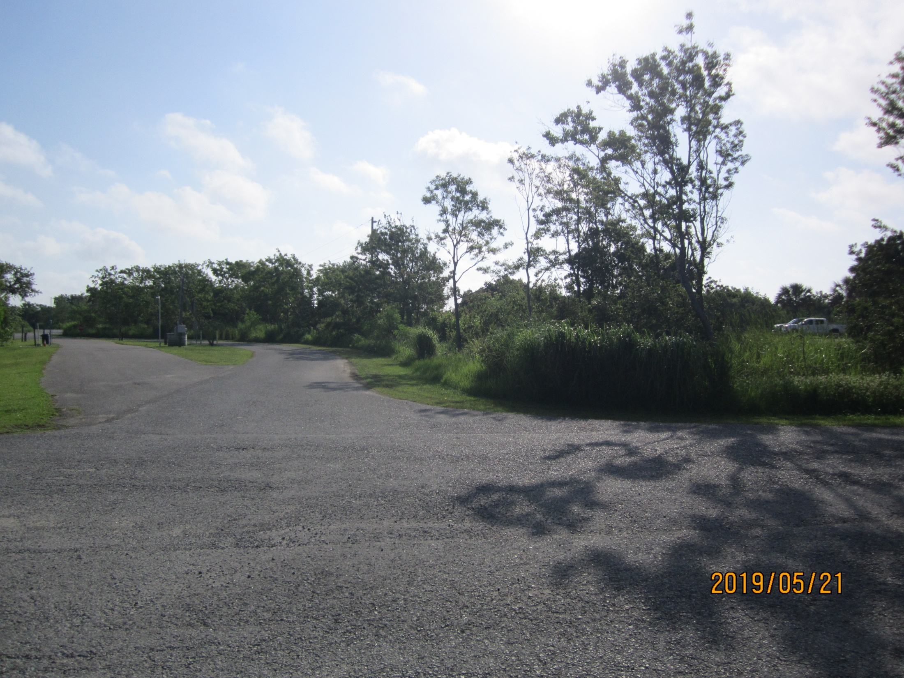

Slide 18
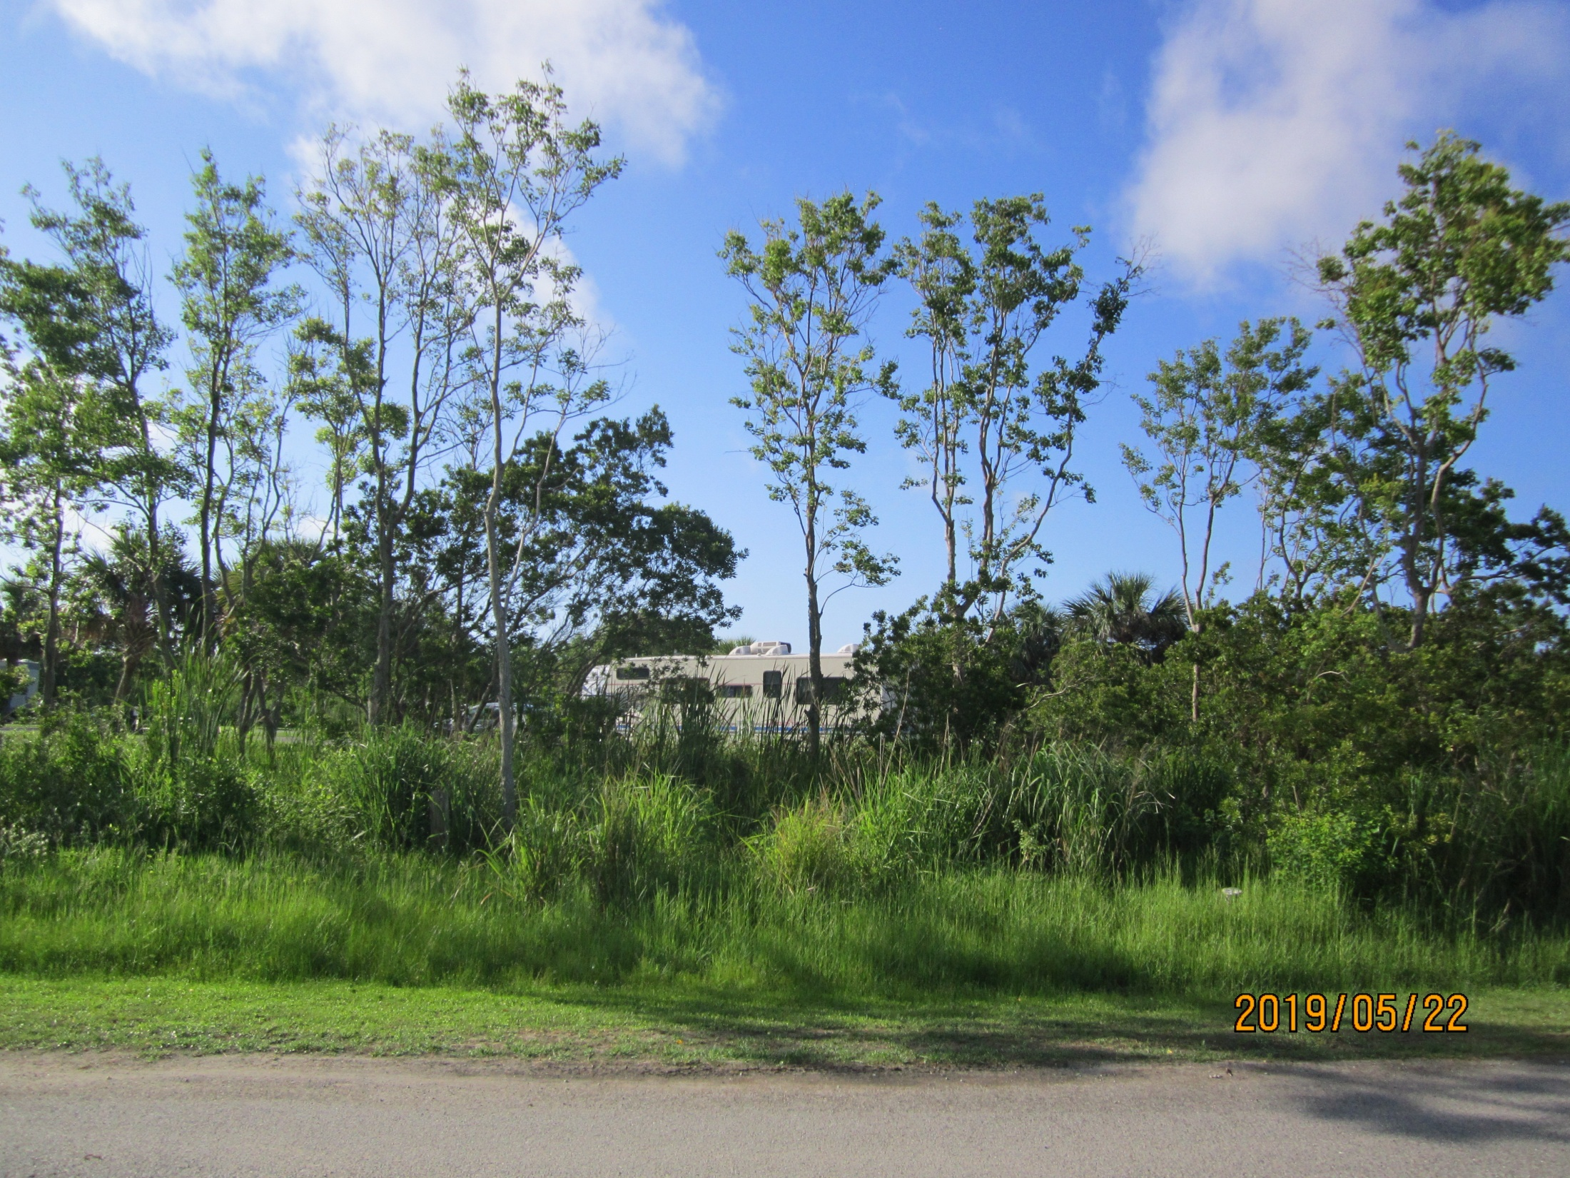

Slide 19
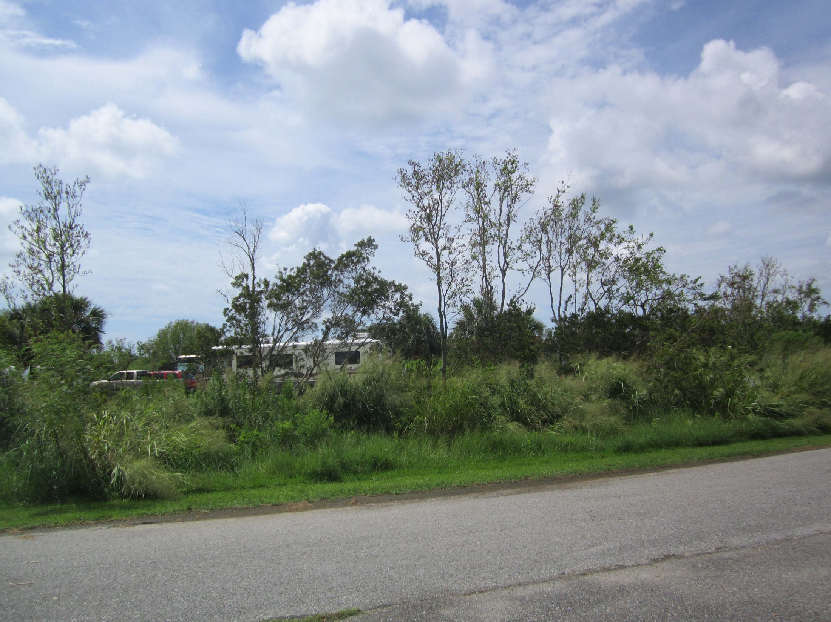
06/22/2019

Slide 20
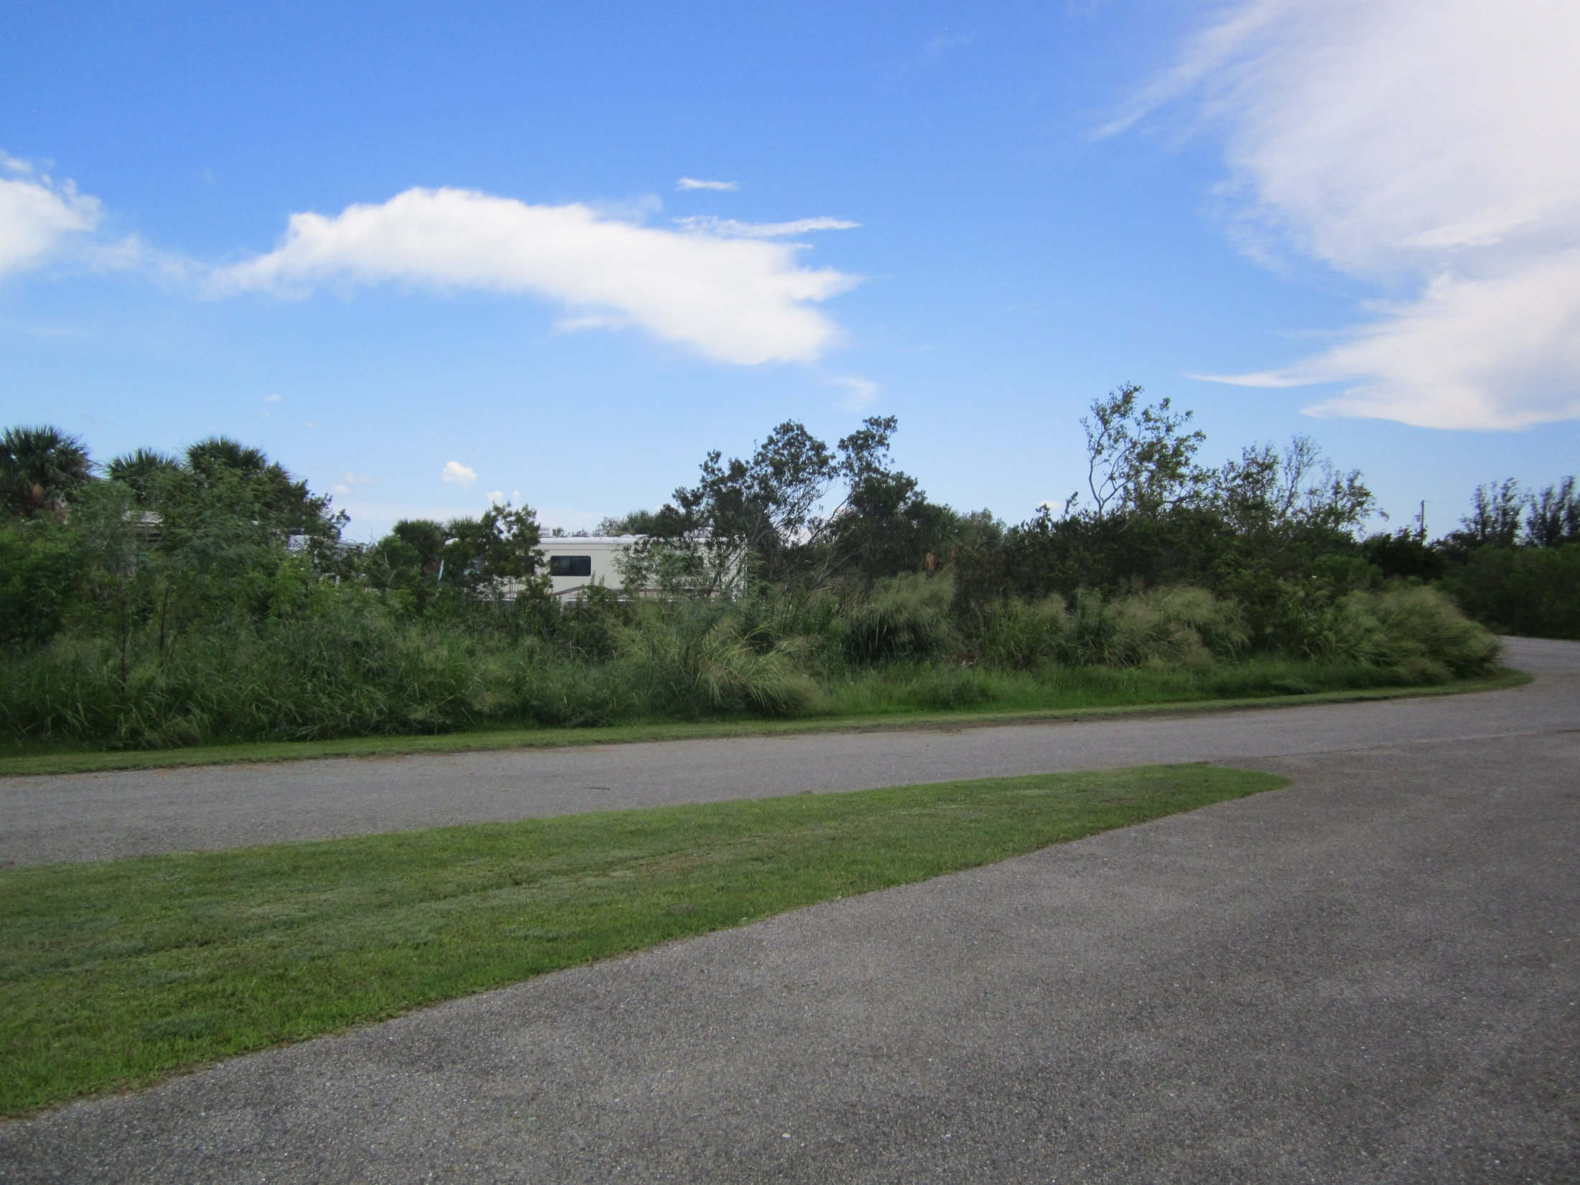
7/31/2019

Slide 21
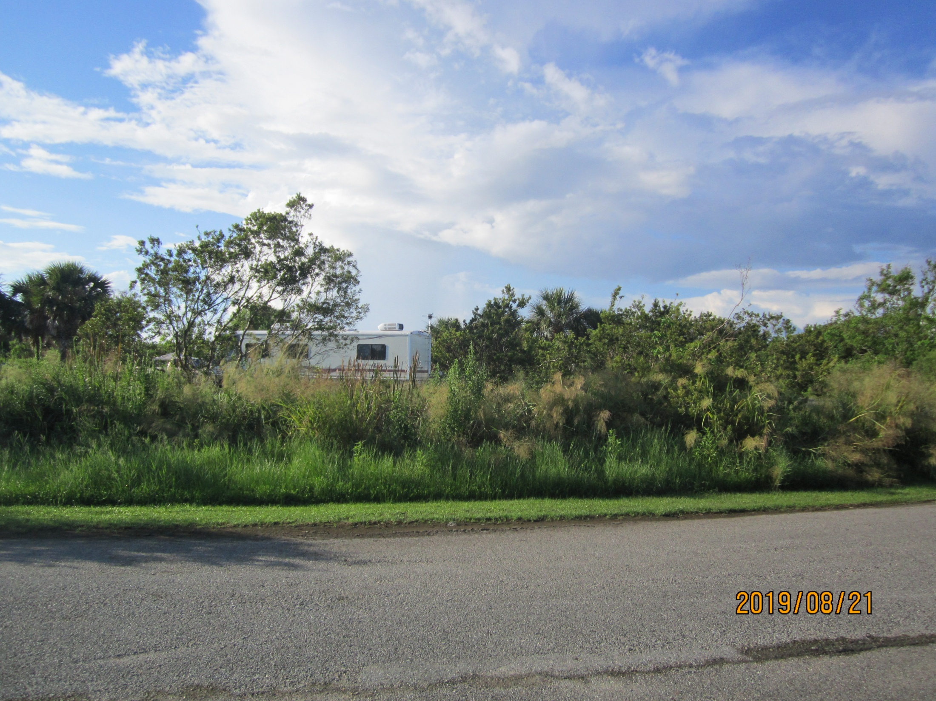

Slide 22
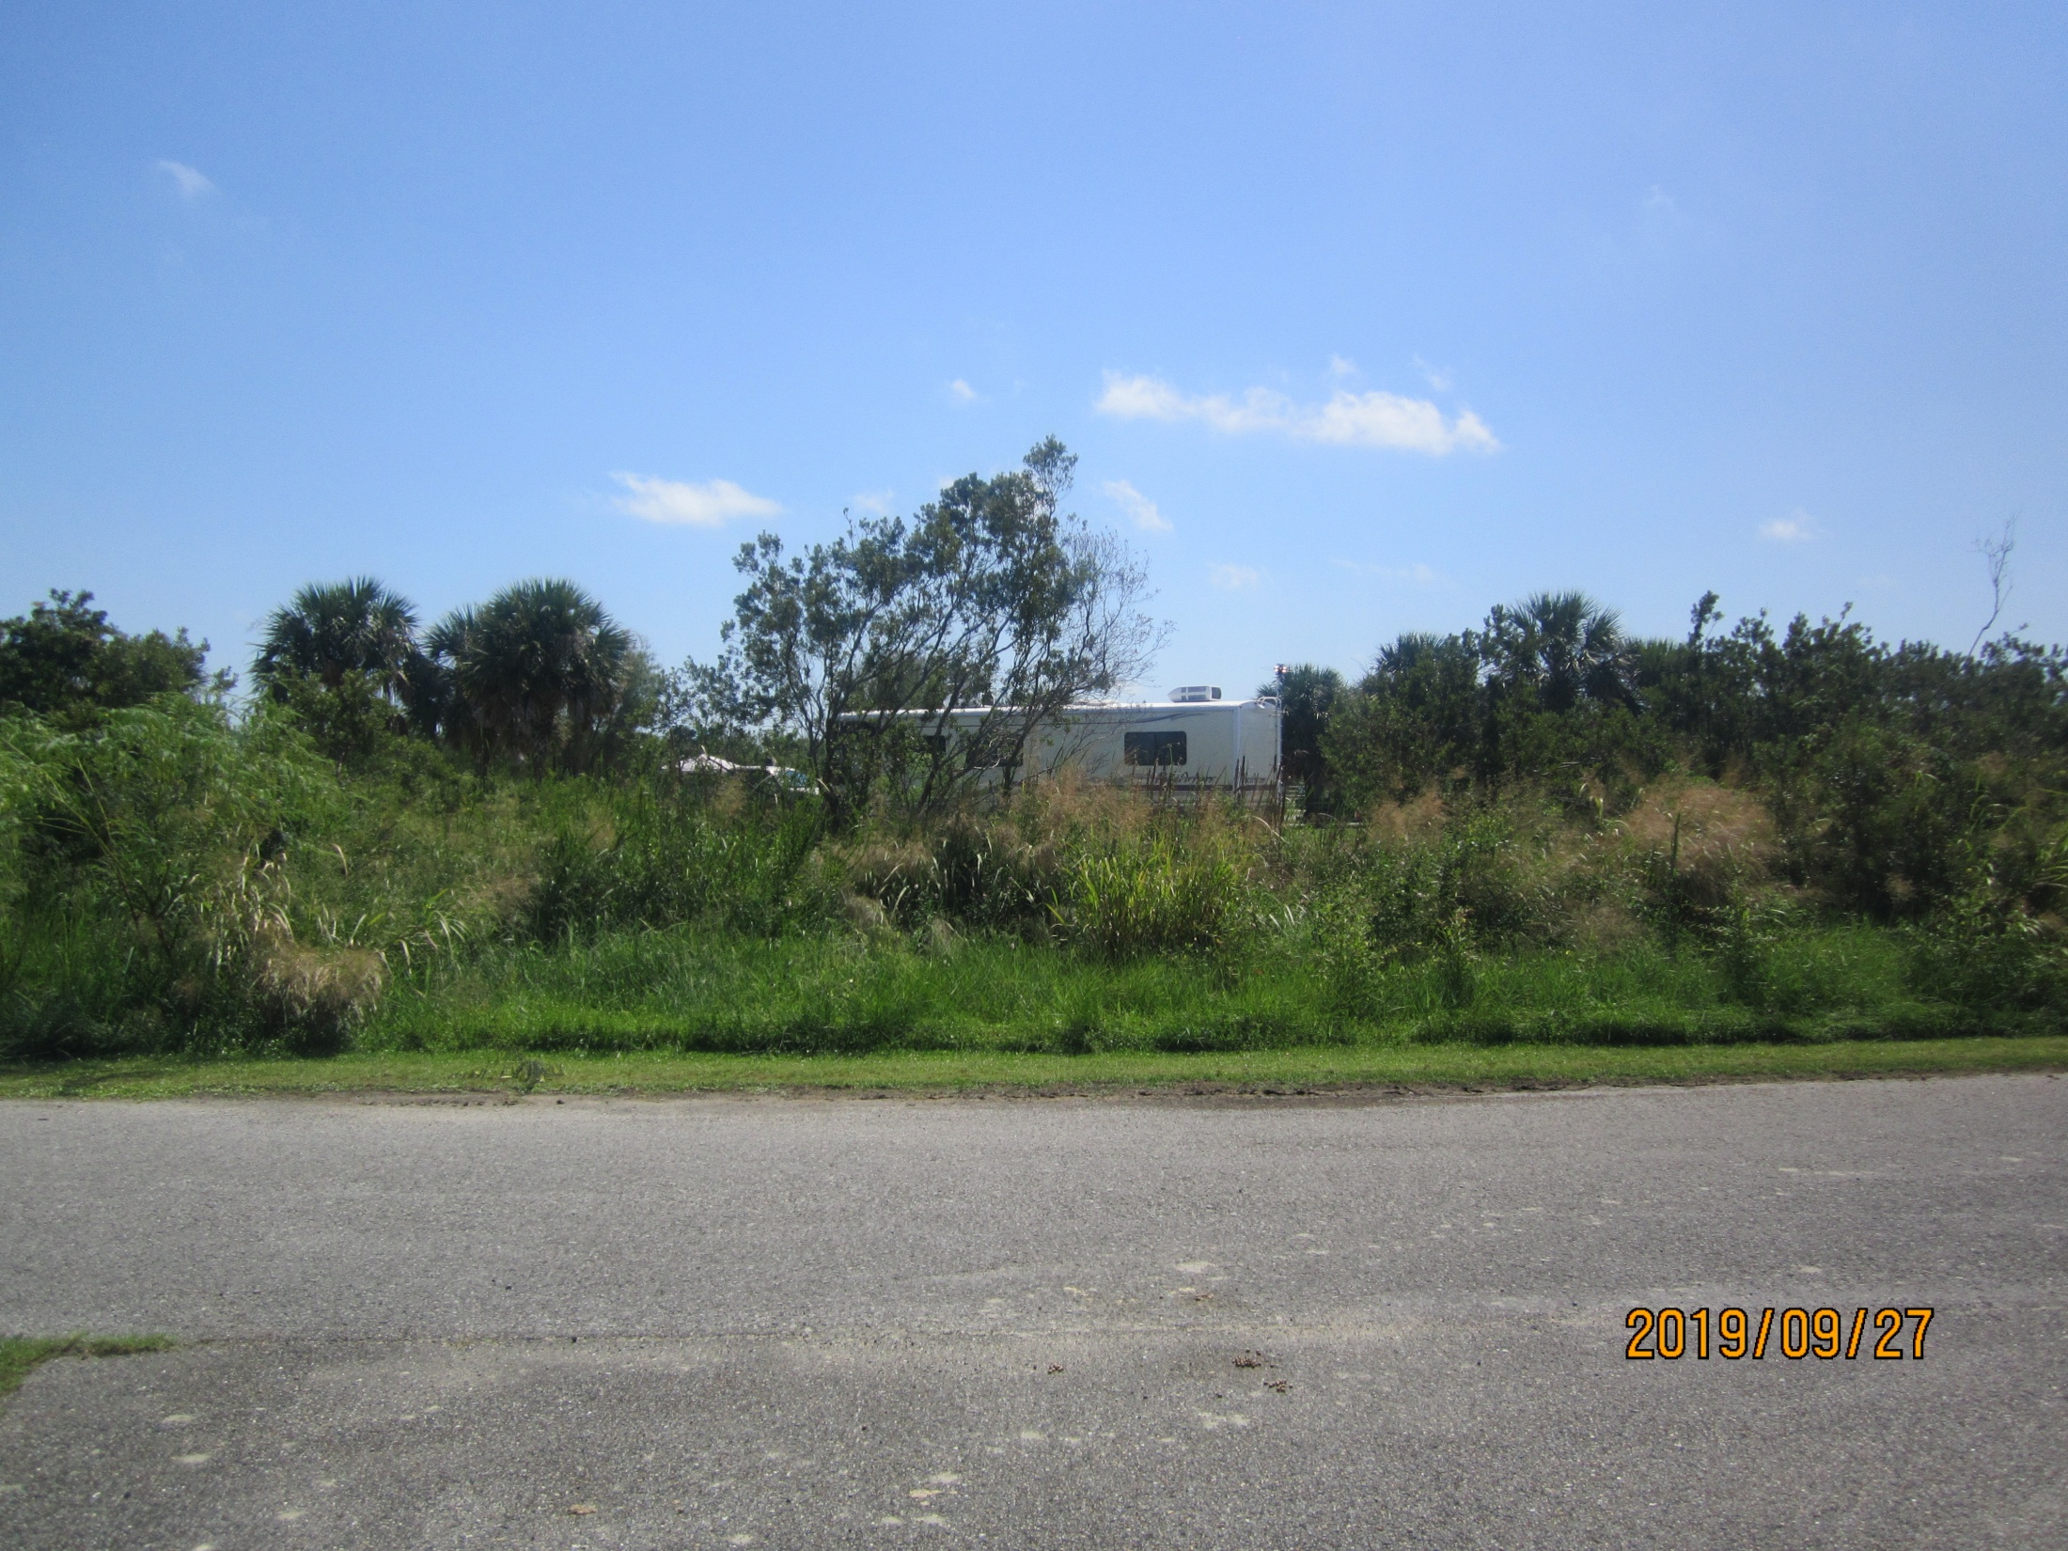

Slide 23
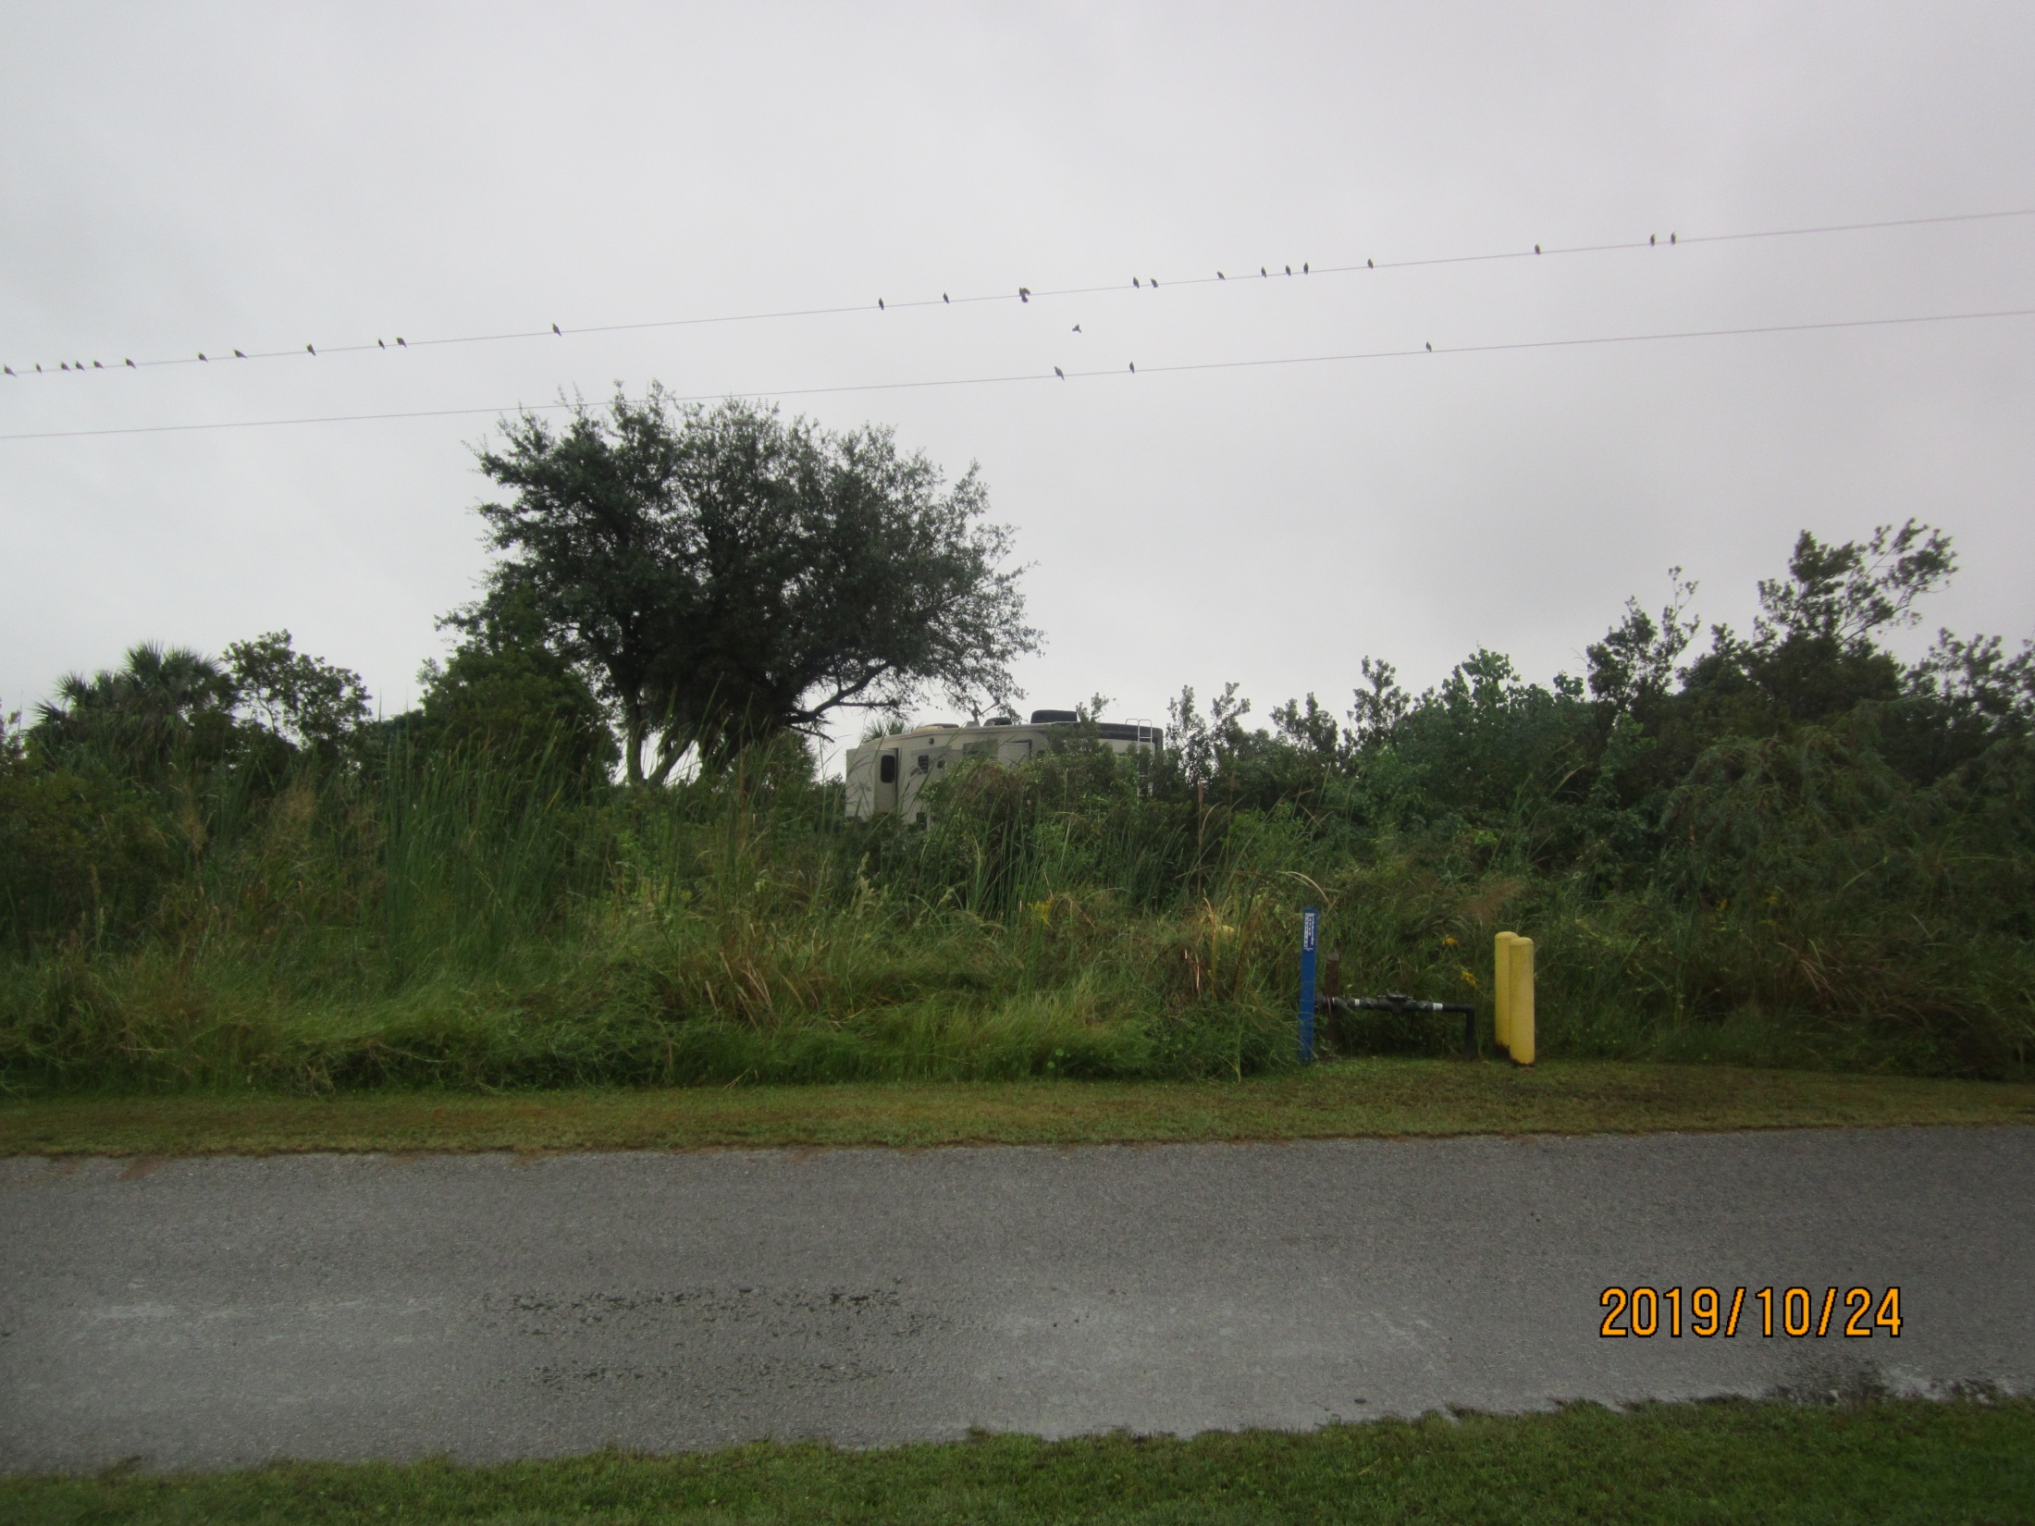

Slide 24
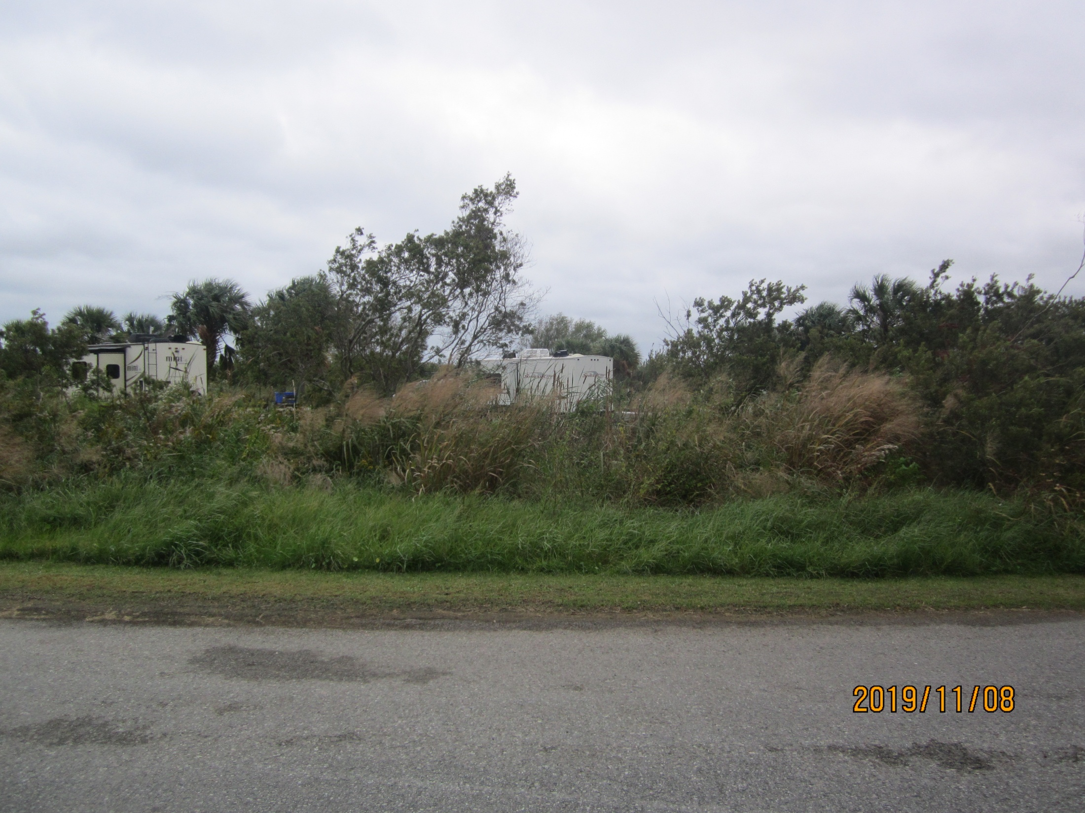

Slide 25
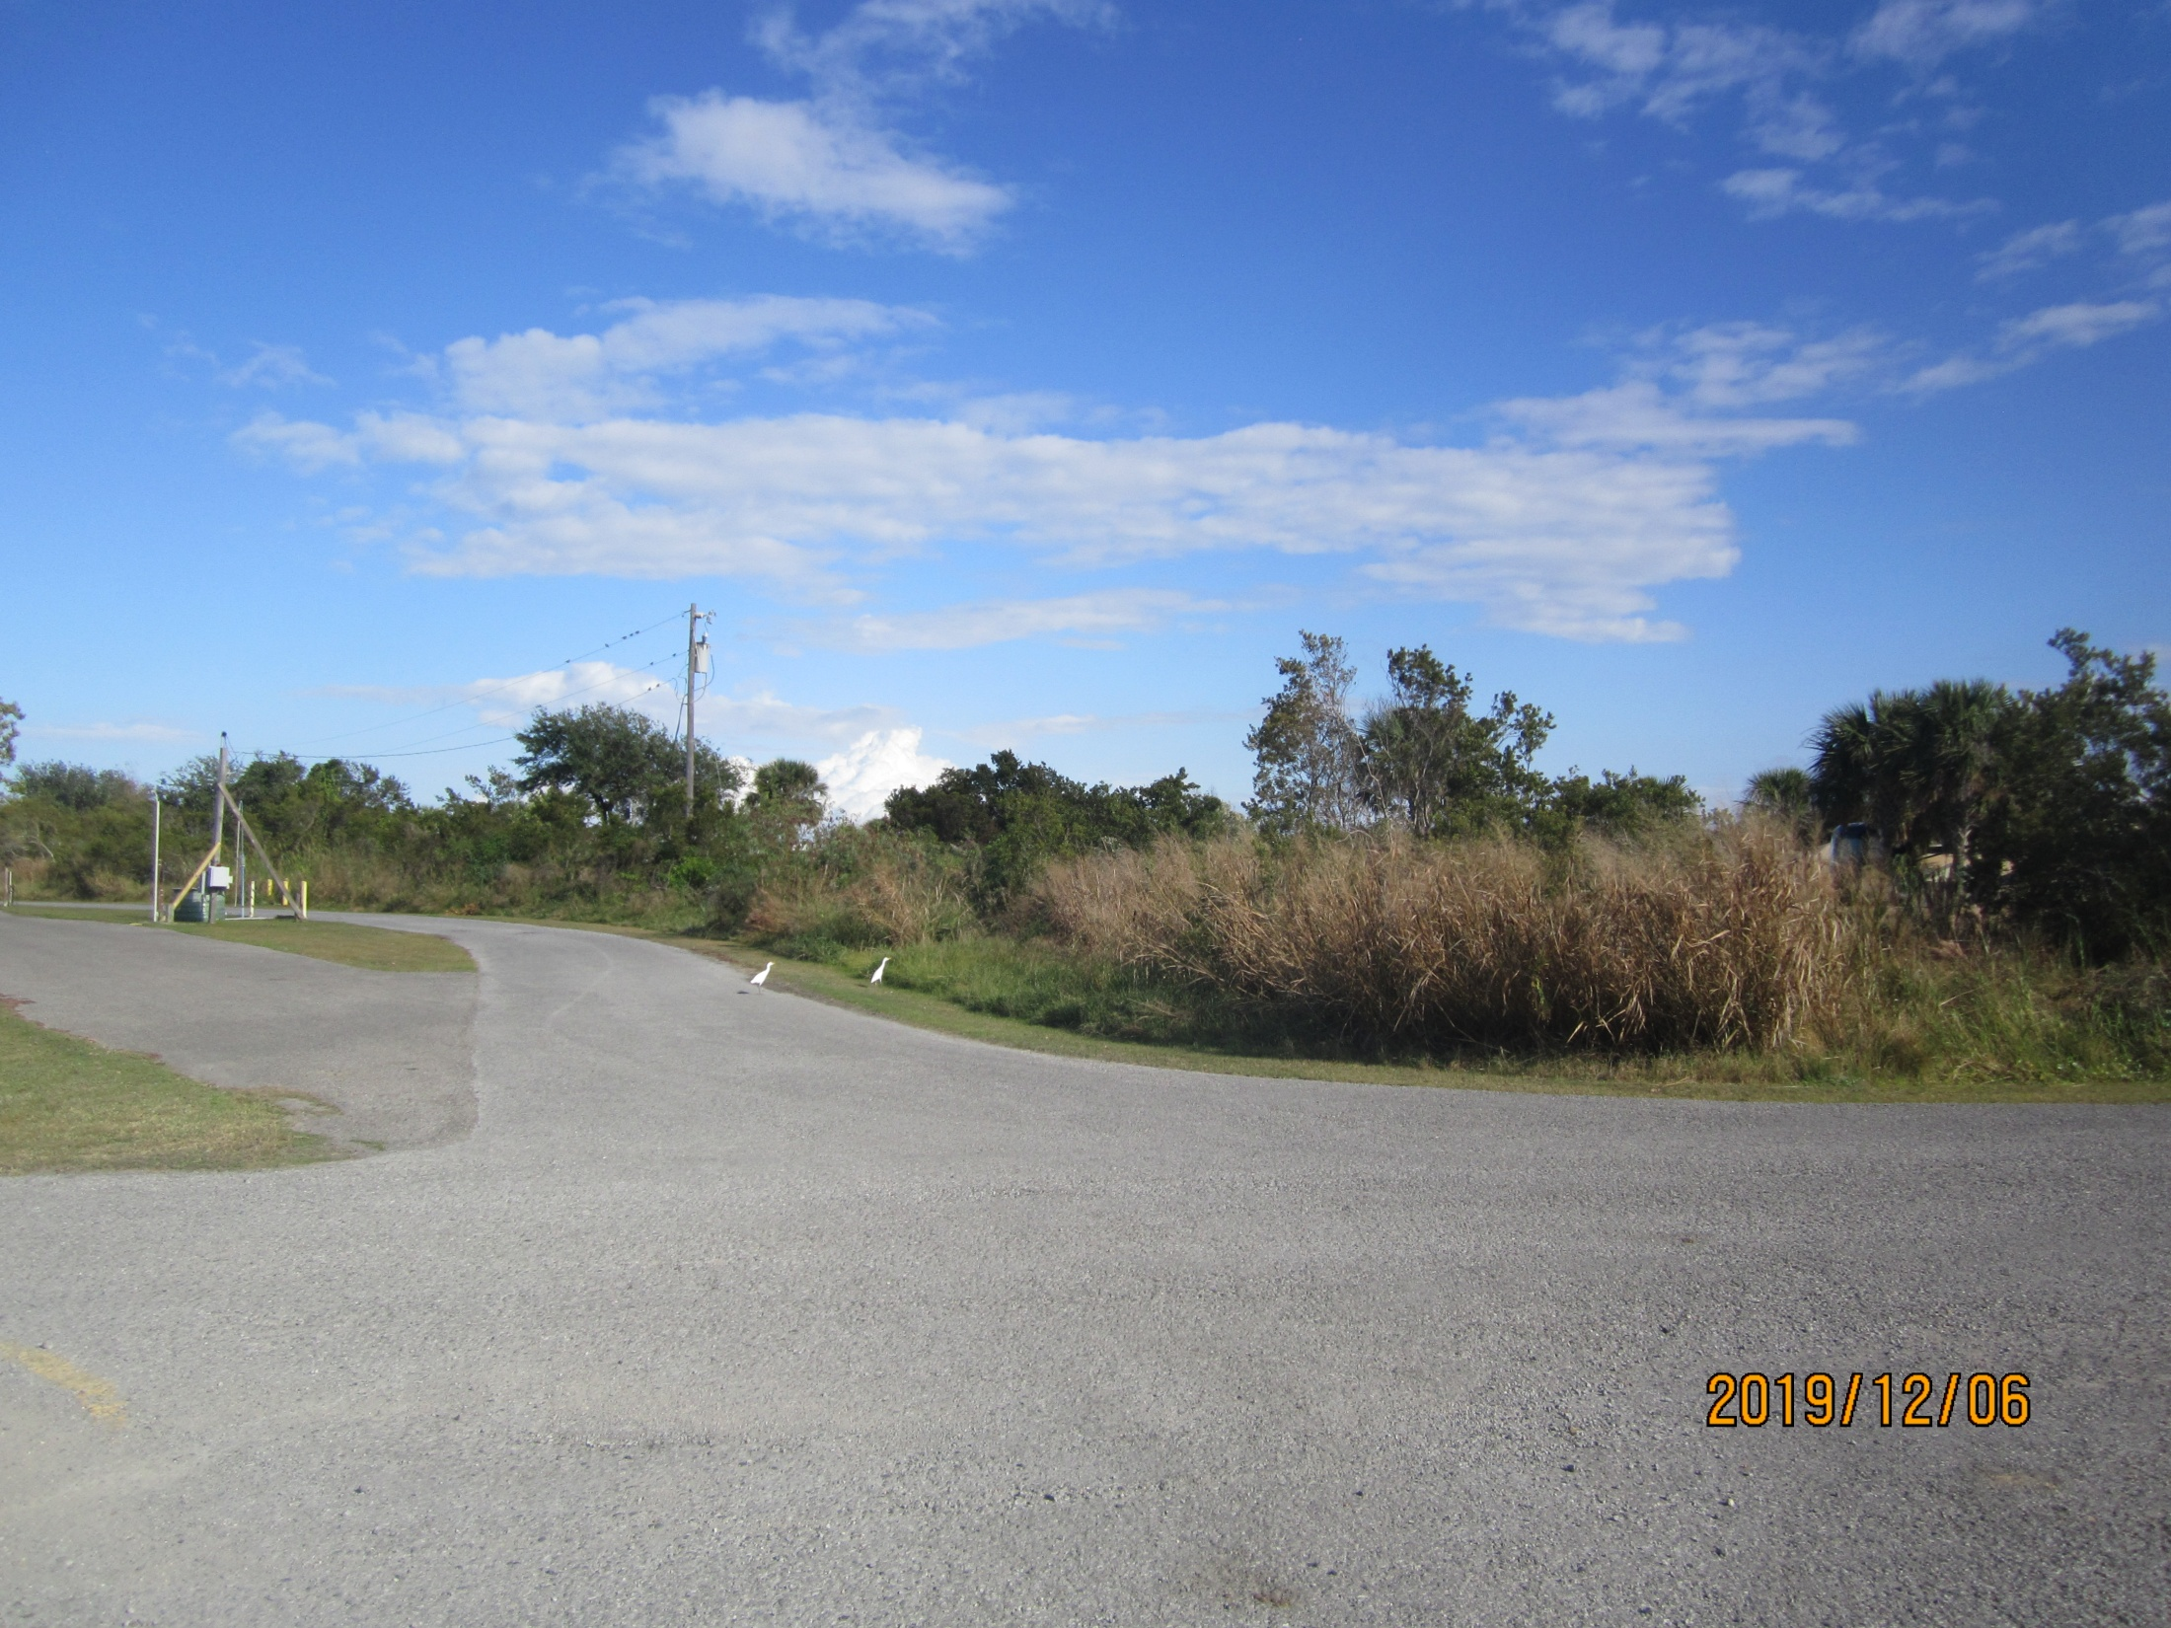

Slide 26
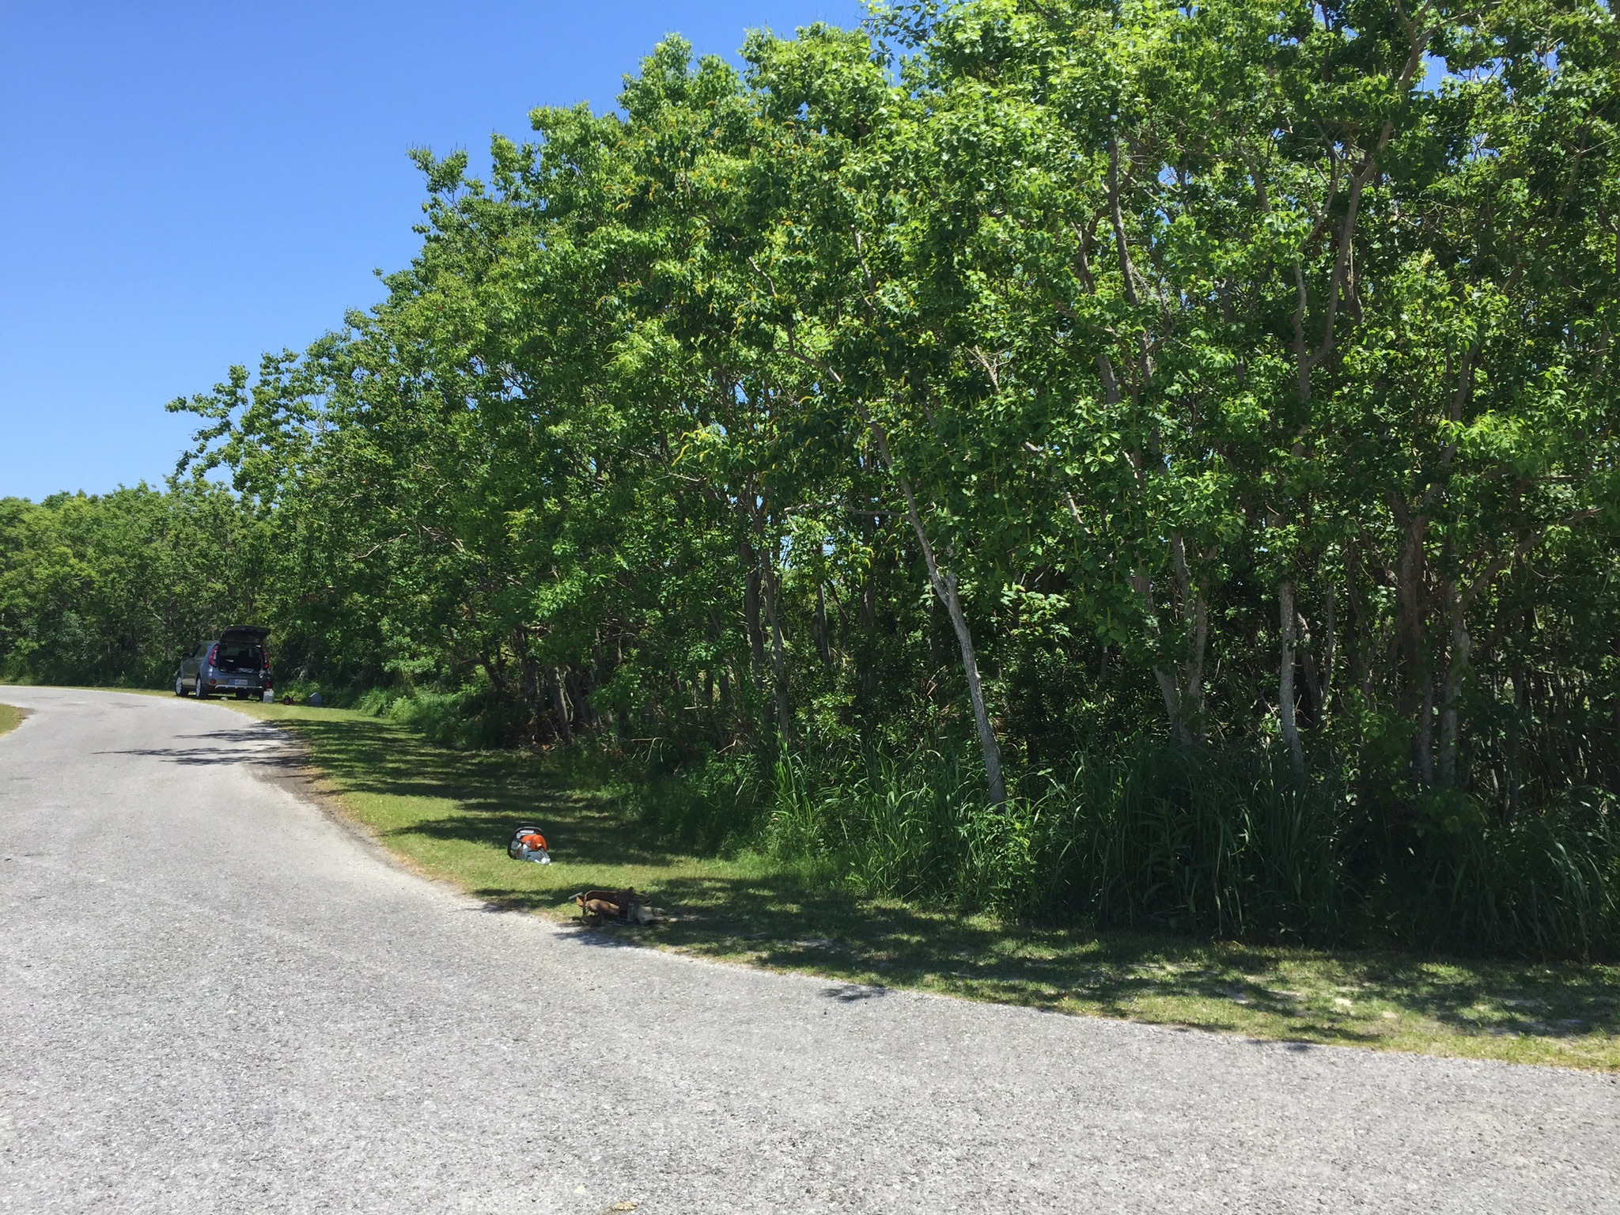
6. Dump Station facing east.
03/01/2018

Slide 27
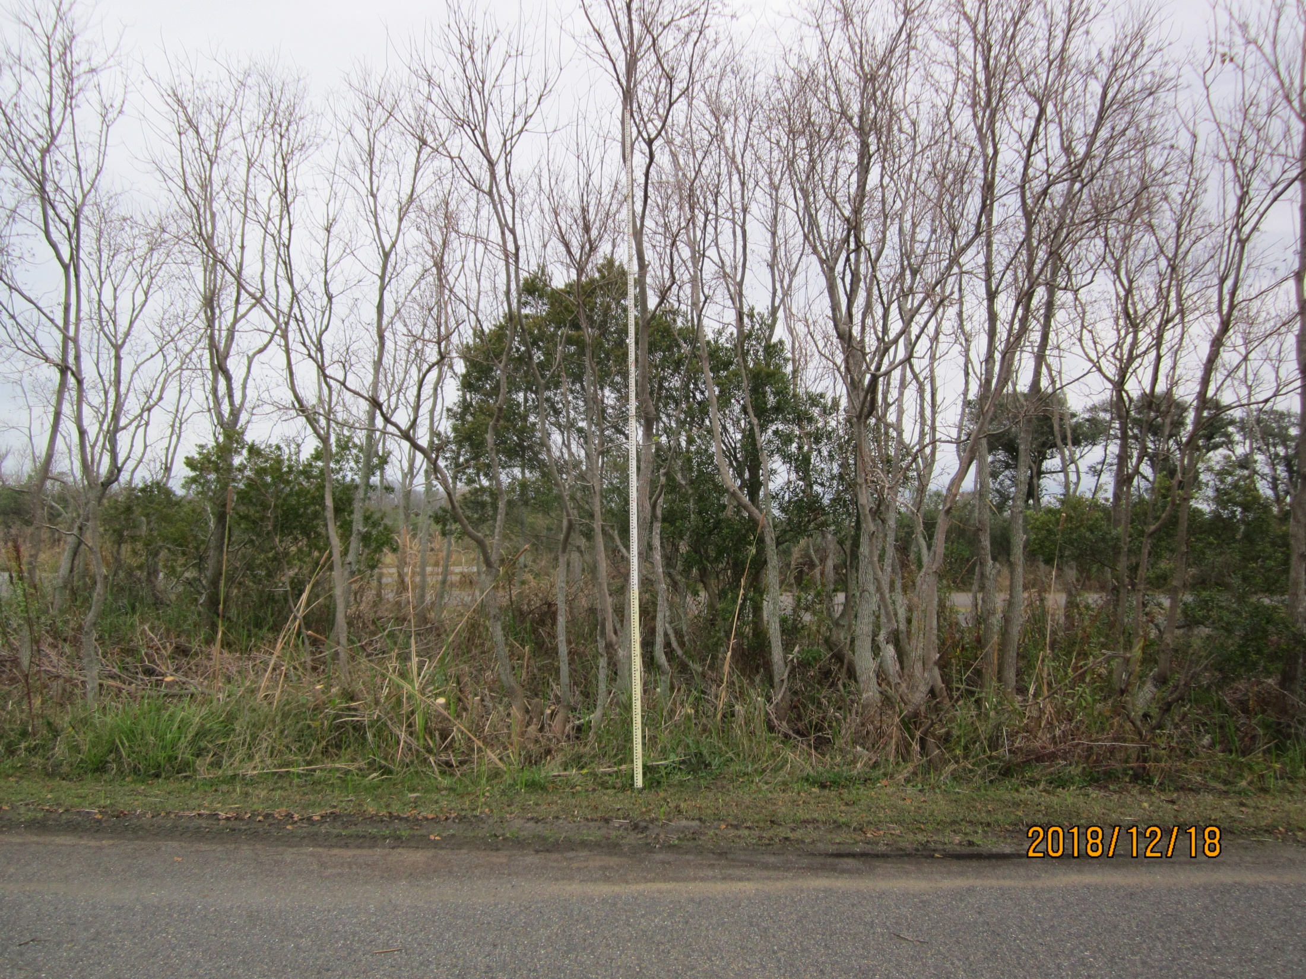
This image is taken from the south side facing north.
Stem Density was close to 10 stems per 2X2 meters.

Slide 28
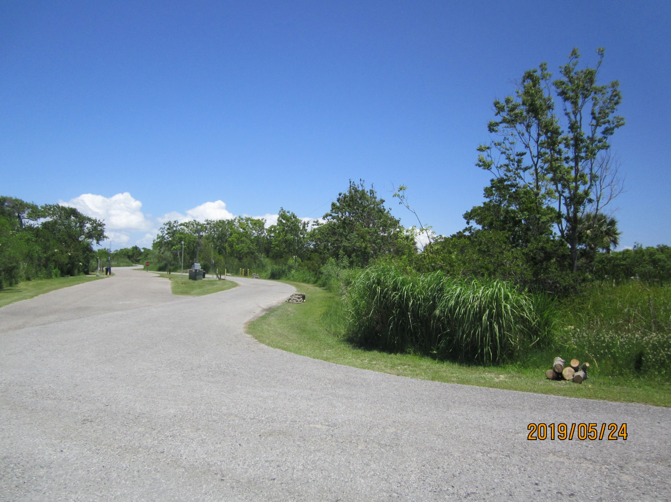

Slide 29
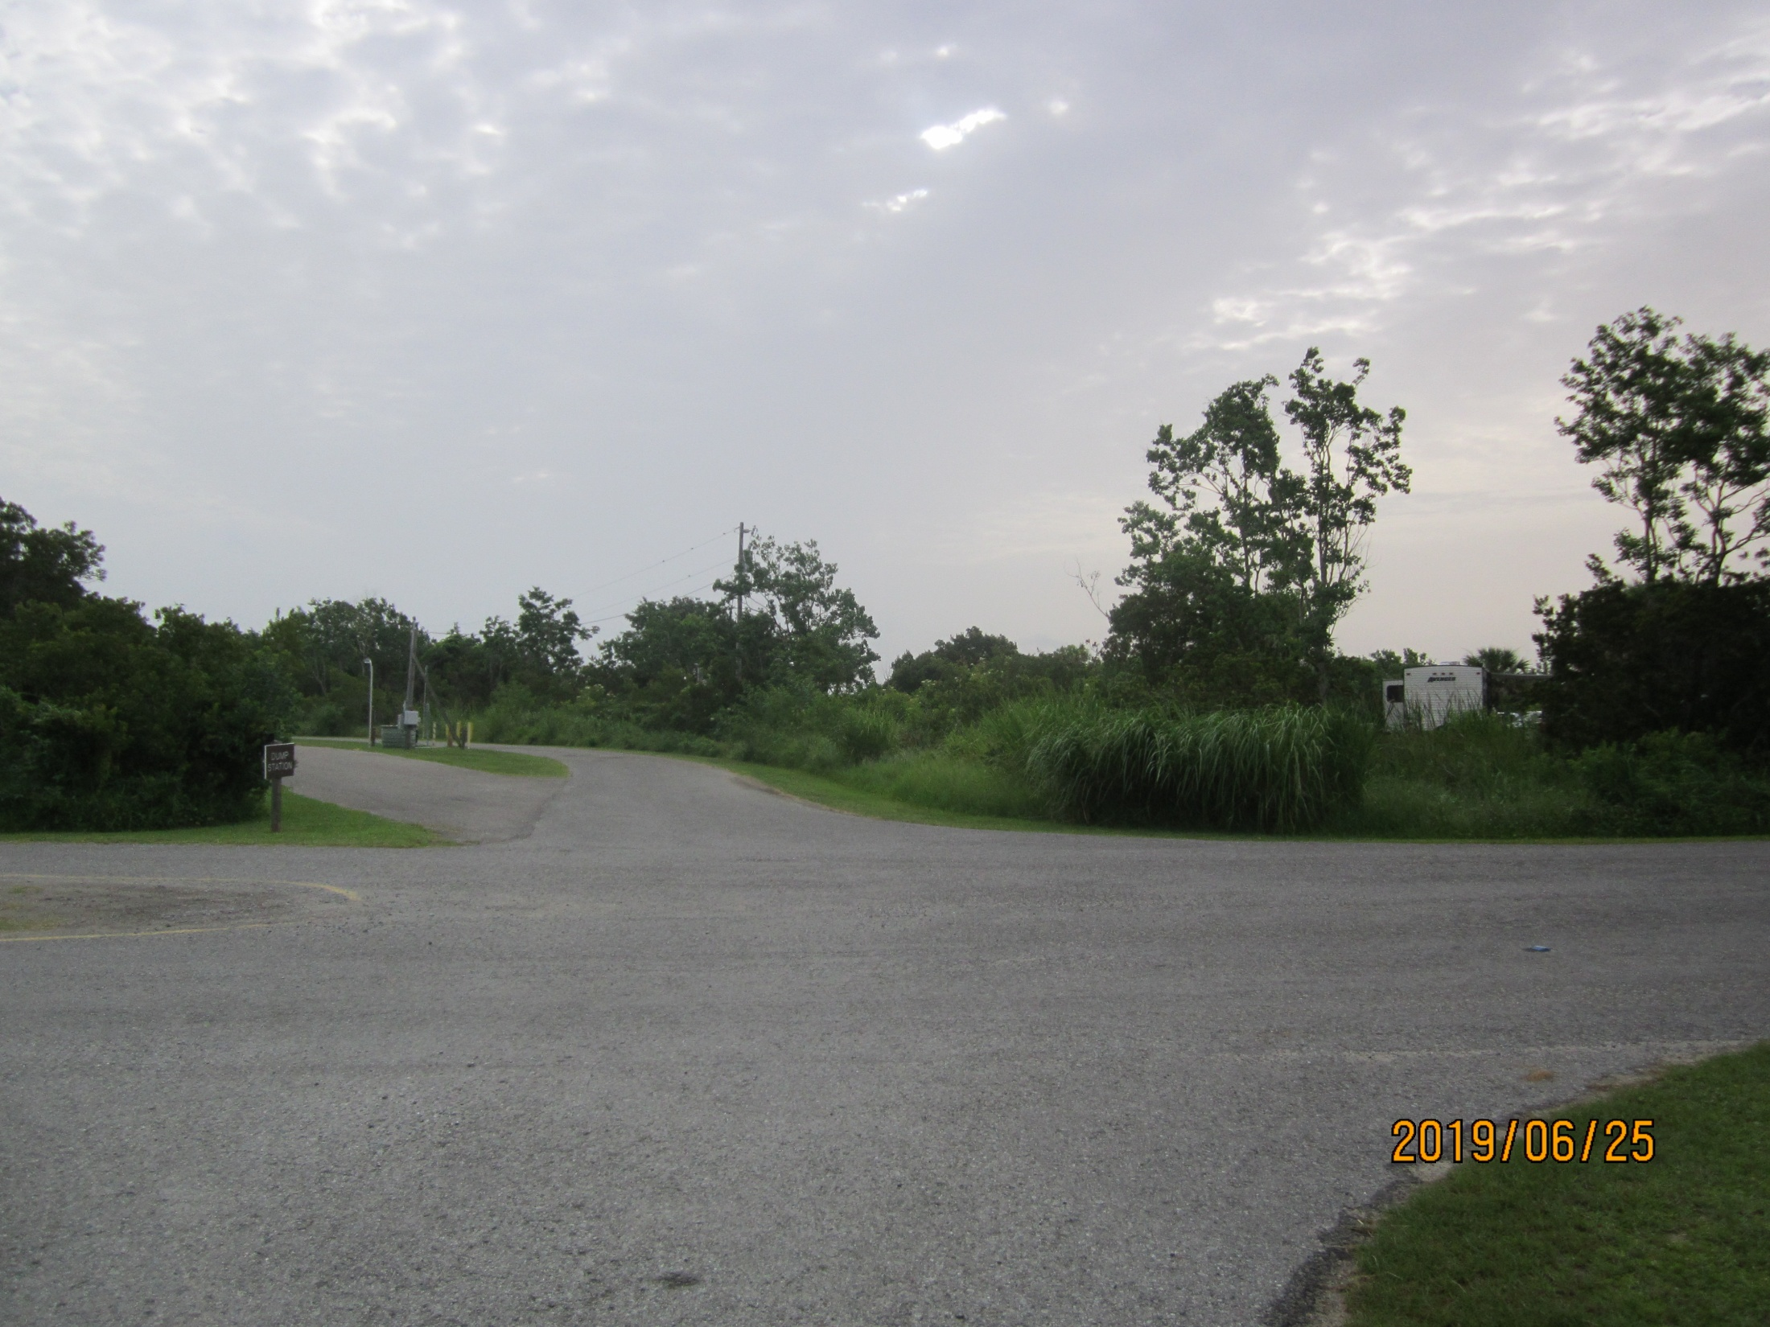

Slide 30
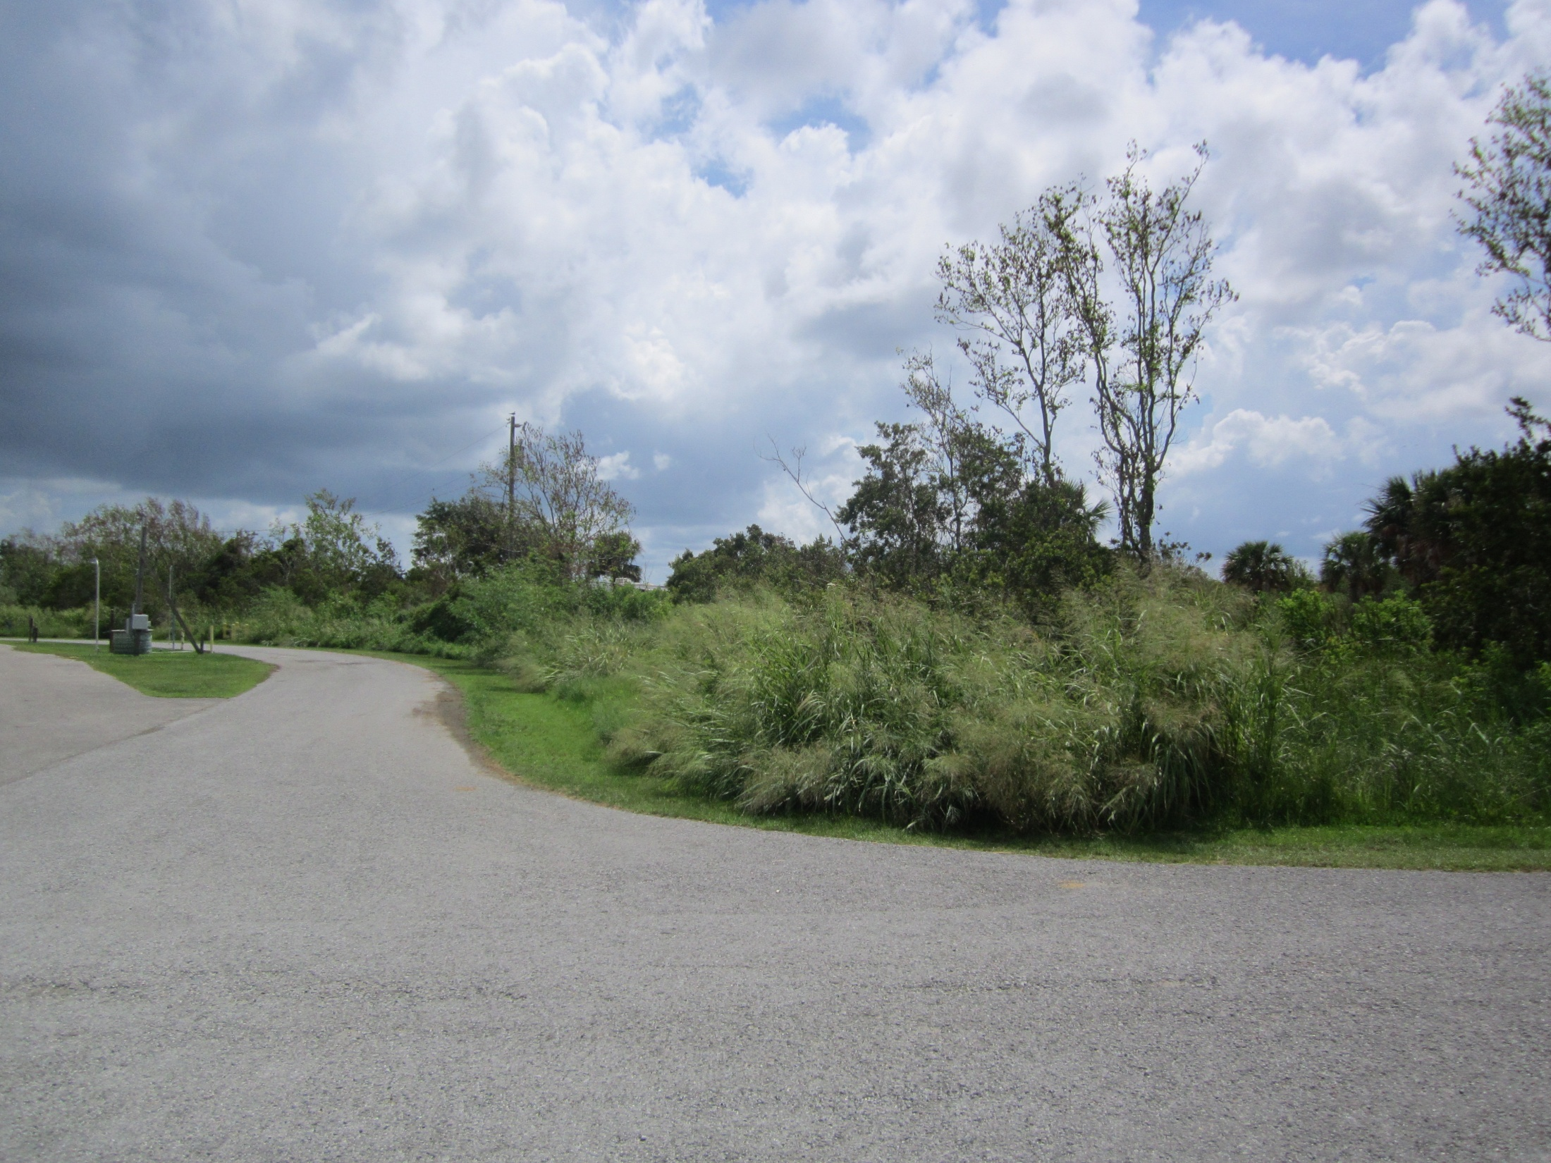
07/31/2019

