Slide 1
Hurdles with nurdles: Gulf-wide Citizen Science project
Jace Tunnell
Mission-Aransas National Estuarine Research Reserve
August 1, 2019

Slide 2
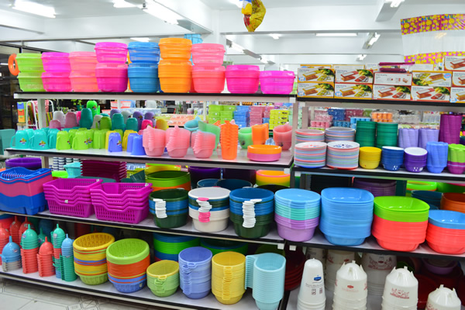
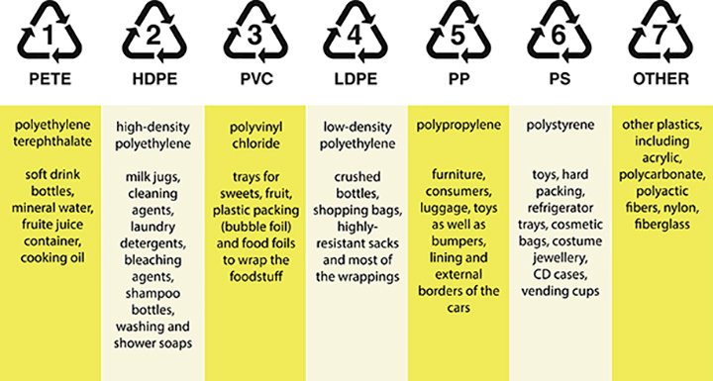
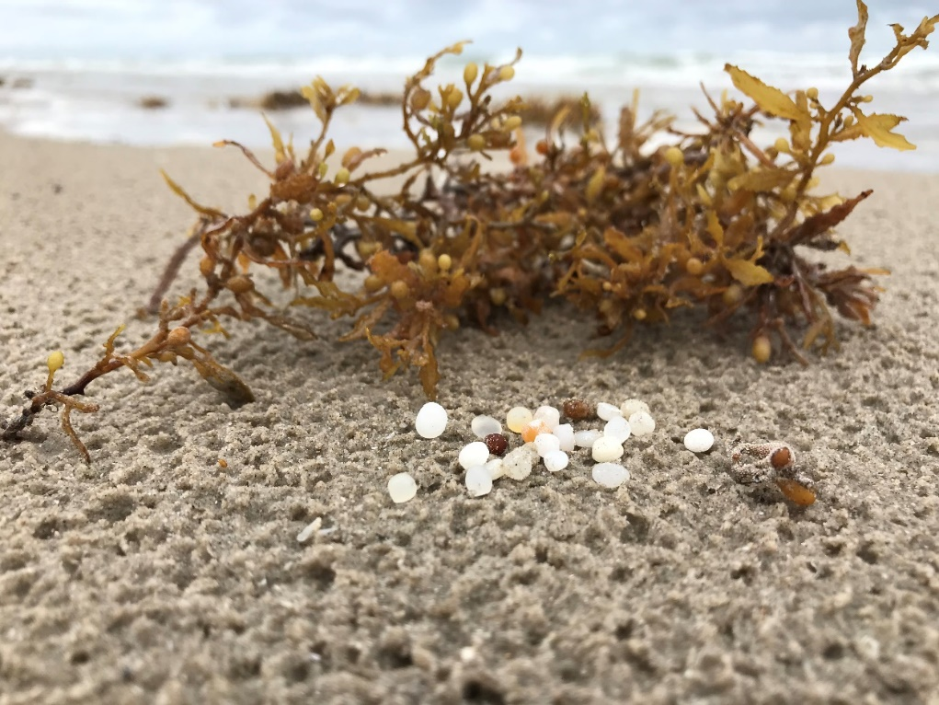
What is a nurdle?
Nurdle – raw plastic
Basis for everything plastic

Slide 3
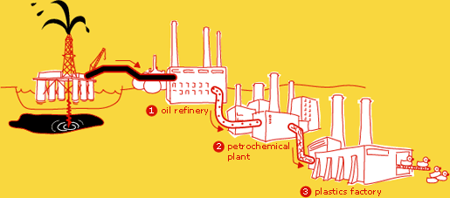
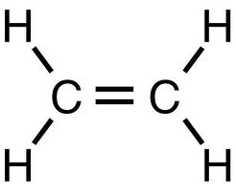
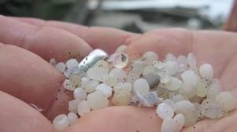
Nurdle production
Crude oil
Polyethylene
Ethylene
Image source: www.nobelprize.org
“Nurdles”

Slide 4
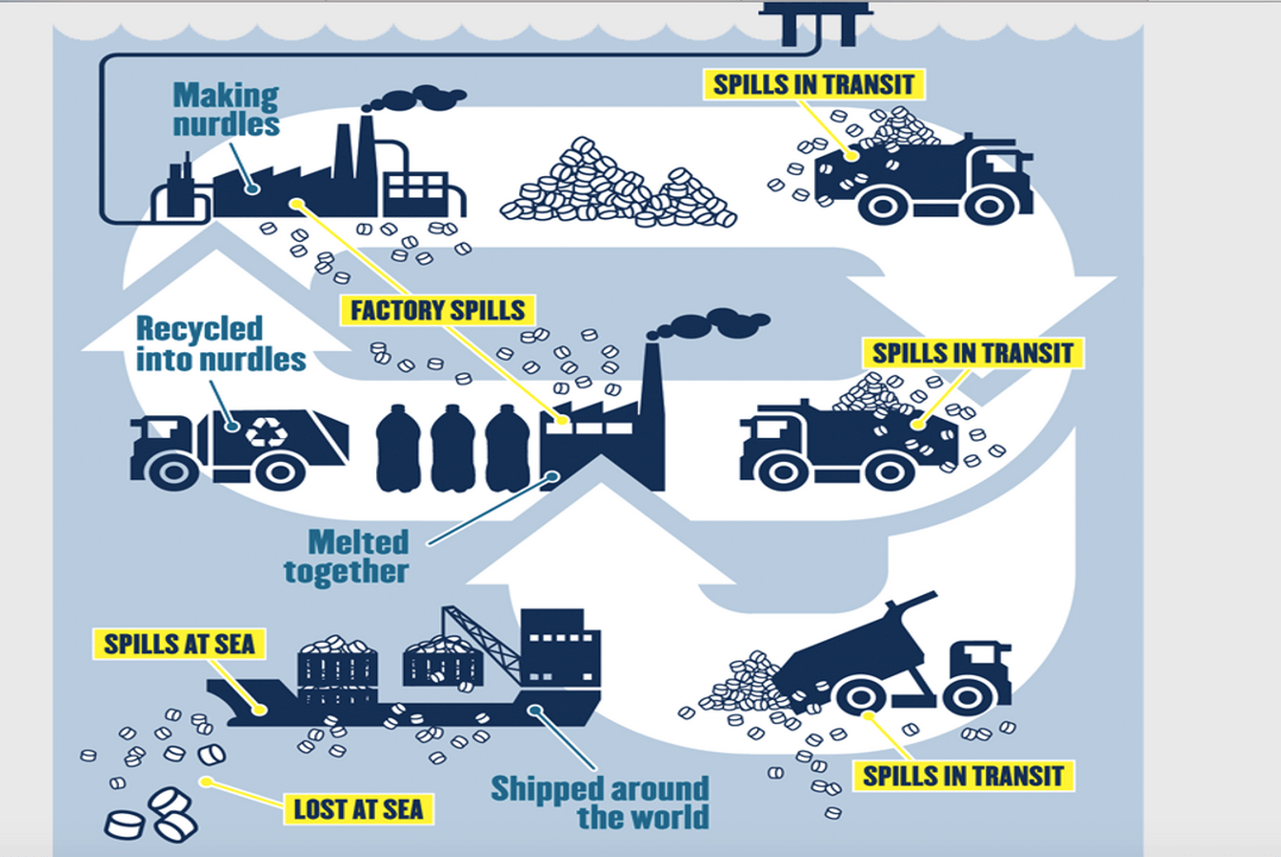
Release to Environment

Slide 5
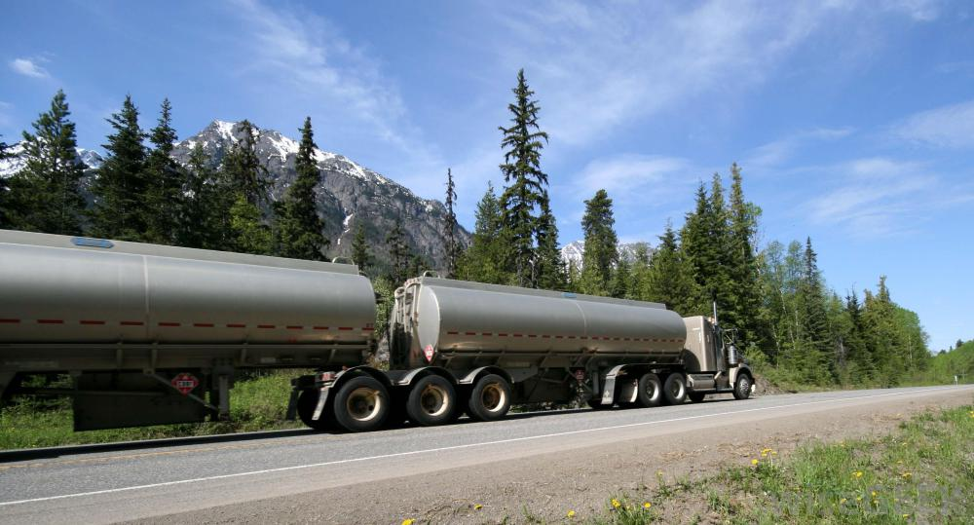
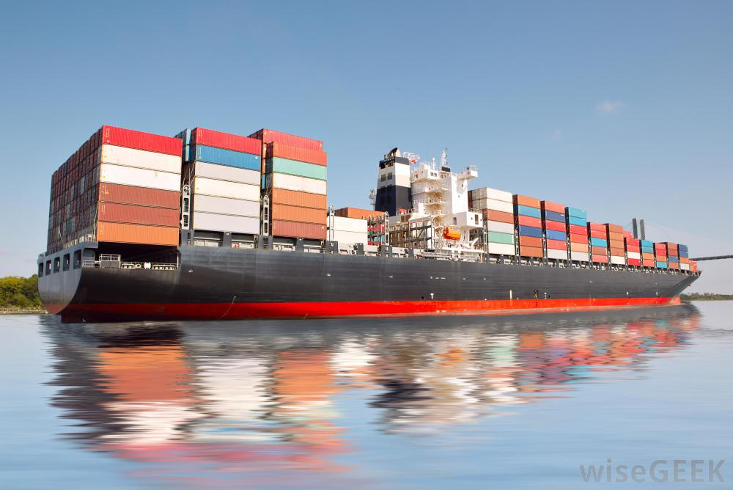
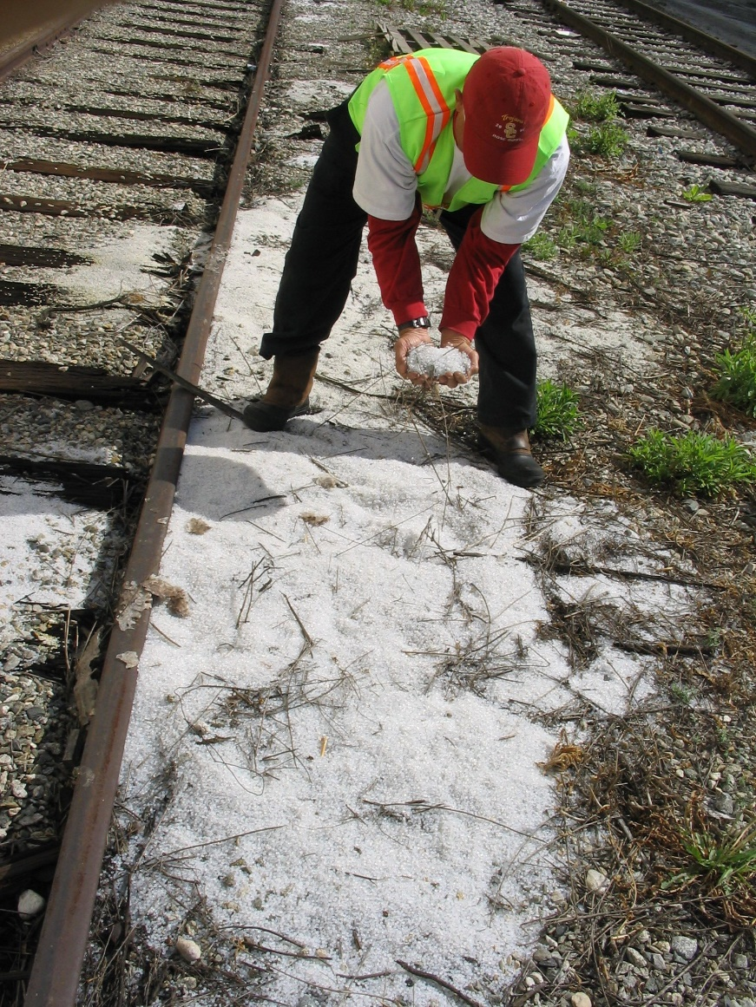
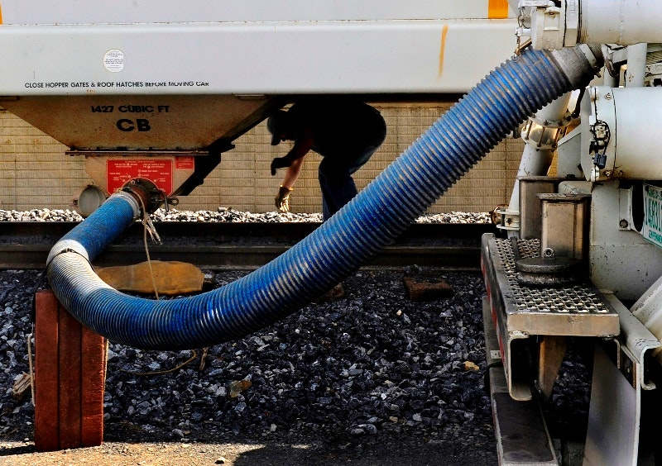
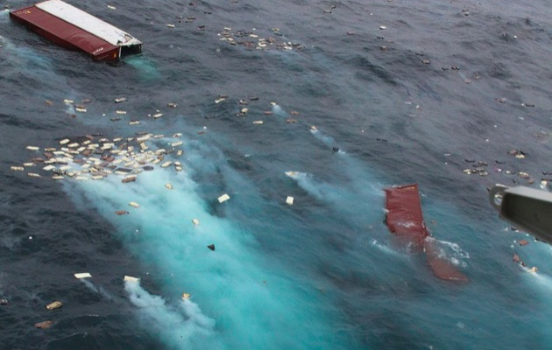
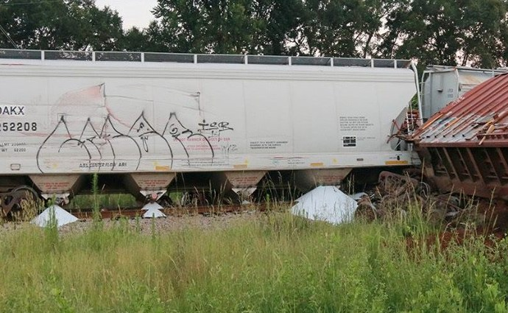
Release to Environment

Slide 6
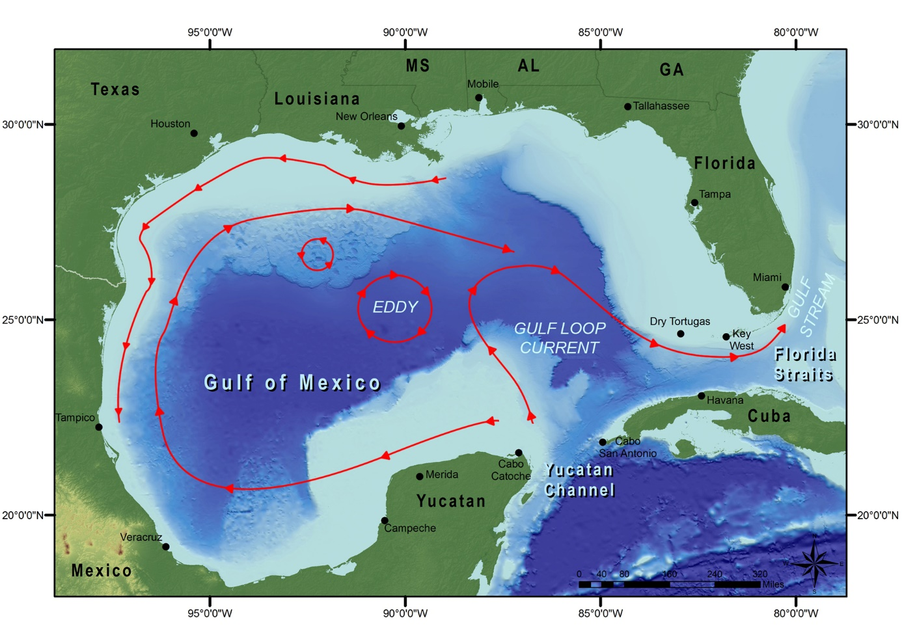

Slide 7
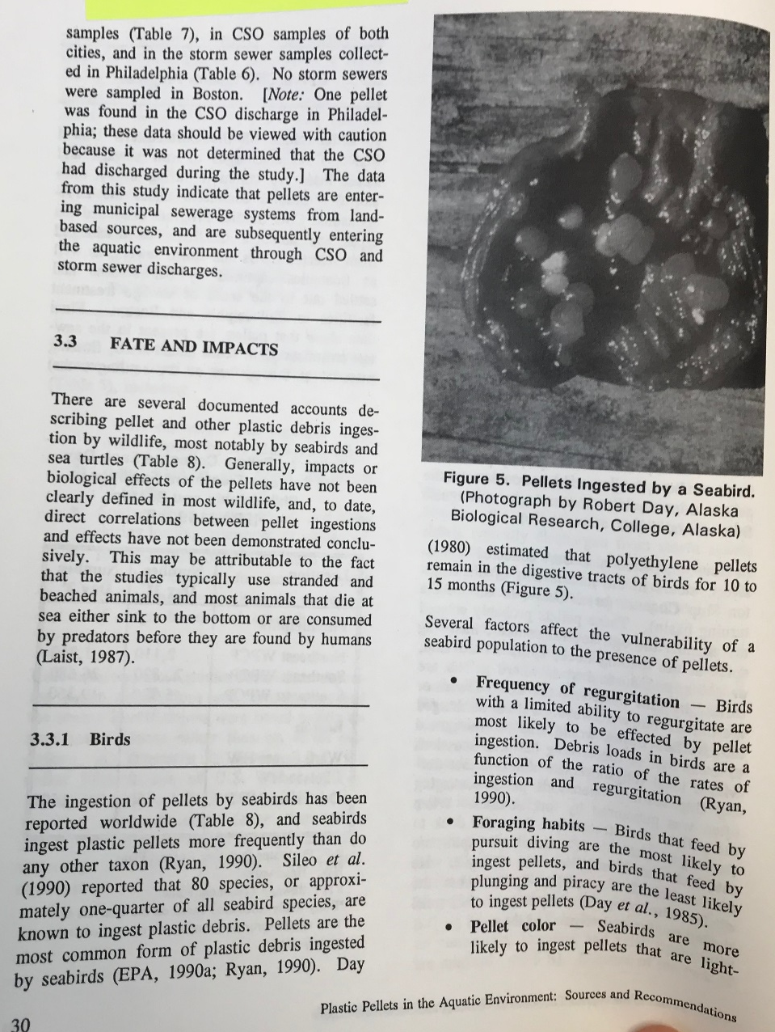
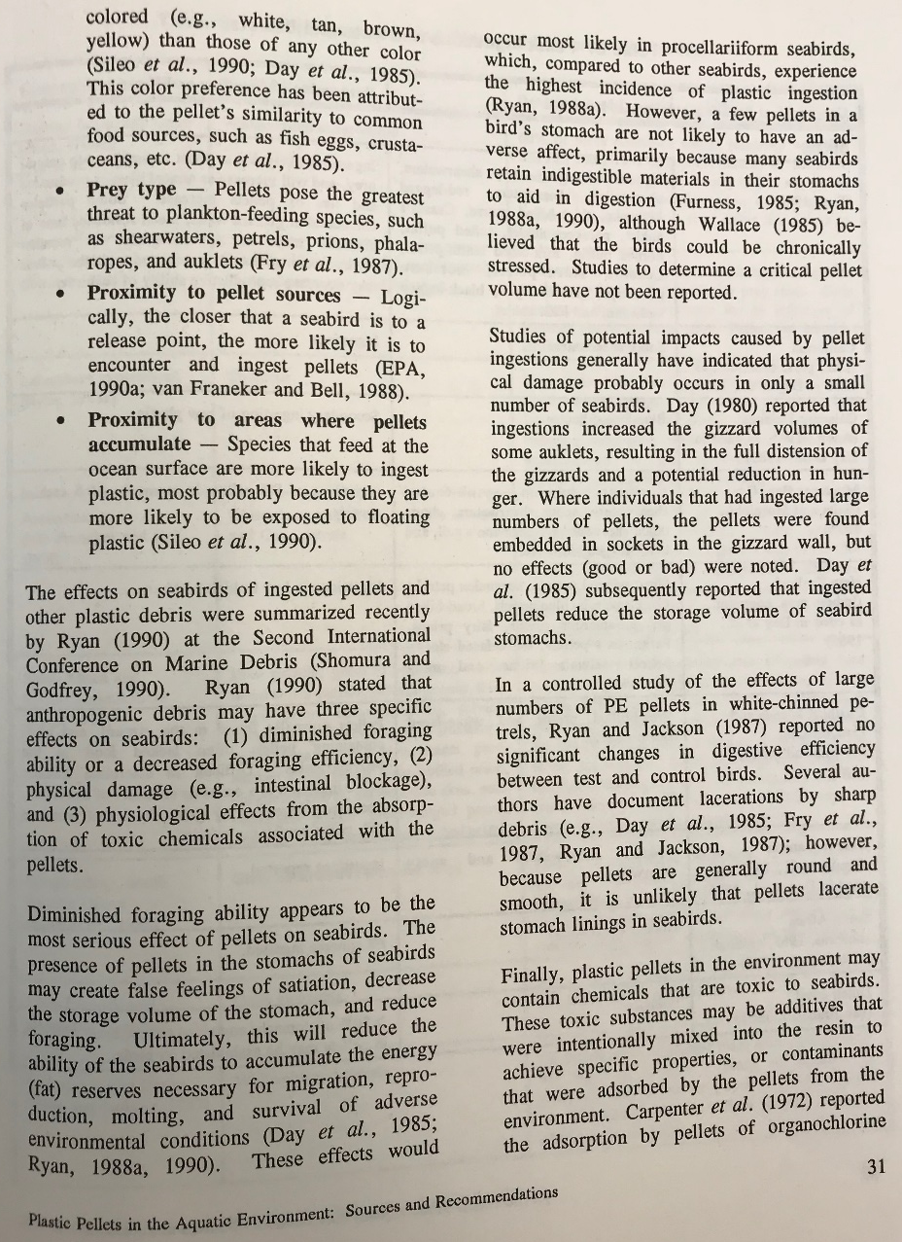
Impacts
1992 EPA Report on Plastic Pellets
Wildlife eat
Toxins
Human health
Aesthetics
ARK turtle x-ray, September 2018

Slide 8
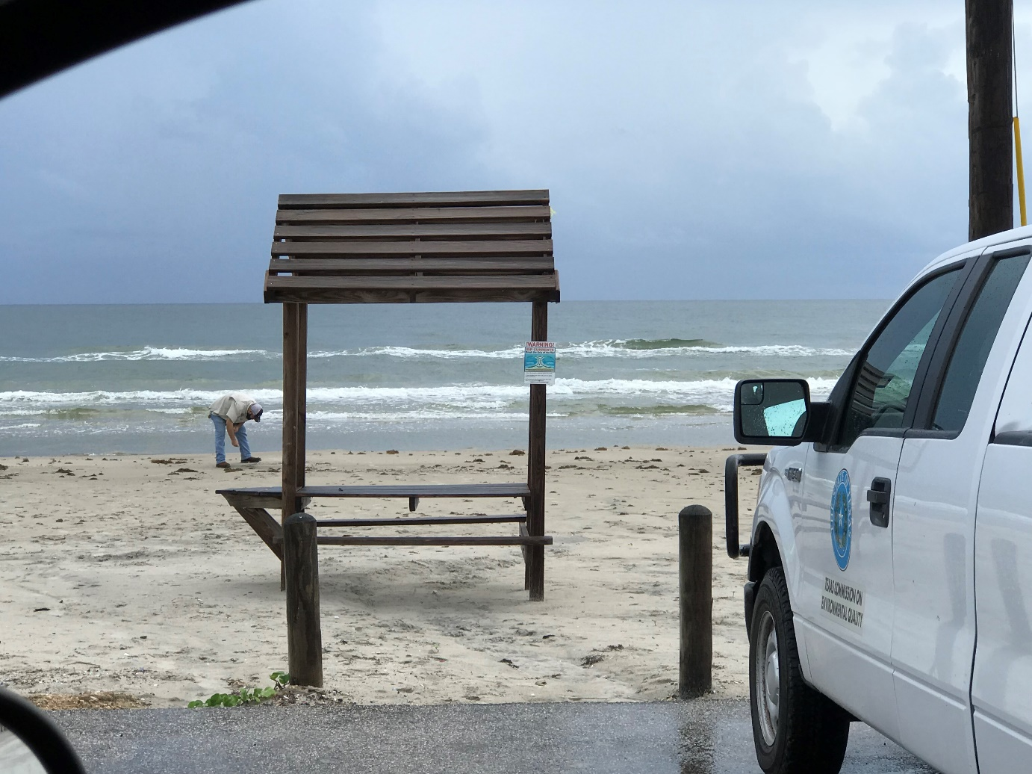
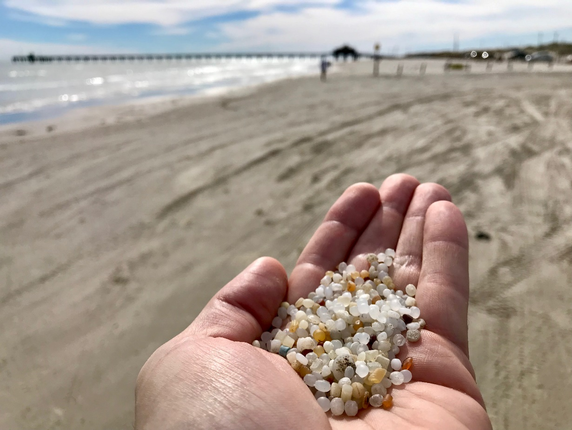
Nurdle spill on beach
September 28, 2018
Nueces County, Bob Hall Pier

Slide 9
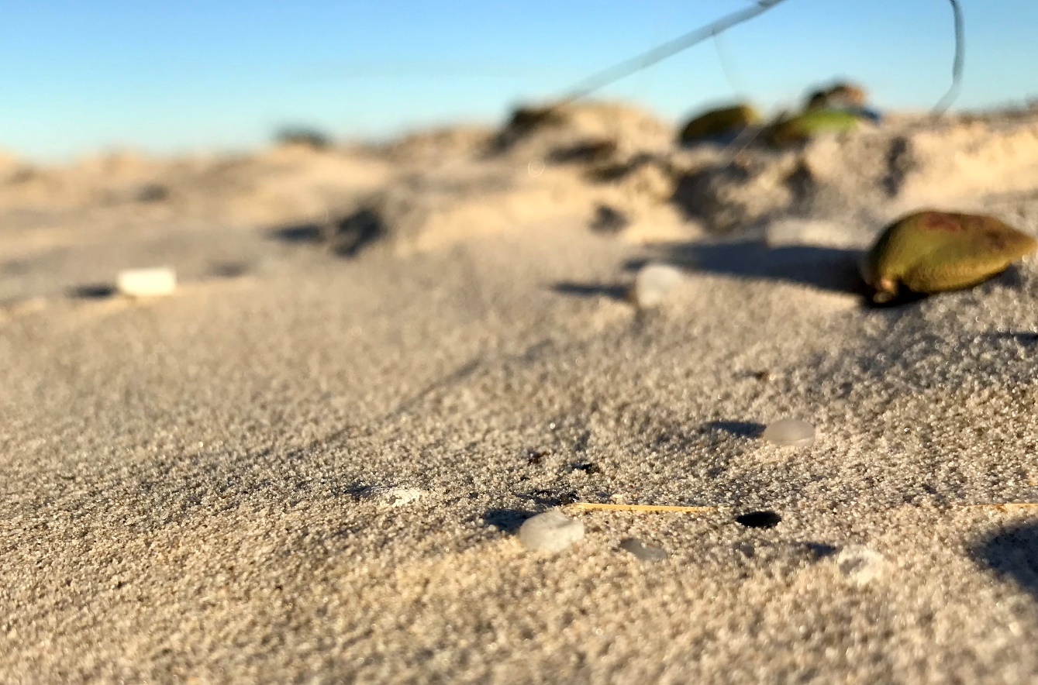
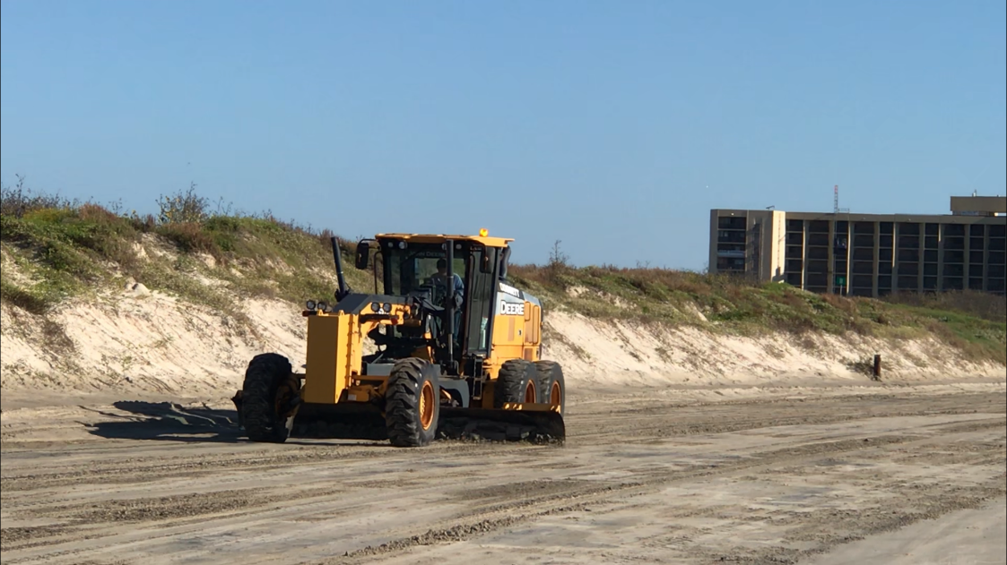
Issues
Beach maintenance
High tides
Driving on beach
Wind blowing sand
Similar with oil spill
Time sensitive to clean up

Slide 10
Distribution
www.nurdlehunt.org.uk

Slide 11
Citizen Science Project

Slide 12
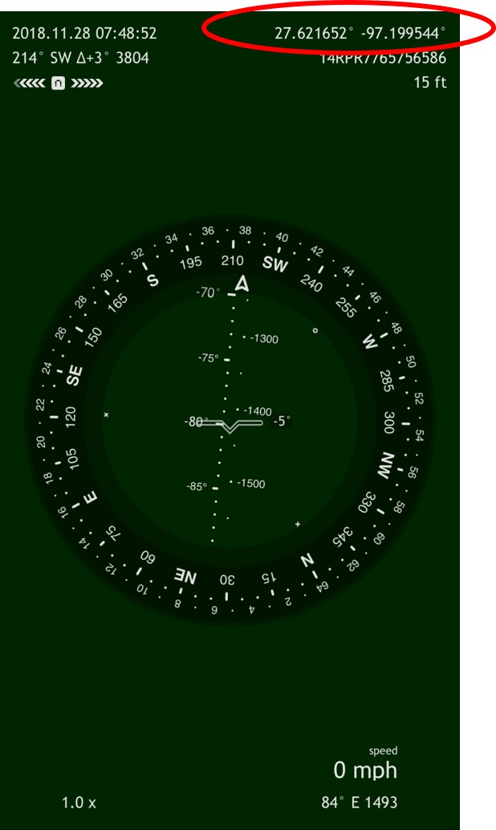
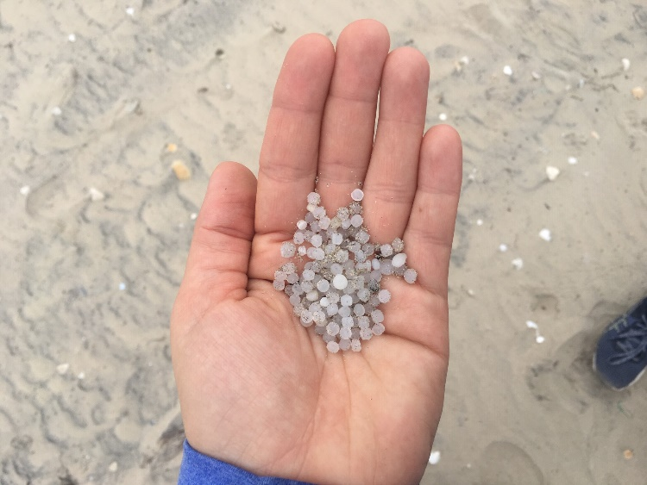
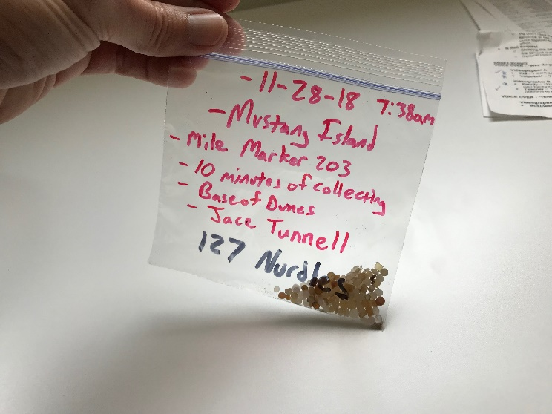
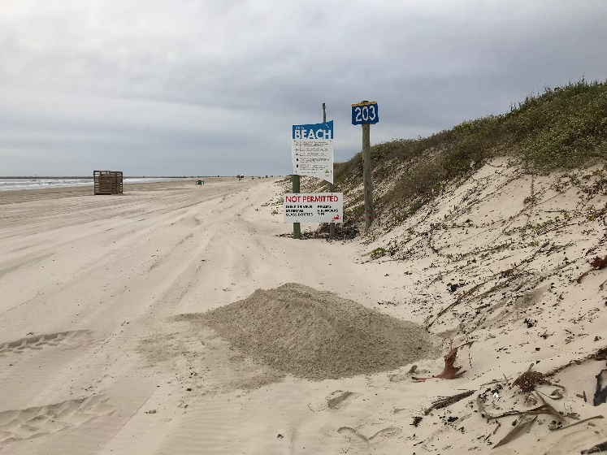
Nurdle Patrol
Find nurdles, then collect for 10 minutes
Put in container or bag and label
Add location, date, time, how many nurdles
Take pictures of nurdles found and beach
Email Jace@utexas.edu

Slide 13
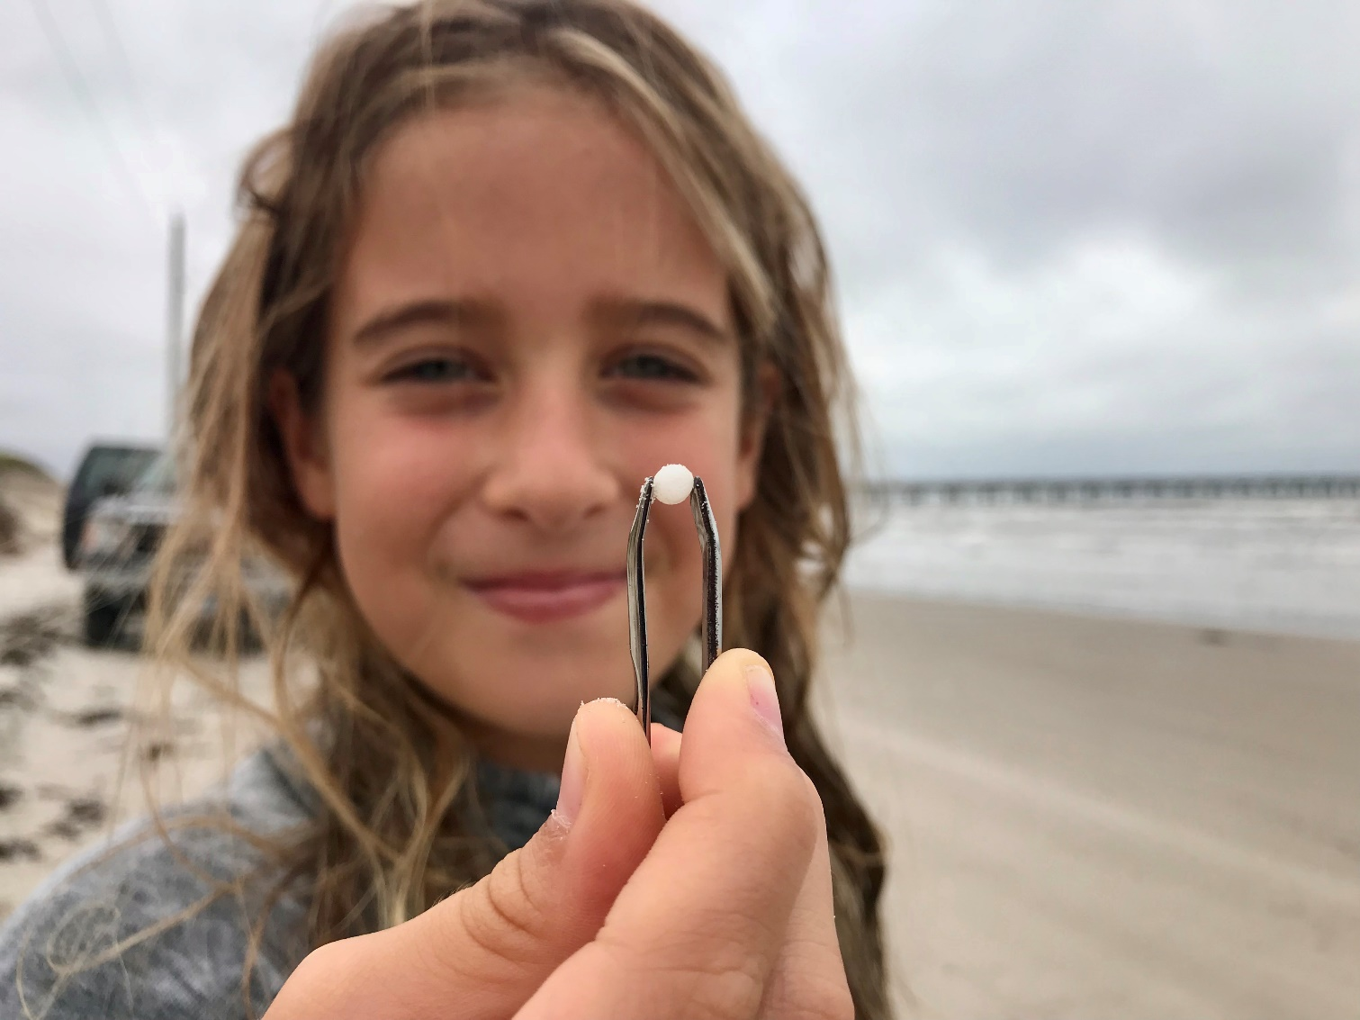
Training Video
Mission-Aransas Reserve

Slide 14
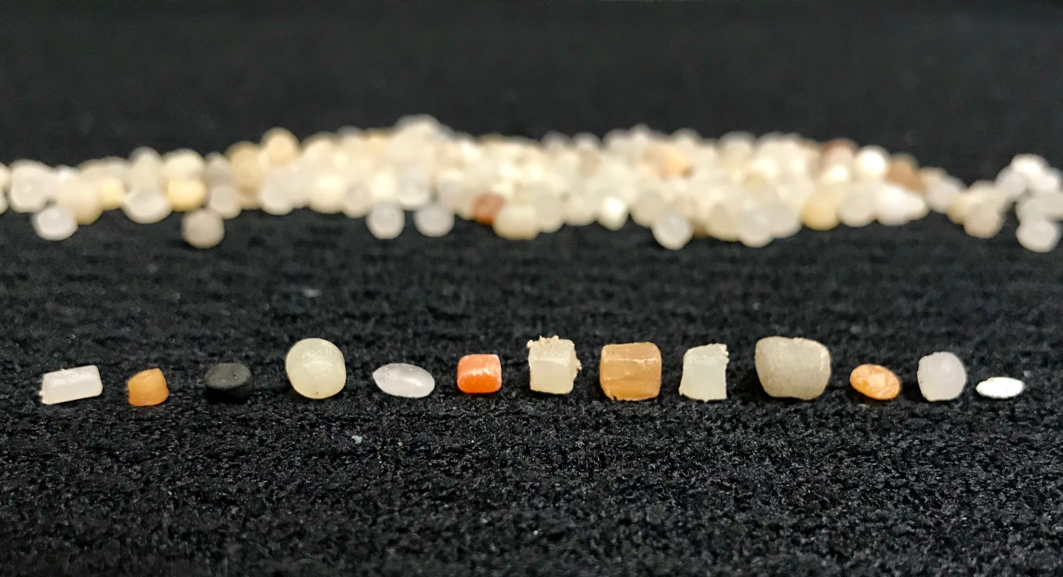
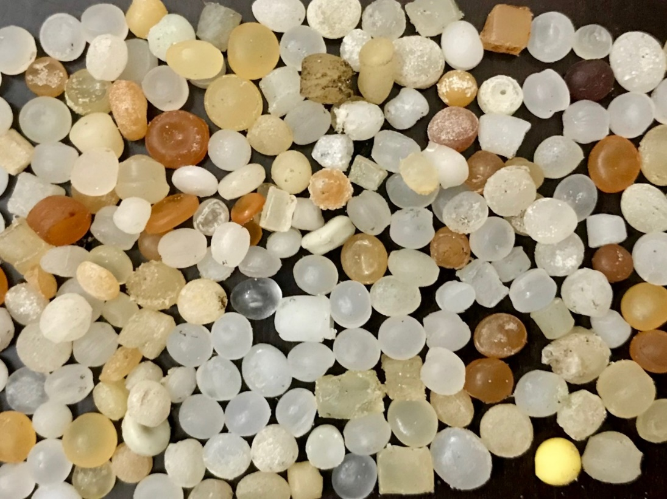
Types being found

Slide 15
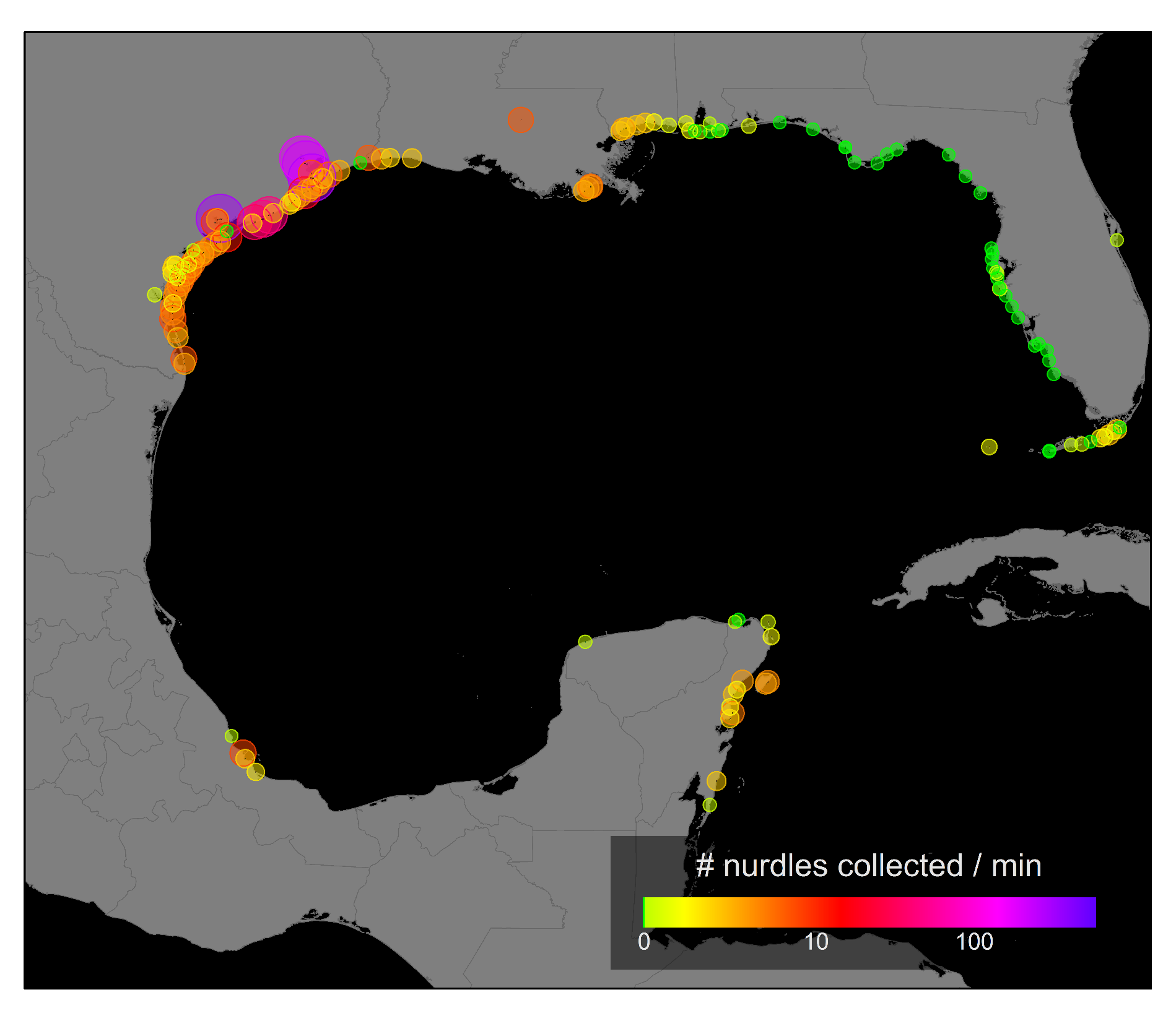
Gulf of Mexico

Slide 16
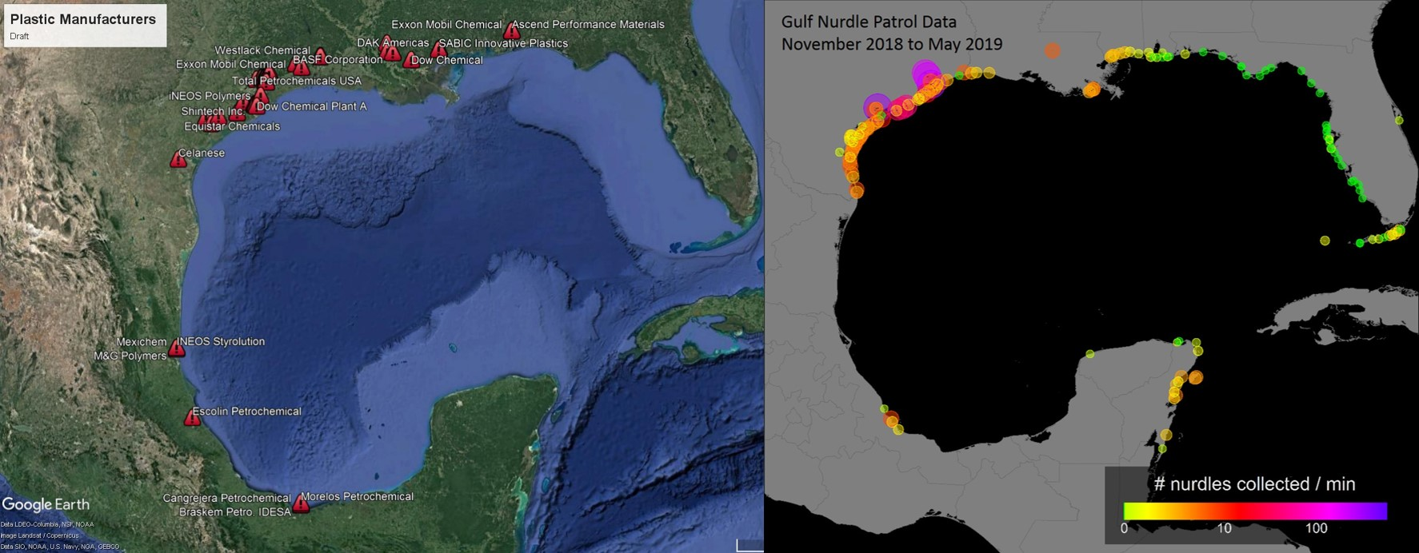
Gulf of Mexico

Slide 17
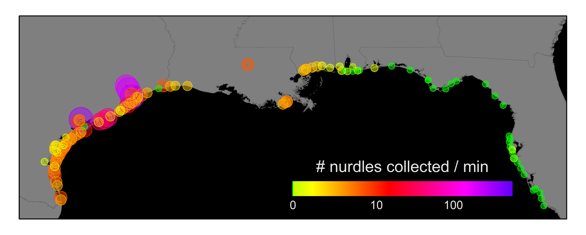
Gulf of Mexico

Slide 18
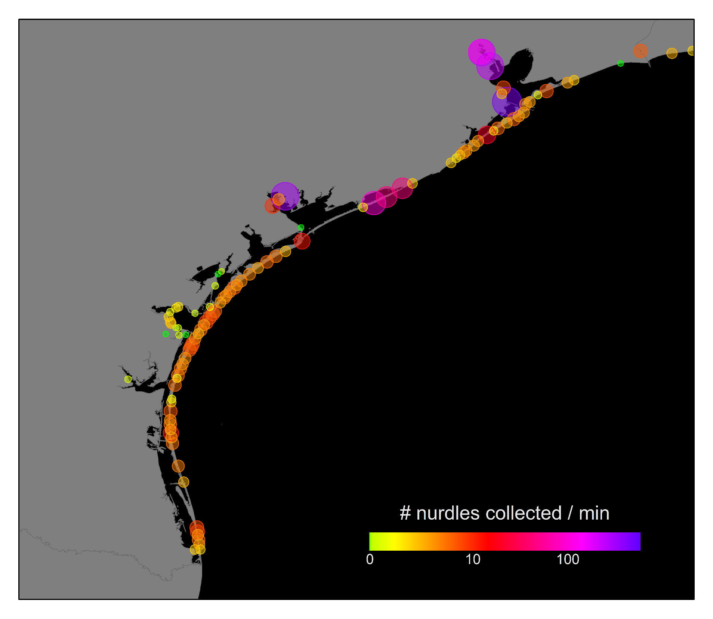
Texas
Gulf of Mexico

Slide 19
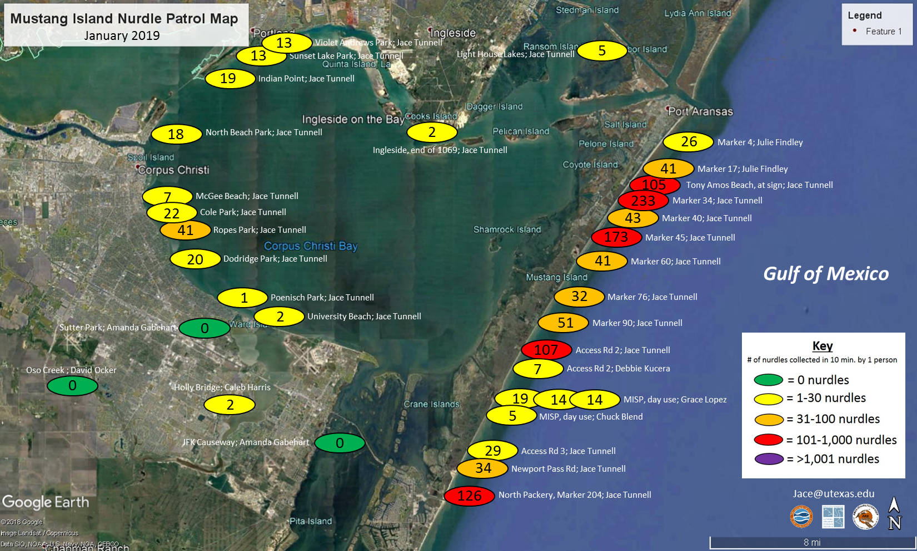

Slide 20
Why should we care?
New Polyethylene projects

Slide 21
What can be done?
Follow the guidance of Operations Clean Sweep.
Develop data base to link nurdles to manufactures.
Create chain of custody for nurdles being shipped.
Stricter stormwater permits.
Quick accountability by plastic pellet industry.
At home, we can refuse, reduce, reuse, repurpose, recycle.

Slide 22
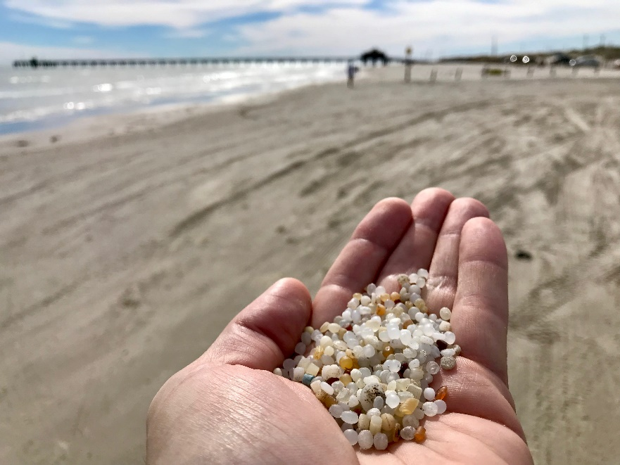
Future of Project
New website for Nurdle Patrol
Expanding partnerships
Create Microplastics Science Team
Work with environmental agencies

Slide 23
www.MissionAransas.org
Facebook

Slide 24
Why? Our next generation

Slide 25
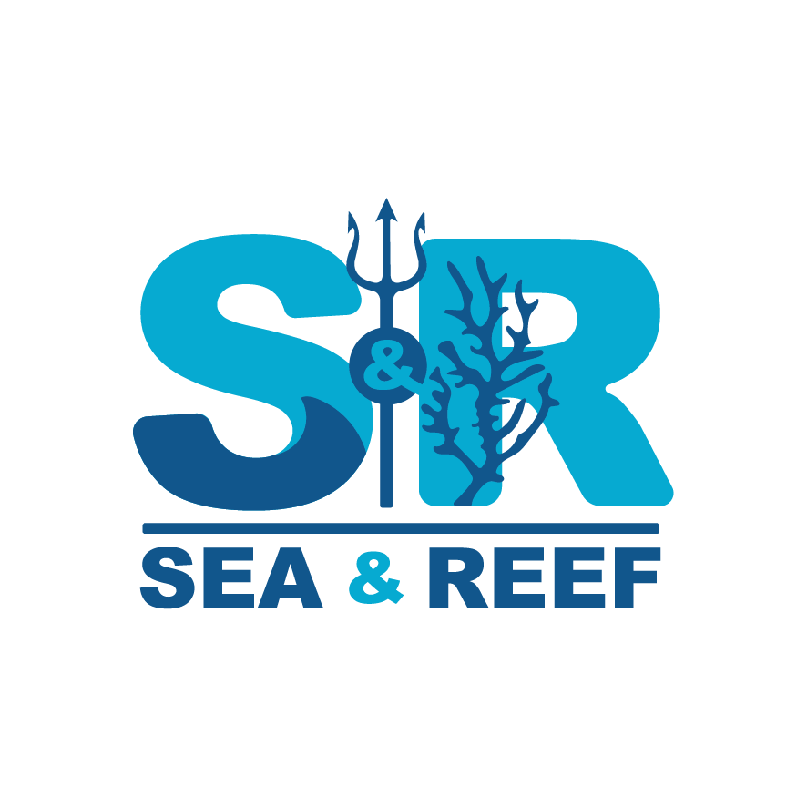
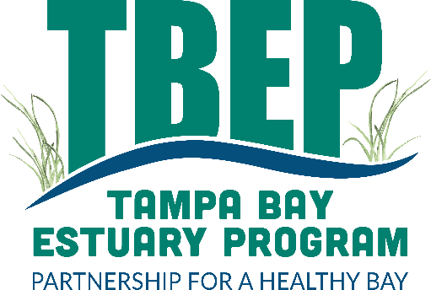
Thank you!
All Citizen Scientists!
Partners:
Katie Swanson
Jacob Augs
Dr. Lindsay Scheef
Dr. Zhanfei Liu
Dr. Kelly Dunning
Jace@utexas.edu

