Slide 1
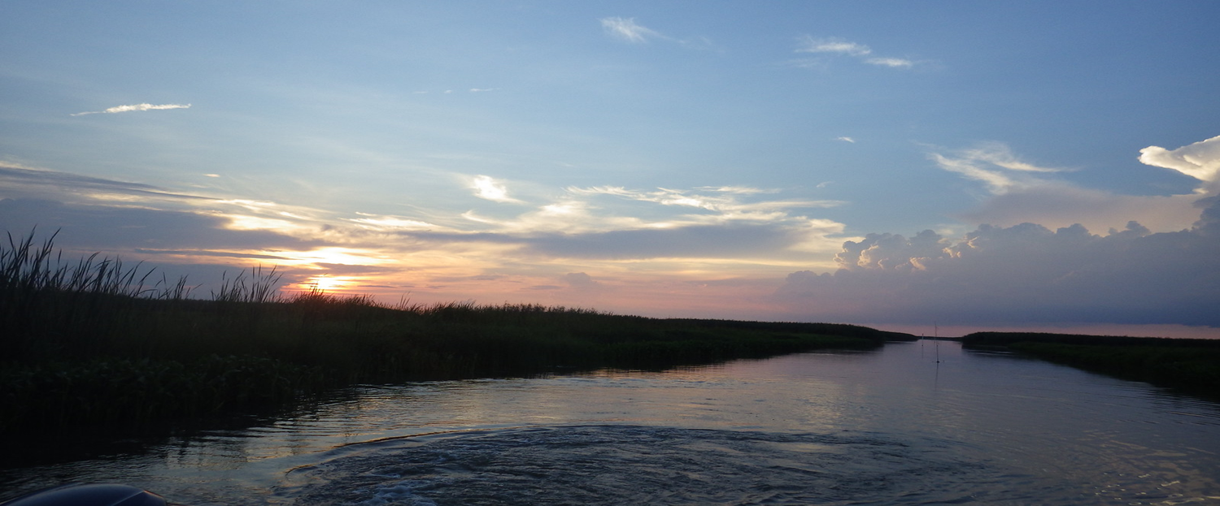
BTNEP Climate Ready Estuary Report
May 2nd, 2019

Slide 2
Purpose
Assess climate change vulnerabilities
Develop and implement adaptation strategies
Engage and educate stakeholders

Slide 3
Process is mandatory!

Slide 4
Vulnerability assessment
+
action plan
Climate Change adaptation

Slide 5
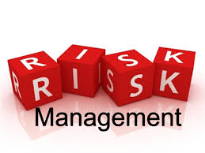
Risk Based Planning
Risk management is about an organization.
Goals
Context
Decisions
Help identify problems.
Better and more informed decisions.

Slide 6
How do we decide what to do?
Broader missions more problems.
Risks can grow quickly!
Ex. 5 goals, 6 stressors, 4 risks for each stressors.
5 x 6 x 4 = 120 risks.
How to decide what to do when there are not enough resources to do everything that needs to be done?

Slide 7
The Workbook
Guide to climate change adaptation planning.
Provides decision-support tools, helps plan climate change adaptation strategies, and builds capacity of local managers.
Step-by-step application of risk management methodology.
Part 1: Vulnerability assessment.
Part 2: Action Plan and Implementation.

Slide 8
The Workbook
Vulnerability assessment
(Part I)
+
Implementing an action plan
(Part II)
Climate Change adaptation
San Juan Bay Estuary Climate Change Adaptation Plan

Slide 9
The WorkBook
Identify key stakeholders, learn their interests, and level of involvement.

Slide 10
The WorkBook
Identify key stakeholders, learn their interests, and level of involvement.
Identify goals and establish scope and boundaries for vulnerability assessment.

Slide 11
The WorkBook
Identify key stakeholders, learn their interests, and level of involvement.
Identify goals and establish scope and boundaries for vulnerability assessment.
Create broad list of climate change risks that might affect BTNEP’s ability to achieve its goals.

Slide 12
The WorkBook
Identify key stakeholders, learn their interests, and level of involvement.
Identify goals and establish scope and boundaries for vulnerability assessment.
Create broad list of climate change risks that might affect BTNEP’s ability to achieve its goals.
Prioritize risks.

Slide 13
The WorkBook
Identify key stakeholders, learn their interests, and level of involvement.
Identify goals and establish scope and boundaries for vulnerability assessment.
Create broad list of climate change risks that might affect BTNEP’s ability to achieve its goals.
Prioritize risks.
Develop consequences/probability matrix and review with stakeholders.

Slide 14
Consequence/probability Matrix
High
Likelihood Probability of Occurrence
Medium
Priority
Low
Medium
High
Low
Low
Medium
High
Consequences of Impact

Slide 15
The WorkBook
Explore opportunities and constraints. Develop list of potential partners.

Slide 16
The WorkBook
Explore opportunities and constraints. Develop list of potential partners.
Decide whether to mitigate, transfer, accept, or avoid each risks.

Slide 17
The WorkBook
Explore opportunities and constraints. Develop list of potential partners.
Decide whether to mitigate, transfer, accept, or avoid each risks.
Develop a list of adaptation actions and select best actions for implementation.

Slide 18
The WorkBook
Explore opportunities and constraints. Develop list of potential partners.
Decide whether to mitigate, transfer, accept, or avoid each risks.
Develop a list of adaptation actions and select best actions for implementation.
Create plan to ensure actions are moving forward and risks are mitigated.

Slide 19
The WorkBook
Explore opportunities and constraints. Develop list of potential partners.
Decide whether to mitigate, transfer, accept, or avoid each risks.
Develop a list of adaptation actions and select best actions for implementation.
Create plan to ensure actions are moving forward and risks are mitigated.
Monitor and review vulnerability assessment and action plans and update as necessary.

Slide 20
Consequence/probability Matrix
High
Likelihood Probability of Occurrence
Medium
Priority
Low
Medium
High
Low
Low
Medium
High
Consequences of Impact

Slide 21
The WorkBook
Risks are based on 7 stressors identified in the Workbook:
Warmer winters (17)
Warmer summers
Warmer water
Increase storminess
Increasing drought
Sea level rise
Ocean acidification
Increase in disease prevalence and survival of overwintering populations.

Slide 22
The WorkBook
Risks are based on 7 stressors:
Warmer winters (17)
Warmer summers (23)
Warmer water
Increase storminess
Increasing drought
Sea level rise
Ocean acidification
More intense storms and hurricane events

Slide 23
The WorkBook
Risks are based on 7 stressors:
Warmer winters (17)
Warmer summers (23)
Warmer water (19)
Increase storminess
Increasing drought
Sea level rise
Ocean acidification
An increase in the concentration of diseases and pathogens, which can impact human health.

Slide 24
The WorkBook
Risks are based on 7 stressors:
Warmer winters (17)
Warmer summers (23)
Warmer water (19)
Increase storminess (28)
Increasing drought
Sea level rise
Ocean acidification
Higher insurance rates, forcing residents to be uninsured.

Slide 25
The WorkBook
Risks are based on 7 stressors:
Warmer winters (17)
Warmer summers (23)
Warmer water (19)
Increase storminess (28)
Increasing drought (22)
Sea level rise
Ocean acidification
A lower water table, which will cause an increase in subsidence along the coastline.

Slide 26
The WorkBook
Risks are based on 7 stressors:
Warmer winters (17)
Warmer summers (23)
Warmer water (19)
Increase storminess (28)
Increasing drought (22)
Sea level rise (31)
Ocean acidification
Increase in aquafer salinity

Slide 27
The WorkBook
Risks are based on 7 stressors:
Warmer winters (17)
Warmer summers (23)
Warmer water (19)
Increase storminess (28)
Increasing drought (22)
Sea level rise (31)
Ocean acidification (12)
More corrosive waters, which will impact the shell development of bivalves and exoskeleton of crustaceans.

Slide 28
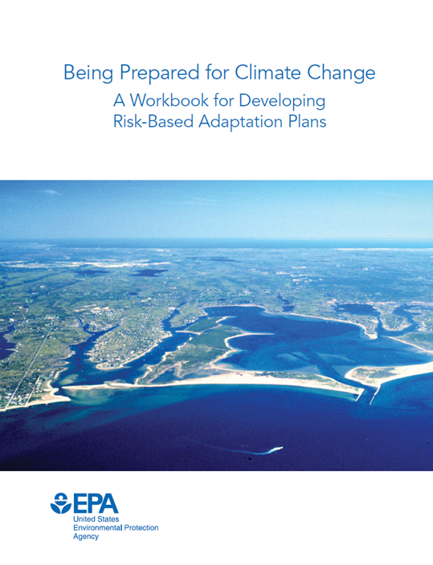
Risk identification
Total of 152 risks divided into three categories.
Risks to plants and wildlife
Risks to Ecosystems
Risks to humans
Risks were identify through:
Literature review
Workbook
Published CRE reports

Slide 29
Risk survey

Slide 30
How you can help
Help make BTNEP a climate ready estuary by:
Being involve in the CRE process.
Provide inputs and comments.
Participate in email surveys.

Slide 31
Participation Survey
BTNEP will send an email survey following the Management Conference meeting.

Slide 32
THANK YOU
Huy Vu, Ph.D
Christine DeMyers, Ph.D
Scott Hemmerling, Ph.D
1110 RIVER ROAD S., SUITE 200, BATON ROUGE, LA. 70802
225-448-2813
WWW.THEWATERINSTITUTE.ORG

