Slide 1
Port Fourchon Belle Pass Channel Deepening Section 203 Study
Draft Environmental Impact Statement

Slide 2
www.portfourchon.com

Slide 3
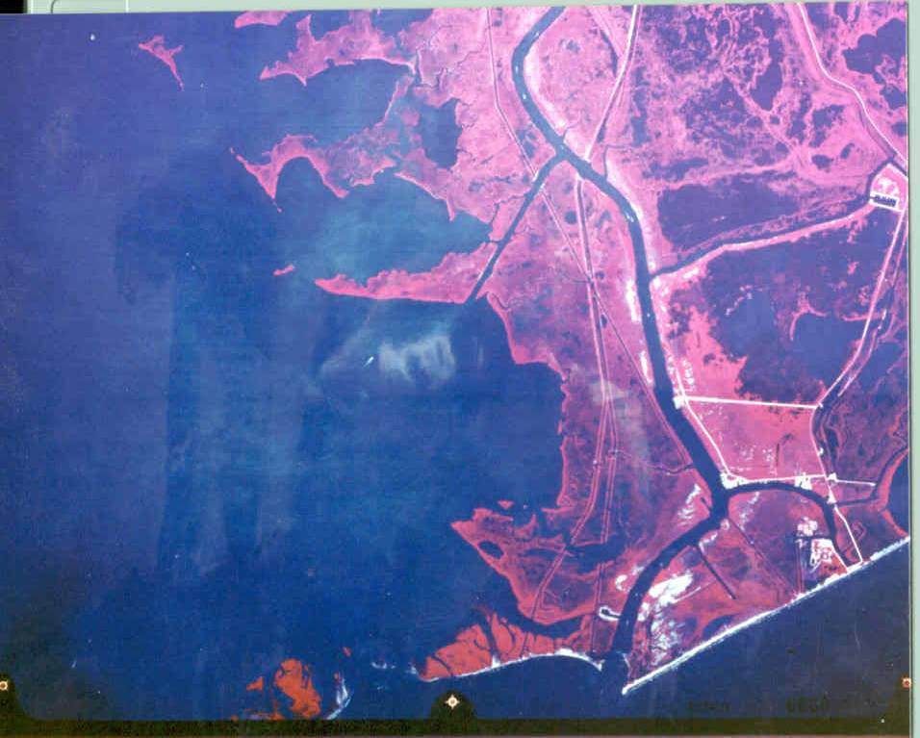
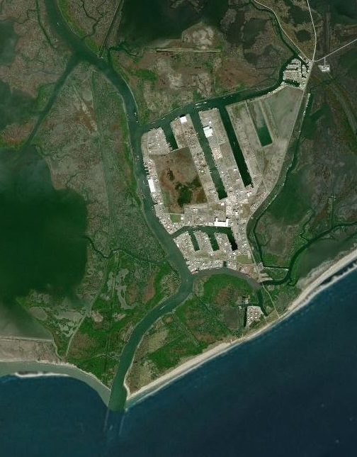
2005
1978
2017

Slide 4
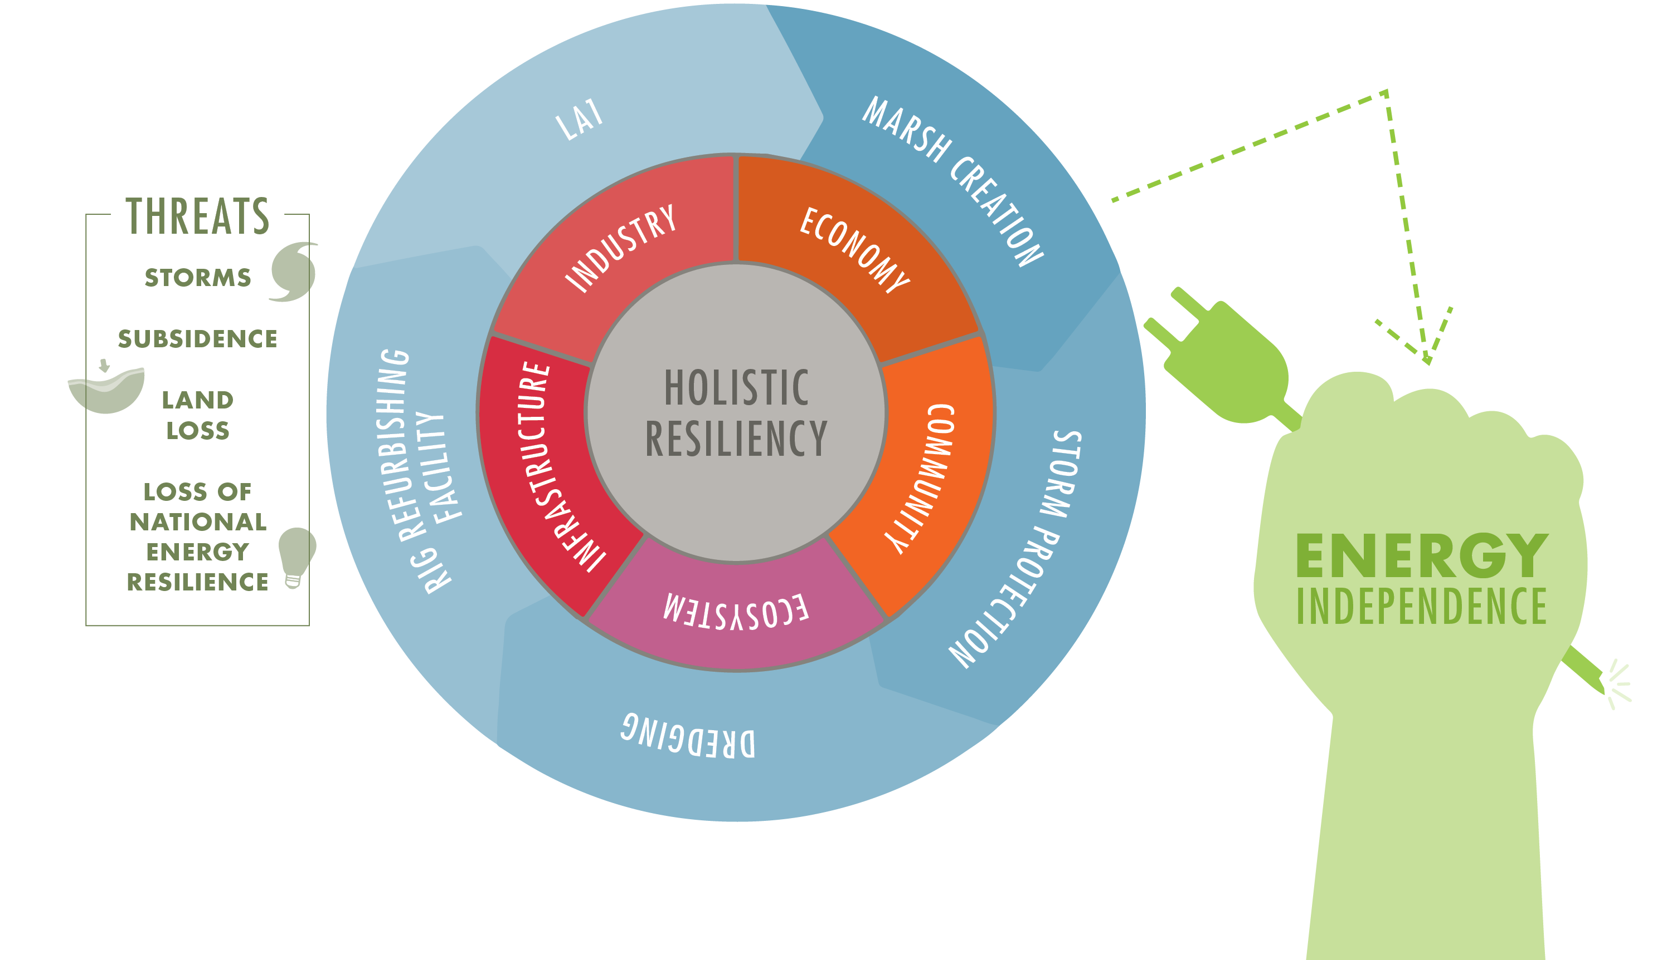
Holistic Resiliency

Slide 5
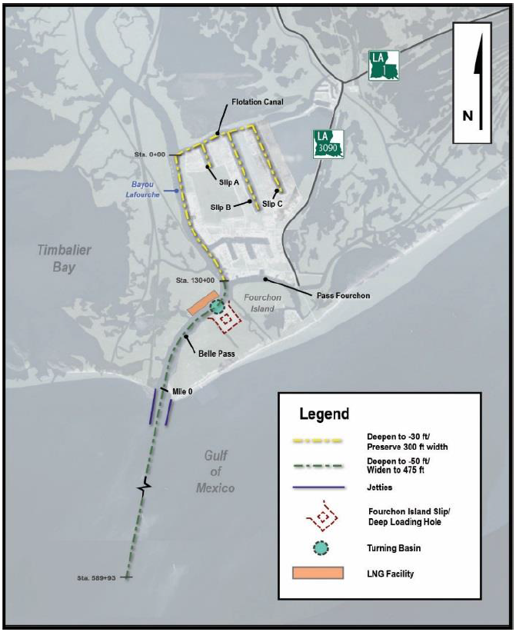
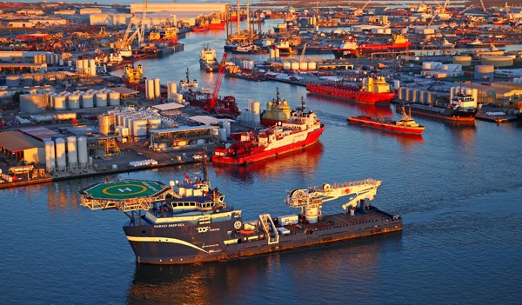
Project Background
To provide adequate depth/width for:
  Reducing navigation transportation cost
  Accommodating existing and future offshore service vessels, drilling rigs & production platforms
Boost regional economy
Coastal restoration and holistic resiliency

Slide 6
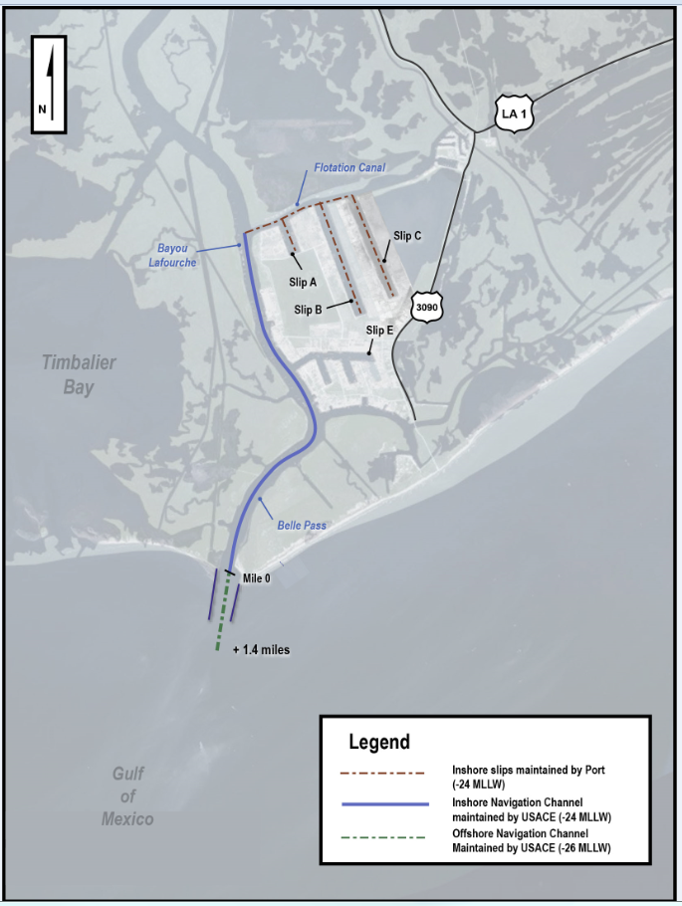
Scope of Study
Deepening of Bayou Lafourche & Northern Expansion Slips: From -24 feet to -30 feet
Deepening of Belle Pass: From -24-26 feet to -50 feet
Widening of Belle Pass: from 300 feet to 475 feet

Slide 7
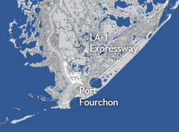
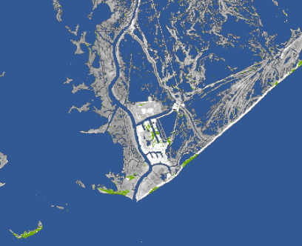
Opportunities
Direct:
  Reduce transportation costs
  Maintain & grow US Market share in service, repair & fabrication of oil & gas vessels & structures
  Generate employment via one-stop shopping
Indirect:
  Beneficial use of dredged material
    Yields renewable resource of materials for land creation, providing asset protection
    86 million cubic yards (MCY) over project life
    LA is losing more than 17 sq. miles/yr of coast
  Emergency Response
  Energy Independence
  National Security

Slide 8
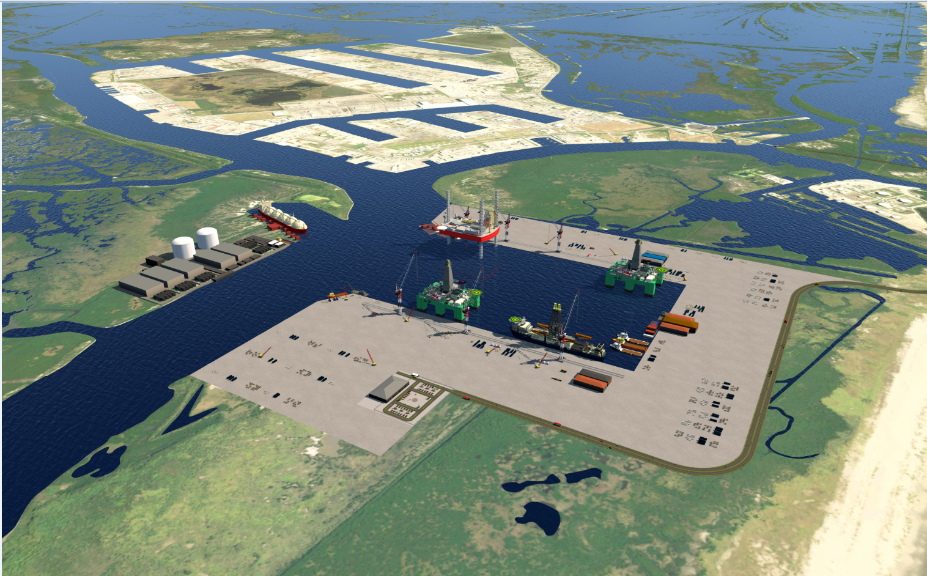
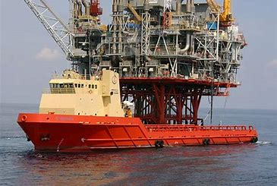
Objectives
Increase the inner harbor channel depths to accommodate larger vessels, rigs & platforms
Increase the entrance channel approach (depth and width) at Fourchon Island to accommodate increased number of larger vessels, rigs & platforms to include LNG export vessels

Slide 9
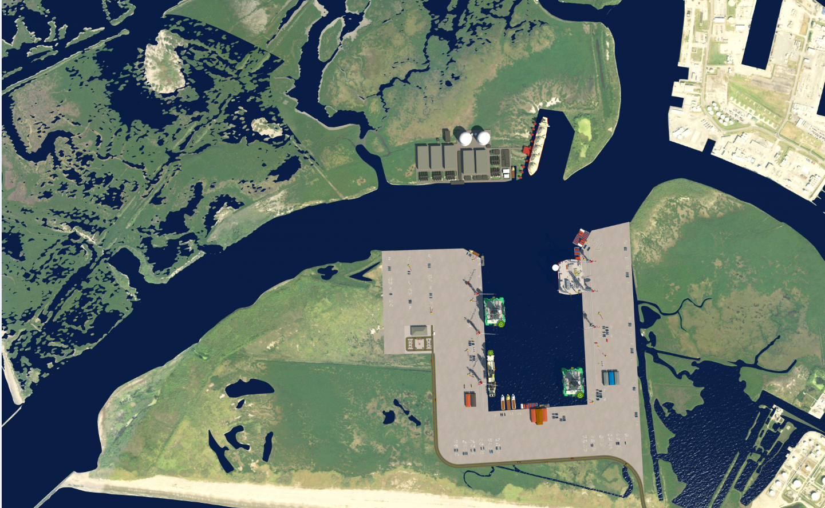
Future Without Project Conditions
LNG Turning Basin, Rig/Drillship slip with deep hole
Port’s current activities continue
Land loss around Port and proximal areas continues unabated
Gulf shoreline erosion of West Belle Pass and Caminada Headlands continues unabated

Slide 10
Alternatives Considered
The following SET or COMBINATIONS of alternatives are considered.
Future WITHOUT Project Conditions:
  Alternative 1: “No Action” (existing federal channel)
Future WITH Project Conditions:
  Alternative 2: To deepen the existing Navigation Channel and other channels (-30 ft.) within the port to accommodate deep water OSV’s.
  Alternatives 3 - 6: To deepen, extend, and/or widen the existing Navigation Channel to as much as 475 ft. wide -50 ft. deep to accommodate drill ships, cargo vessels, drilling rigs with thrusters, and heavy hauling vessels.

Slide 11
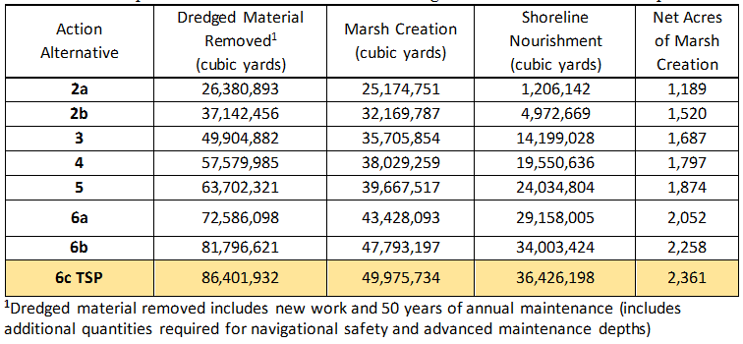
Benefit Cost Analysis & Tentatively Selected Plan (TSP)
All the alternatives considered have positive Benefit-Cost Ratios (BCR).
Net economic benefits increase from Alternative 2 through Alternative 6.
Environmental benefits increase Alternative 2 through Alternative 6.
Sea level rise and subsidence factors are incorporated into the estimation of the net acres of 2,361 marsh.
36 million cubic yards of dredged material – Unrealized shoreline nourishment benefits.

Slide 12
Environmental Compliance
Major/Relevant Issues – Environmental Impacts
Activities
Dredging & Placement (Sediment Dynamics- Long & Short Term)
  Dredging Techniques
  Contaminants
Pipeline Relocation
Resources
Wetlands
Water Quality
Wildlife Resources
Fisheries Resources
Essential Fish Habitat (EFH)
Threatened & Endangered Species (T&E)
Benthic habitats
Air Quality
Cultural Resources
Impacts & Mitigation
Alternatives
Tentatively Selected Plan (TSP)

Slide 13
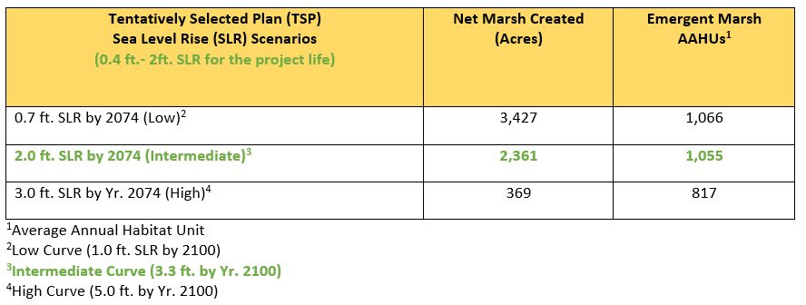
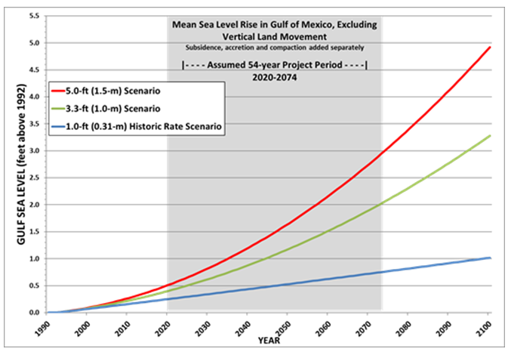
Wetlands (50 years of project life)

Slide 14
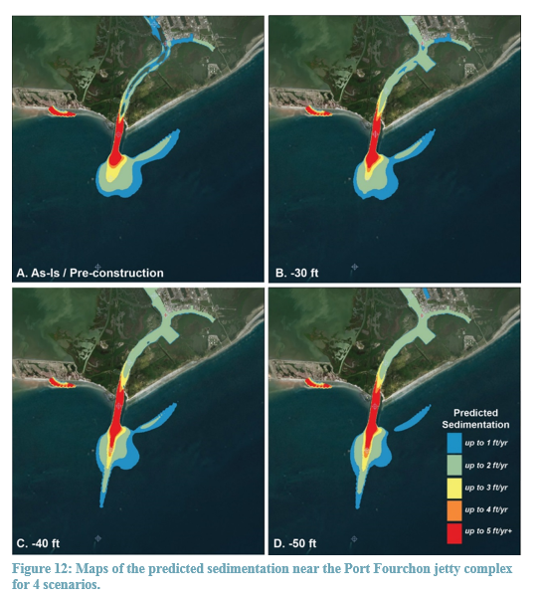
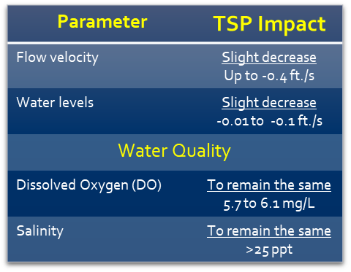
Modeled Water/Habitat Quality Impacts
Minimal vertical stratification
Flow was generally well mixed, & quickly advected out of the system
Water volume residence times were not long enough to promote significant biological/chemical reactions capable of altering water quality
No significant impacts to the ecosystem. All parameters well within normal ranges.

Slide 15
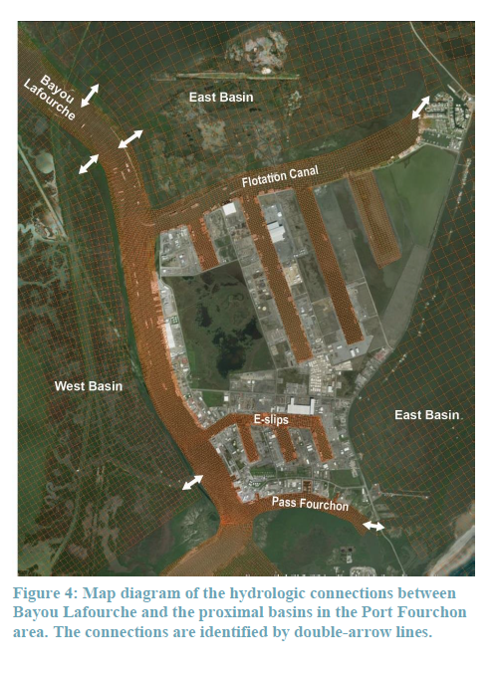
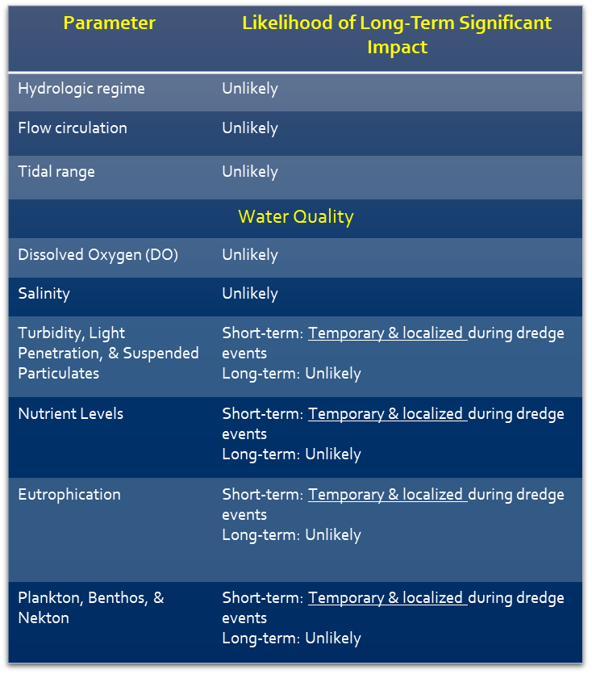
Overall Ecosystem Impacts
No Significant Direct, Indirect, and Cumulative Impacts.

Slide 16
Habitat Impacts
Tentatively Selected Plan (TSP) with:
  ~4,717 acres of shallow open water to marsh habitat (placement impact);
  2,361 net acres of marsh
  Nourishment of barrier shoreline habitats
Wildlife Resources
  Dredging and placement (new work and maintenance) may disrupt or displace wildlife resources – Temporary and Limited
Fisheries Resources – Adverse impacts- Temporary and Limited
  TSP would provide fisheries/wildlife resources more productive habitats:
    Intertidal marsh
    Marsh edge
    Shallow water

Slide 17
Essential Fish Habitat
Direct, Indirect, and Cumulative Impacts
• Dredging (Temporary) and Placement Impacts: 299 acres of marine soft bottom habitat (dredging impacts)
  Estuarine emergent wetlands, mangrove wetlands, mud, sand, shell, and estuarine water column.
  Estuarine emergent wetland is the primary type of EFH- Significant increase
  Shallow open water habitat would increase.
  Adverse impact to open water EFH, more productive types of EFH would be created and enhanced.
  Open water habitat would form within the marsh platform as ponds and other water bodies.
Dredge Material Suitability
The dredged material does not have contaminants and is suitable for marsh creation.

Slide 18
Benthic Impacts
Loss of benthic resources (Direct, Indirect, and Cumulative Impacts)
  The EFH (marine soft mud) currently experiences frequent wave, wind, and current induced disturbances –Adapt -Recovery
  Recolonization of benthic micro fauna would occur.
  Only temporary impacts to substrates
Entrainment Impacts
  Early life history stages of fishes are most vulnerable.
  Entrainment-induced mortality rates is low for abundant demersal species, while mortality rates for entrained fishes happen only for a small proportion of total fish population.
Vessel/Equipment Strike Impacts
  Minimal Impacts are anticipated (versus existing conditions)
Noise Impacts
  Minimal impacts are anticipated (versus existing conditions)

Slide 19
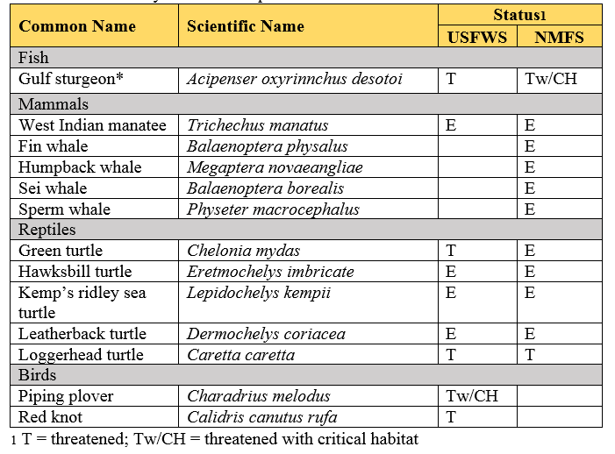
Threatened & Endangered (T&E) Species Impacts
  Atlantic Sturgeon, Sea Turtles, Piping Plover, Red Knot, and West Indian Manatee
    Dredging and Placement Impacts (Temporary)
      TSP may affect, but not likely to adversely impact each of the T&E species.
      ESA Project Review and Guidance approved by USFWS, which includes guidance by USFWS on the BMPS in order to avoid and minimize the impacts.

Slide 20
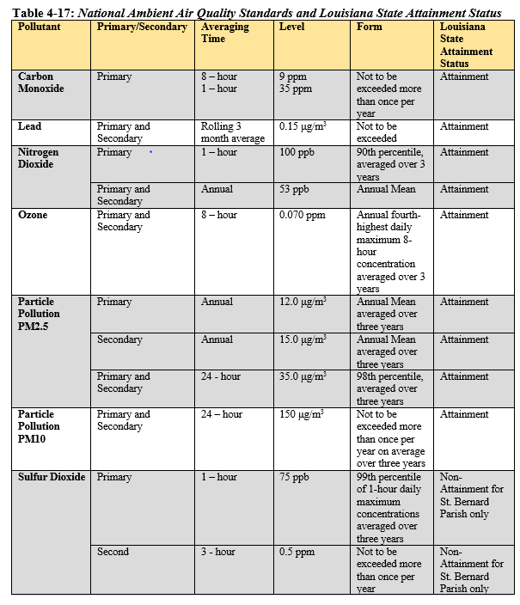
Air Quality Impacts
The project area is in attainment for all pollutants listed by NAAQS.
No significant impacts
  The rural nature of the area and existing air quality.

Slide 21
Cultural Resources Impacts
Phase 0
  Sites identified are in the dredging area
  No sites identified in the placement areas
Phase 1
  The report is being finalized and will be incorporated in to the Final EIS.

Slide 22
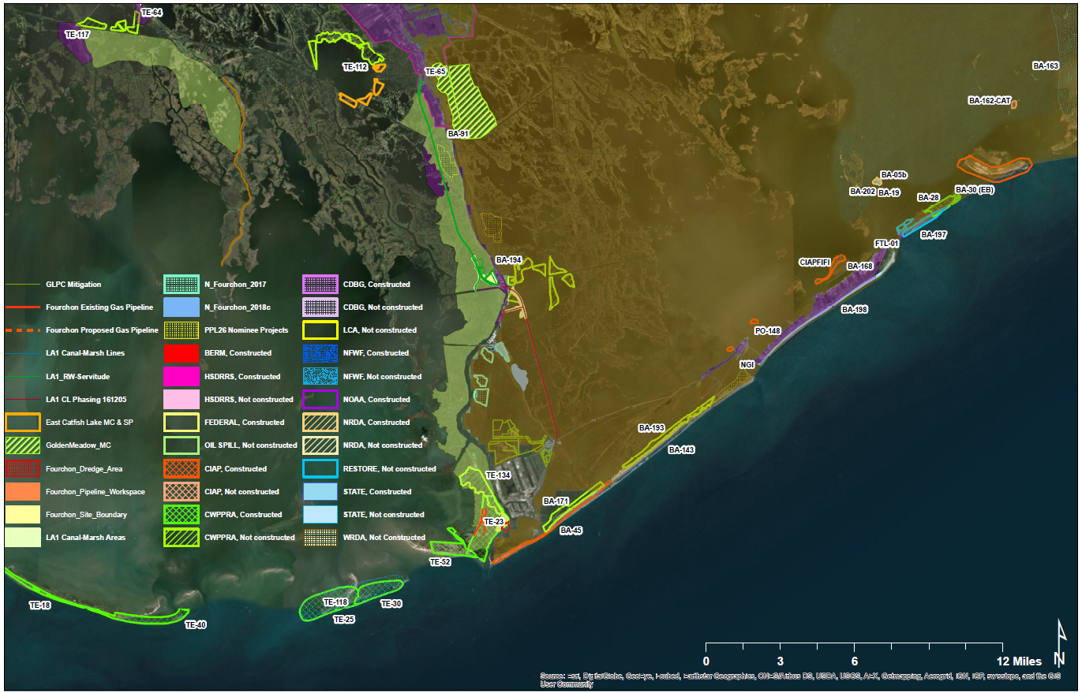
Possible Synergies with Other Actions
The TSP is expected to create synergies with the Federal, State, and local land use, restoration, and protection plans.

Slide 23
Recurring Sediment Source
Opportunity to align sediment availability with priority restoration in B-T basins

Slide 24
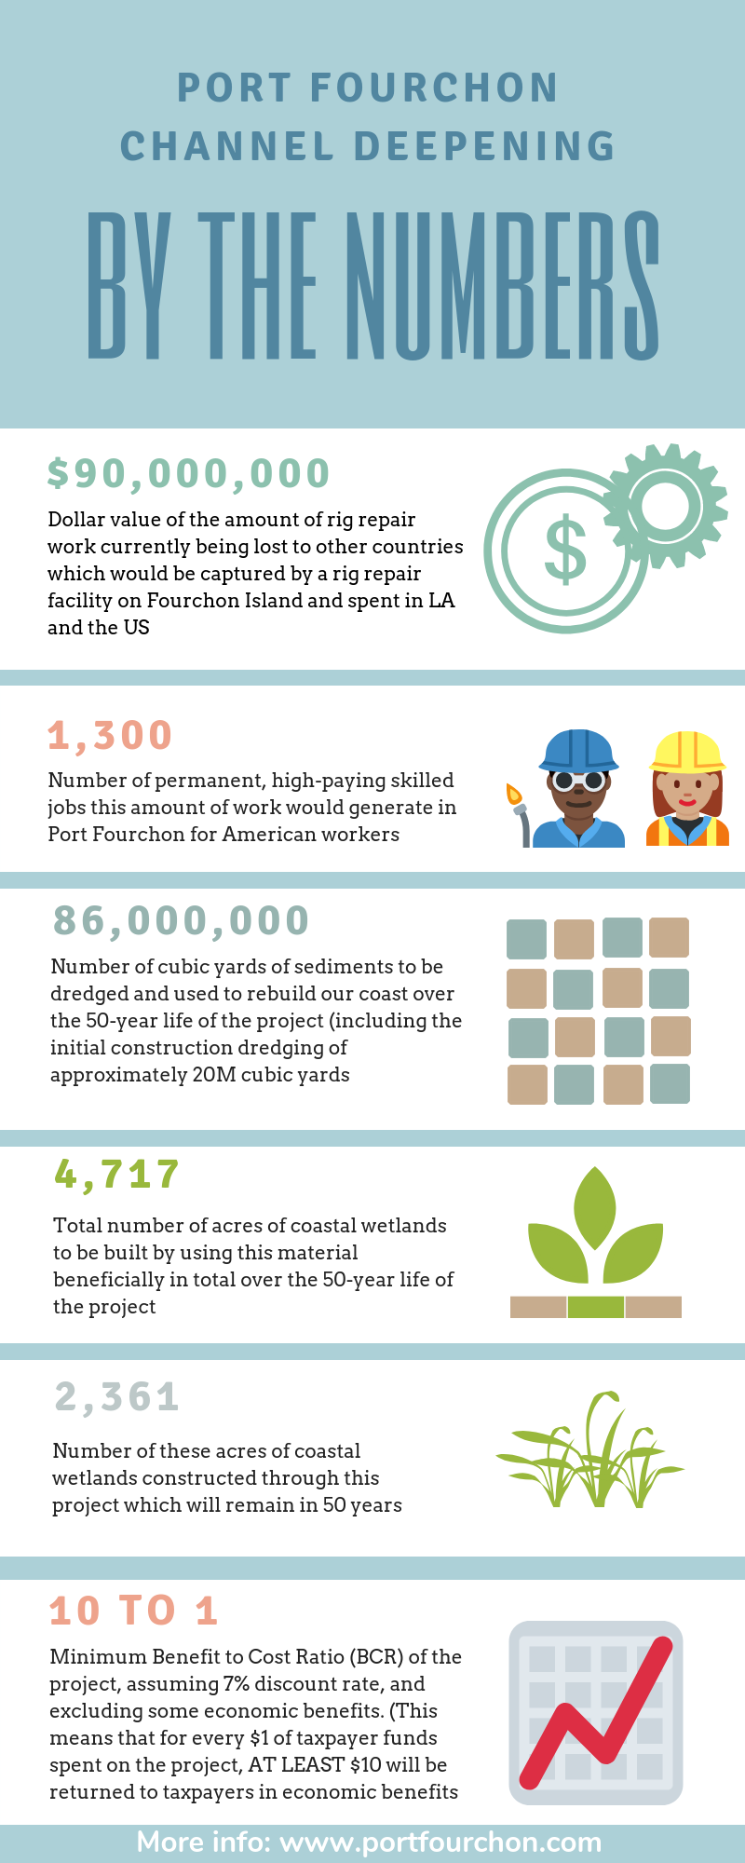
Maximizing Benefits (50 years)
~86,000,000 cubic yards of fill over 50 year life of project
Fourchon is in the most sediment starved area of coast, making BUDM critical opportunity
4,717 acres of marsh creation in 50 yrs
2,361 acres of which remain in 50 yrs
Average Annual Habitat Units (AAHUs) 1,055
Creating a renewable sediment resource in heart of B-T basins

Slide 25
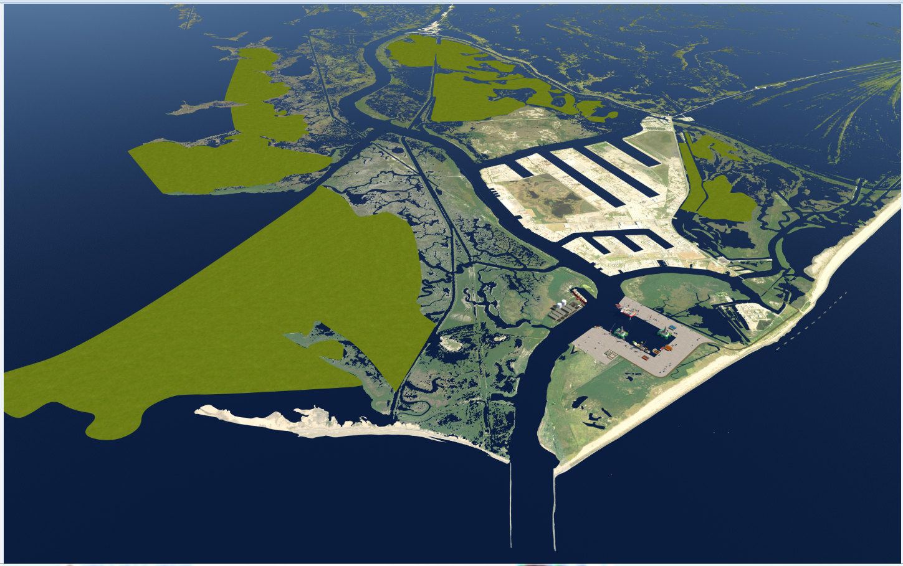
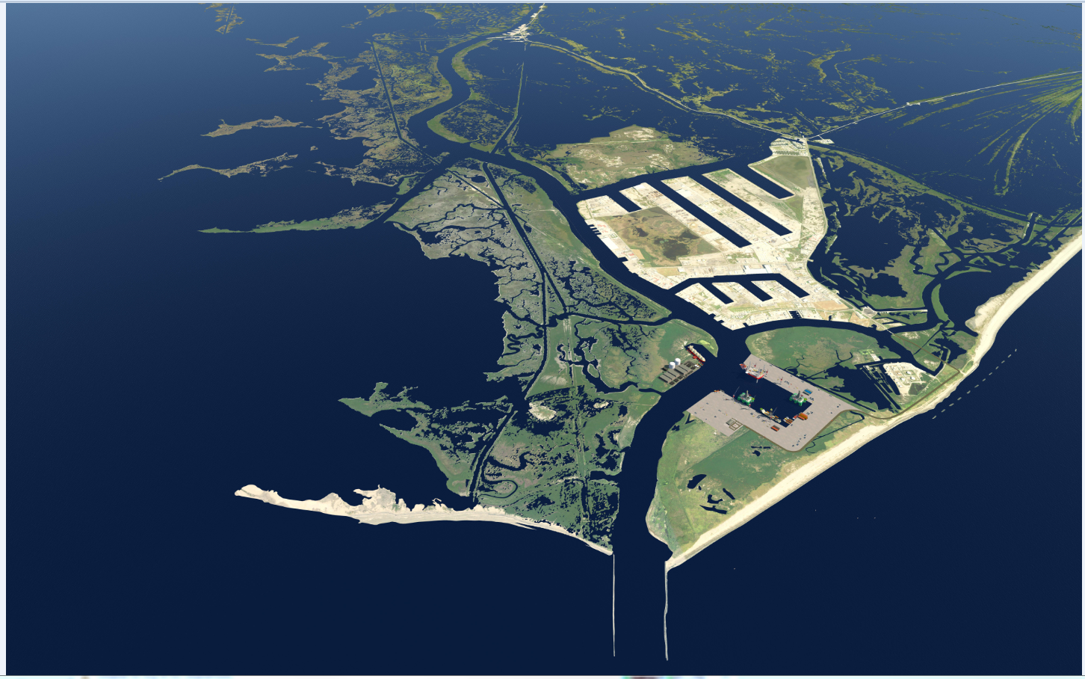
Future With and Without the Project

Slide 26
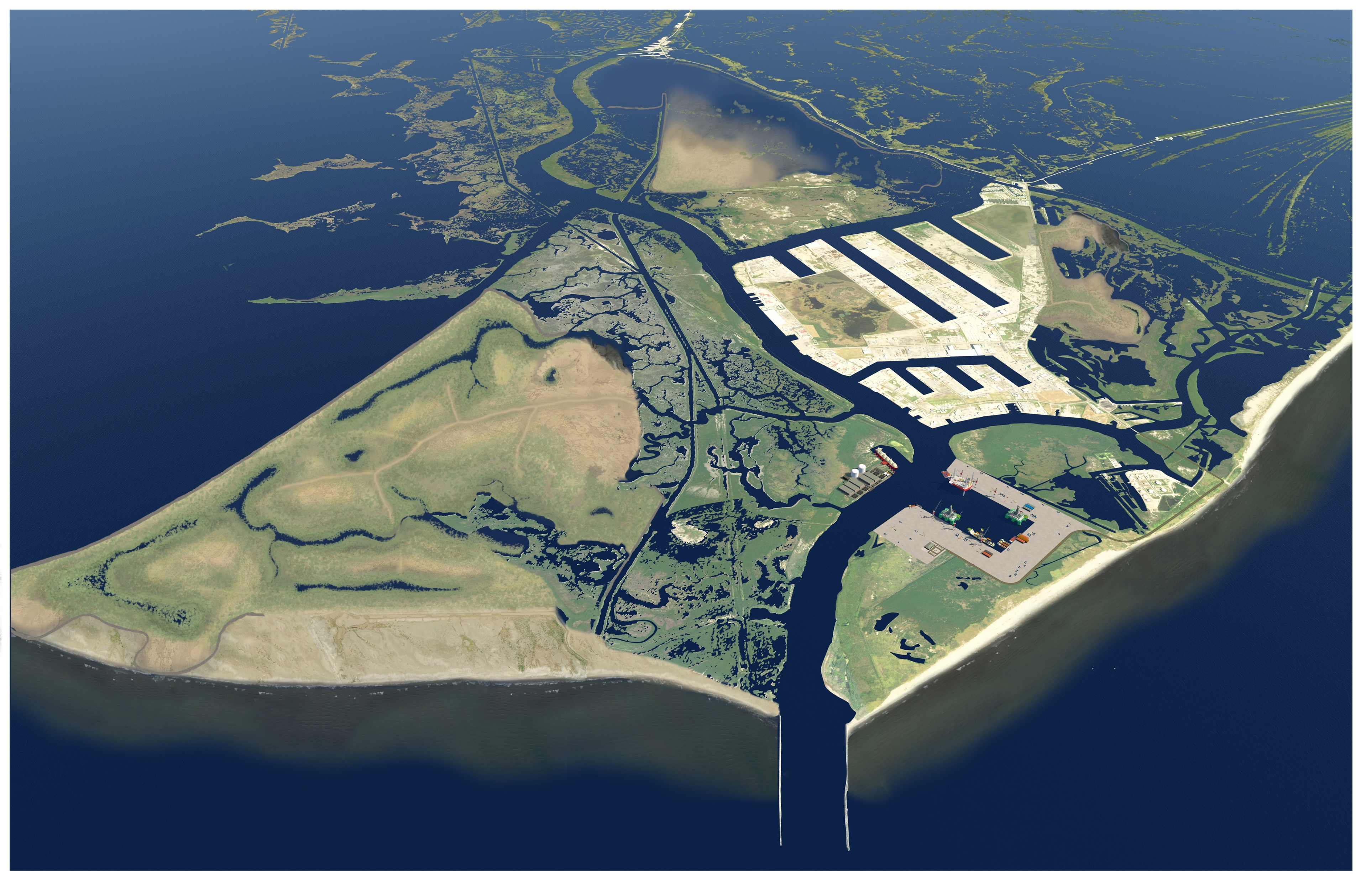
Future With Project (mid-project YR36-40)

Slide 27
National Environmental Policy Act Compliance

Slide 28
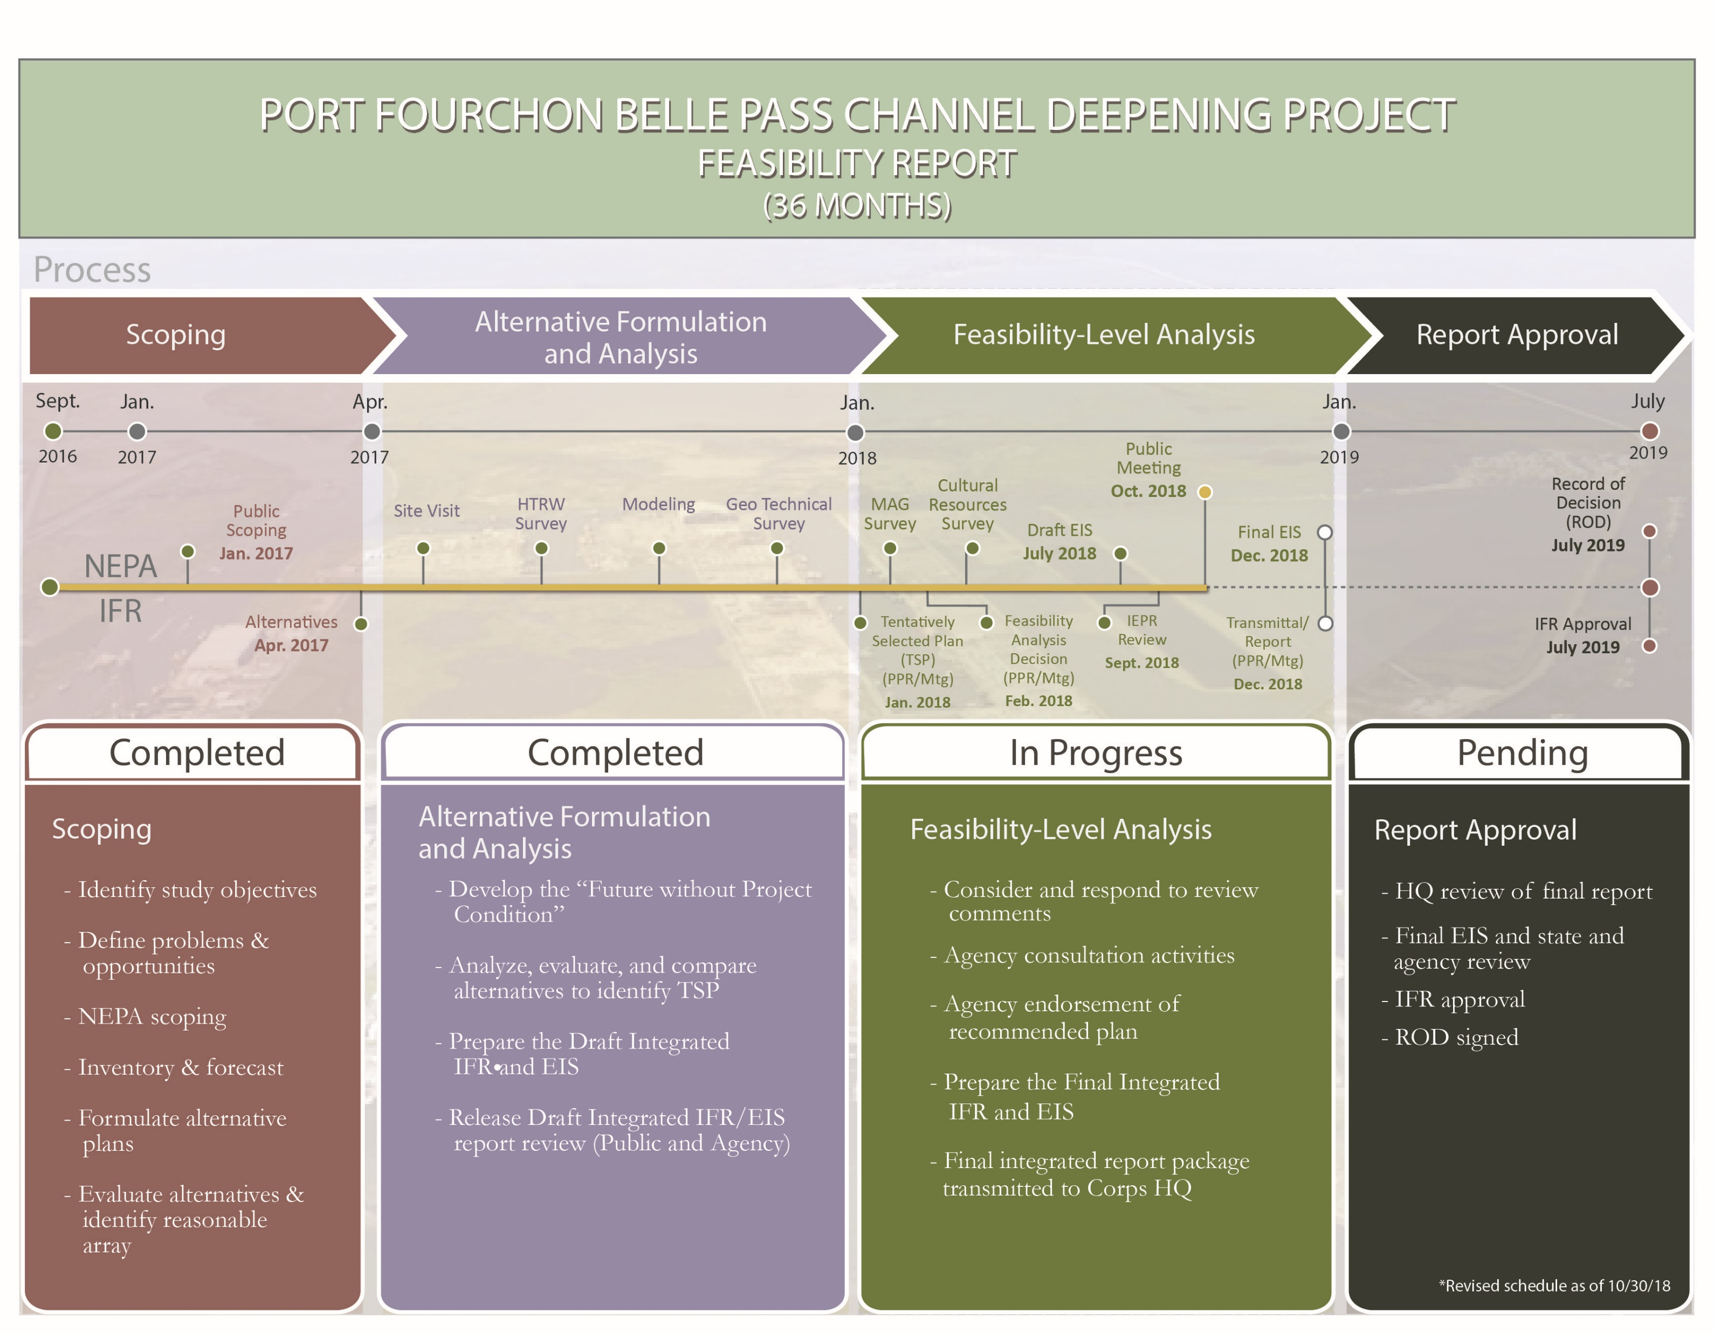
Process and Next Steps
We Are Here

Slide 29
Summary
Major Project Activities: Dredging, Placement, and Pipeline Relocation
Environmental Impacts (Direct, Indirect, and Cumulative): Minimal, largely temporary and localized negative
The project would result in: 2,361 net acres of wetlands over 50 years
The project will result in additional unrealized benefits: continued nourishment of barrier shoreline through maintenance dredging over the project life.

Slide 30
Submitting Comments:
Comment Period Open until November 7, 2018
Email: portfourchon203@gisy.com
Mail: Port Fourchon Belle Pass Channel Deepening Project
  Greater Lafourche Port Commission (GLPC)
  16829 East Main Street
  Cut Off, LA 70345

Slide 32
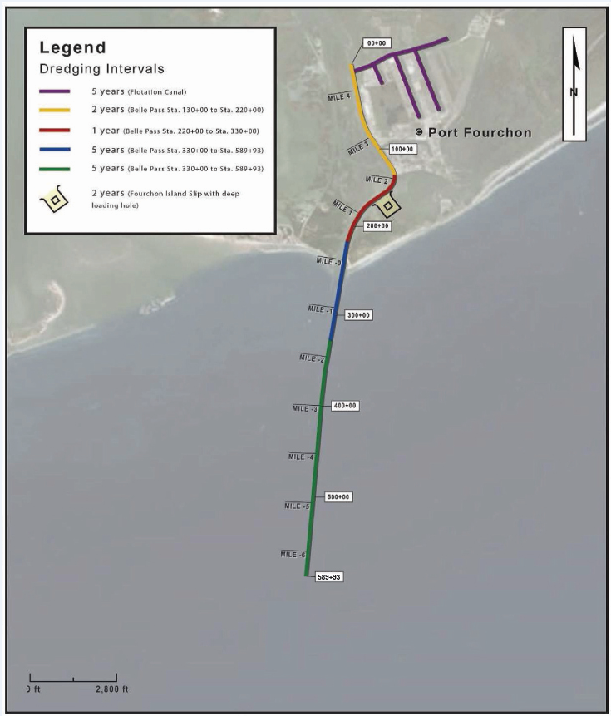
Tentatively Selected Plan (TSP)
6c (300 ft. x 30 ft.; 475 ft. x 50 ft.)
Channel Reaches:
Slip A, B, C & Flotation Canal
  Width: 300 ft.
  Depth: -30 ft. Elev.
Sta. 0+00 to Sta. 130+00:
  Width: 300 ft.
  Deepening: -30 ft. Elev.
Sta. 130+00 to Sta. 598+30
  Width: 475 ft.
  Deepening: -50 ft. Elev.
Turning Basin
  Dimensions: 1,755 ft. x 1,985 ft.
  Depth: -50ft. Elev.

Slide 33
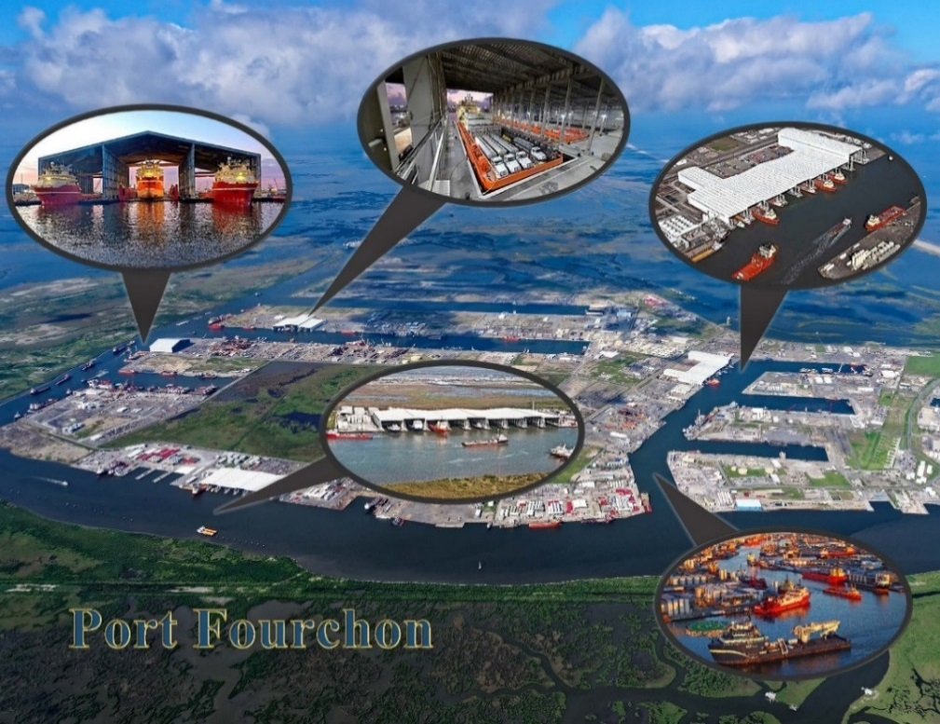
Existing Conditions
Infrastructure
Traffic

