Slide 1
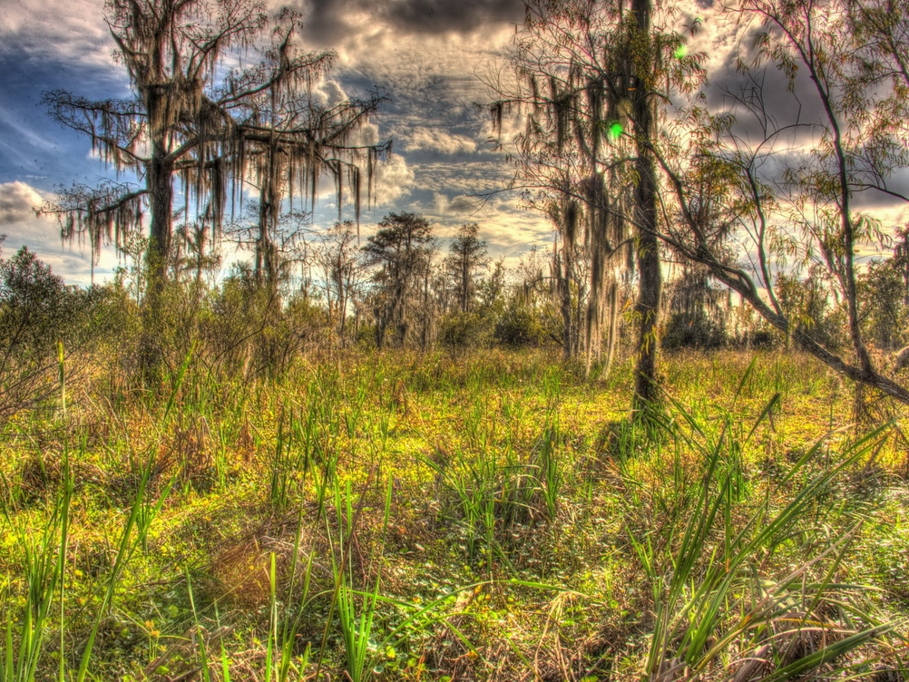
Angela Rathle and Aleutia Scott
Jean Lafitte National Historical Park and Preserve

Slide 2
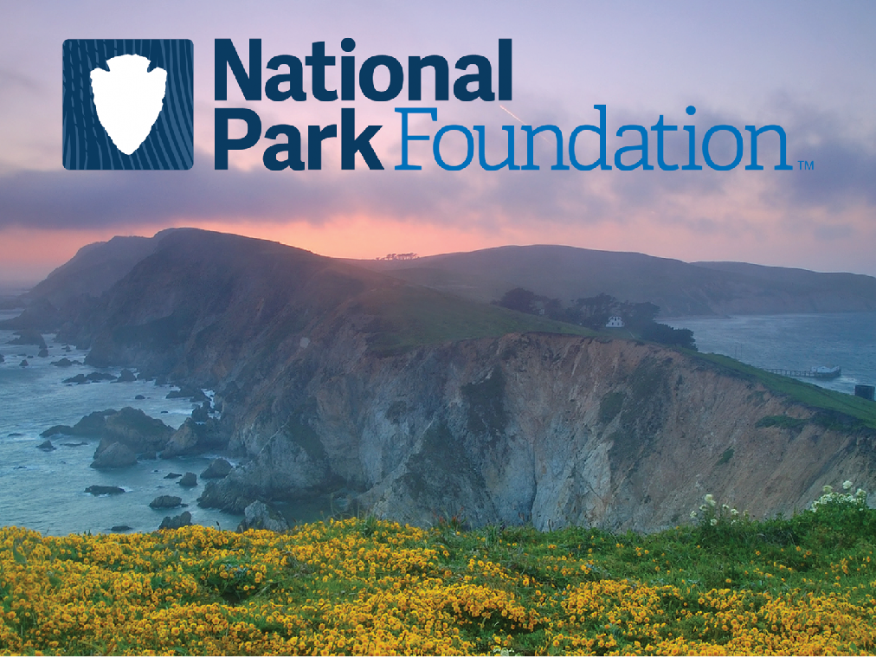
Thank you to our funders and partners!

Slide 3
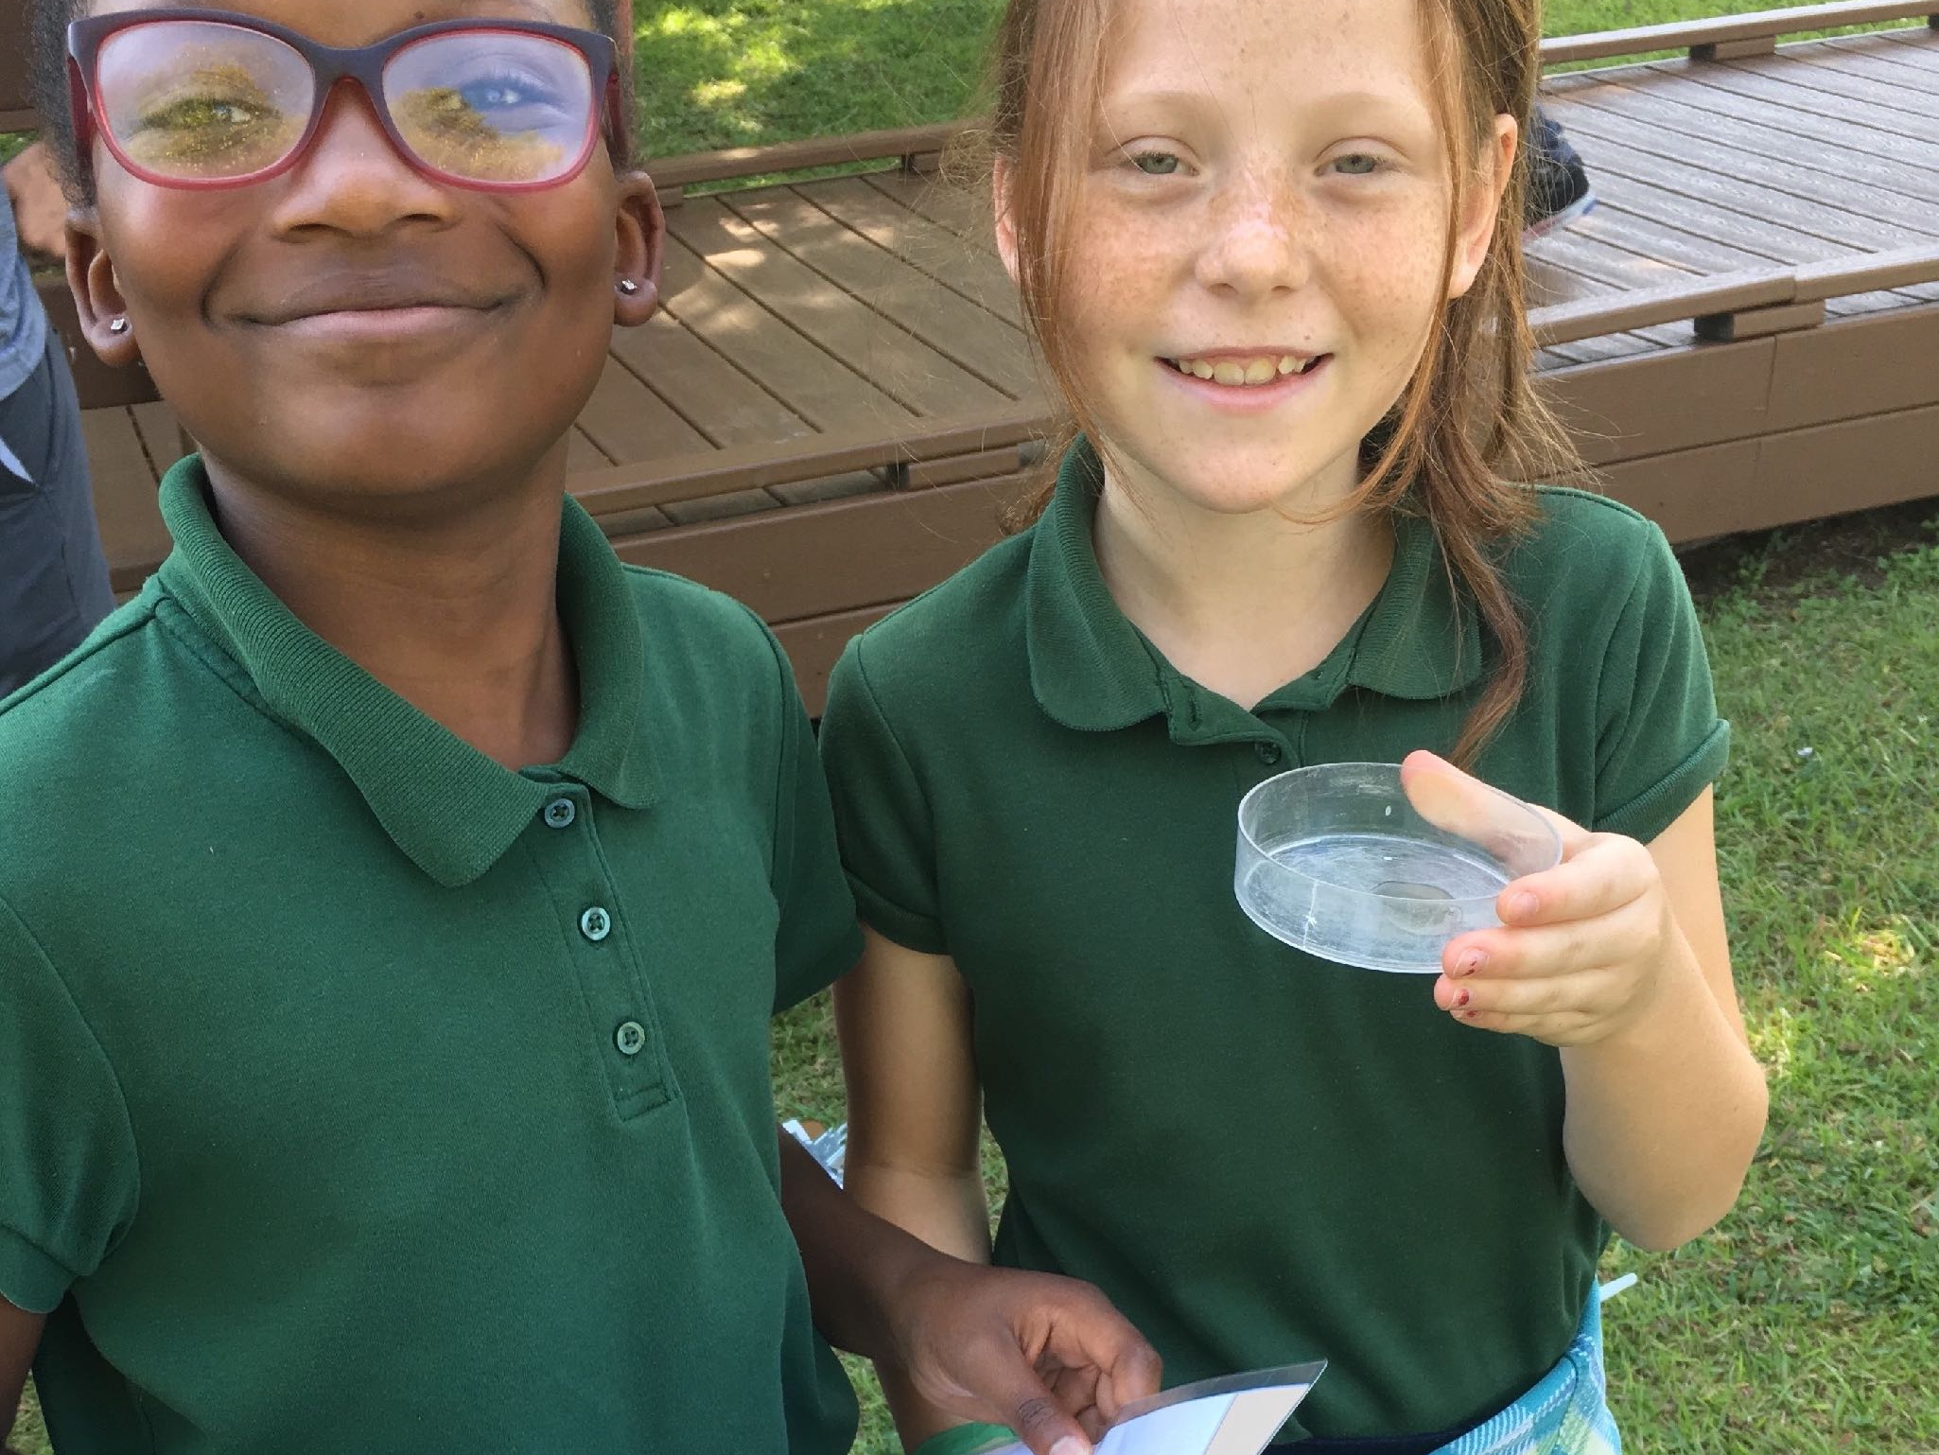
Kimberly Cooke and Lea Schram von Haupt
Science Programming at JELA

Slide 4
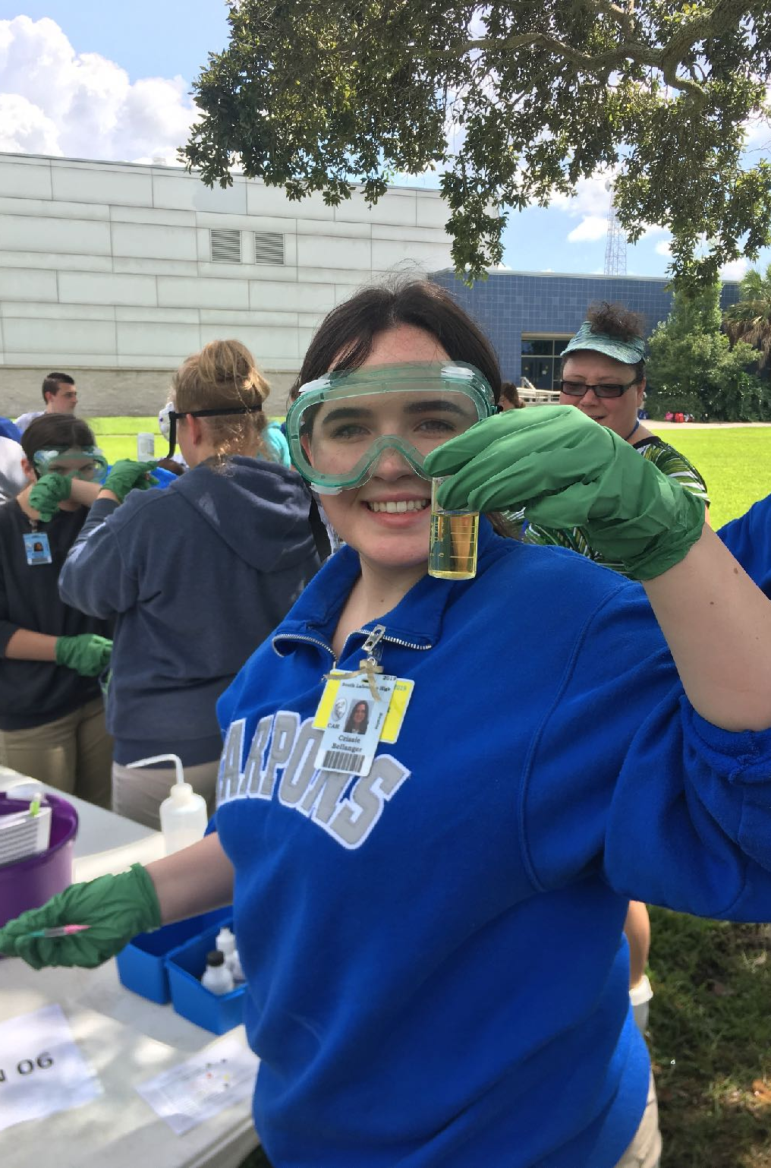
Program Mission:
To become a valuable resource for teachers, schools, and the community and to ensure that underserved populations are given frequent and repeated access to these programs.
To create hands-on, NGSS-aligned, science curriculum and programming that can be used across Jean Lafitte National Historical Park and Preserve.
To partner with school districts and educational partners to create science-based curriculum and professional development.

Slide 5
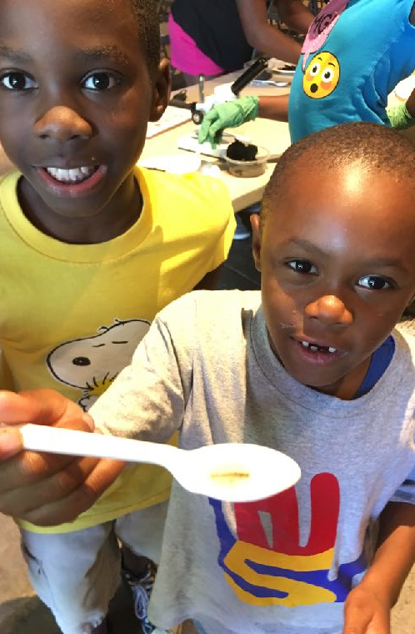
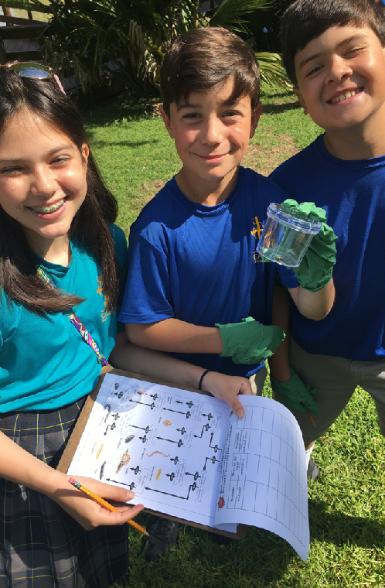
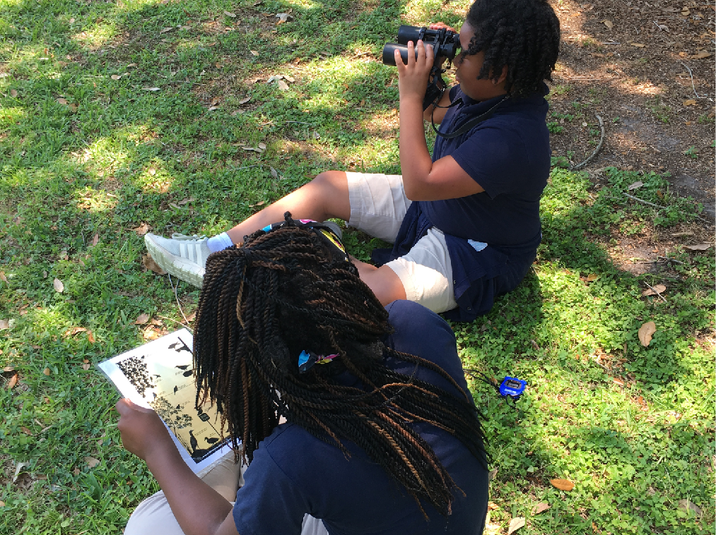
Current Programs
School Programming
After-School Science Clubs
Community Programming
Summer Camps
Volunteer Programming
Living Downriver
Outreach

Slide 6
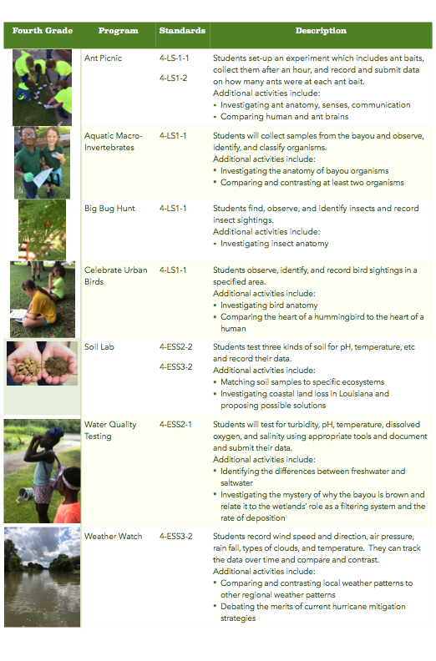
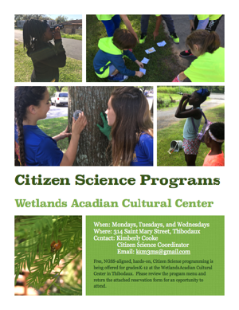
School
Programming
Utilizes existing citizen science projects
Aligned to NGSS for each grade level
Focuses on how to collect data and how to use it to answer questions
Facilitates hands-on, experiential learning

Slide 7
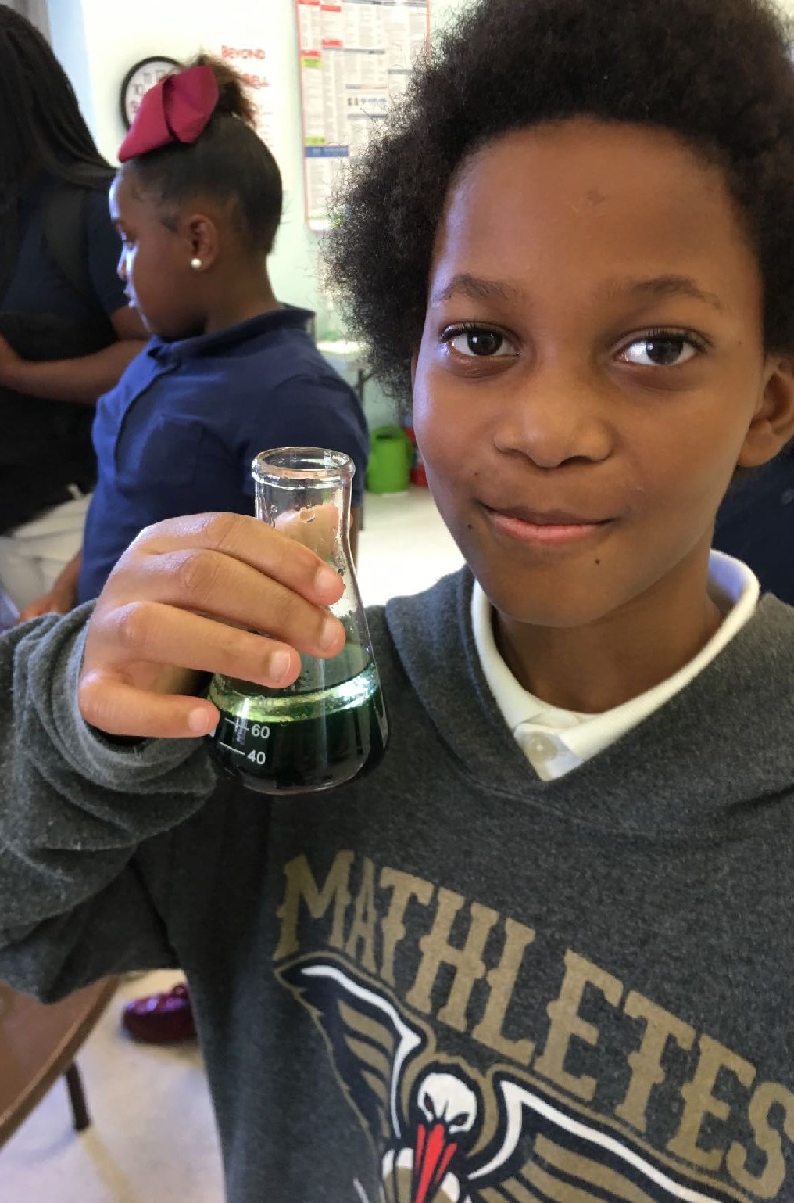
After School: Weekly Science Clubs
Two sites: Wallace Center in Raceland and Hi-5 in Thibodaux
Serves about 25 students each week
Ages range from 5 to 12 years
Hands-on, student-driven

Slide 8
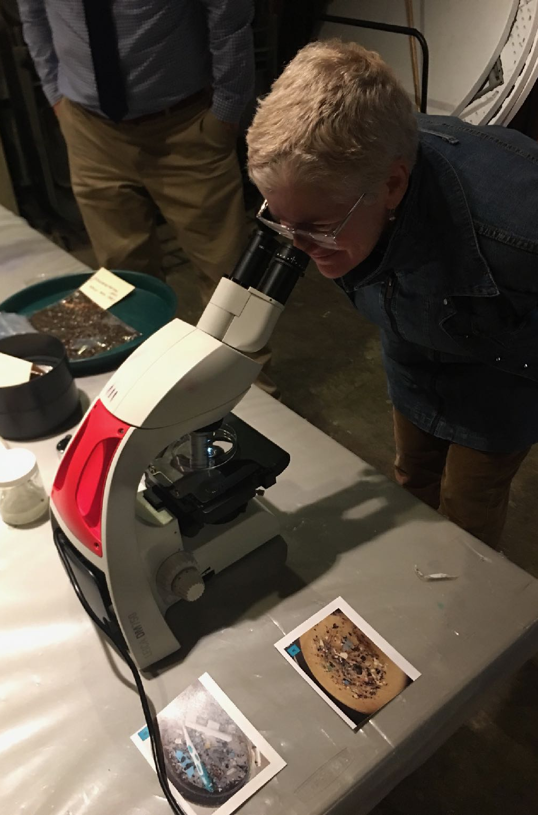
Community Programming
Two science-focused community events/programs each month
Diverse topics range from water quality to plants
Ages and audience vary depending on the program
Partnering for programming: Science Ya-Ya and Audubon Society

Slide 9
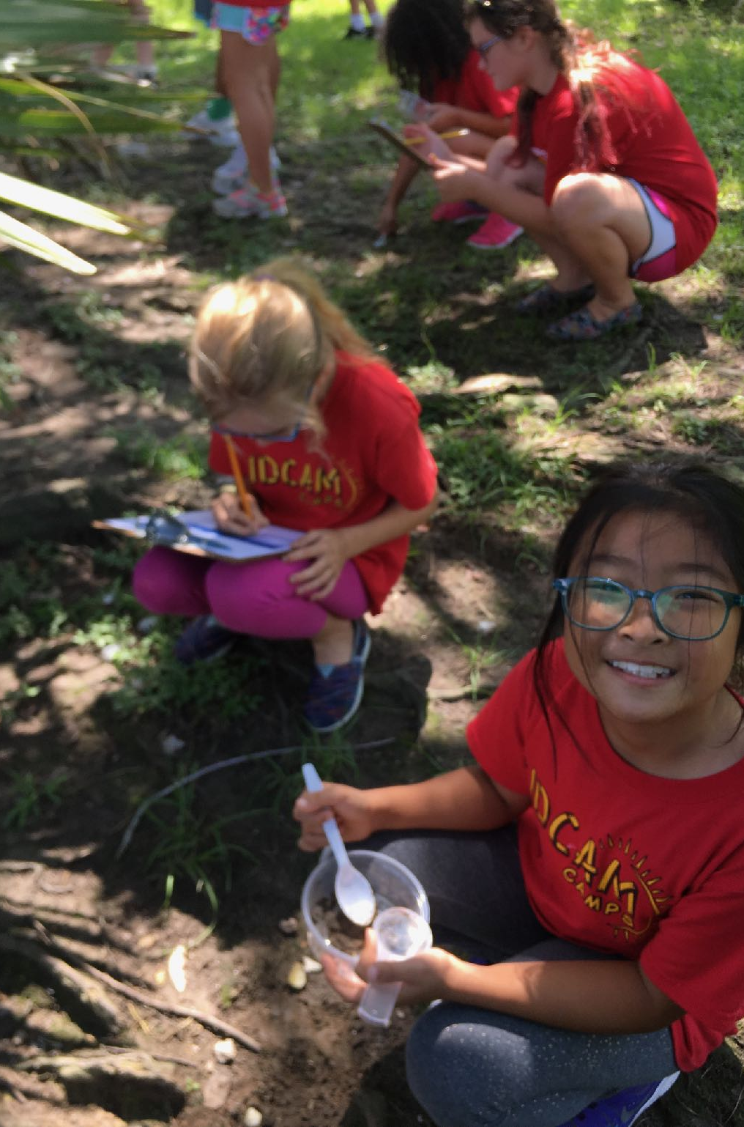
Summer Camps
Mini-camps for Hi-5
Facilitating programming for JELA summer camps
Partner camps with NORDC
Environmental Stewardship Camps

Slide 10
Volunteer Programming
Nature’s Notebook: Birds and Plants
Frogwatch
Water Quality Testing Training

Slide 11
Living Downriver: Watershed Education
South Lafourche High School: 160 Students and two teachers
Patrick Taylor Science and Technology Academy: 75 students and one teacher
Monthly collection of water quality and aquatic macro-invertebrate data
Coastal Lab, Nicholls, CERF, and JELA visits
Extension materials for teachers including professional development and lesson plans

Slide 12
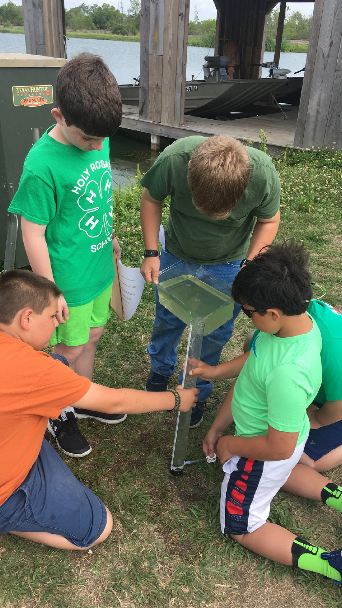
Outreach
Offsite Community and Organization-Sponsored Events
School-Based Visits
Partner-Focused Outreach (School-Boards, Nicholls State University, etc)

Slide 13
CURRENT PROGRAMS
Program | Audience | BARA | WACC
Ant Picnic | 2nd-5th Grade
Bird Programming (eBird, Celebrate Urban Birds, Counts, Migration) | Community and schools
Aquatic Organisms (dipnetting and Leaf Pack) | 2nd-HS
Big Bug Hunt | K-5th Grade
BioBlitz: iNaturalist | Adults
Canoe Treks | Adults
Firefly Watch | Community
Frogwatch | Adults
Outreach | Schools, After-school, Scouts, Summer Camps
Picture Post | Community
Plant Programming (Plant ID Lab, Invasive Species) | Community and schools
Phenology Trail/Nature’s Notebook | Community and Schools
Soil Lab | 4th-HS
Watershed Education | HS
Water Quality Testing | 4th-HS
Weather Watch | K-HS

Slide 14
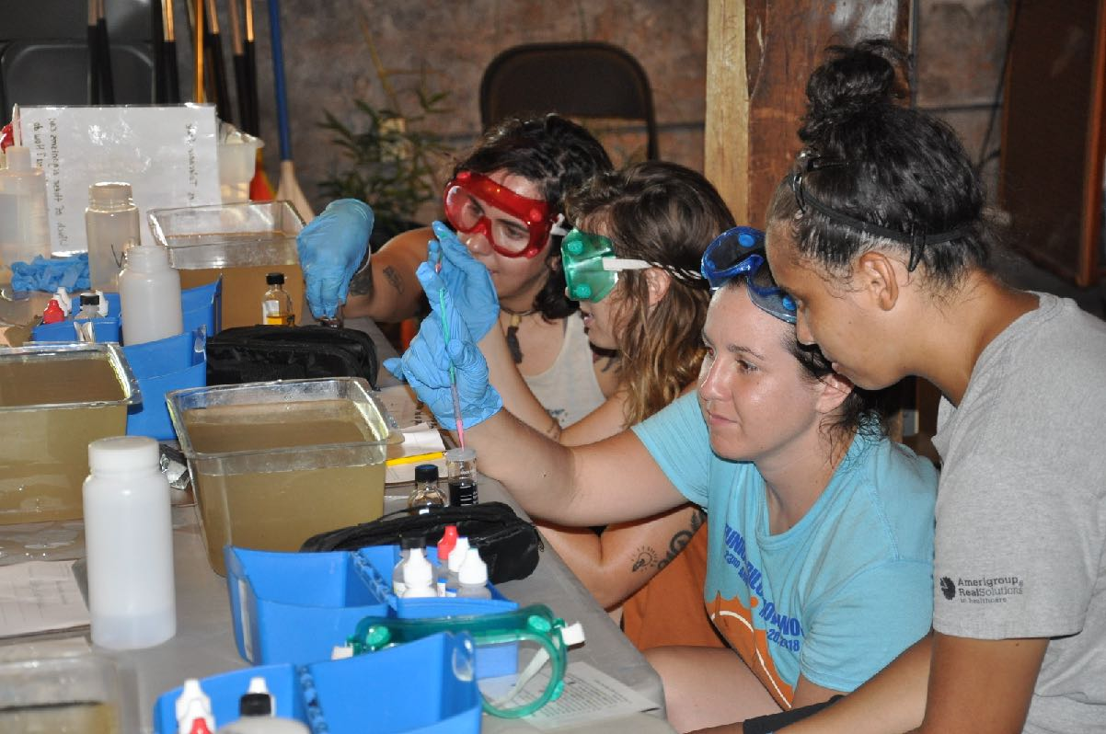
Success Leads to Growth
Participants test for dissolved oxygen after the “Understanding Bayou Lafourche: an Ecological Perspective” canoe trek (Summer version)
Our programming met and exceeded the expectations set for the first three years of funding after only one year, and continues to grow and serve over 6,000 participants annually. Currently, we are exploring possible additional fiscal partners that service all of Southeast Louisiana to support the expansion of this programming into the remaining JELA sites.

Slide 15
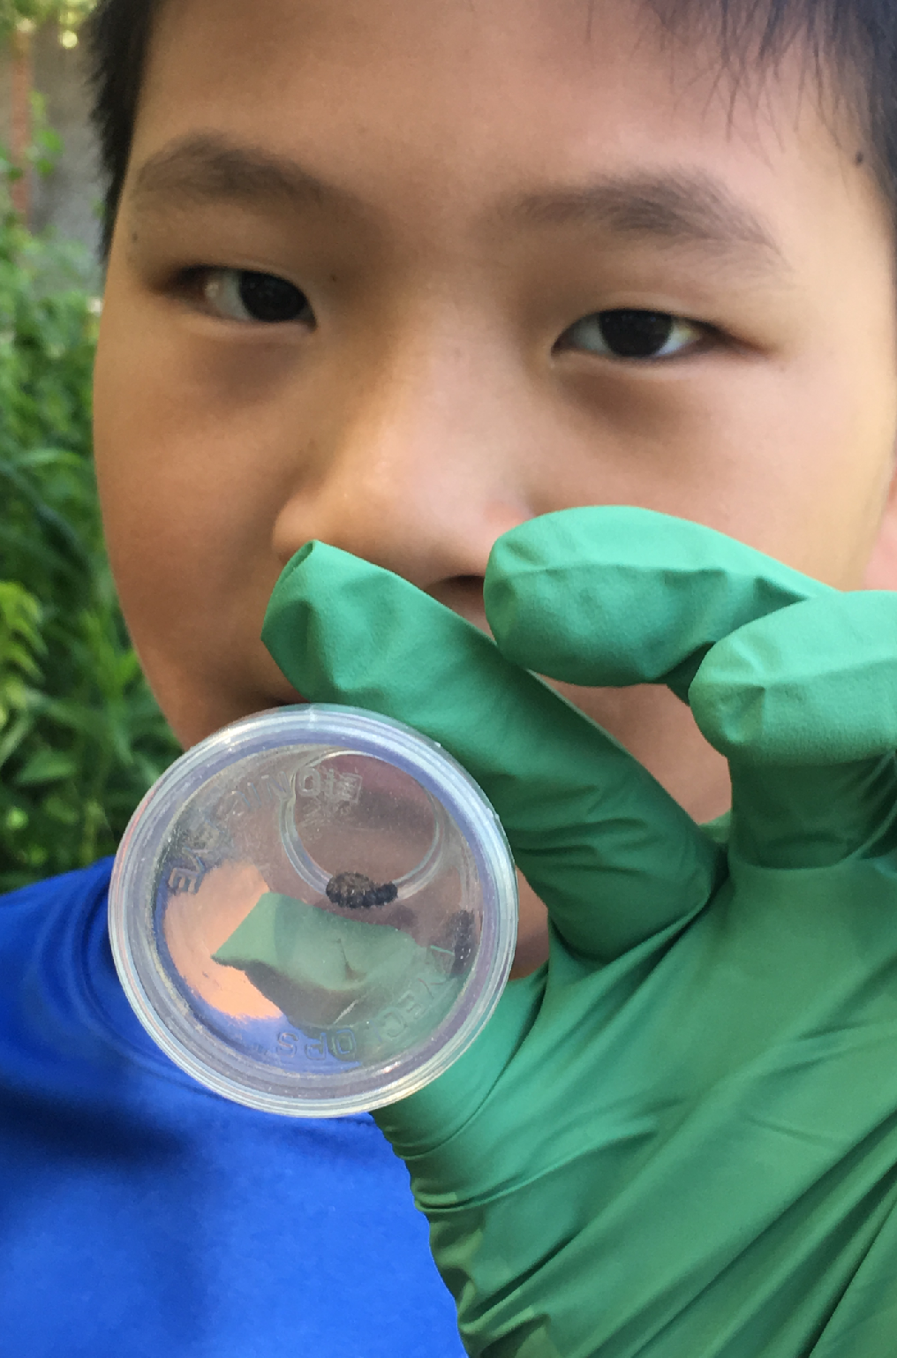
Expanding the Program
Growth will happen in phases.
The goals of the initial phase are to…
Spread existing science programming
Develop and implement training
Foster partnerships with LDOE and school boards
Reduce barriers for underserved populations
Increase education-based volunteer opportunities
Future phases include:
A paid environmental stewardship program
A regional conference on citizen science
Developing an online and in-person networking resource

Slide 16
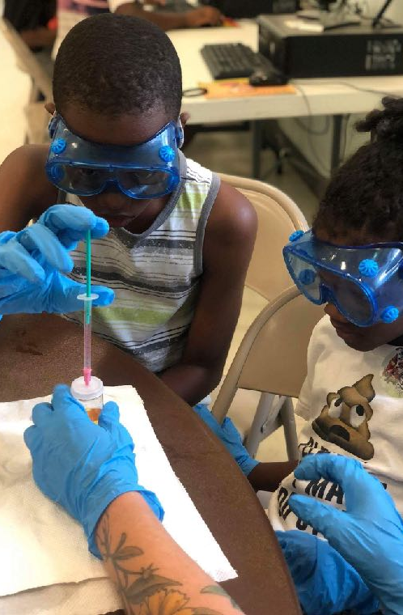
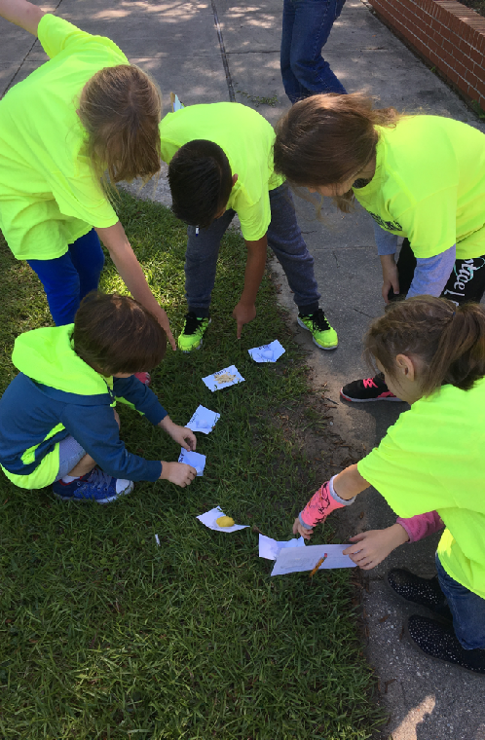
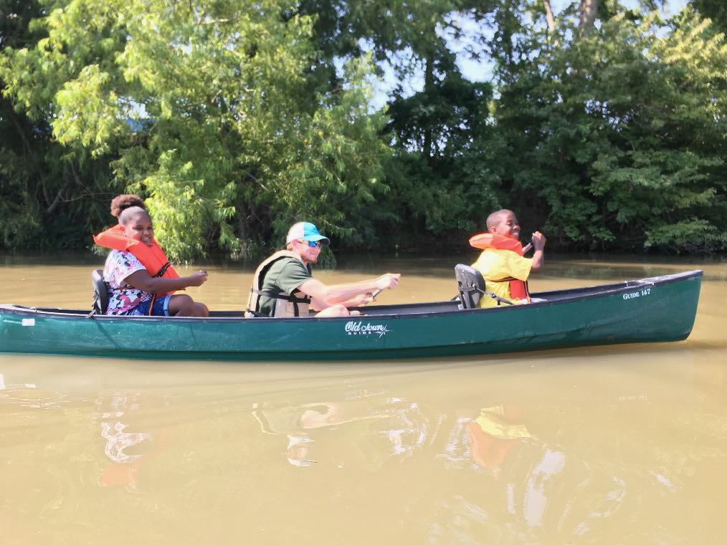
Questions?

