Slide 1
Quantifying and Prioritizing Opportunities for Canal Backfilling in Louisiana
Dusty Pate

Slide 2
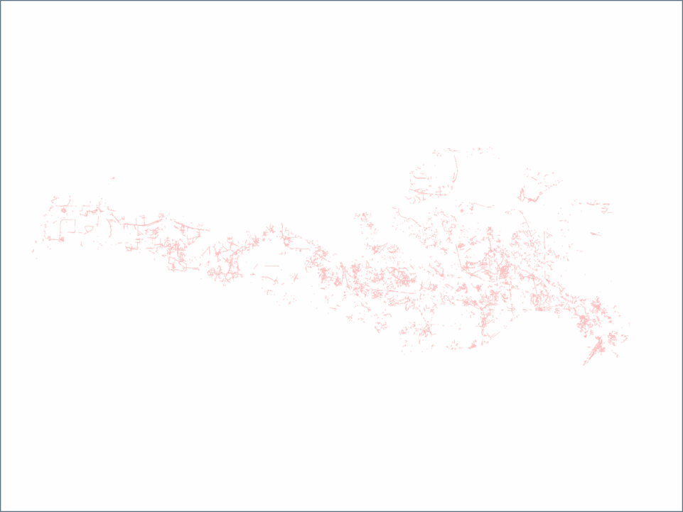
Objectives
Quantify area of canal spoilbanks
Prioritize backfillable spoil
Analyze backfilling opportunities

Slide 3
Base Dataset

Slide 4
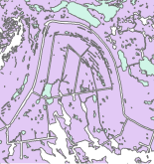
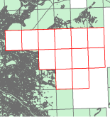
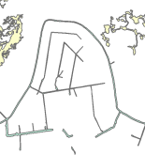
Spatial Improvement
Erased with these Datasets
Leaves this
Upland/Spoil
Missing Quads
Featureless Polygon

Slide 5
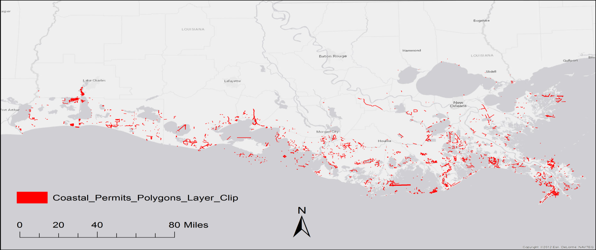
Temporal Improvement

Slide 6
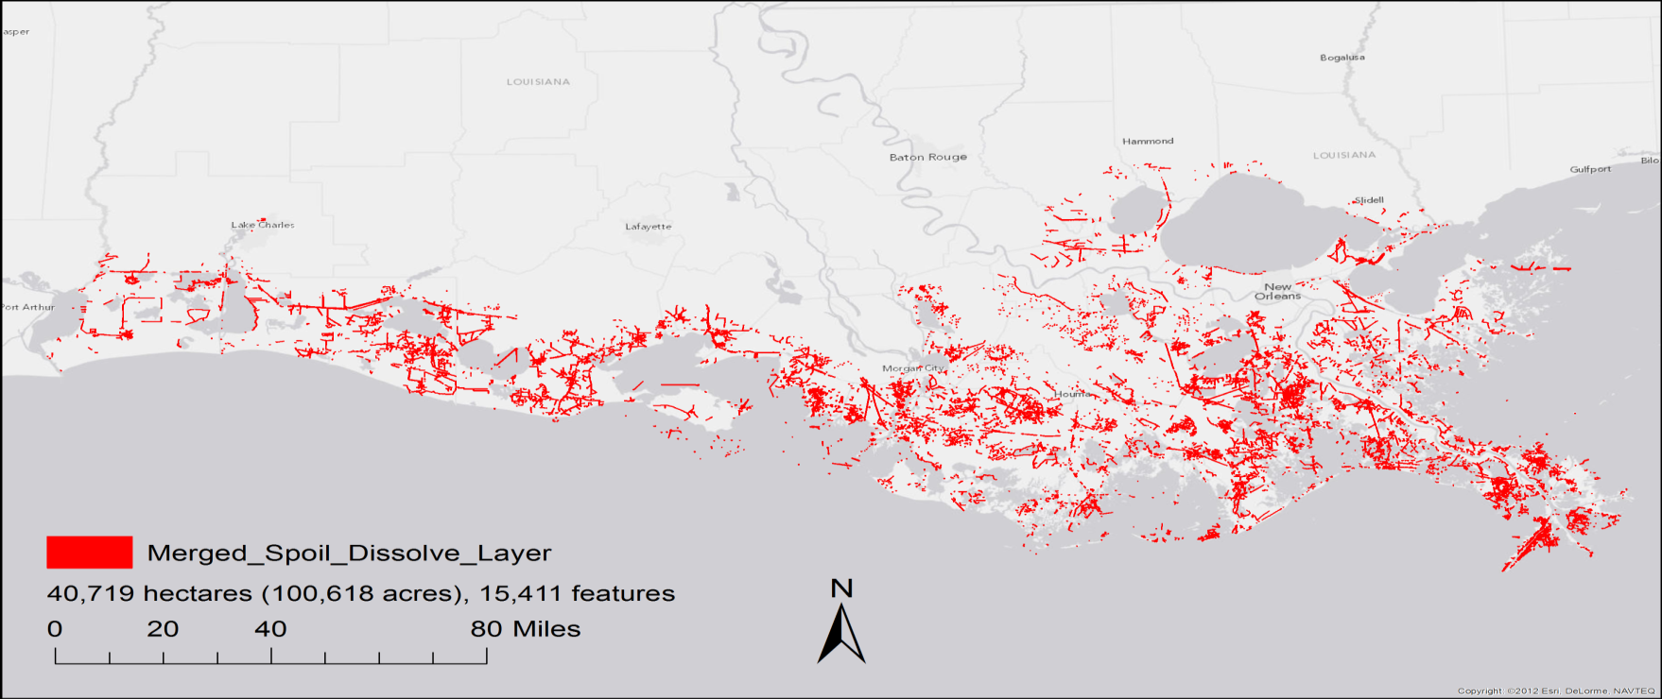
Coastwide Spoil

Slide 7
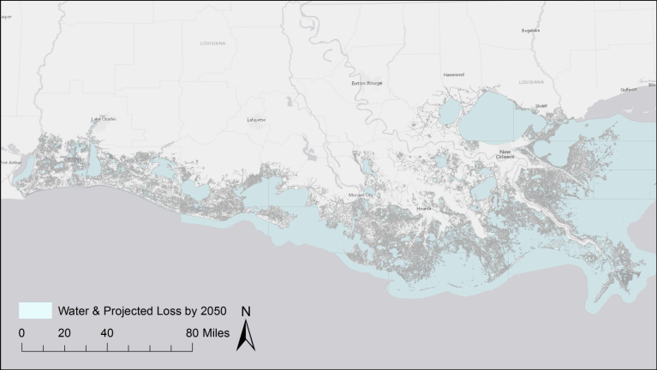
Remove Water and Projected Loss

Slide 8
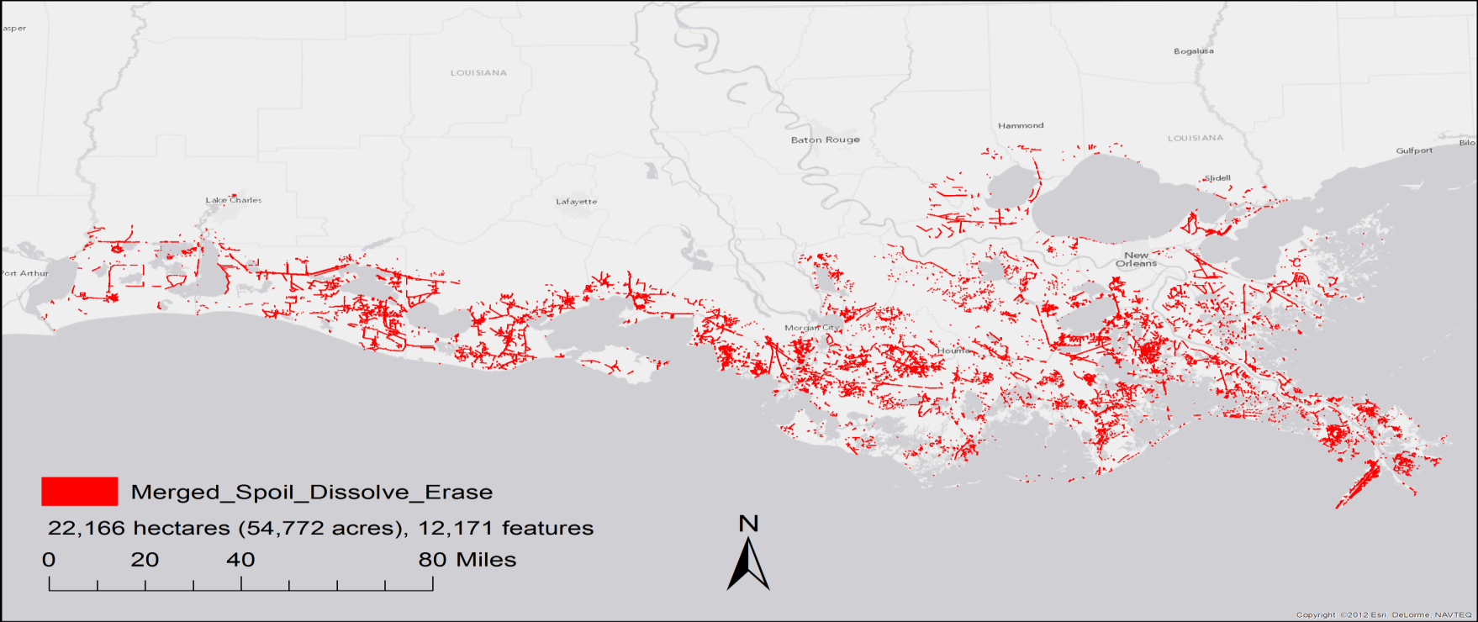
Relatively Stable Spoil

Slide 9
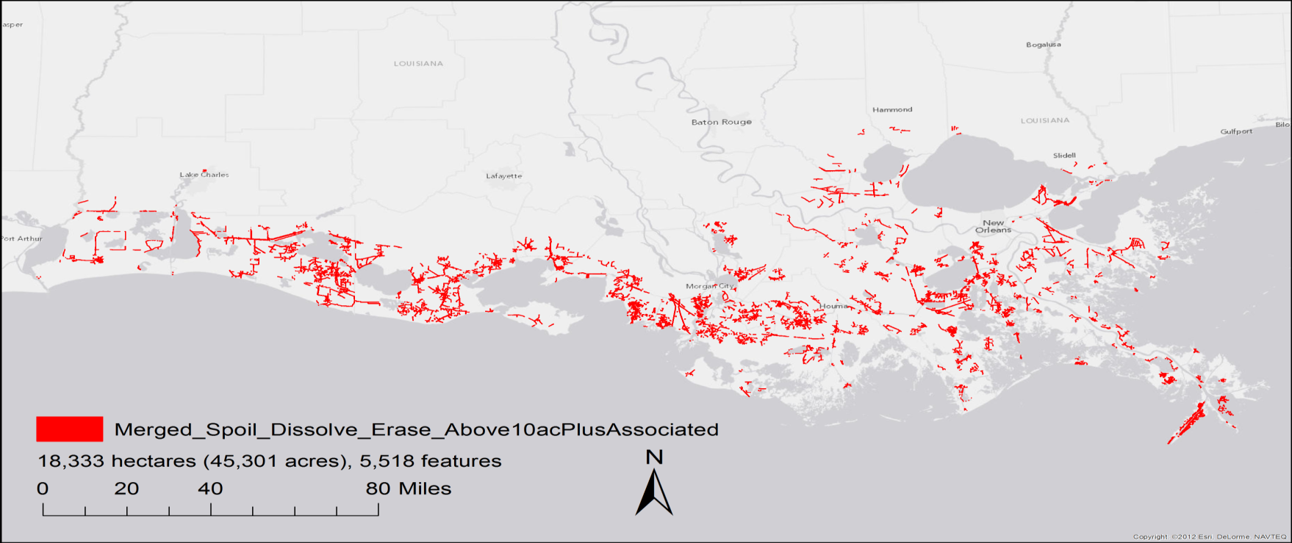
Large Relatively Stable Spoil

Slide 10
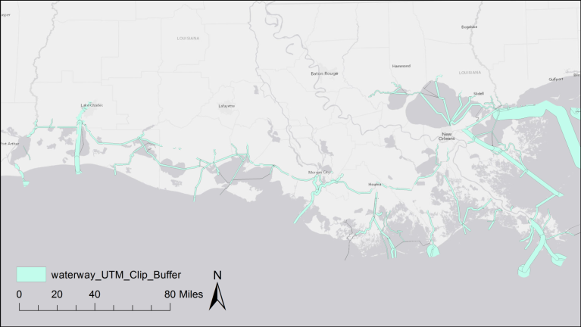
Remove Spoil - Navigation Channels

Slide 11
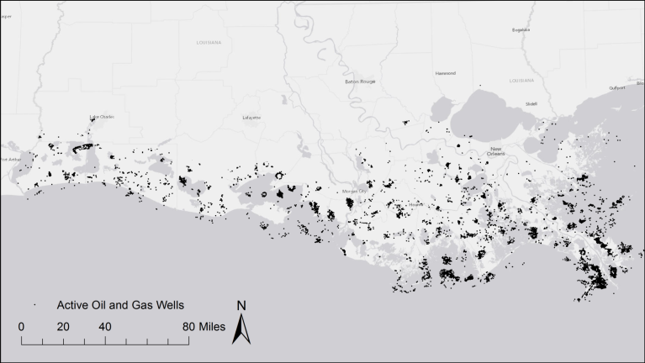
Remove Spoil - Active Oil & Gas Wells

Slide 12
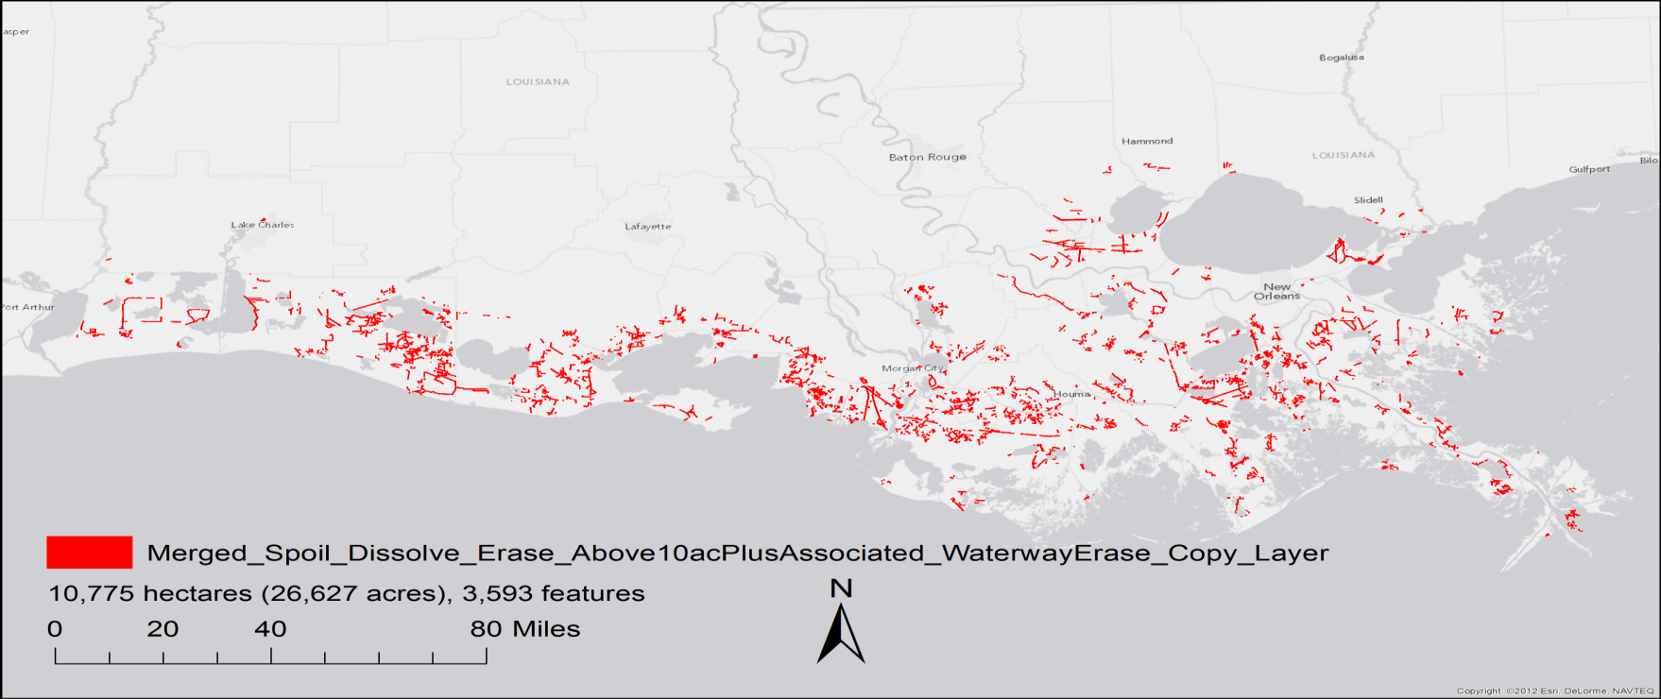
Backfillable Spoil

Slide 13
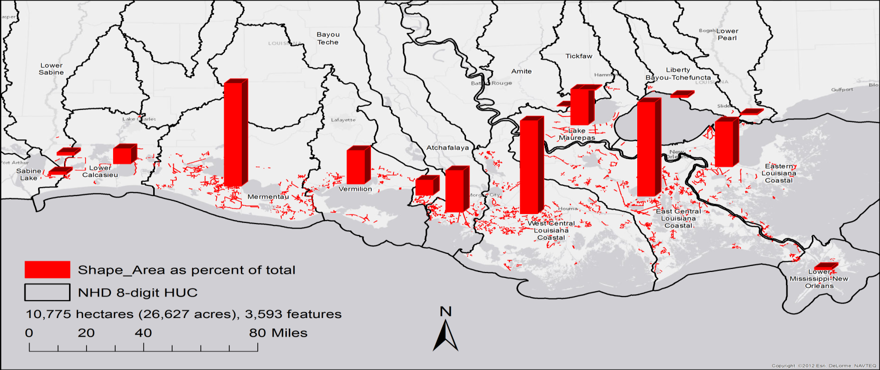
Backfillable Spoil - Hydrologic Basin

Slide 14
Backfillable Spoil - Adjacent Habitat
Sasser and others 2014

Slide 15
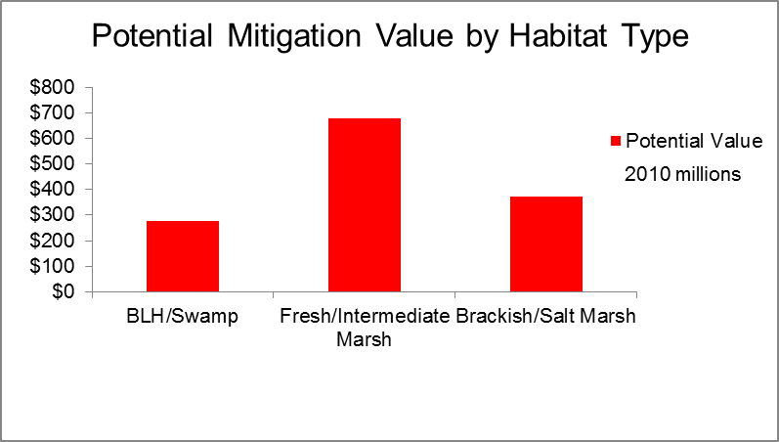
Mitigation Value - Adjacent Habitat
Buatt and others 2010

Slide 16
Results
Mitigation value* of spoil area if restored $1.33B
Cost of backfilling $0.87B
Annual ecosystem service value** $0.14B/year
Net present value of $1.06B - $2.73B after 50 yrs
Create 7,830 jobs***
*Buatt and others 2010
**Costanza and others 2006
*** Ryan 2014

Slide 17
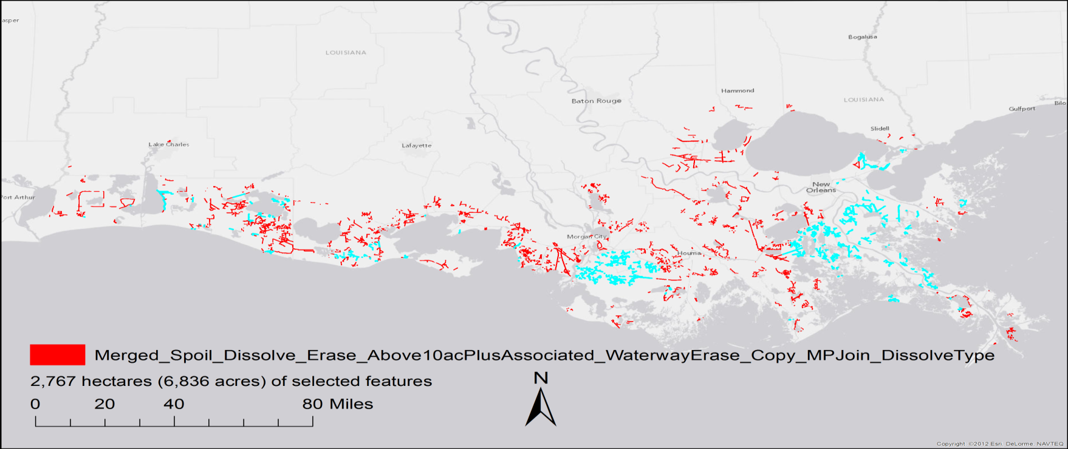
Backfillable Spoil - 2012 Master Plan

Slide 18
Updates
Land loss projections
Coastal use permits
Active oil and gas wells

Slide 19
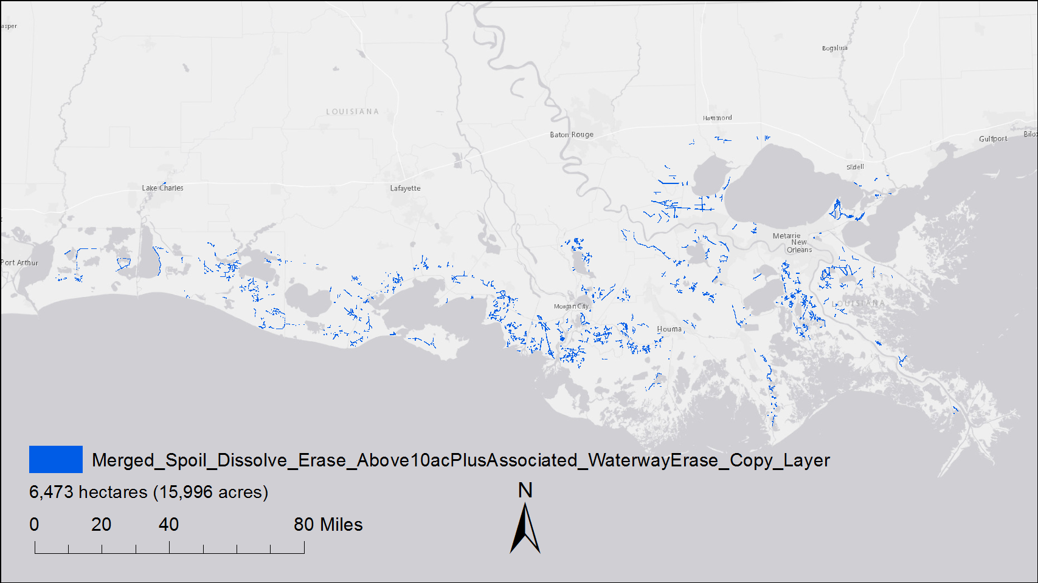
Updated Backfillable Spoil

Slide 20
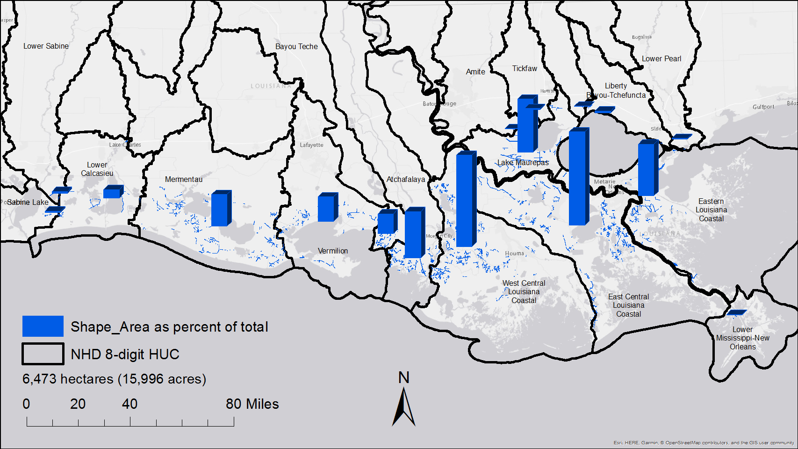
Updated Backfillable Spoil - By Basin

Slide 21
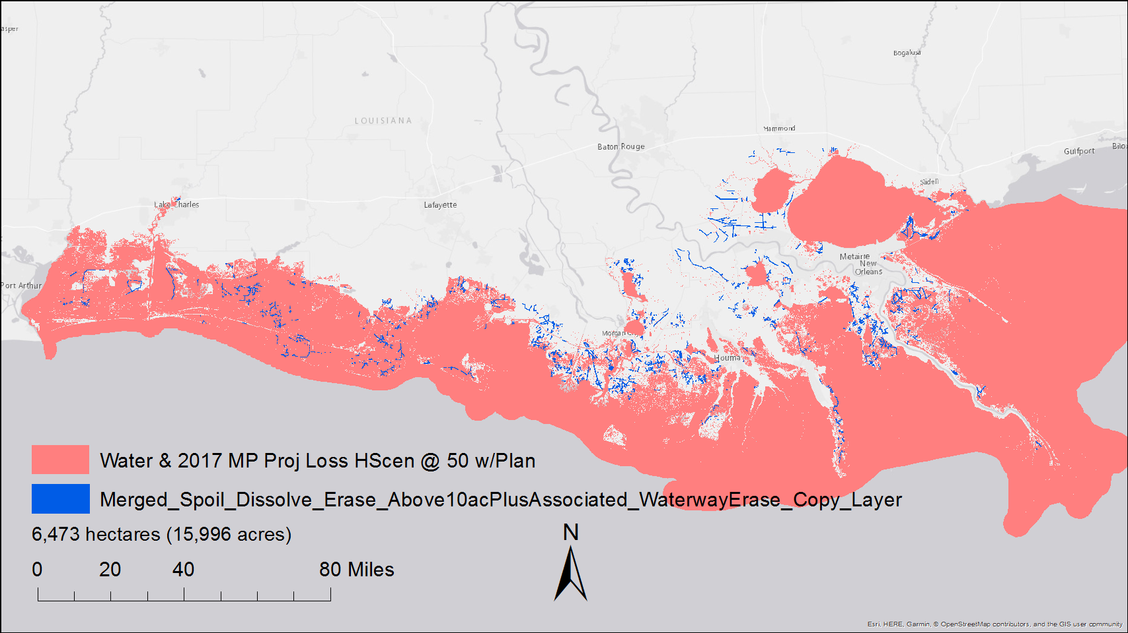
Updated Water & Land Loss w/Backfillable Spoil

Slide 22
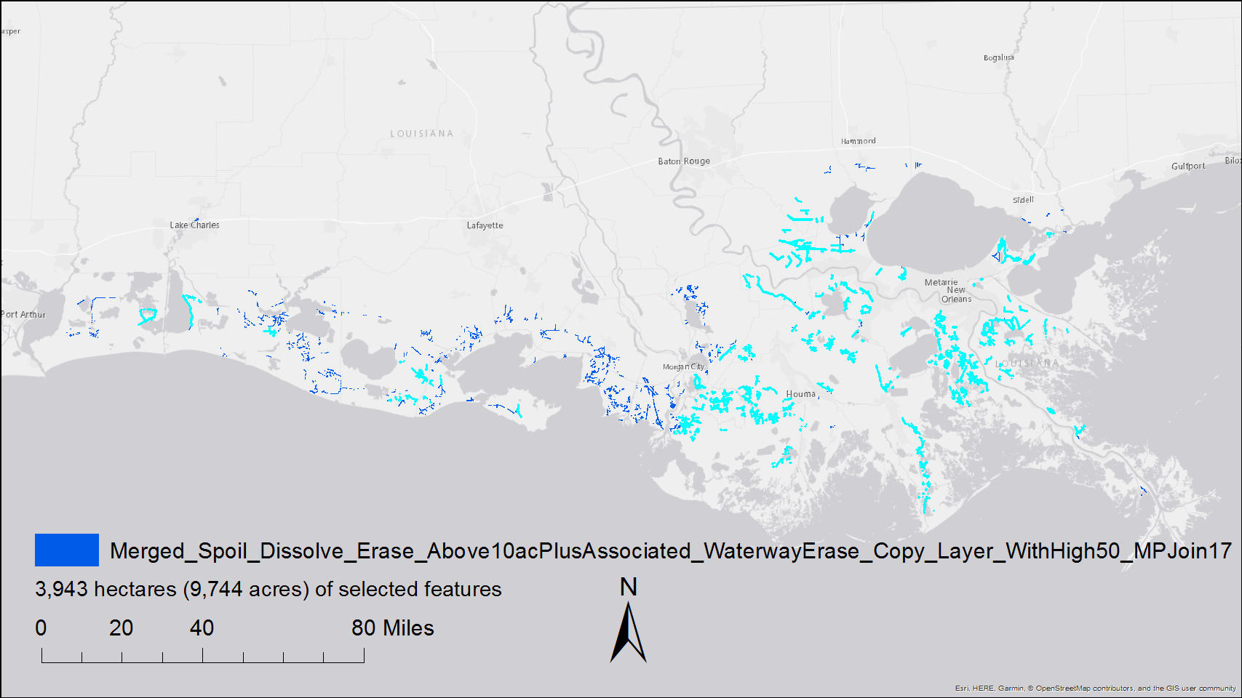
Updated Backfillable Spoil - 2017 Master Plan

Slide 23
Updated Results
Mitigation value* of spoil area if restored $0.77B
Cost of backfilling $0.52B
Annual ecosystem service value** $0.91B/year
Net present value of $12B - $23B after 50 yrs
*Buatt and others 2010
**Costanza and others 2014

Slide 24
Update Summary
40% less stable spoil @ 50 years
Greater importance of delta
Increase in ecosystem service valuation

Slide 25
