Slide 1
CSFI Flood Insurance
Update
February 1, 2018

Slide 2
TAKE ACTION
NFIP Set to Expire Thursday, February 8
NFIP set to expire Thursday, February 8
Short-term extension likely
TAKE ACTION TODAY – visit csfi.info/takeaction to urge your Senators to secure a deal on a multi-year reauthorization with pro-policyholder reforms as soon as possible!
Notes:
Matt – can you generally beautify/convey urgency and make this an image: http://csfi.info/take-action/

Slide 3
Key Outstanding issues
Role of Private Market Biggest Hurdle
Role of private market and how to prevent cherry-picking
Resolving the NFIP’s debt
Funding for Mitigation
Immunity with regards to claims
Notes:
Can we make this headline the main image? http://www.theadvocate.com/baton_rouge/news/politics/article_65a077ee-f857-11e7-bfbc-7bf9154d2b30.html

Slide 4
Insurance - NFIP
The CSFI strategy has four focus areas for incremental improvement.
Mitigation
Mapping Process
Affordability
Program Participation
Notes:
Can we use the first pages of each of these docs for the two images for this slide?
https://www.cassidy.senate.gov/imo/media/doc/Cassidy-Gillibrand%20Section%20Summary%204_25_17_%20FINAL.pdf
https://www.menendez.senate.gov/imo/media/doc/SAFE-NFIP-Section-by-Section-6-13-17.pdf

Slide 5
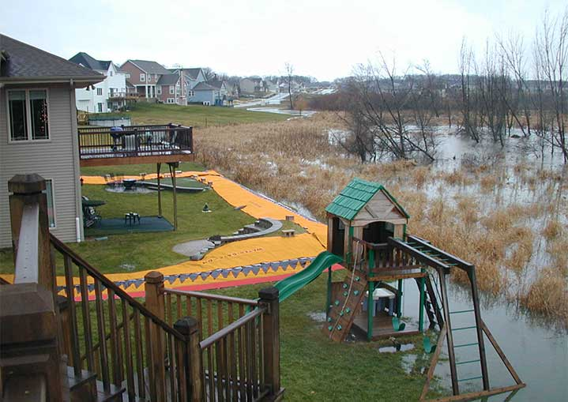
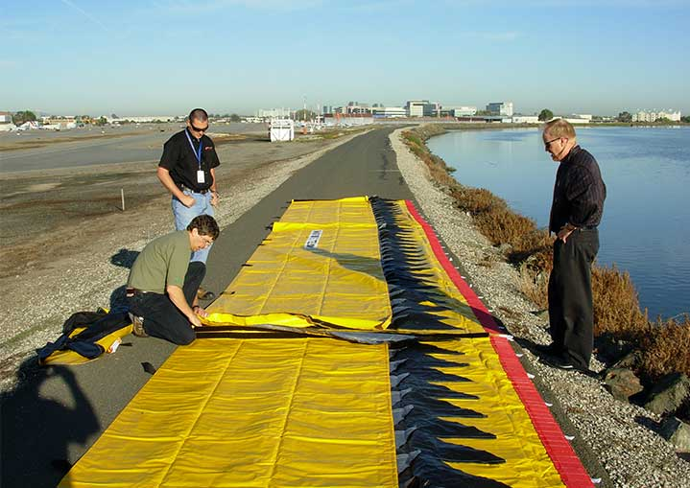
Insurance - NFIP
1. Mitigation
Transformational Improvements
Freeze interest accrual to FEMA mitigation funds, generating $400M annually
Incremental Improvements
Add option for increased ICC coverage
Expand eligibility to any repetitive loss properties in and outside of the SHFA
Maintain requirements that any private flood coverage is equal to NFIP coverage, which preserves post disaster mitigation coverage similar to ICC on private flood policies

Slide 6
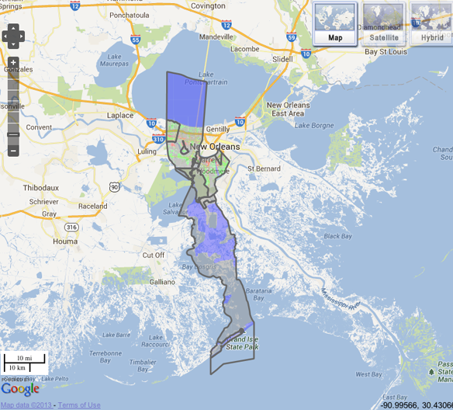
Insurance - NFIP
2. Mapping Process
Transformational Improvement
Adopt recent innovations in elevation science to radically improve mapping and precision, including use of LIDAR data
Increase authorization for the National Flood Mapping Program to accelerate the completion of the mapping the entire country
Incremental Improvements
Codify exclusion provisions so that parishes and counties can adopt portions of maps at a time
Provide a credit to all pre-FIRM properties who secure an elevation certificate
Fund reimbursements for successful map appeals
Include a policy equivalency fee on private flood policies to continue funding for mapping
Notes:
CB please check / amend

Slide 7
Insurance - NFIP
3. Affordability
Transformational Improvement
Establish affordability program outlined in Cassidy-Gillibrand bill
Incremental Improvements
Preserve grandfathering and basement exception
Include continuous coverage language in reauthorization to allow property owners to leave and NFIP and subsequently return if they choose
Include all fees associated with a policy when calculating annual premium increases
Include “Loss of Use” coverage for business

Slide 8
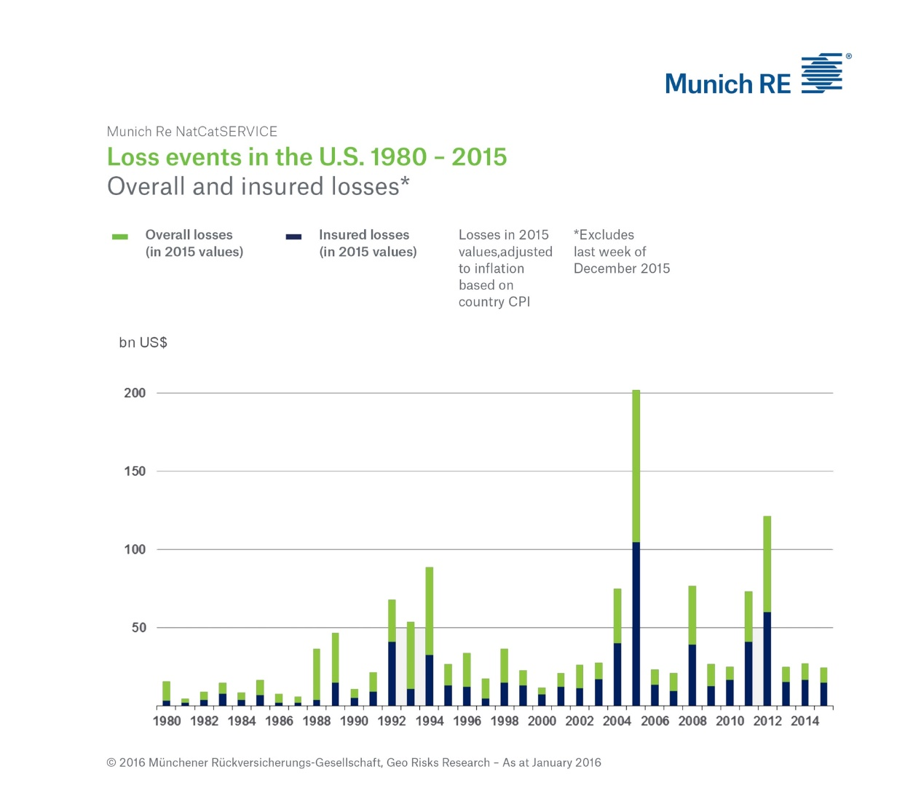
Insurance - NFIP
4. Program Participation
Transformational Improvement
Offer a default “opt-out” flood insurance policy
Incremental Improvement
Consider mandatory purchase of flood insurance for properties that have experience a loss and federal disaster assistance was accepted to repair or replace the structure
Increase renewal periods from 1 year to 2 or 3 years
Notes:
NFIP and NAIC should collectively identify impediments to presenting consumers a default policy that allows consumers to take only one action to purchase a hazard policy and an NFIP policy.
2. NFIP should be directed to engage in product testing that offers consumers a “default” insurance option where consumers are required to actively decline (opt-out) flood insurance coverage. Based on the outcome of consumer testing, NFIP and NAIC should move to expand “default” options that include NFIP coverage as appropriate.
1. NFIP and state insurance supervisors, working with WYO companies and insurance agents, should facilitate offering a default policy option to consumers living in areas with residual or moderate flood risk a Preferred Risk Policy, with subsequent options and targeted communities developed as appropriate.
2. For consumers living in areas with residual and moderate flood risk, NFIP and state insurance supervisors, working with WYO companies and insurance agents, should appropriately incentivize offering single purchase options with the opportunity for consumers to opt-out of the default option or to purchase additional coverage if the consumer chooses to protect against catastrophic events.

Slide 9
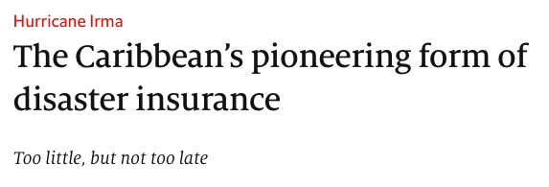
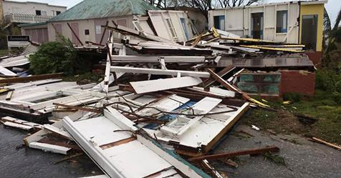
Insurance – National Catastrophic?
Transforming Catastrophic Risk Insurance

Slide 10
Key Information and Contacts
Whitepapers on flood insurance reform and additional materials can be found at csfi.info. To participate on regular update conference calls with coalition members, email Caitlin Berni at cberni@gnoinc.org
Michael Hecht President and CEO mhecht@gnoinc.org Caitlin Berni
SVP of Policy and Communications cberni@gnoinc.org

