Slide 1
WATER TREATMENT OPERATIONS
AT LAFOURCHE PARISH WATER DISTRICT NO.1

Slide 2
The Lafourche Parish Water District’s water source is Bayou Lafourche. The original treatment plant, located near Lockport, was expanded from 2 MGD in 1955 to 4 MGD in 1963, to 6 MGD in 1973, to 8 MGD in 1980, and to 12 MGD in 2002. The District constructed a 4 MGD treatment plant near Thibodaux that went on line in early March 1989 and was expanded to 6 MGD in January 2001. Total combined daily capacity from both plants 18 MGD.

Slide 3
The treatment plant near Lockport (South Plant) has a high service pumping system consisting of (2) 1400 gpm, (2) 3750 gpm and (2) 5600 gpm pumps. Storage capacity at the plant consists of 300,000 gallons below ground and 3 – 500,000 gallon and 1 – 1,000,000 gallon ground storage tanks.

Slide 4
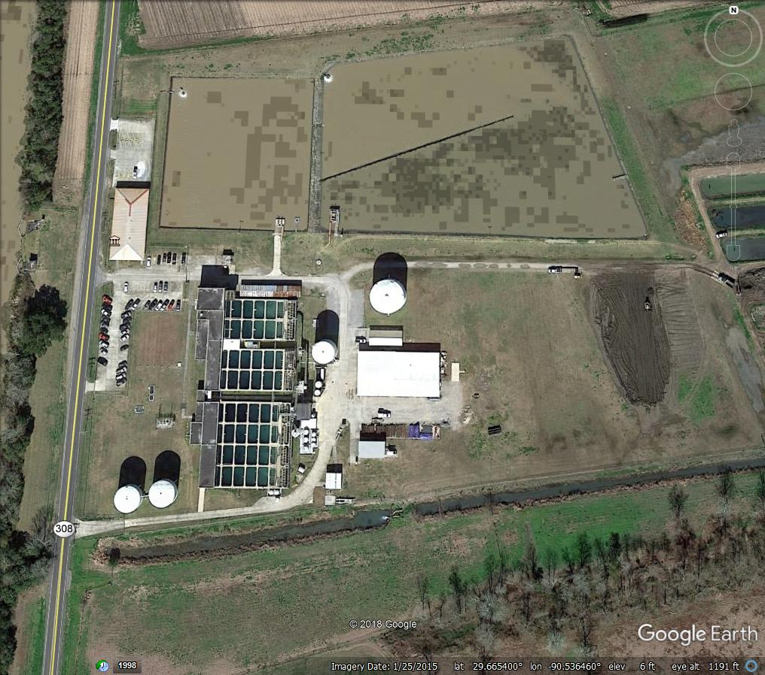
South Water Treatment Plant
Lockport, LA

Slide 5
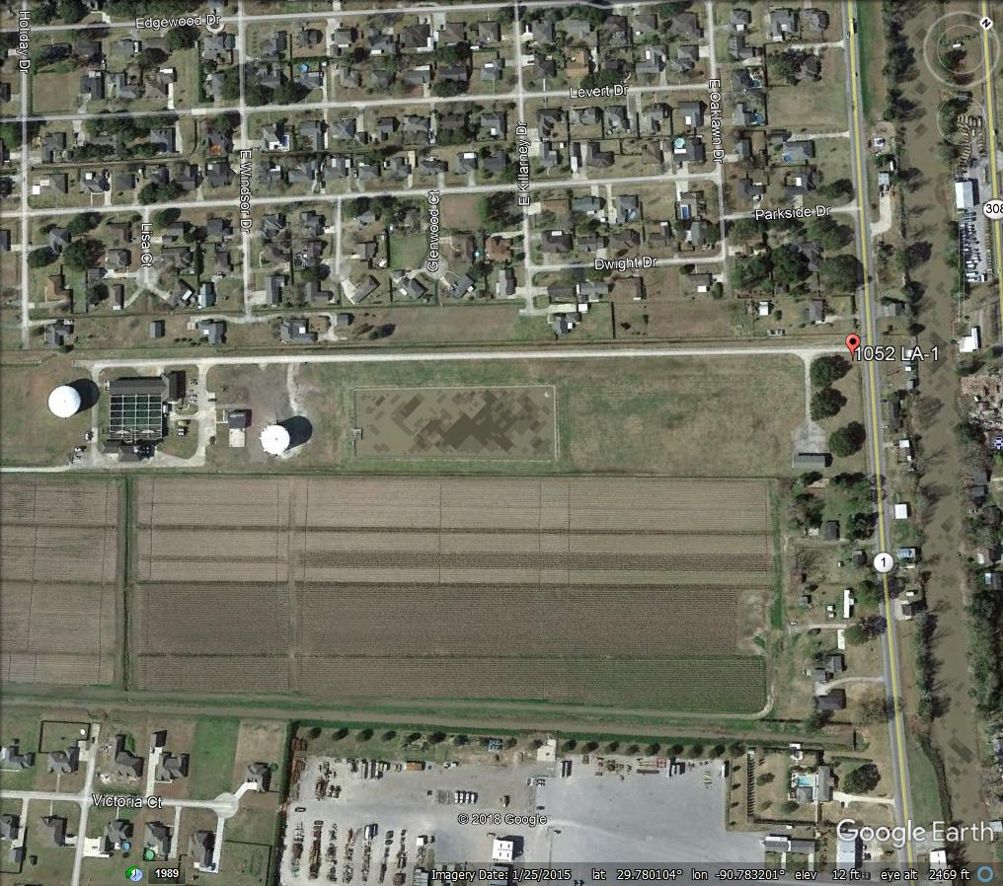
North Water Treatment Plant
Thibodaux, LA

Slide 6
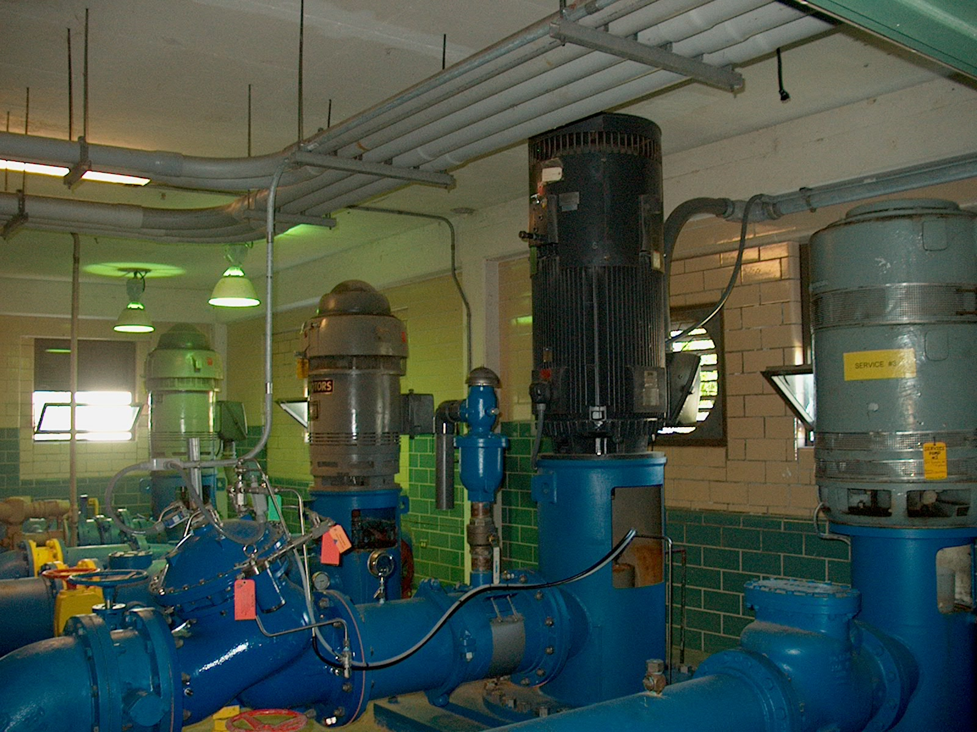
High Service Pumps at South Plant

Slide 7
The treatment plant near Thibodaux (North Plant) has a high service pumping system consisting of (1) 1800 gpm, (1) 2500 gpm and (3) 4200 gpm pumps. Storage capacity consists of approximately 400,000 gallons below ground and (2) 2,000,000 gallon ground storage tanks.

Slide 8
The Raw Water Pump Stations have a total of five pumps that pump
water from Bayou Lafourche into one of the two reservoirs we have at
the South Plant. There are also six pumps that pump water from the
reservoirs to the rapid mixer.

Slide 9
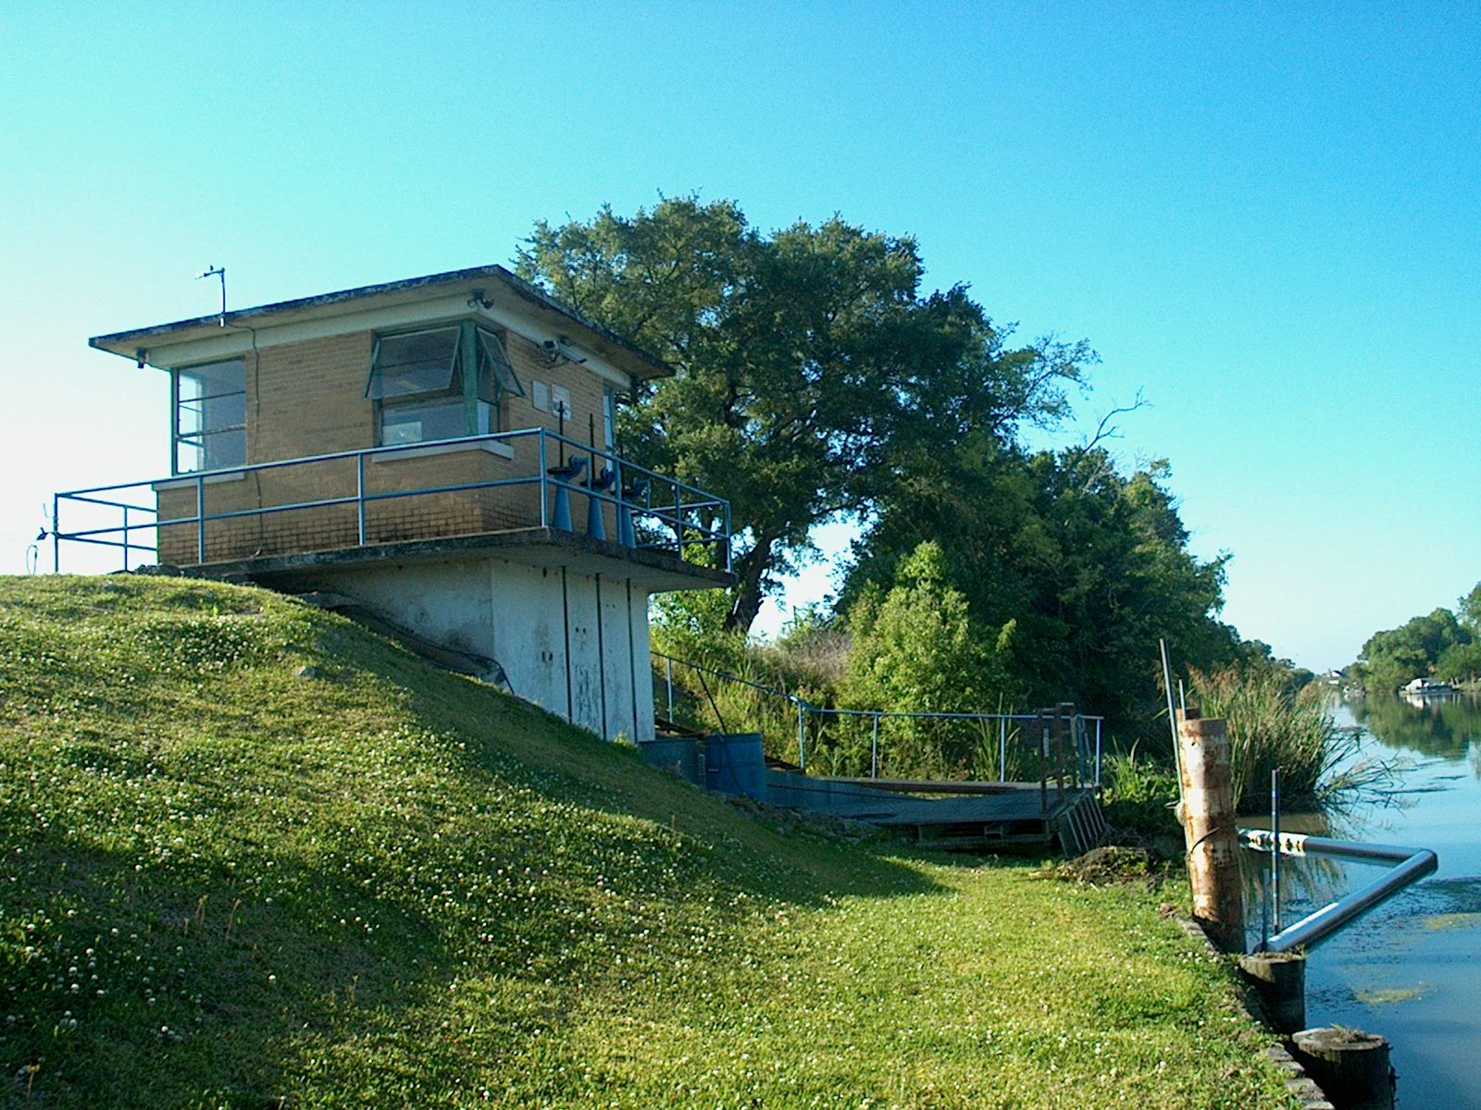
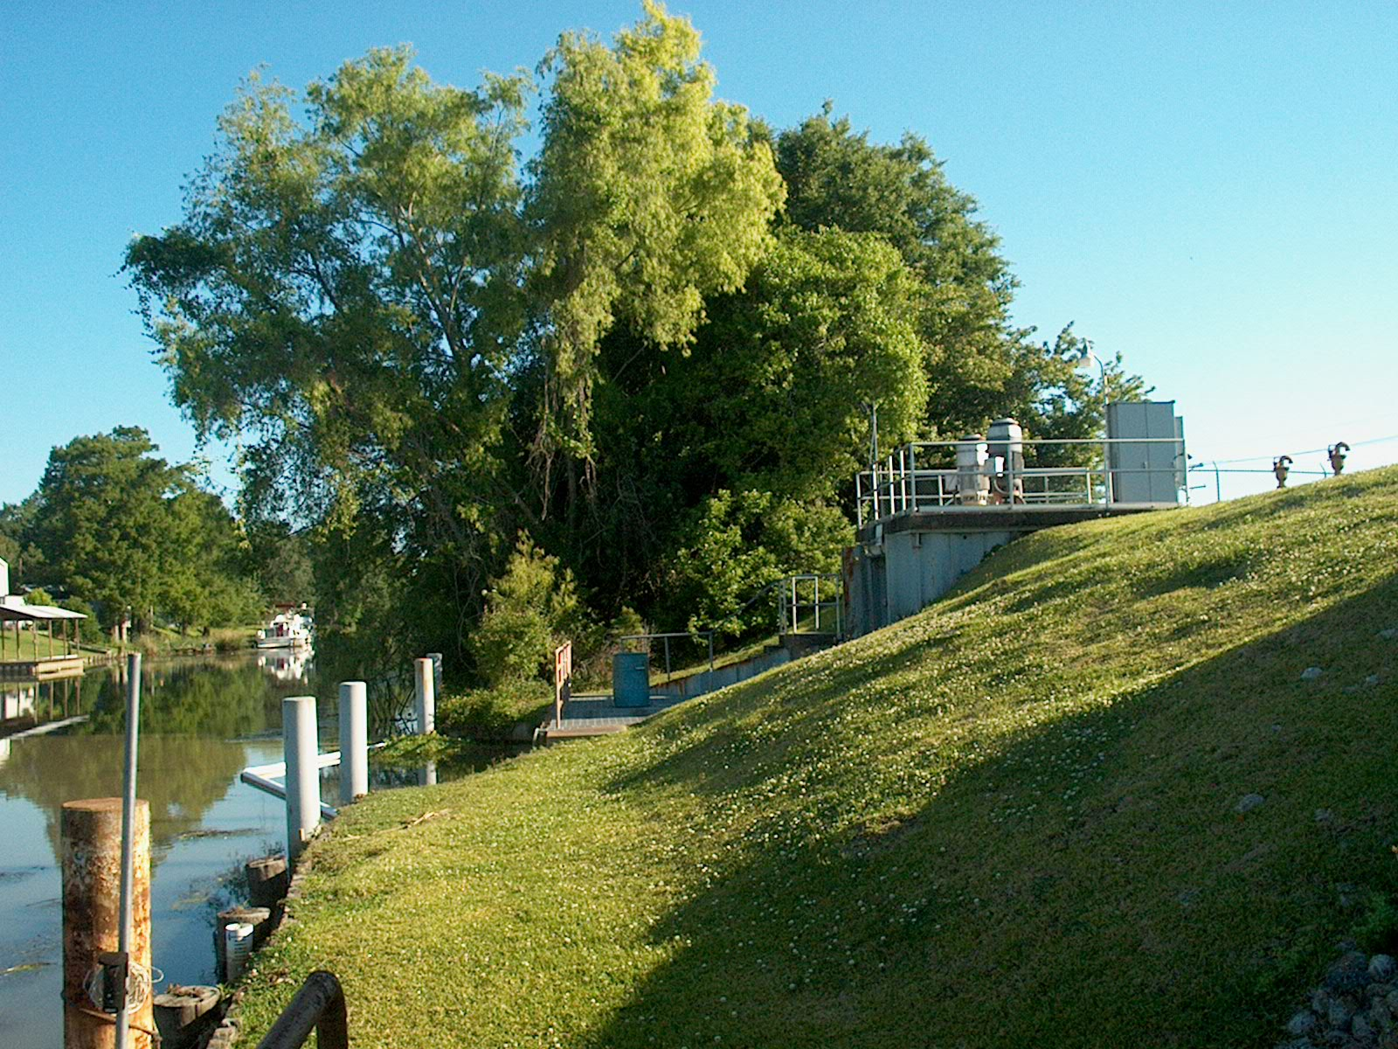
Raw Water Pump Stations – South Plant

Slide 10
The South Plant has two reservoirs with approximately 5 million gallons capacity in the smaller reservoir and 15 million gallons capacity in the larger one. The North Plant has one reservoir with approximately 5 million gallon capacity. The reservoirs act a pre-sedimentation basin where the heavy solids drop out. At certain times of the year we feed sodium permanganate into the raw water to help with taste and odor problems.

Slide 11
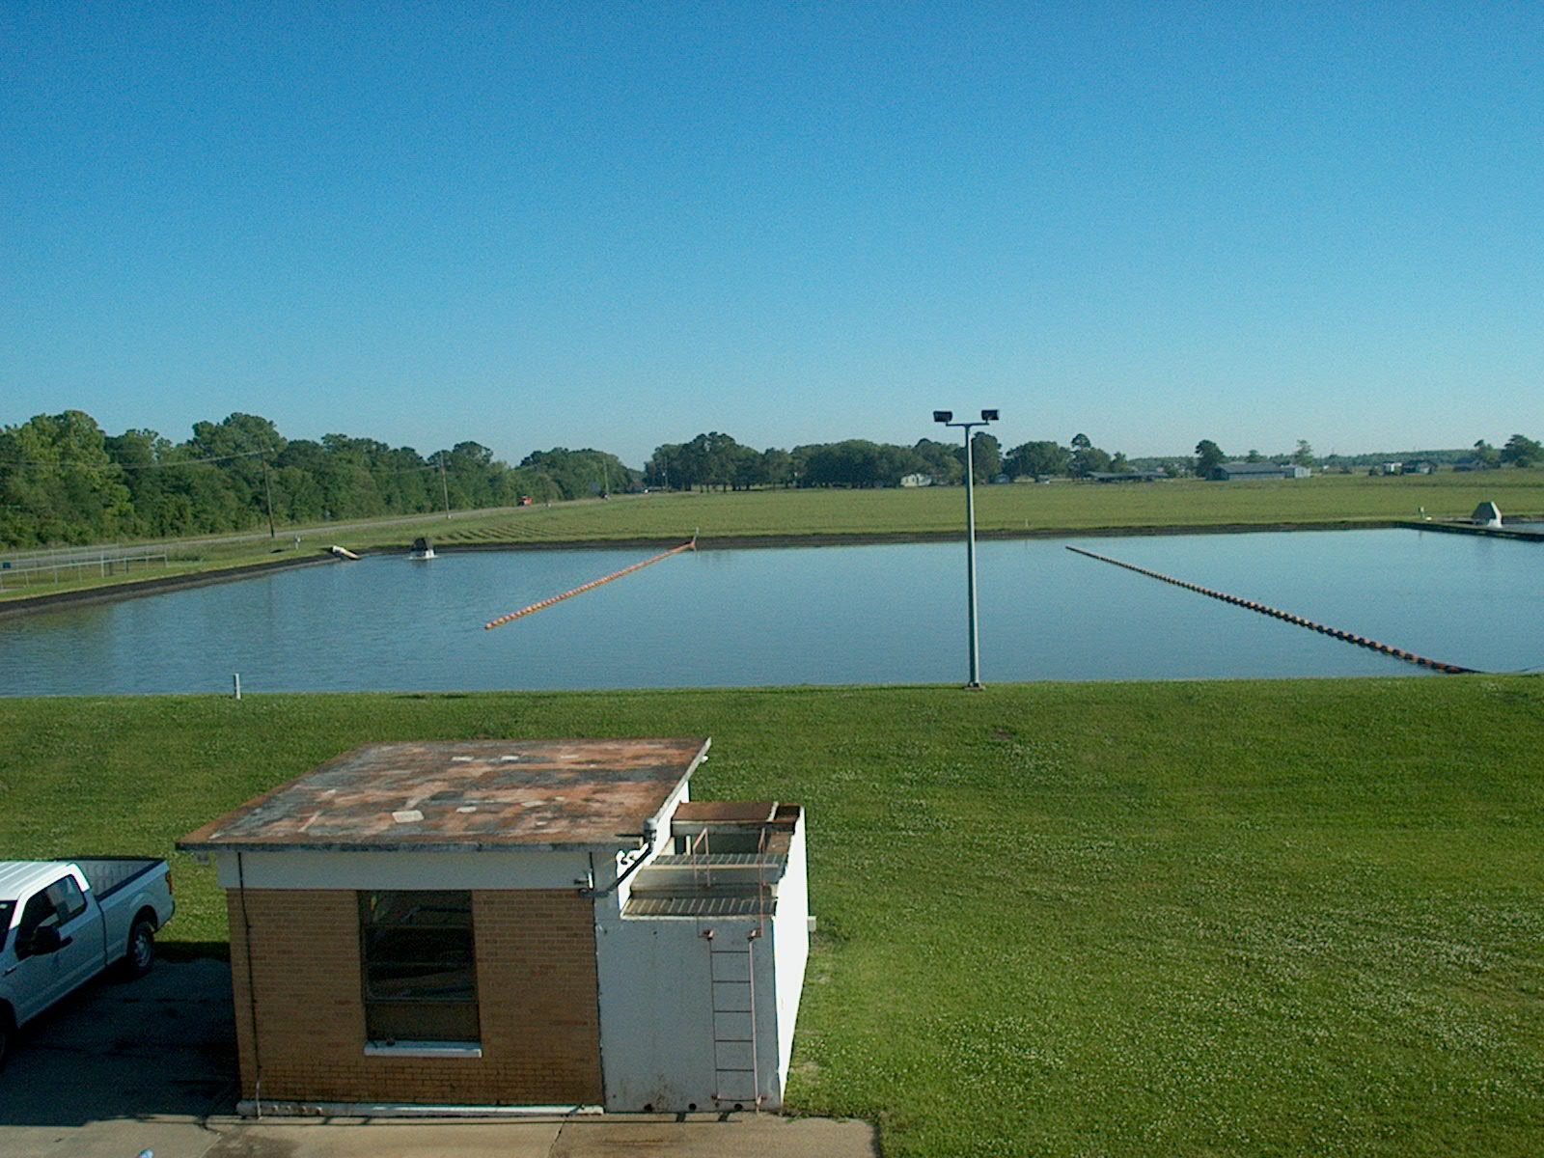
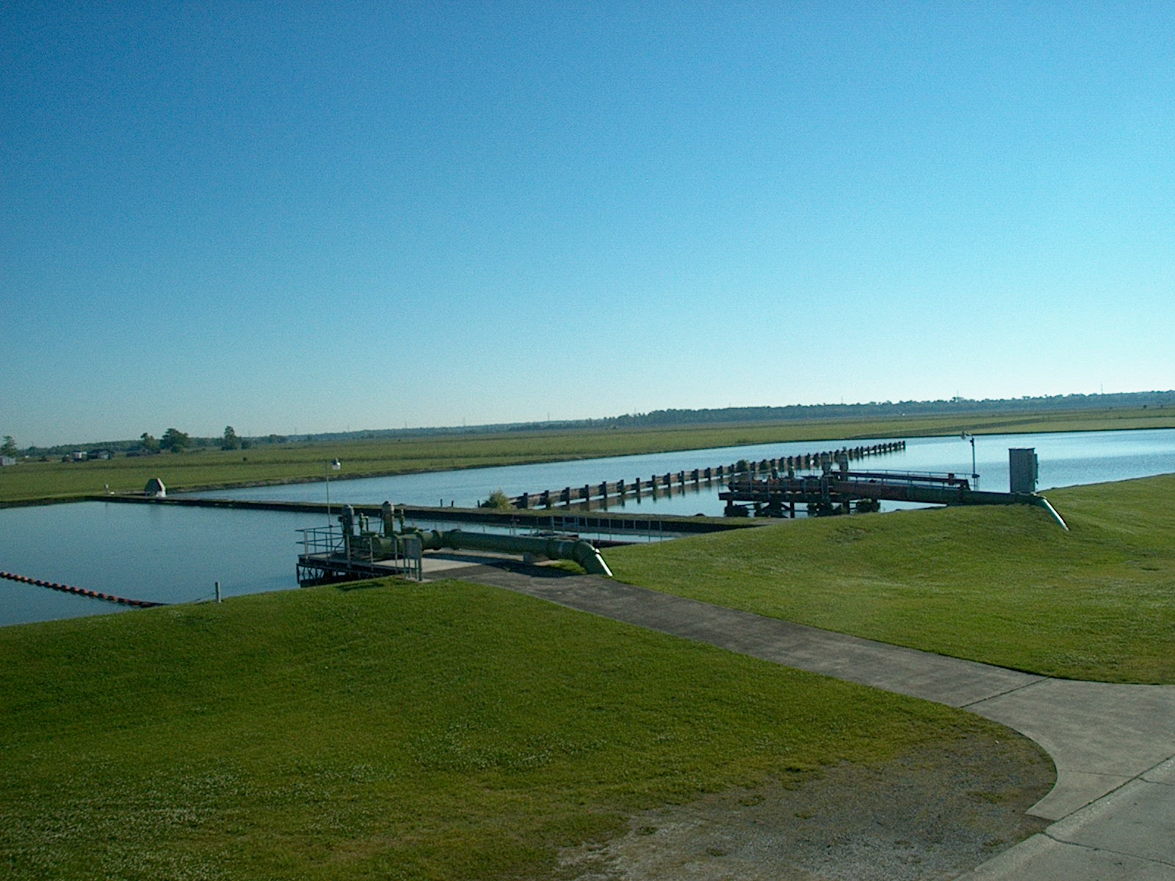
Curtains in the reservoir aid in increasing detention time and help in the elimination of dead zones.

Slide 12
The water is then pumped into the mixer where chemicals are
added to aid in the formation of floc. The flocculation process is the
gathering of sediment in the water by use of chemicals such as alum
and polymer.

Slide 13
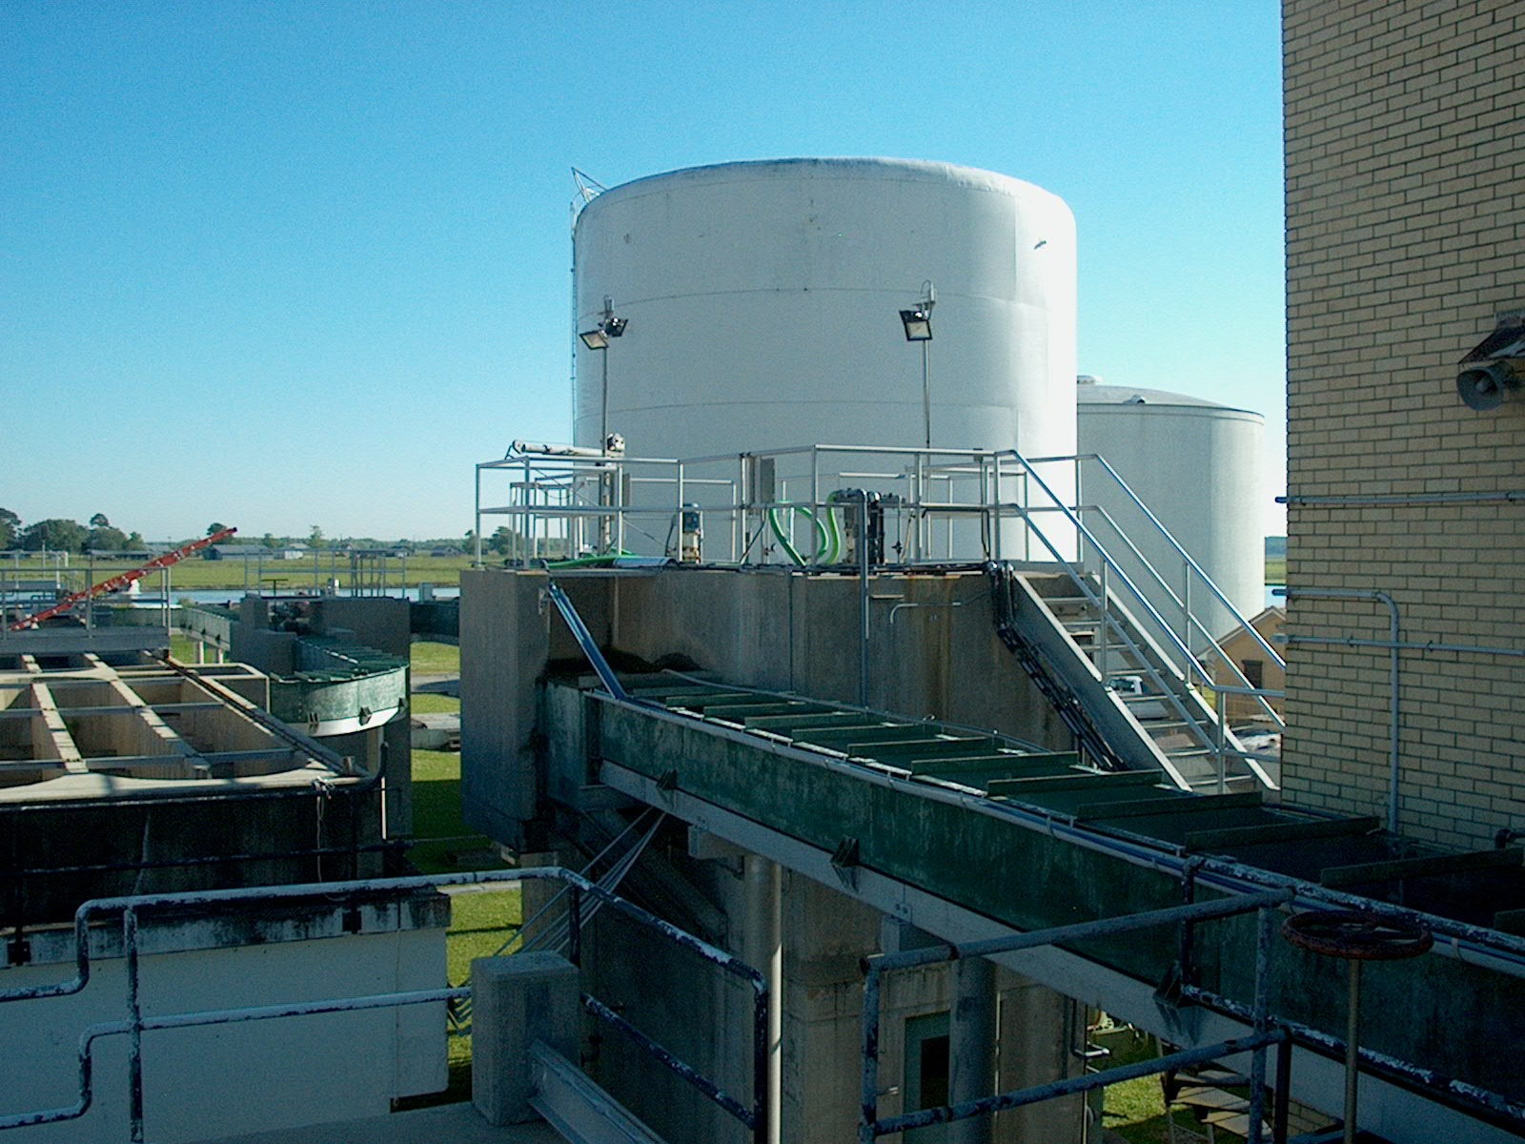
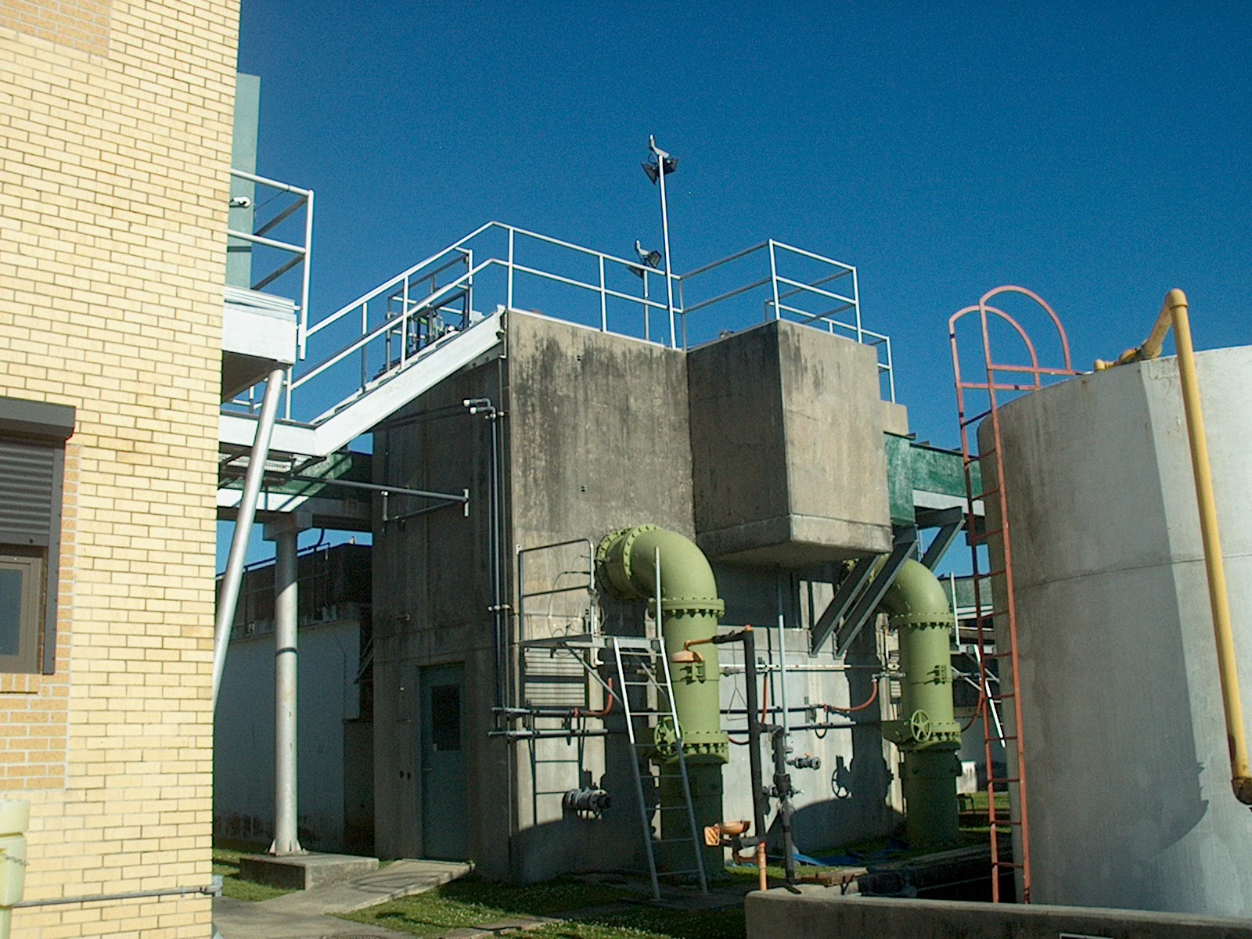
Rapid Mixer at South Plant

Slide 14
We also add chlorine dioxide to aid in the disinfection of the
water, powdered activated carbon for taste and odor and fluoride
dental hygiene.The water runs from the mixer through troughs into a
splitter box then into the flocculation basin, which is a series of over
and under baffles that stirs and mixes the chemicals in the water to
aid in the formation of floc.

Slide 15
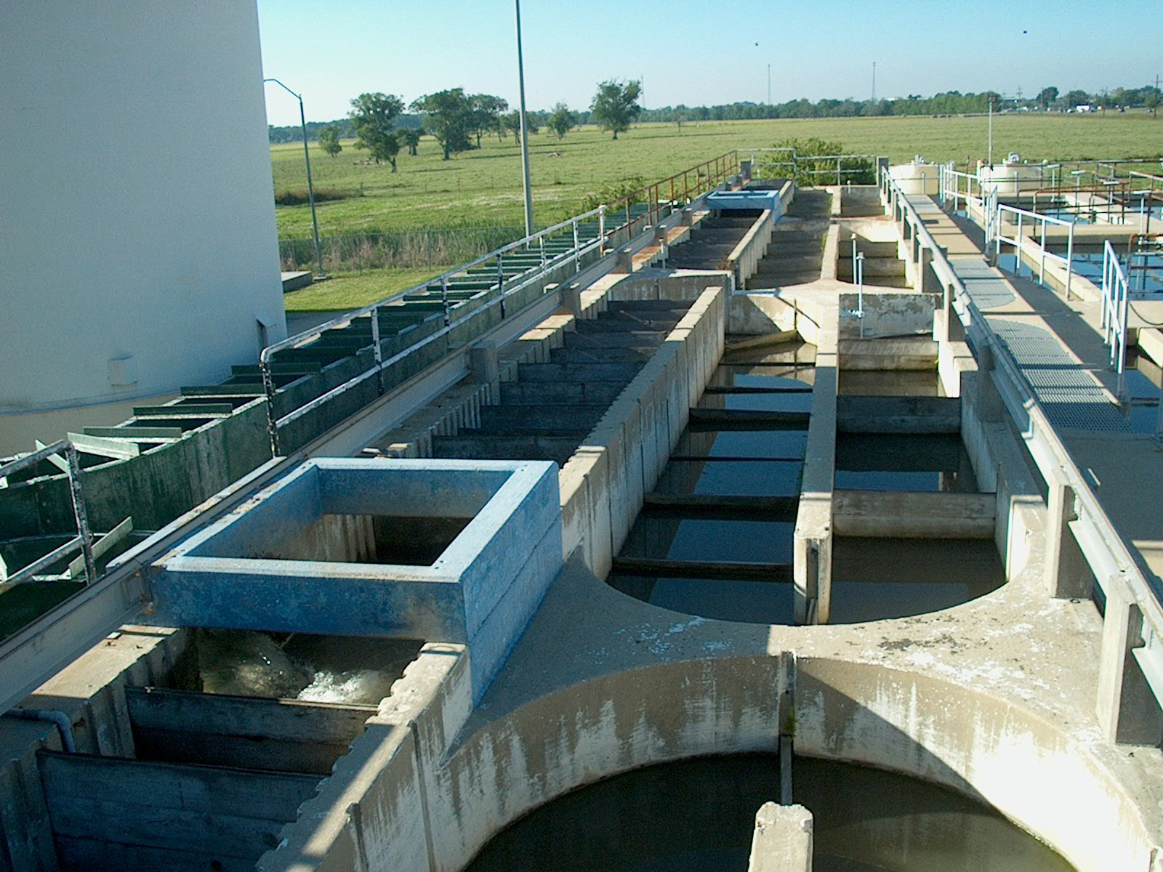
Flocculation Basins
Water flows in troughs from the mixer going into the splitter box then into the flocculation basins.

Slide 16
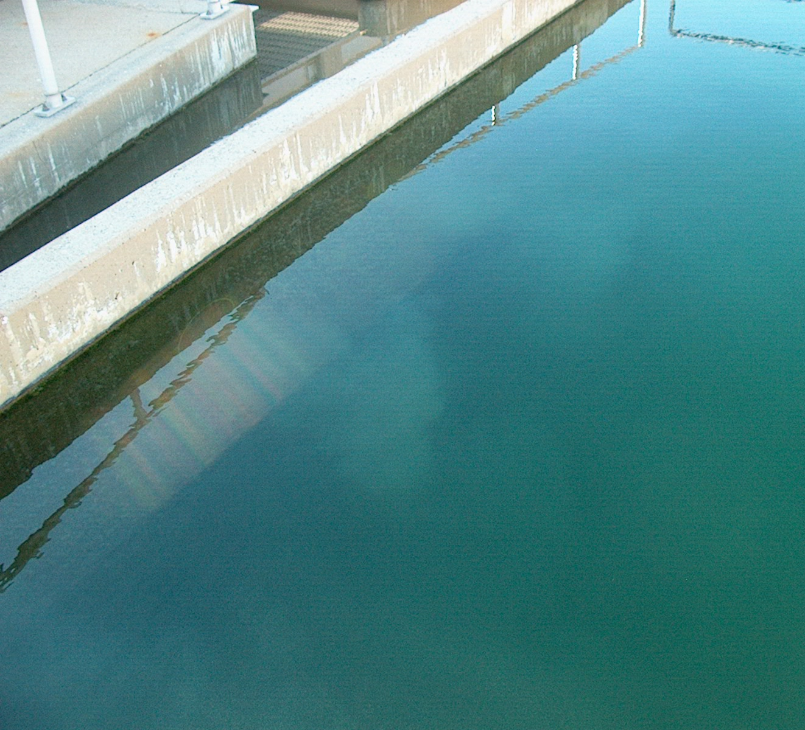
Wall Between Flocculation Basin & Sedimentation Basin
Floc exiting into the sedimentation basin through openings in the wall.

Slide 17
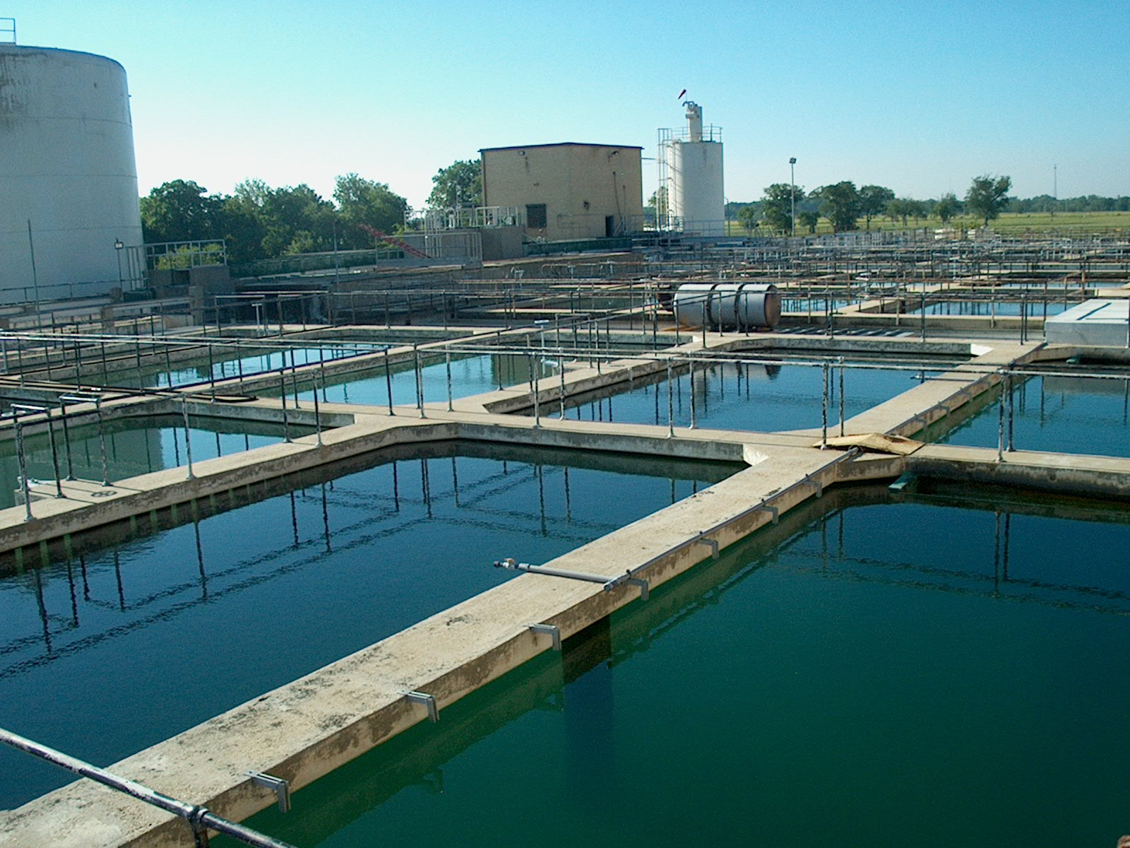
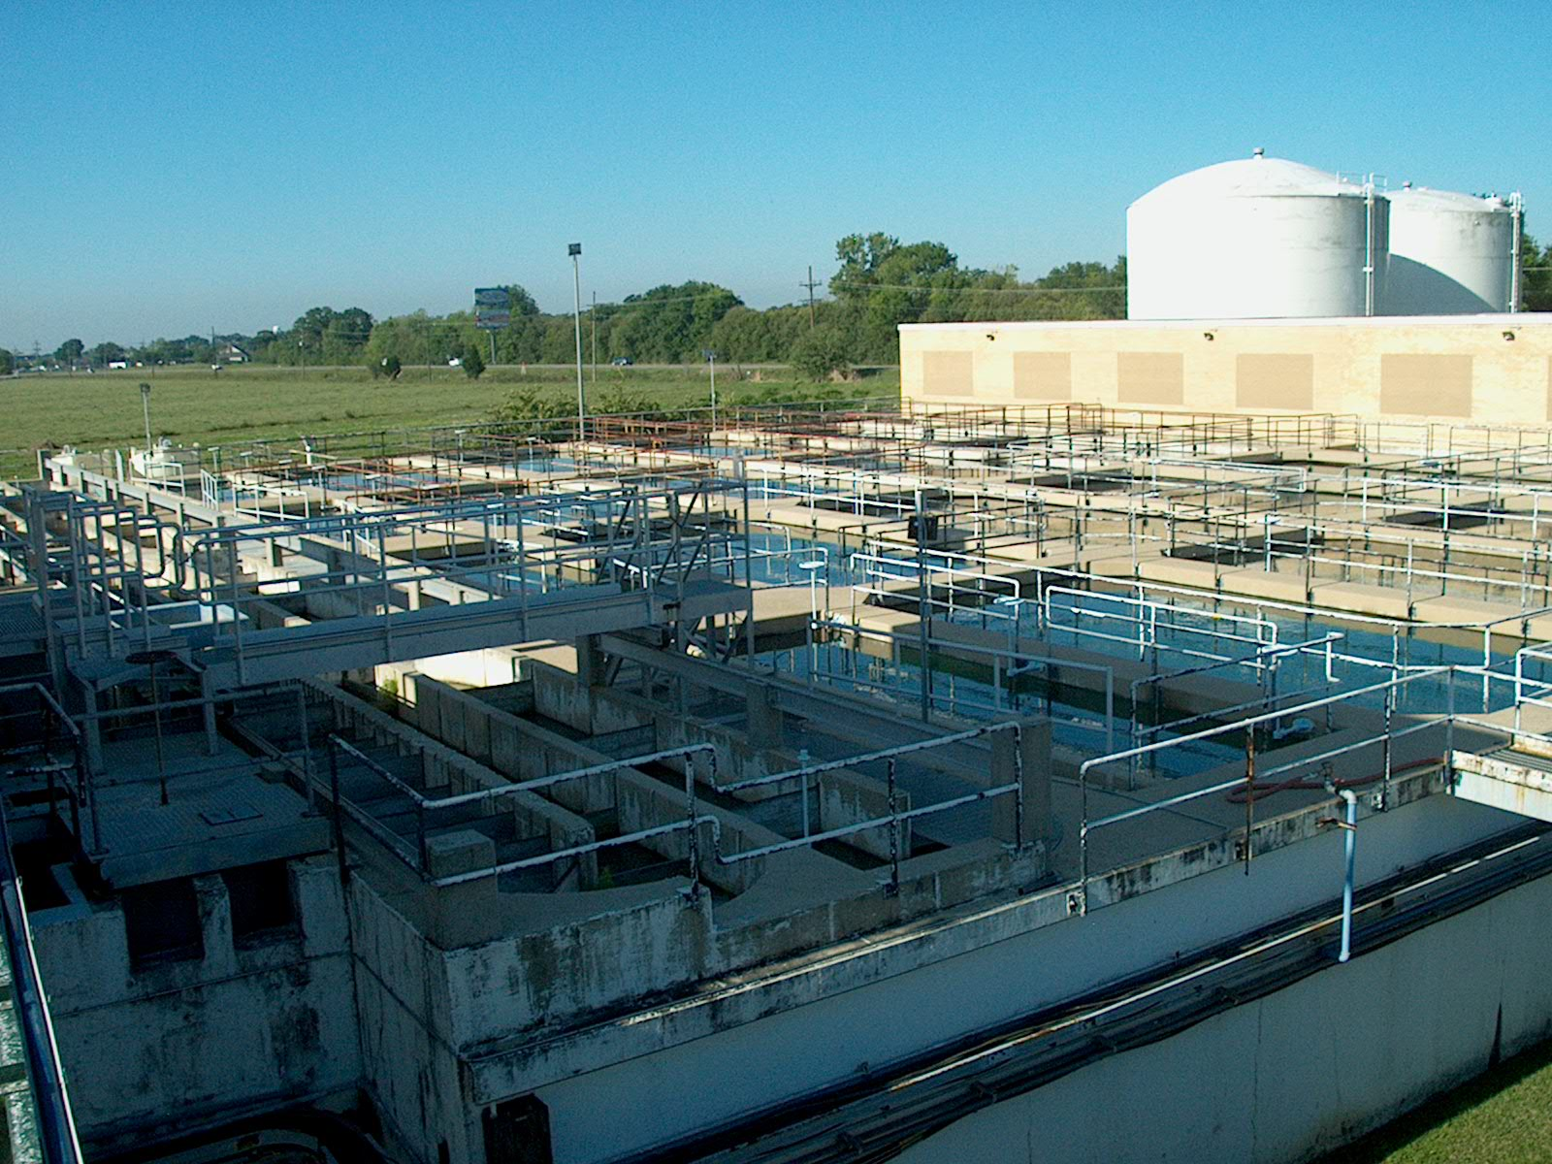
Sedimentation Basins at the South Plant.

Slide 18
The water continues in the sediment basin and comes in
contact with a baffle wall to further aide in the settlement of floc.
On the back side of the baffles the water skims over the weir and
into a trough.

Slide 19
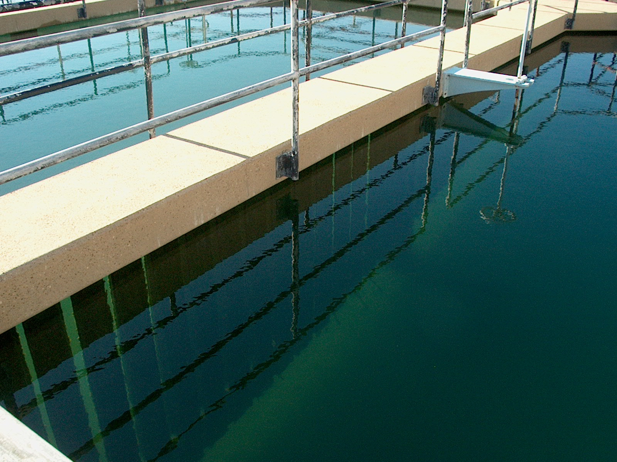
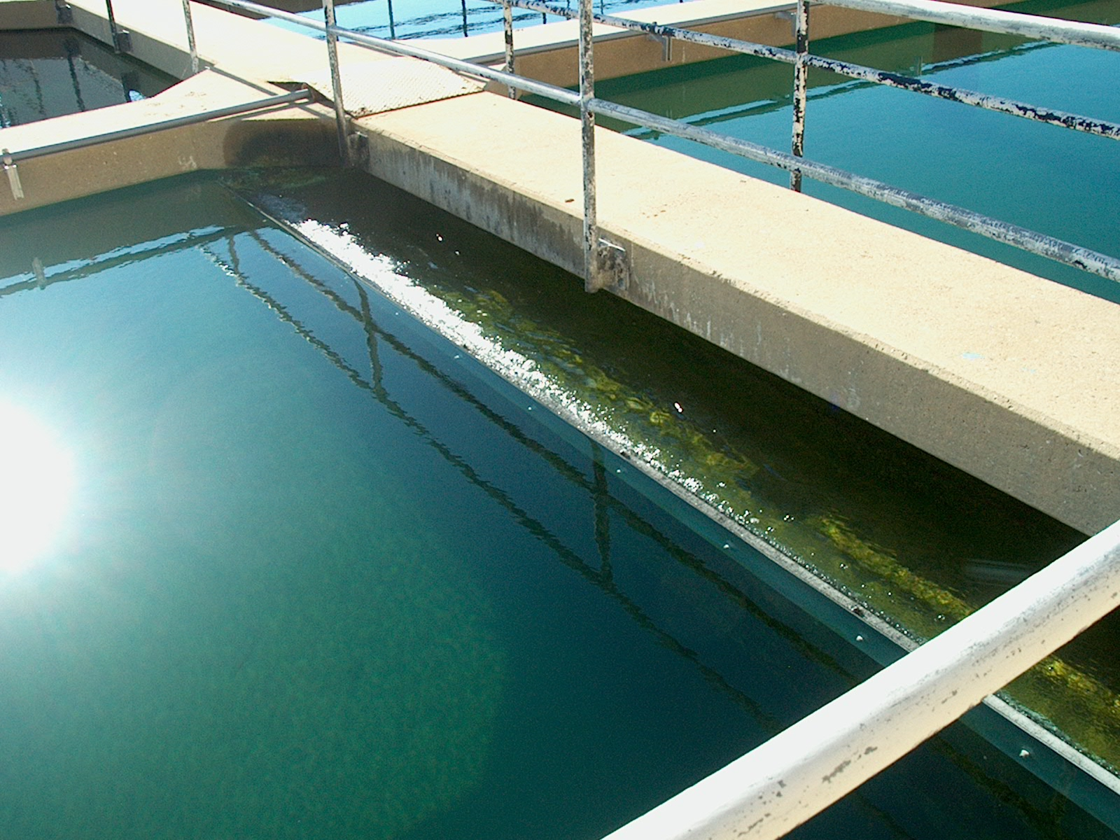
Baffles and Weir in Sedimentation Basin.

Slide 20
Once in the filter area the water passes through the filters by way
of gravity. The filters we have are dual media filters with anthracite
and sand with gravel underneath.

Slide 21
After the filters ammonia and chlorine is added to the filtered water for disinfection and the water then enters the underground clearwell going to the storage tanks and then pumped into the distribution system.

Slide 22
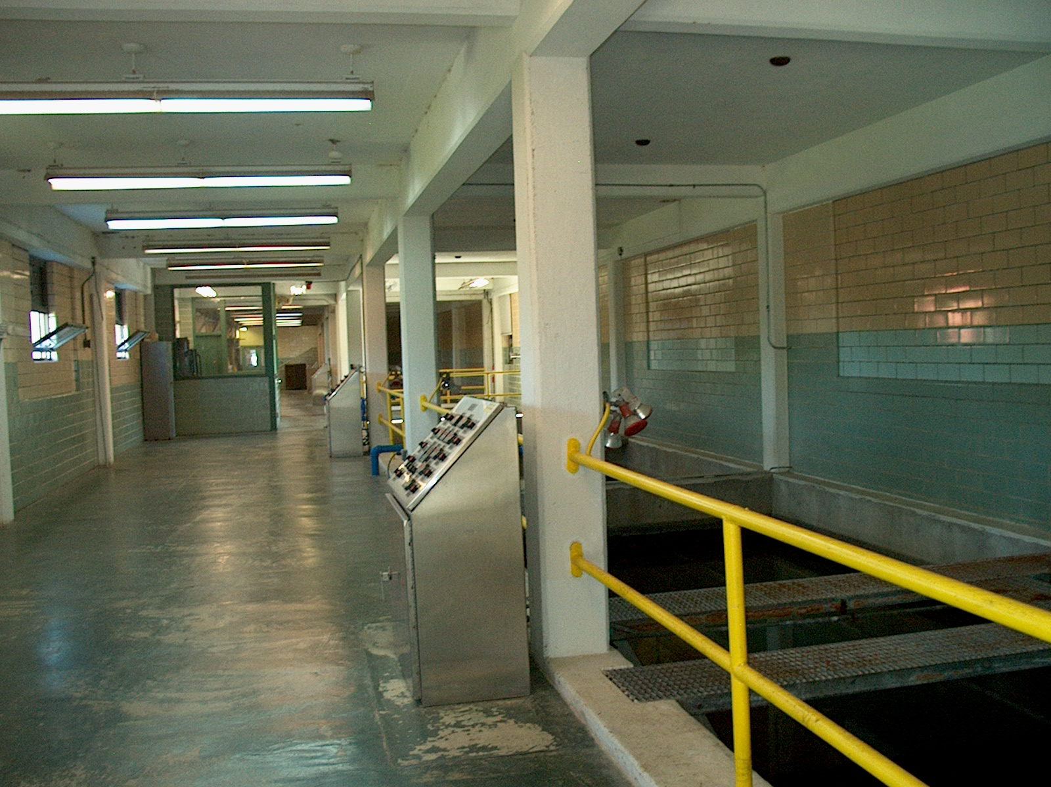
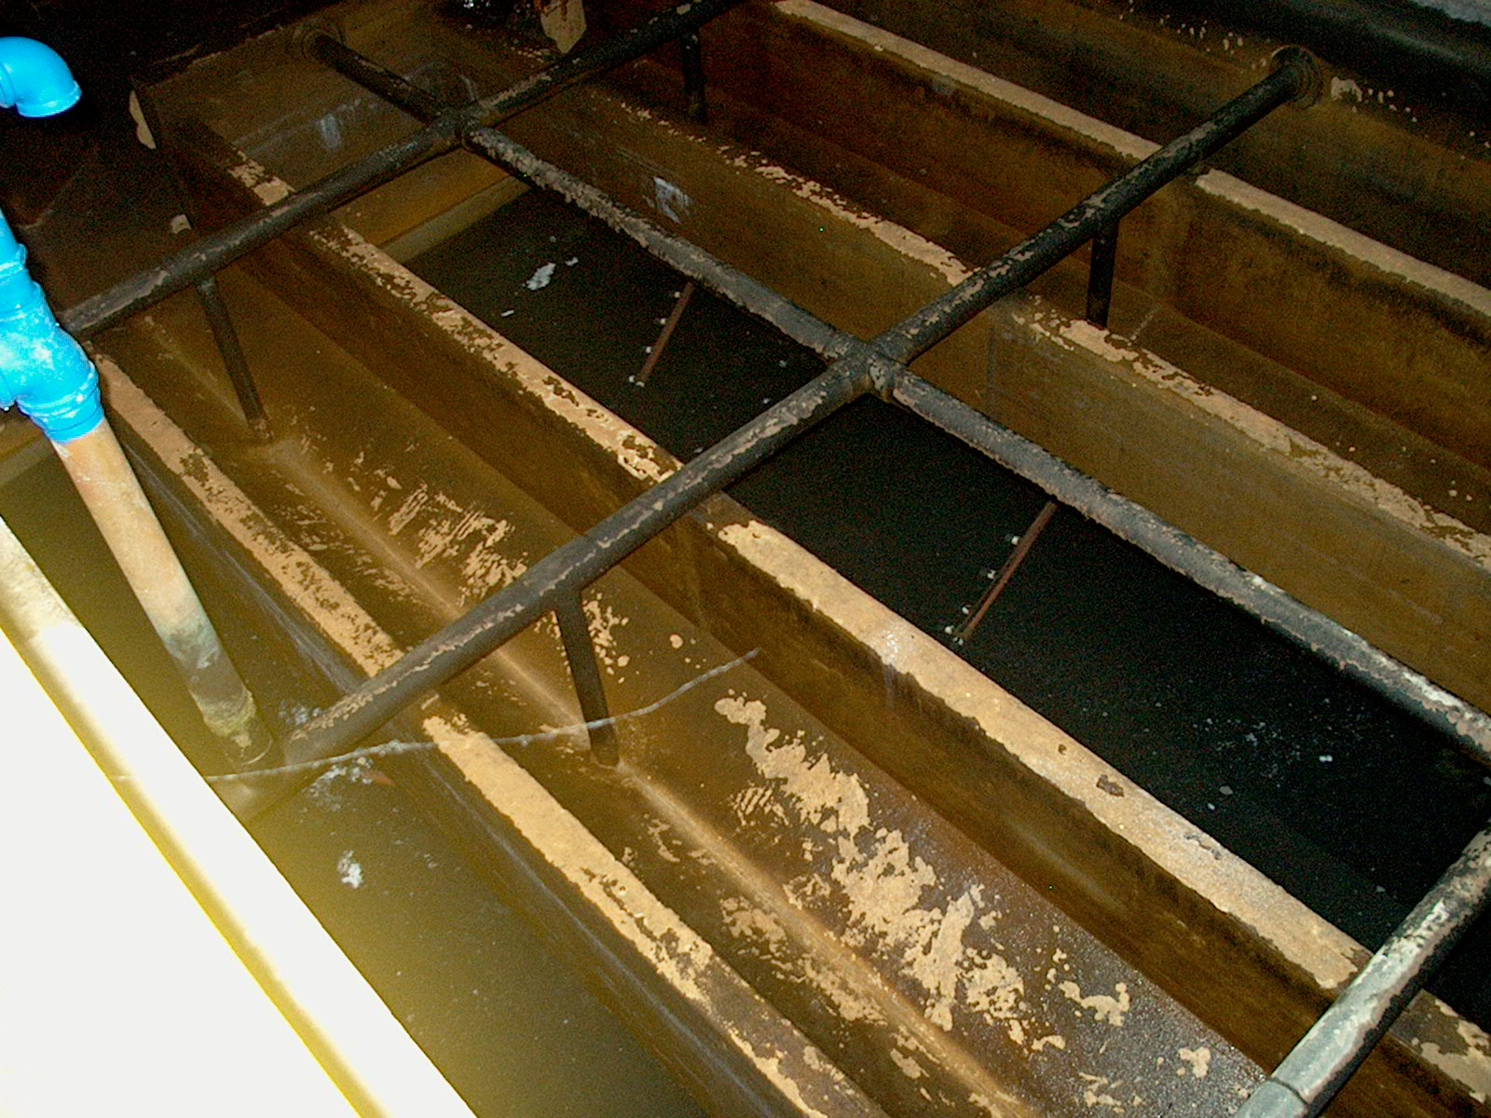
Filter Gallery & Filter

Slide 23
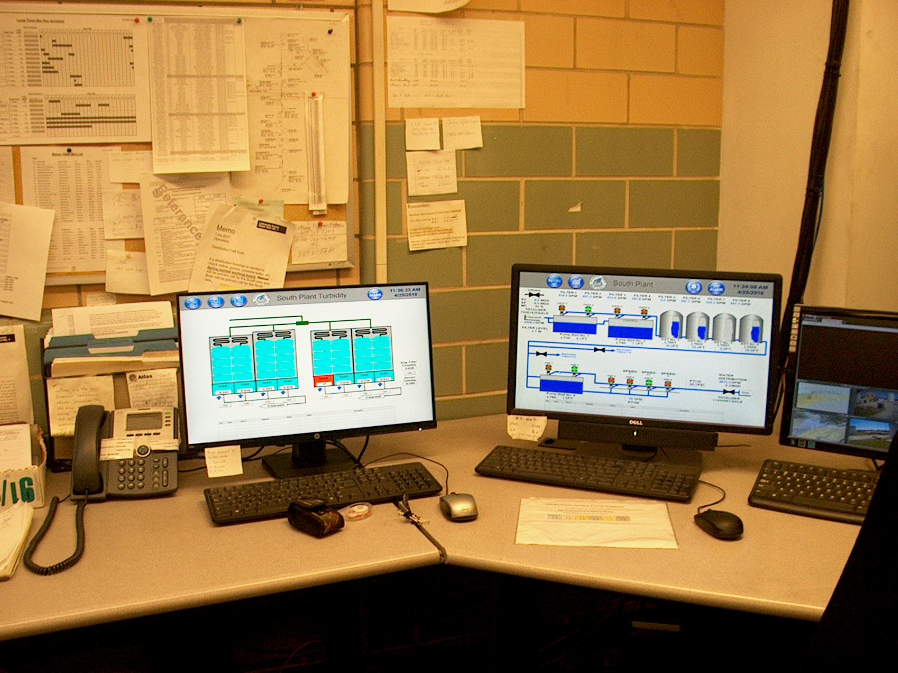
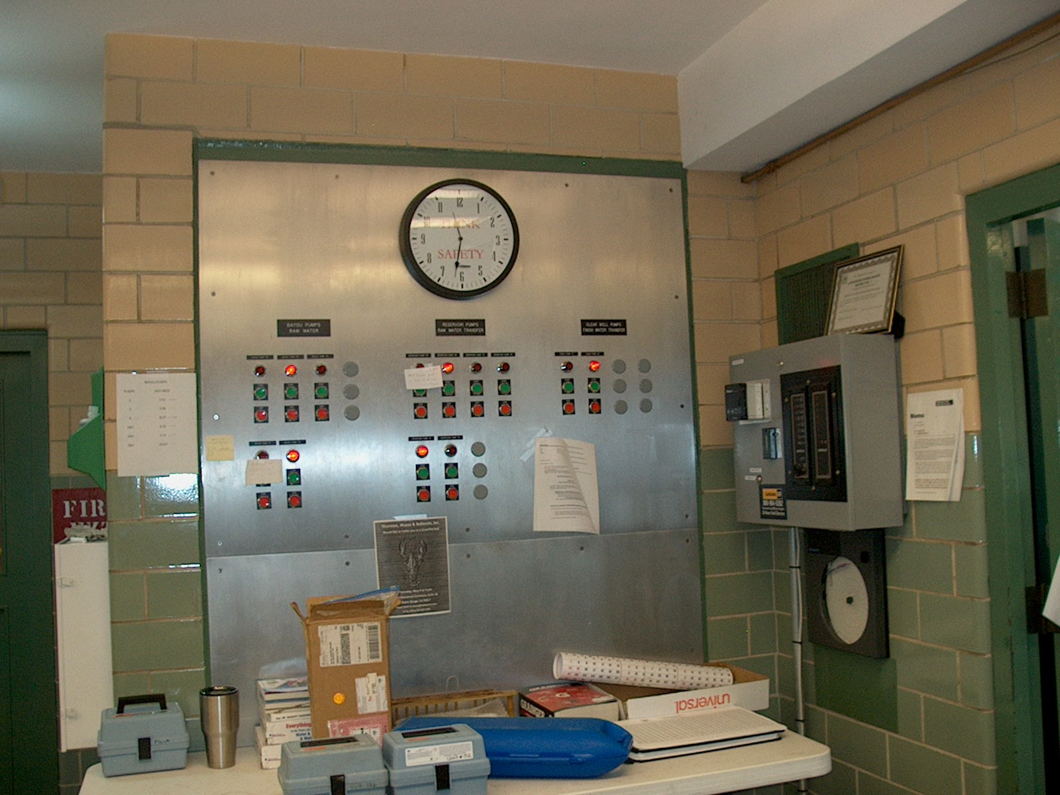
Controls in Operator Control Room

Slide 24
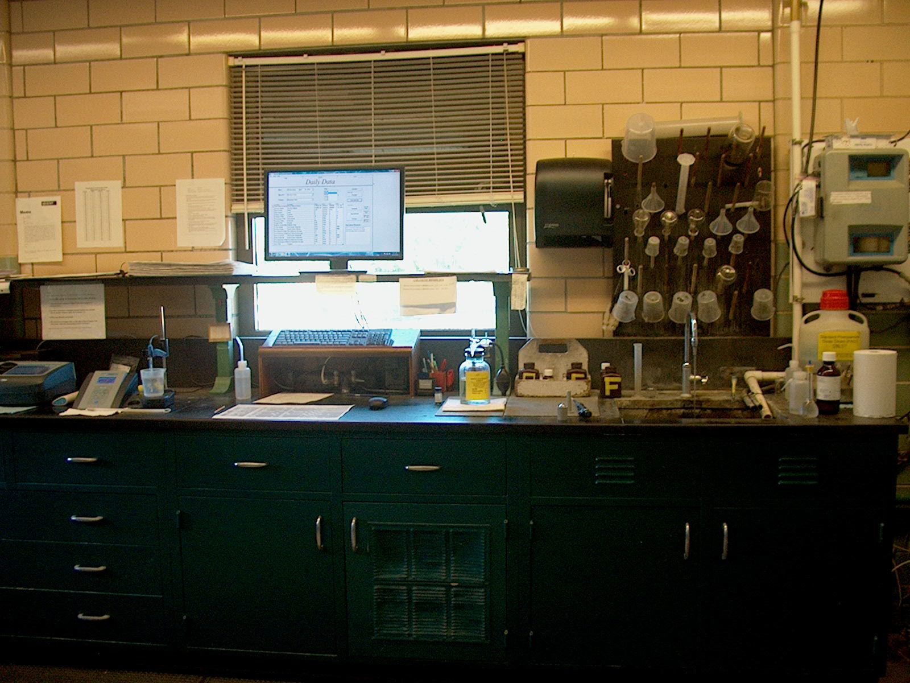
Lab at South Plant

Slide 25
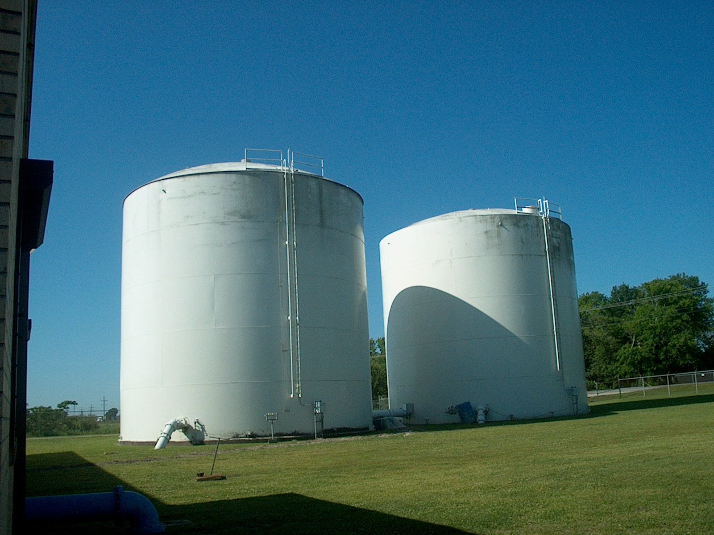
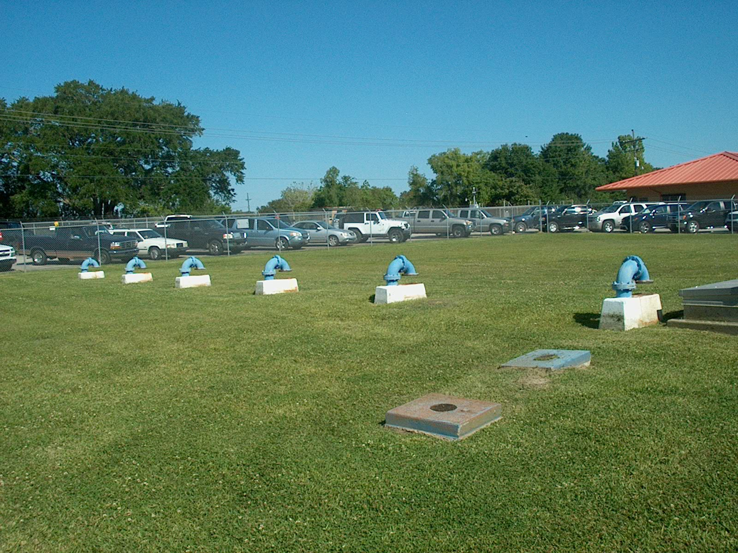
2 – 500,000 Gallon Storage Tanks
& Vents for Underground Clearwell

Slide 26
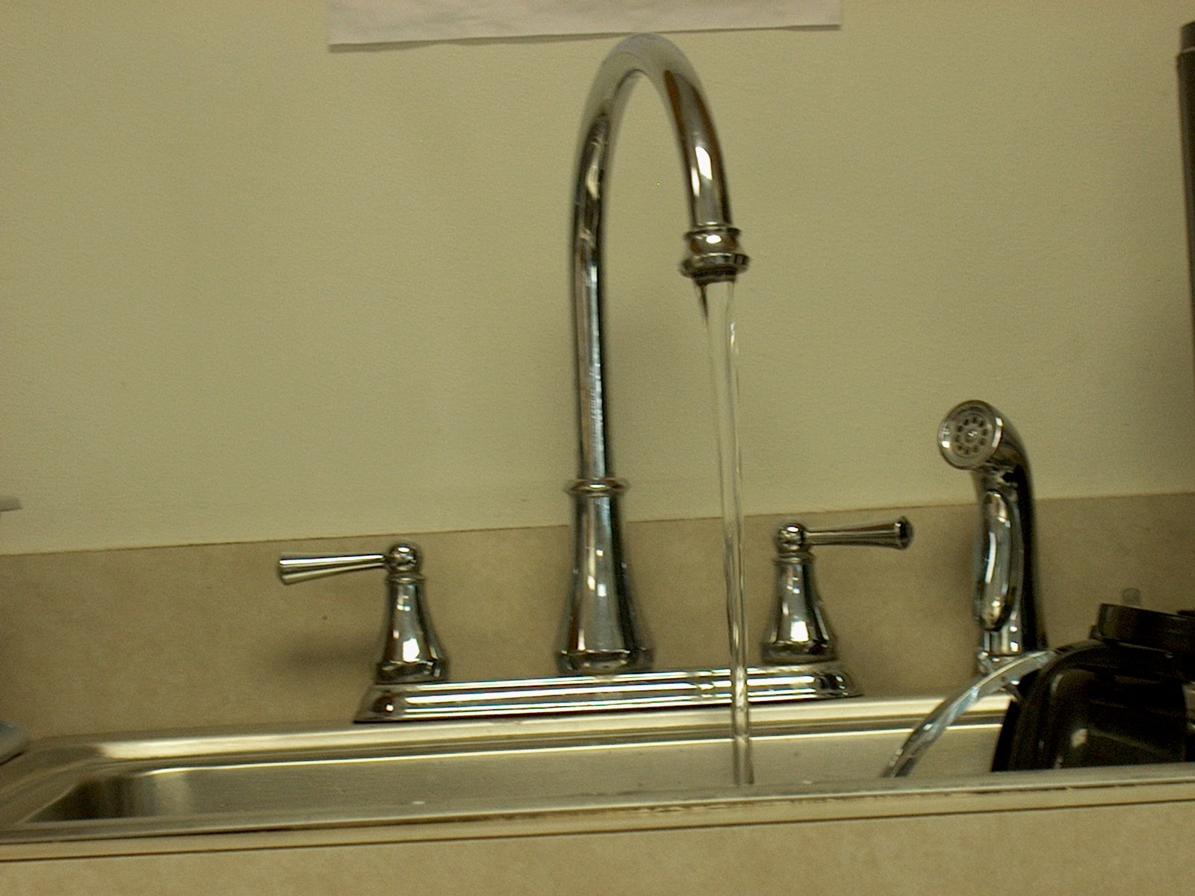
Finished Product – Water meeting all requirements of the federal and state agencies.

