Slide 1

BTNEP CCMP Revision Update
November 2, 2017
BTNEP Management Conference Meeting

Slide 2
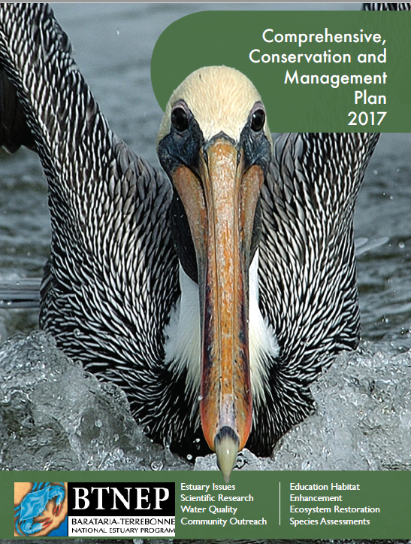
The New BTNEP CCMP
COMING SOON!

Slide 3
EPA Requirements for CCMP Revision
Summary
Reminders
EPA Provided a Content Checklist
  Changes from Old CCMP
  Maps
  Program Structure
  CCMP Action Plans
  Monitoring
  Finance
  Habitat Protection and Restoration
EPA is not prescribing any particular format
CCMP must just meet Content Checklist
EPA Region (i.e. Doug) is the lead on the process
Doug is working with EPA Headquarters

Slide 4
QUICK REVIEW OF EACH CHAPTER
Providing Guidance Document for the BTNEP Organization
And A Context for the Public

Slide 5
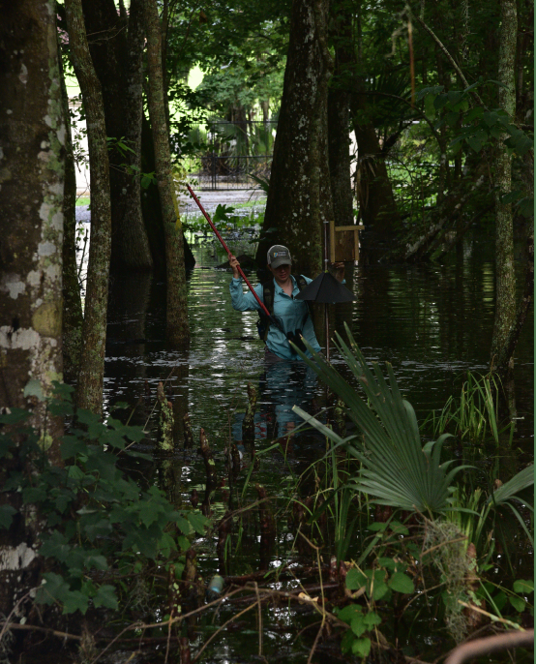
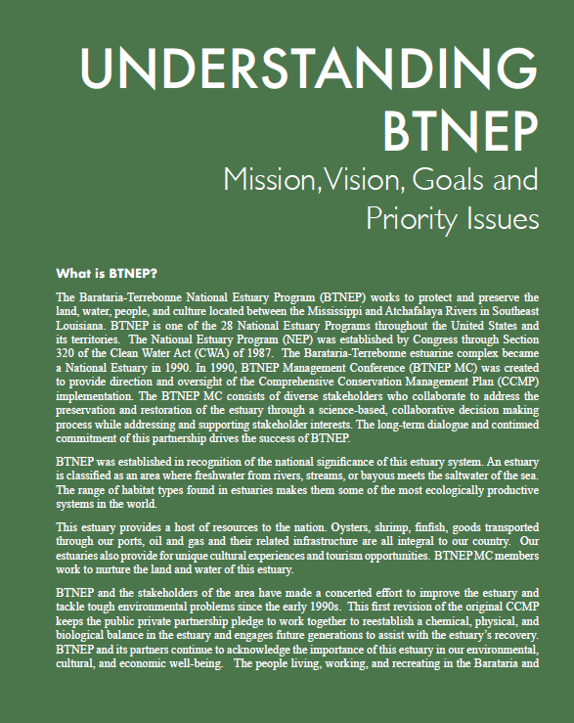
CHAPTER 1 UNDERSTANDING BTNEP
What is BTNEP
Mission
Vision
Goals

Slide 6
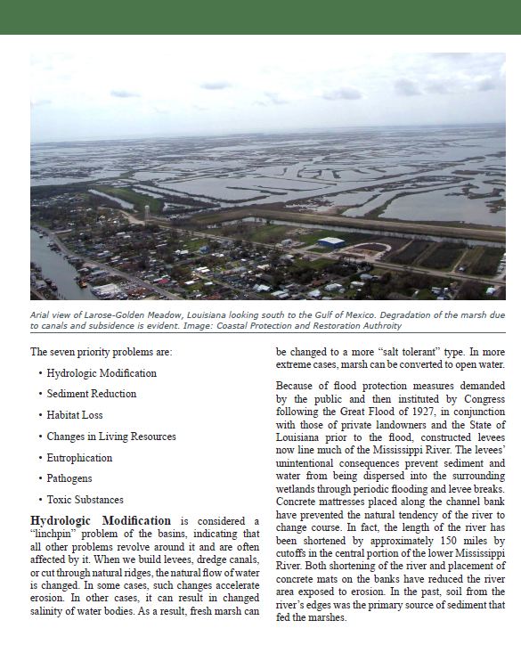
CHAPTER 1 UNDERSTANDING BTNEP
BTNEP Priority Issues
Hydrologic Modification
Sediment Reduction
Habitat Loss
Changes in Living Resources
Eutrophication
Pathogens
Toxic Substances

Slide 7
Chapter 2 Habitats of BTNEP
Upland to the Coast
Agricultural Lands
Forests
Swamps
Marshes
Bayous
Levees
Ridges
Bays
Barrier Islands
Urban and Rural Communities

Slide 8
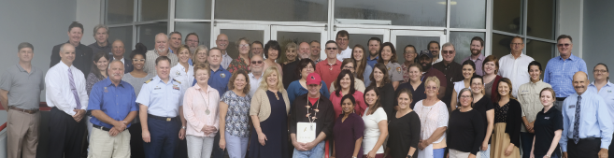
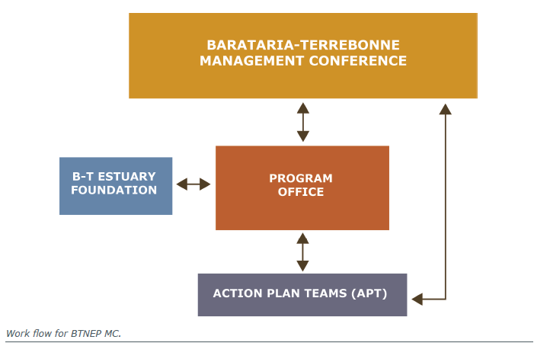
CHAPTER 3
BTNEP MC and
BTNEP Program Staff
The BTNEP Management Conference
Importance of the MC
BTNEP MC Members
BTNEP Structure
BTNEP Program Office

Slide 9
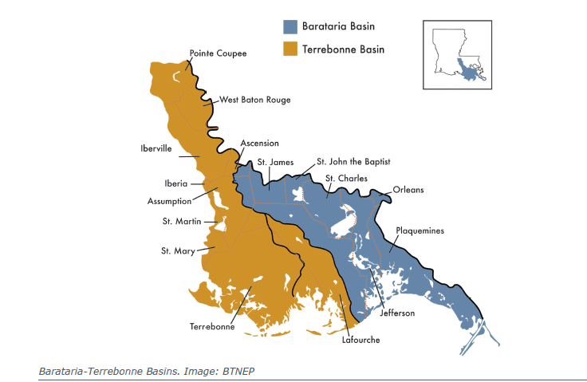
Maps

Slide 10
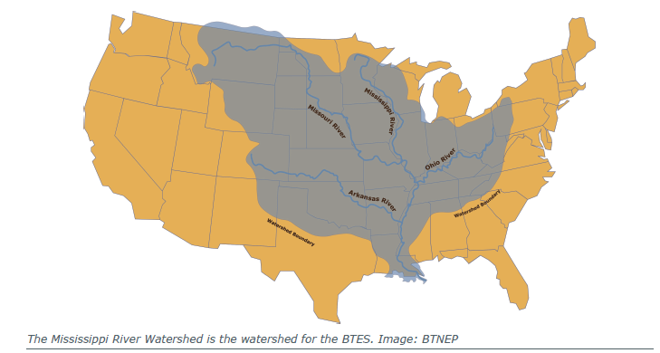

Slide 11
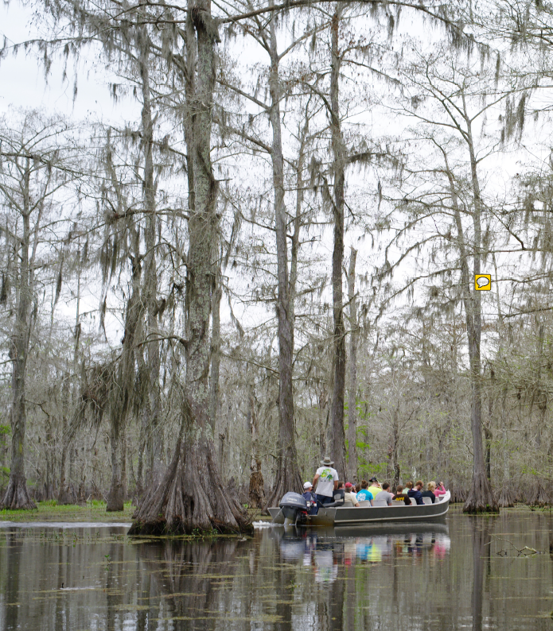
Chapter 5 BTNEP Action Plans
Coordinated Planning and Implementation
Ecological Management
Sustained Recognition and Citizen Involvement
Economic Growth

Slide 12
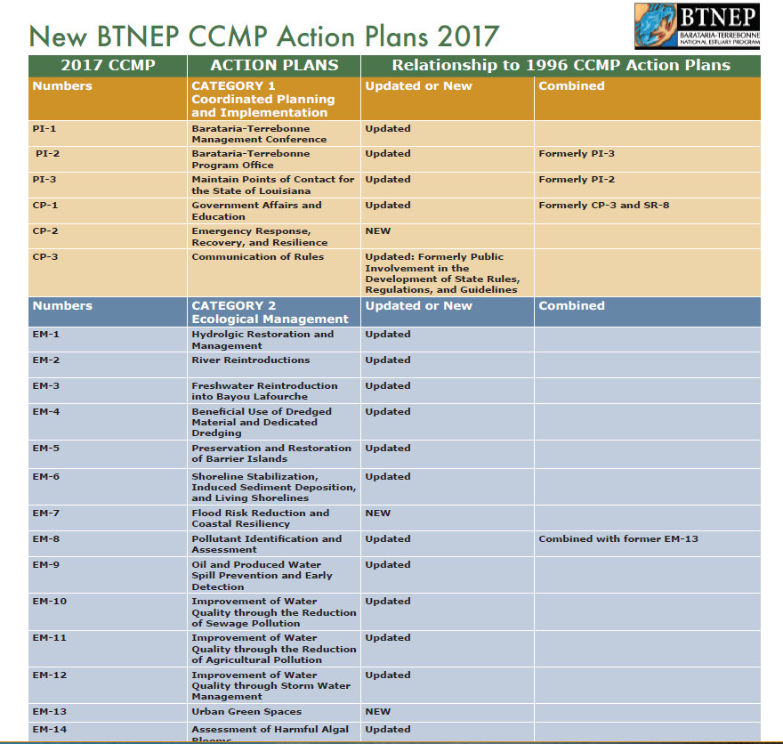

Slide 13
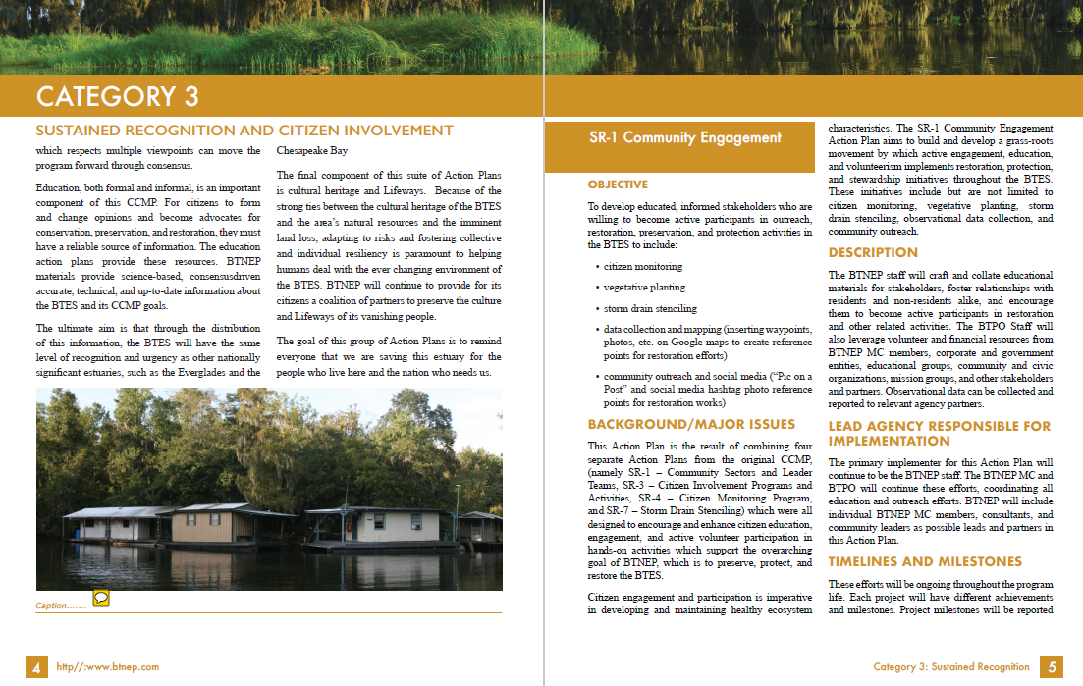

Slide 14
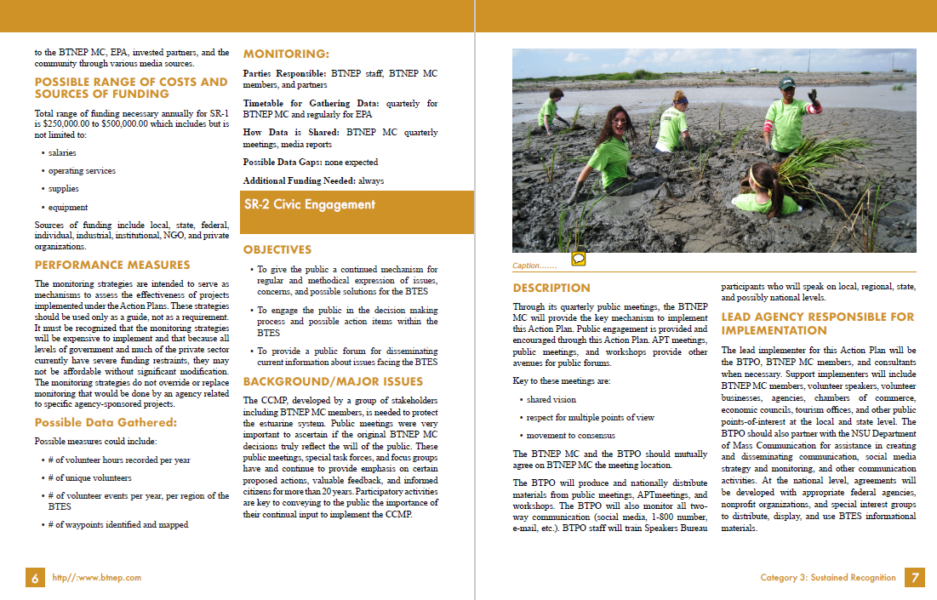

Slide 15
Chapter 6 Finance Strategy
EPA Section 320
State of Louisiana
BTEF
Other Sources

Slide 16
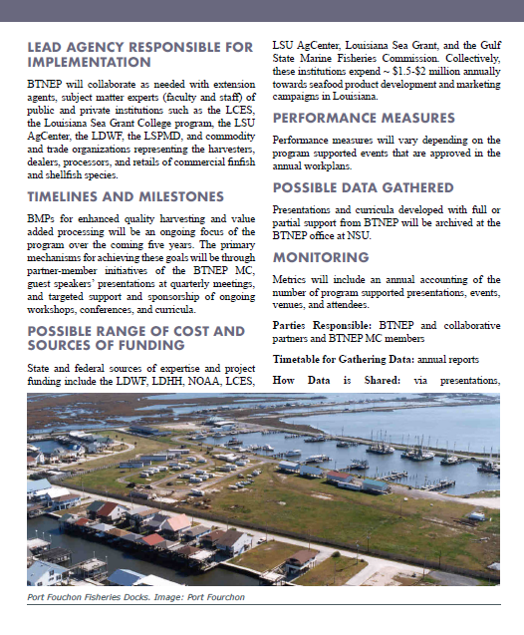
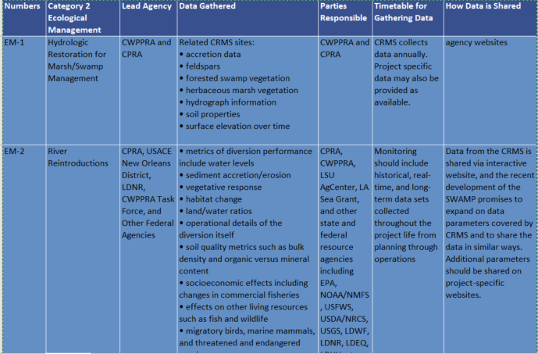
CHAPTER 7 - MONITORING PLAN TECHNICAL SUMMARY
Summary of monitoring as described in each of the Action Plans

Slide 17
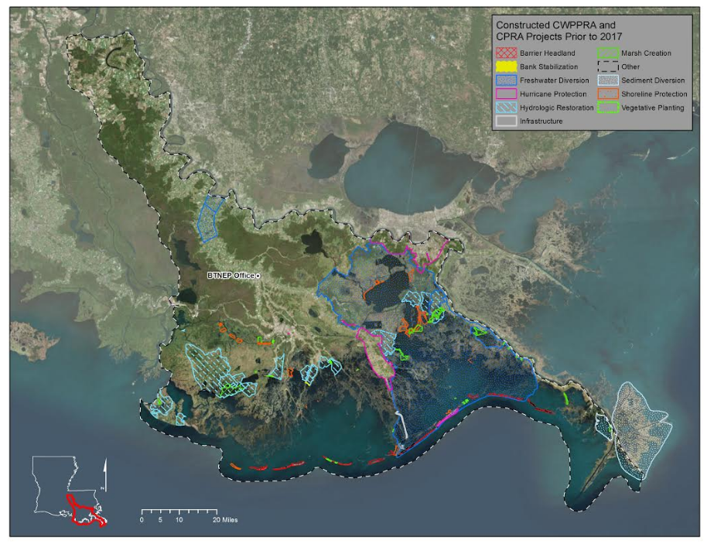
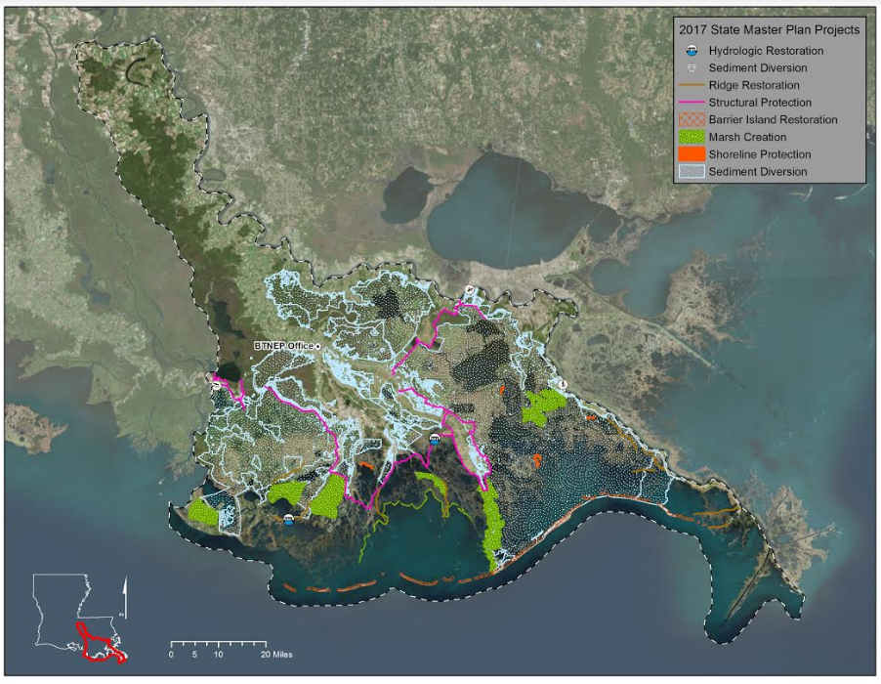
CHAPTER 8 – HABITAT PROTECTION AND RESTORATION STRATEGY
Summary of the Action Plans Addressed in Ecological Management Action Plans

Slide 18
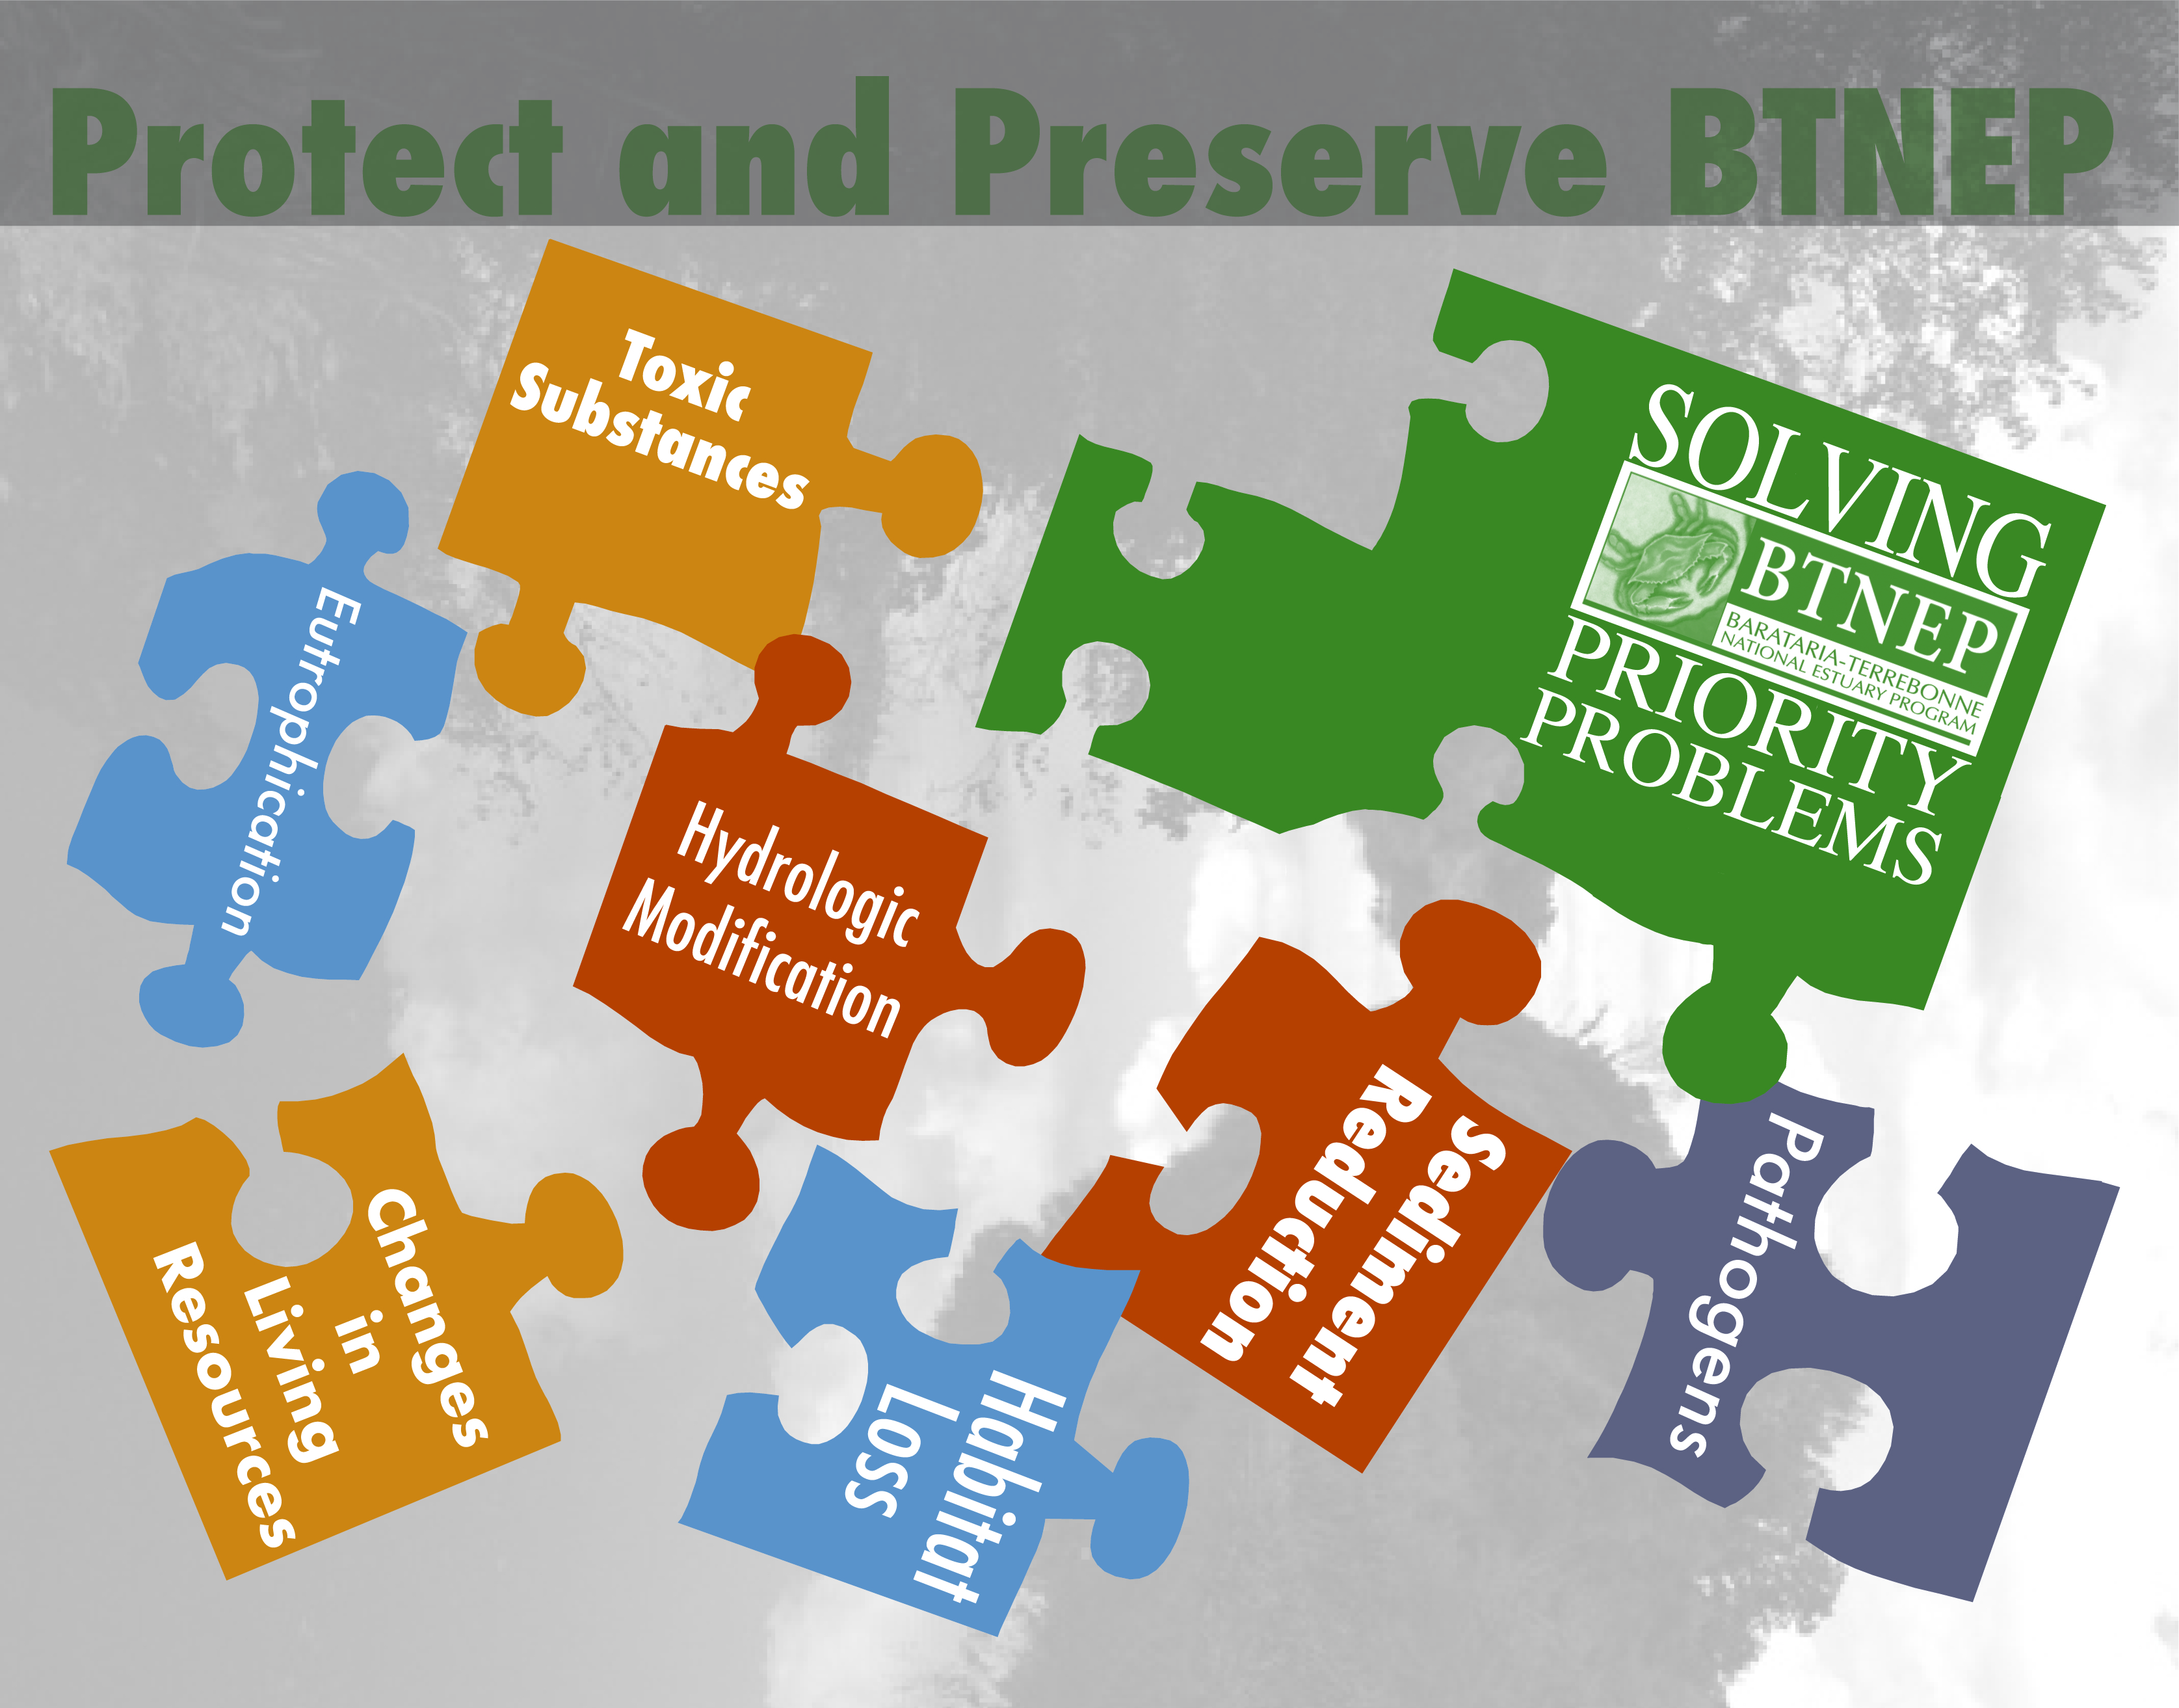
TEAM EFFORT
BTNEP MC
ACTION PLAN TEAMS
COMMITTEE CHAIRS
COMMITTEE MEMBERS
BTNEP STAFF
CONTRACTORS
  KERI TURNER
  PHYLLIS LEAR
  HANNAH FULTON

Slide 19
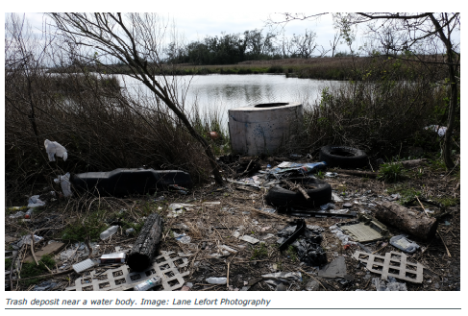

REMAINING ACTIVITIES
COMPLETE EM-18 DRINKING WATER
COMPLETE MONITORING SUMMARY SECTION
COMPLETE HABITAT RESTORATIN SUMMARY
COMPLETE GRAMMATICAL EDITS
COMPLETE LAYOUT AND DESIGN
POST FOR 2 WEEK REVIEW BY BTNEP MC
POST FOR 60 DAY REVIEW BY PUBLIC
EPA REVIEW

Slide 20
