Slide 1
NEW Louisiana Science Standards
Louisiana Science Teachers Association
Nathan Cotten, LSTA President

Slide 2
Background
Current benchmarks were adopted in May 1997.
GLE’s were written in 2004.
The comprehensive curriculum for science was last updated in 2008 under Paul Pastorek.
A Framework for K-12 Science Education published in 2012.
NGSS (Next Generation Science Standards) were released in 2013.
BESE approved the adoption of new Louisiana Student Standards for Science, March 8, 2017.

Slide 3
The Need For New Standards
Why did we need new science standards?
Recent studies have shown that students begin forming complex ideas and explanations at an early age.
Research has shown that content and the process of learning must be taught in tandem.
Research has proven that depth is more important to student learning than breadth.
https://www.slideshare.net/djharland/ngss-070913-wip5-actual-copy

Slide 4
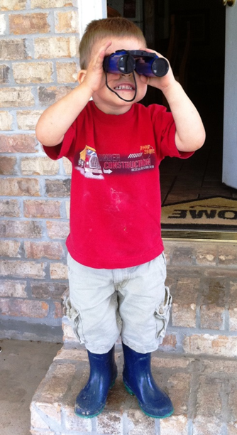
Standards Are Based on the Framework
Children are born investigators
Understanding builds over time
Science and engineering require both knowledge and practice
Connect content to students’ interests and experiences
Content is connected across ALL disciplines
Express ideas grounded in scientific evidence
Prepare students to be scientific literate citizens (college and career ready)
A Framework for K-12 Science Education

Slide 5
Where can I find the new science standards?
http://www.louisianabelieves.com/resources/library/academic-standards
Be sure to select LSS science standards for your grade/subject.

Slide 6
Domains
Louisiana Science Standards are broken down into 5 domains.
Physical Science (PS)
Life Science (LS)
Earth and Space Science (ESS)
Environmental Science (EVS)
Engineering, Technology and Applications of Science (ETS)
Notes:
Mention that ETS only a few standards with this domain.

Slide 7
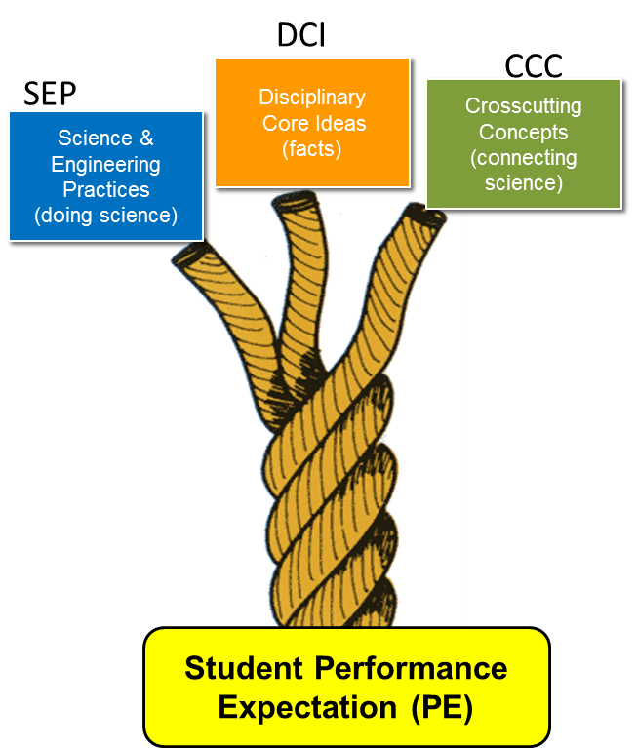
3-Dimensional Learning
Science and Engineering Practices (SEP)
Disciplinary Core Ideas (DCI)
Crosscutting Concepts (CCC)
http://www.nextgenscience.org/three-dimensions

Slide 8
Performance Expectation: Definition
Performance Expectations represent what the students should know and be able to do to be proficient in science.
Performance Expectations are built using all three dimensions:
Science and Engineering Practices
Disciplinary Core Ideas
Crosscutting Concepts
All components are a part of each standard providing clarity and guidance for instructors.

Slide 9
Notes:
Pass out standard, HS-LS1-3

Slide 10
Science and Engineering Practices
The 8 science and engineering practices are:
Ask questions (science) and define problems (engineering)
Develop and use models
Plan and conduct investigations
Analyze and interpret data
Use mathematical and computational thinking
Construct explanations (science) and design solutions (engineering)
Engage in scientific argument from evidence
Obtain, evaluate, and communicate information

Slide 11
Practices in Different Disciplines
Math M1. Make sense of problems and persevere in solving them. M2. Reason abstractly and quantitatively. M3. Construct viable arguments and critique the reasoning of others. M4. Model with mathematics. M5. Use appropriate tools strategically. M6. Attend to precision. M7. Look for and make use of structure. M8. Look for and express regularity in repeated reasoning. | Science S1. Asking questions (for science) and defining problems (for engineering). S2. Developing and using models. S3. Planning and carrying out investigations. S4. Analyzing and interpreting data. S5. Using mathematics, information and computer technology, and computational thinking. S6. Constructing explanations (for science) and designing solutions (for engineering). S7. Engaging in argument from evidence. S8. Obtaining, evaluating, and communicating information. | English Language Arts E1. They demonstrate independence. E2. They build strong content knowledge. E3. They respond to the varying demands of audience, task, purpose, and discipline. E4. They comprehend as well as critique. E5. They value evidence. E6. They use technology and digital media strategically and capably. E7. They come to understand other perspectives and cultures.
Notes:
Here’s a listing of the practices for math, ELA and Science -- key intellectual practices. Each somewhat different by discipline – as you might expect … but there are some striking commonalities.
Ask the group to look and process the practices for the three disciplines, all some think time and then as the group to discuss with shoulder partners and full table. Ask a couple tables for what they notice.

Slide 12
Disciplinary Core Ideas: Definition
Represent a set of ideas that have broad importance across multiple disciplines; provide a key tool for understanding or investigating more complex ideas and solving problems; relate to the interests and life experiences of students; be teachable and learnable over multiple grades at increasing levels of sophistication.
Each DCI describes what students are supposed to know by the end of the grade level and requires prior knowledge/experience.
Disciplinary Core Ideas are grouped into five domains:
Physical Science (PS)
Life Science (LS)
Earth and Space Science (ESS)
Environmental Science (EVS)
Engineering, Technology, and Applications of Science (ETS)

Slide 13
Crosscutting Concepts
The 7 crosscutting concepts are:
Patterns
Cause and Effect: Mechanisms and explanations
Scale, Proportion, and Quantity
Systems and System Models
Energy and Matter: Flows, cycles, and conservation
Structure and Function
Stability and Change

Slide 14
Summary of LSS Parts
Coding and Descriptor (example: 2-PS1-3 Matter and Its Interactions)
Performance Expectation: States what students should be able to do to demonstrate that they have met the standard. Performance expectations are built on the foundation of the science and engineering practices, disciplinary core ideas, and crosscutting concepts.
Clarification Statement: Provides examples or additional clarification of the performance expectation.
Science and Engineering Practices: Detail the behaviors that students should engage in that mimic those of scientists and engineers. | Disciplinary Core Ideas: Describe the most essential ideas (content) in the major science disciplines. | Crosscutting Concepts: Ideas that have applications across all areas of science.

Slide 15
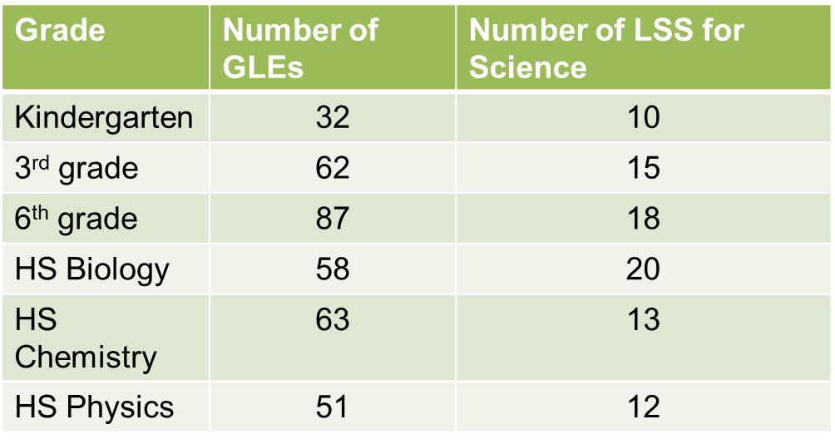
Depth vs. Breadth
Notes:
Identify fewer standards

Slide 16
Louisiana Student Standards for Science
The new standards call for changes in the science classroom. Key shifts called for by the Louisiana Student Standards for Science:
Apply content knowledge | Content knowledge is critical and evident in the standards in the Disciplinary Core Ideas, the key ideas in science that have broad importance within or across multiple science or engineering disciplines. However, simply having content knowledge is not enough. Students must investigate and apply content knowledge to scientific phenomenon.
Investigate, evaluate, and reason scientifically | Scientists do more than learn about science; they “do” science. Science instruction must integrate the practices, or behaviors, of scientists and engineers as they investigate real-world phenomenon and design solutions to problems.
Connect ideas across disciplines | For students to develop a coherent and scientifically-based view of the world, they must make connections across the domains of science (life science, physical science, earth and space science, environmental science, and engineering, technology, and applications of science). The crosscutting concepts have applications across all domains.
Three Dimensional Learning: the integration of the Science and Engineering Practices, Disciplinary Core Ideas, and Crosscutting Concepts in science instruction
Contact LouisianaStandards@la.gov with questions.

Slide 17
Louisiana Student Standards for Science
The Department will provide multiple phases of support as districts and teachers work to implement the Louisiana Student Standards for Science.
PHASE | TIMELINE | FOCUS
Phase 1 | Spring – Summer 2017 | Framework and make-up of the standards Shifts in science instruction Progressions of learning
Phase 2 | Fall 2017 | Educators begin implementation of the new standards, practice implementing aligned tasks, pilot 3-dimensional lessons LDOE releases scope and sequence documents, revised instructional tasks, sample EAGLE items
Phase 3 | Spring –Summer 2018 | Quality curriculum piloted Suite of assessment items/item sets released on EAGLE Field test in grades 3-8
Contact LouisianaStandards@la.gov with questions.
Notes:
*The trainings you are doing at the Summit, as well as those held over the summer will all focus on Phase 1. Be clear about this to participants.

Slide 18
Louisiana Student Standards for Science
Area | Support and Timeline
Assessment Email assessment@la.gov with questions | Previous RFP secured vendor for assessment development Field test for grades 3-8 – Spring 2018 Operational test – Spring 2019 Platform the same as ELA, Math, Social Studies, and EAGLE EAGLE Assessment Tool Teacher Leader Advisors, who will help create sample assessment items, hired and trained Summer 2017 EAGLE items created throughout the 2017-2018 school year

Slide 20
Questions
Contact Information
Nathan Cotten, nathancotten@tpsd.org
Notes:
Each group should add info

