Slide 1
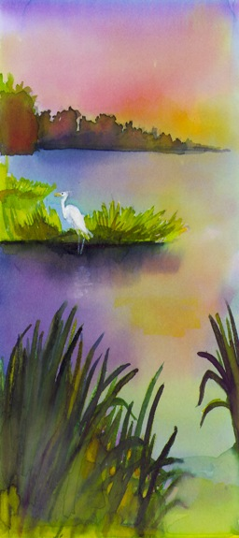


Bayou Lafourche Cleanup 2017

Slide 2


Slide 3

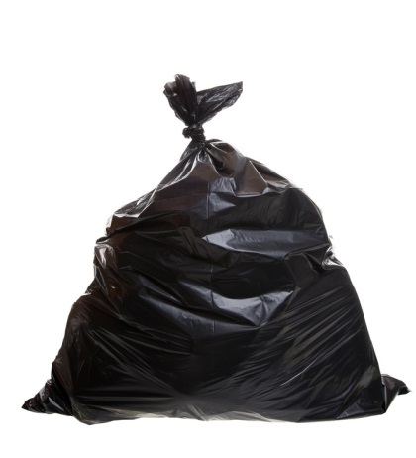

Results from 98/302 tally sheets
Shoreline and Recreational
2719 Plastic Bottles
1929 plastic bags
2281 Plastic food containers
1389 Glass bottles
1669 Aluminum cans
1707 Cup, Plates, forks, spoons, straws
28 Furniture
188 Toys/balls
165 Clothing

Slide 4
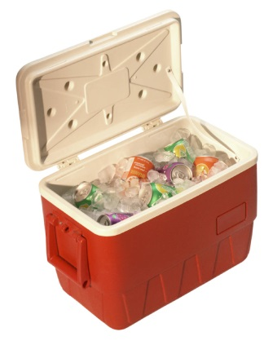

Results from 97/302 tally sheets
Fishing and Boating
181 Bait Containers or lures
78 Traps, nets, and line
52 Ropes or Straps
310 Plastics(tarps, coolers, buckets, etc.)
632 Styrofoam (Buoys/floats, coolers)
Crab traps and crawfish traps

Slide 5
Results from 97/302 Tally Sheets
Smoking Activities
2543 Cigarettes (filters or cigar tips)
320 Lighters/tobacco packaging
2015 results:
2041 Cigarette Butts
438 lighters/packaging

Slide 6
2017 Totals
12,909 Shoreline and Recreational
1,253 Fishing and Boating
2,863 Cigarettes/Packaging
105 Medical Hygiene
587 pieces of trash and dumping
17,717 Total

Slide 7
Comparison to last years
Category | 2012 (# of items) | 2013 | 2014 | 2015 | 2017
Shoreline/Recreational | 33,115 | 19,892 | 24,381 | 22,409 | 12,729
Fishing and Boating | 1851 | 950 | 624 | 3868 | 1251
Smoking Related | 4672 | 1688 | 2447 | 2479 | 2863
Medical/Hygiene | 277 | 186 | 98 | 76 | 104
Dumping Activities | 1269 | 1267 | 5800 | 1477 | 583
Total | 47,953 | 24,003 | 32,929 | 30,309 | 17,530

Slide 8
Dumpster Tonnage
Site | 2012 | 2013 | 2014 | 2015 | 2017
Leeville | 1.03 | 0.55 |  | 3.31
South Lafourche | 0.57 |  | 0.97
South Lockport | 0.73 | 0.92
Lockport | 4.5 | 0.875 | 1.84 | 0.52 | 1.17
Belleview | 1.35 | 5.26 | 5.73 | 6.99 | 9.02
Raceland | 0.84 | 1.83 | 2.51 | 1.51 | 7.46
St Charles | 0.82 |  | 3.88 | 0.72 | 1.04
NSU | 1.42 | 1.94 | 2.88 | 1.40 | 0.67
Thibodaux | 0.31 | 0.54 | 2.42 | 0.61 | 0.46
Bayou Rowing | 0.66 | 0.88 | 1.42 | 1.64 | 0.22
Labadieville | 0.92 | 0.88 | 3.76 | 0.79 | 0.26
Napoleonville | 4.5 | 0.88 |  | 4.50 | 0.13
Donaldsonville | 0.32
Total Tonnage | 17.97 | 14.54 | 25.41 | 21.99 | 20.43

Slide 9
Volunteers
900 Volunteers working this year (2012 – 1300 volunteers, 2013 – 800 volunteers, 2014 – 900, 2015 - 1032)
Site Captains are awesome!
Only 108 Tires! Last year 329 tires!!

Slide 10
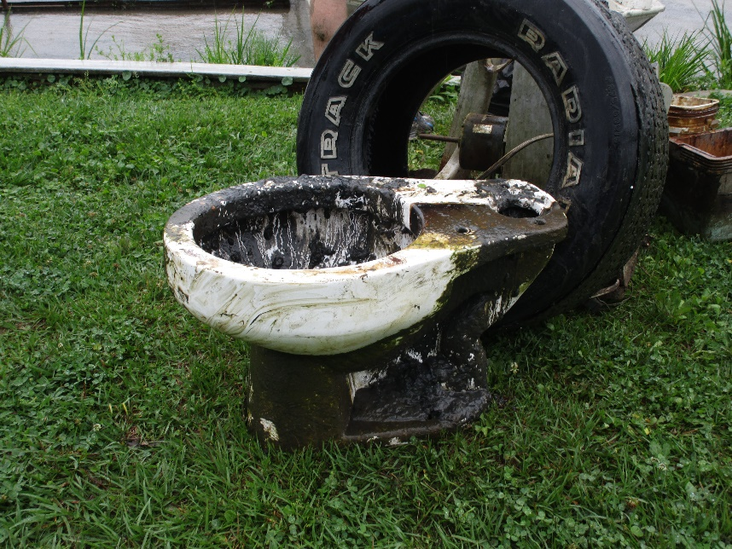
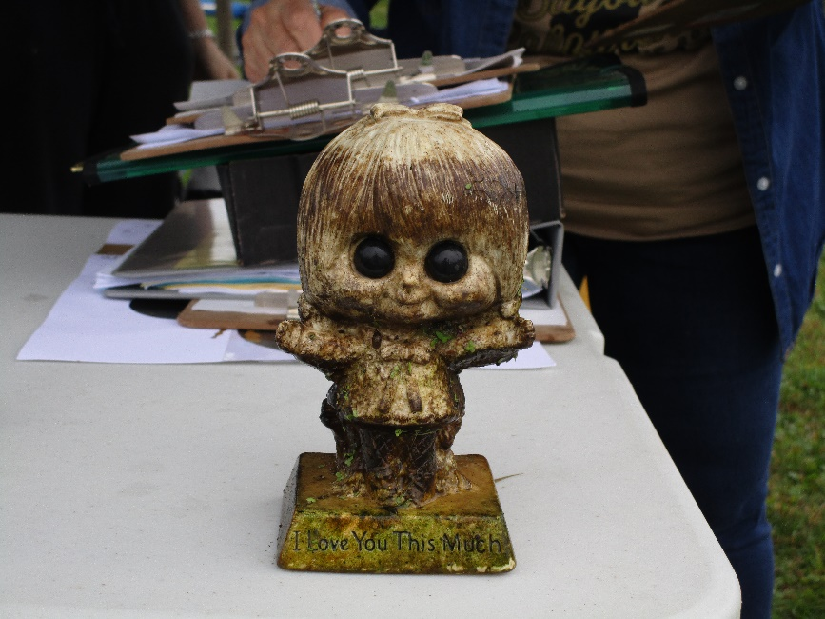
Unusual Items
Lawnmower
Hoses
Cowboy Hat
Campaign Signs (15)
Plastic Flowers
Toilet
Bike seat and bike
Light bulbs
Condom wrappers/box
Kid’s swimming pool
Rear view mirror

Slide 11
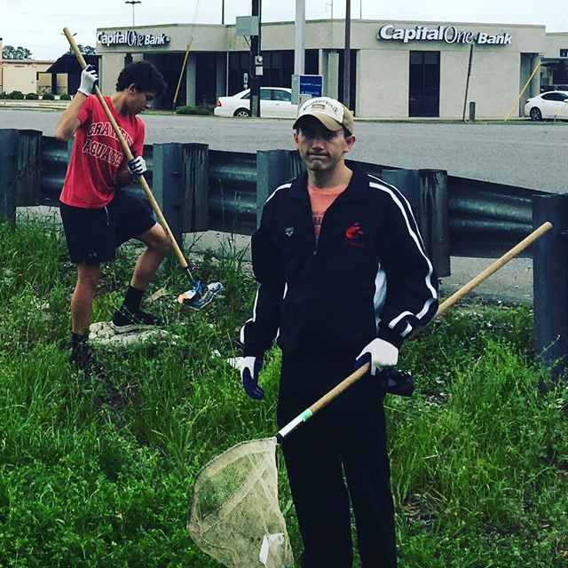
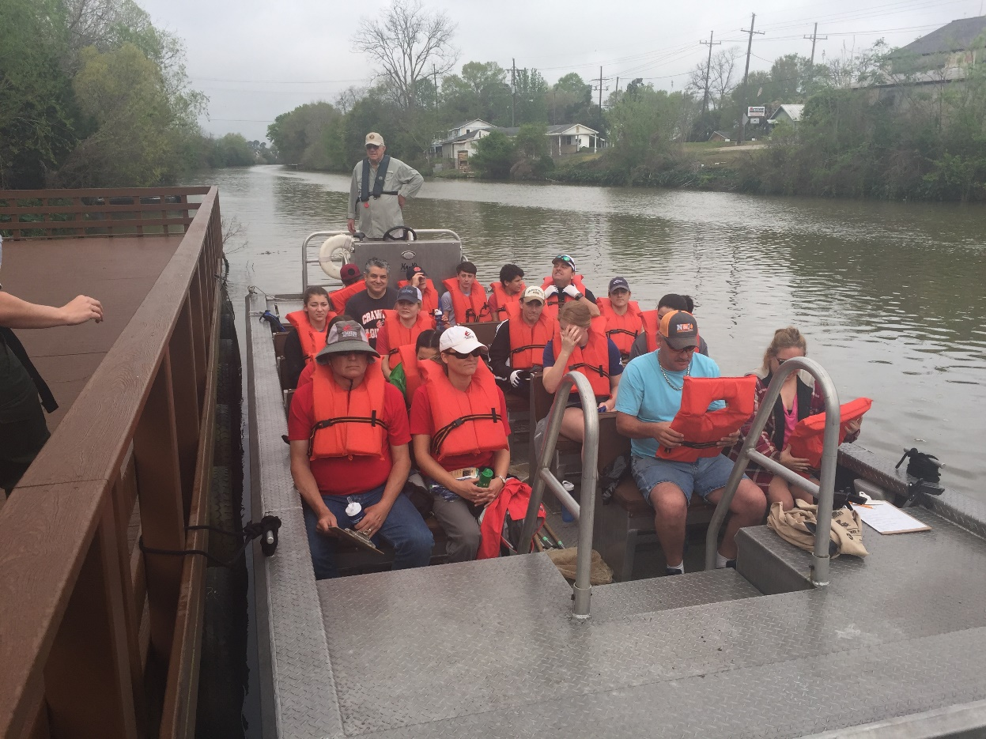
Land and Water Cleanup
Rewarding

Slide 12
Site Captains!
Site | Site Captain Name
Donaldsonville | Sally Cancienne
Napoleonville | Ginger Rushing
Labadieville | Greg Nolan
North Thibodaux | Henry and Hattie Templet
Boy Scout/Girl Scout | Angela Rathle
Percy Brown - St Charles | Alma Robichaux
NSU Bayouside | Allyse Ferrara
St Charles/ North Raceland | Michael Reith
South Raceland | Donald Spahr
North Lockport | Chris Babin
South Lockport | Armand Autin
Cutoff | Peggy Bagala
Leeville | Seth Moncreif

Slide 13
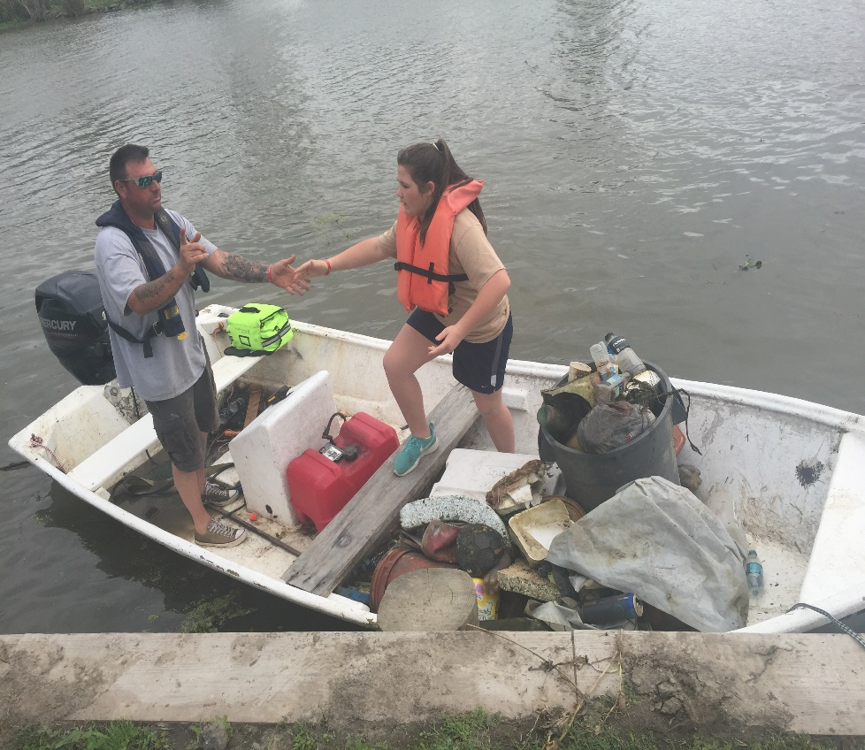
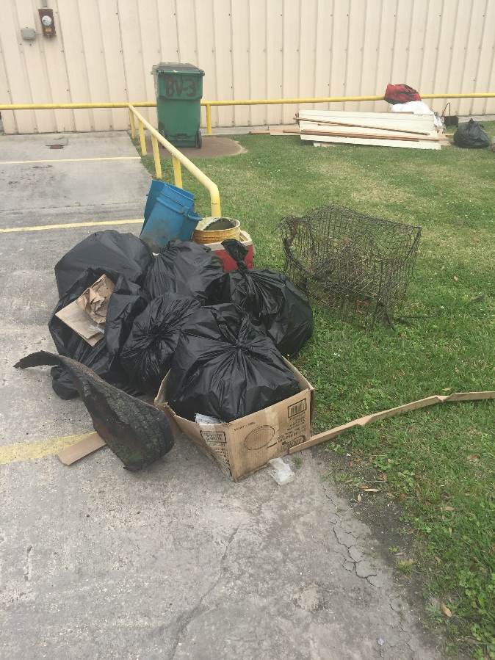
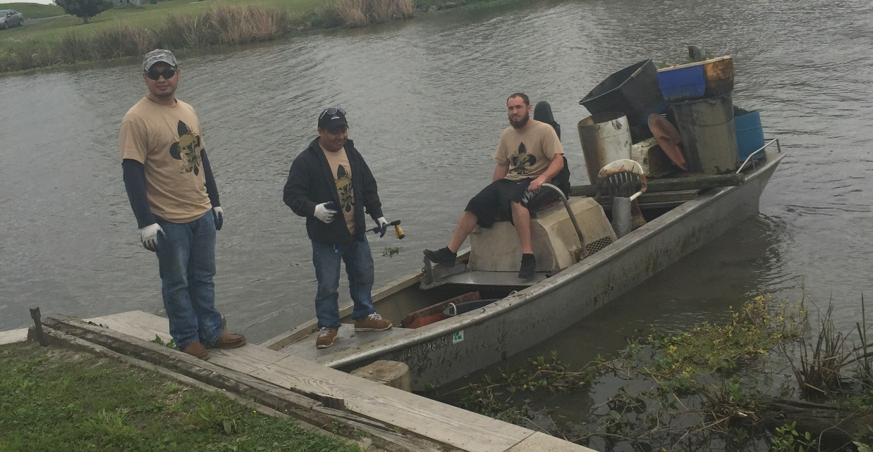
Community
Success

Slide 14
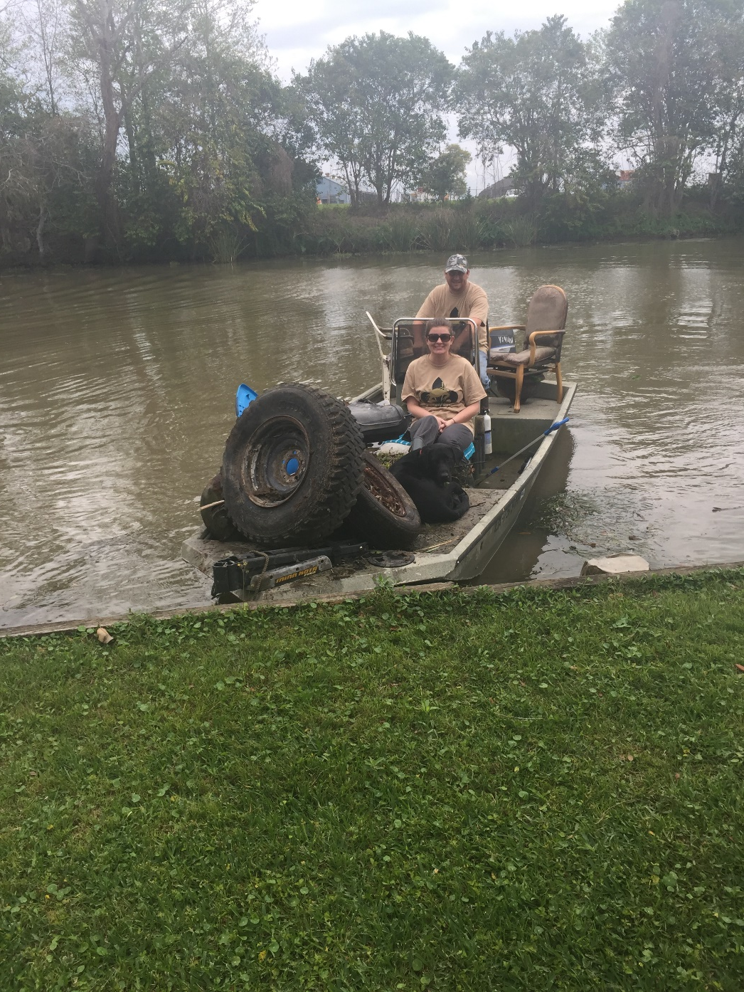
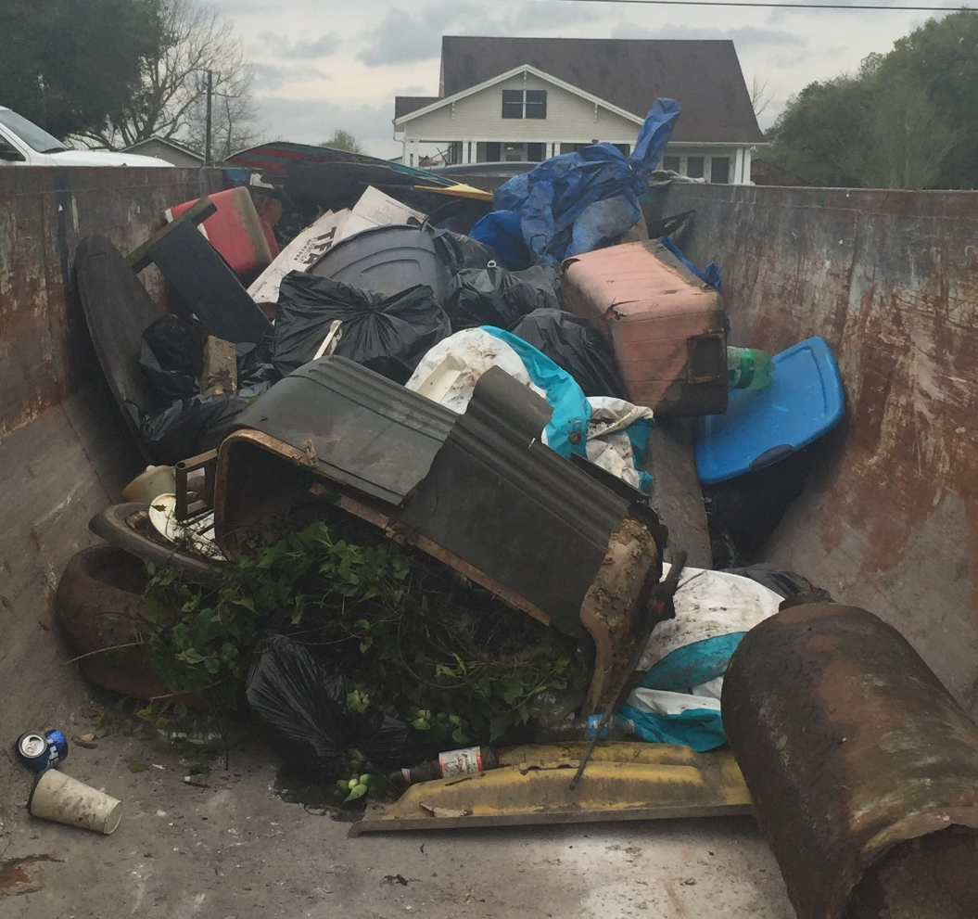

Slide 15
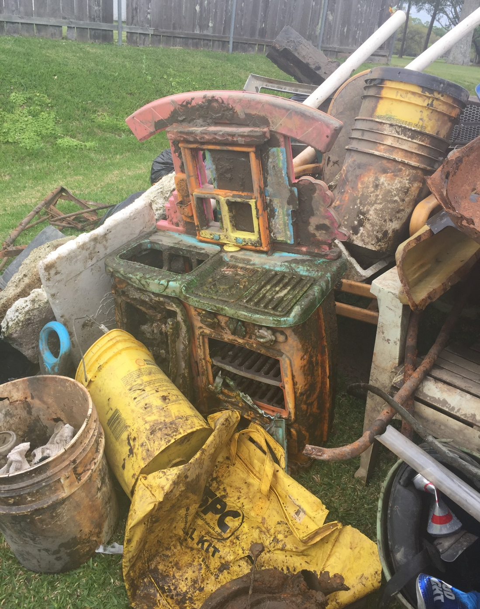
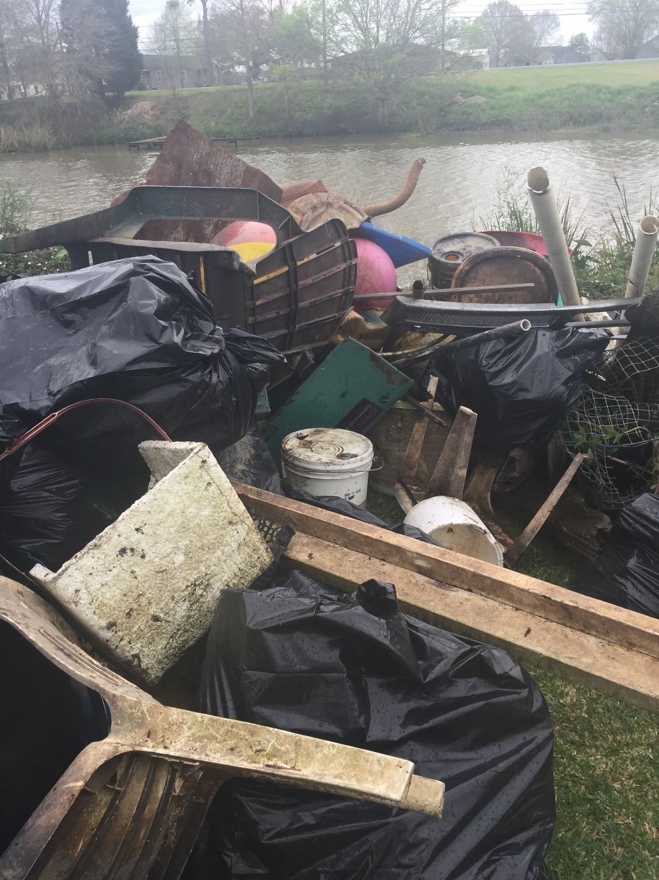

Slide 16
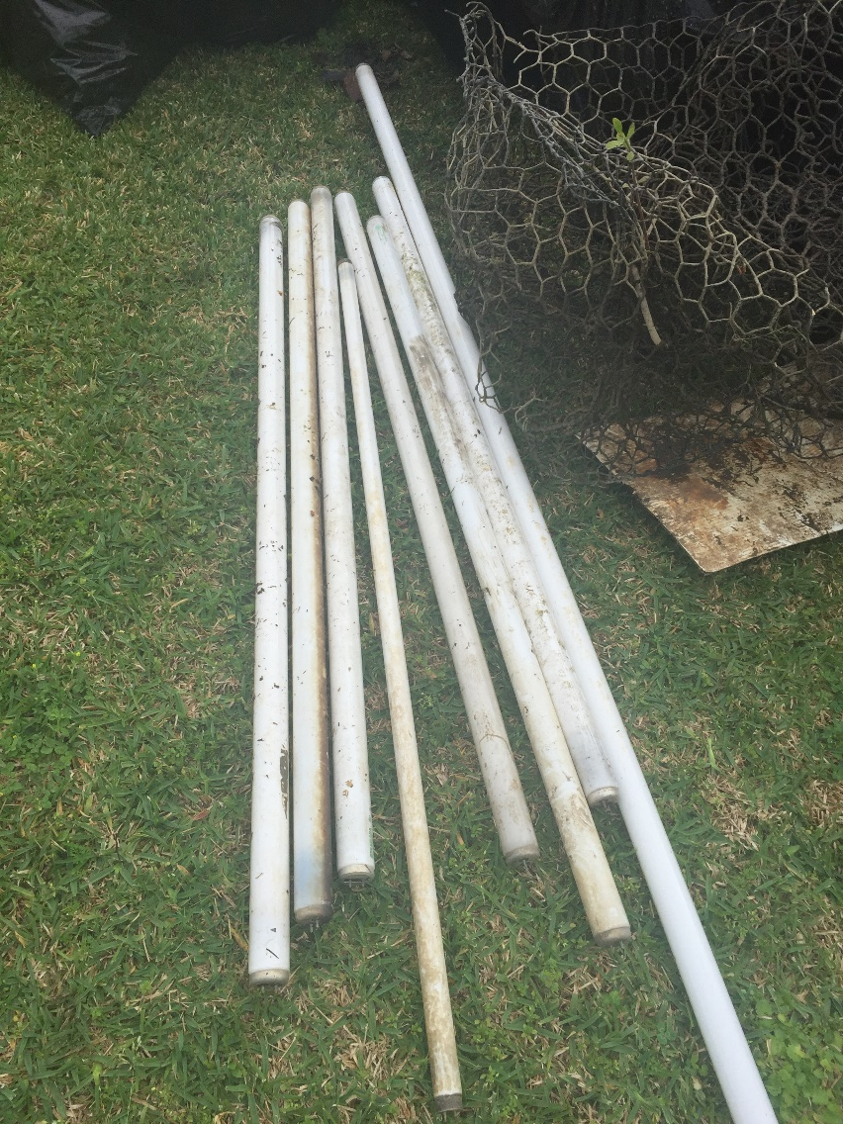
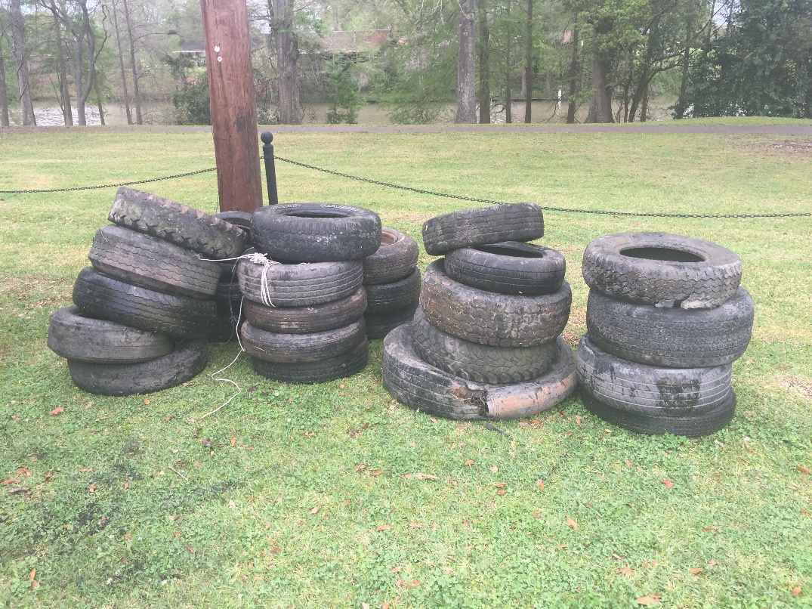
Lightbulbs and Tires cannot go into the dumpsters

Slide 17
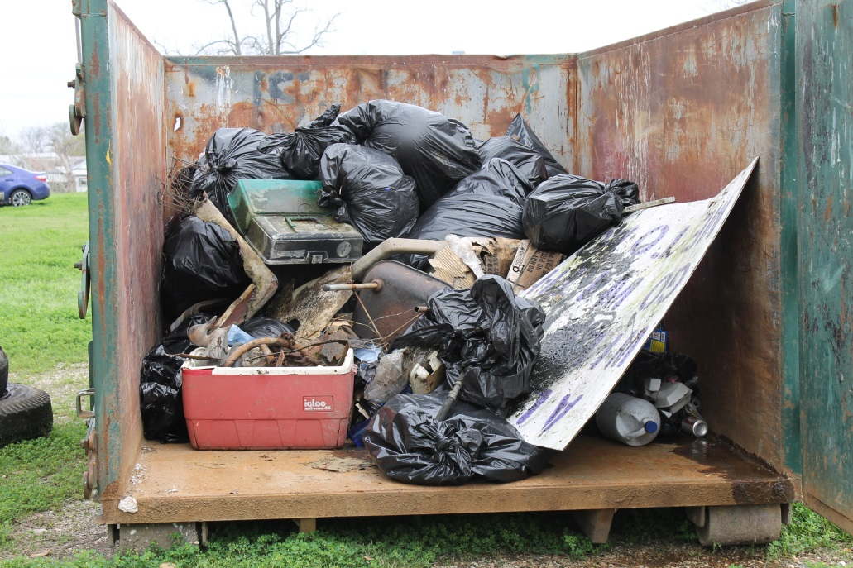
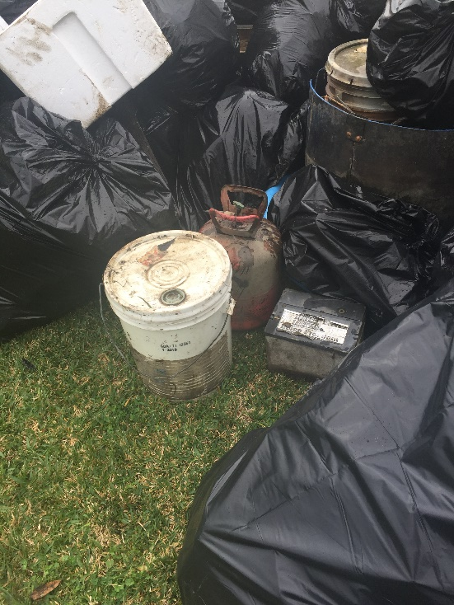
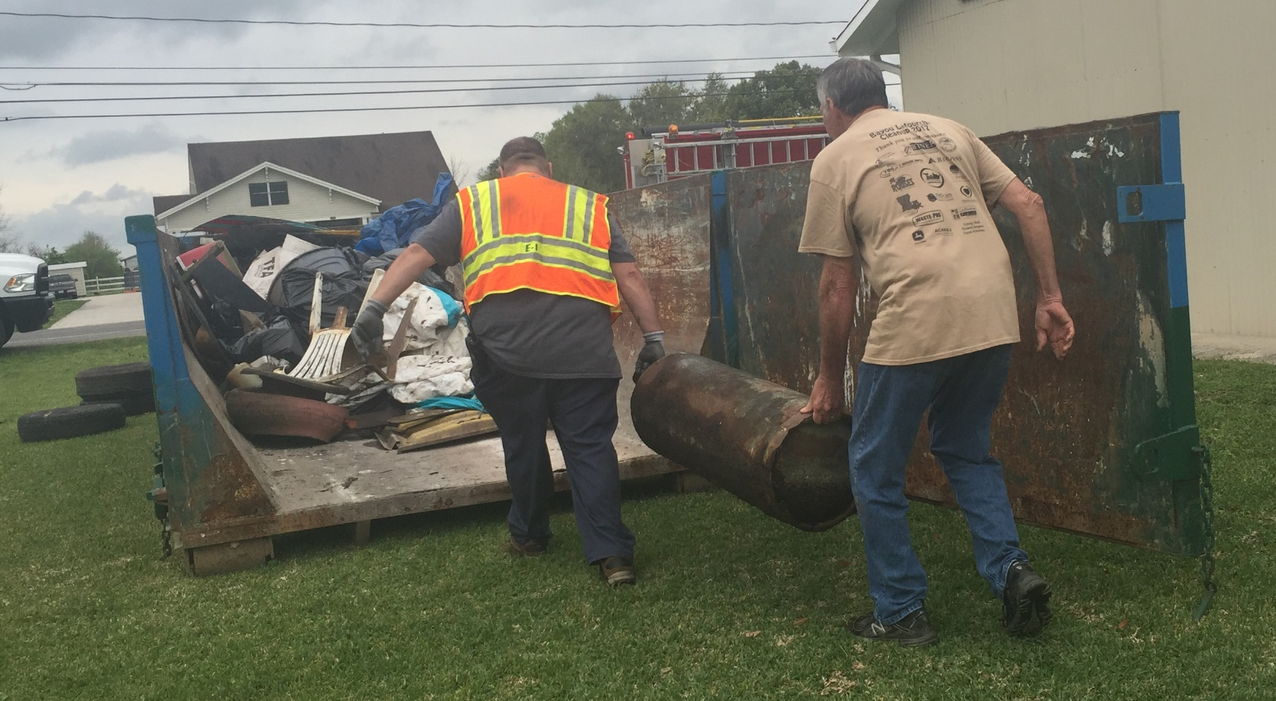

Slide 18
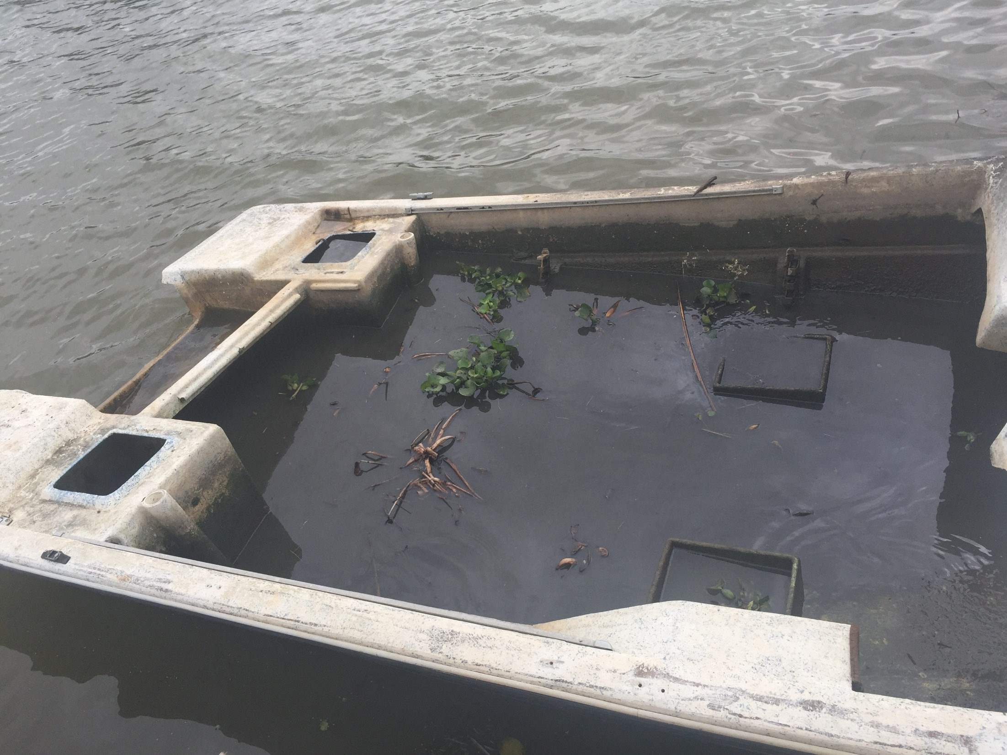

Slide 19
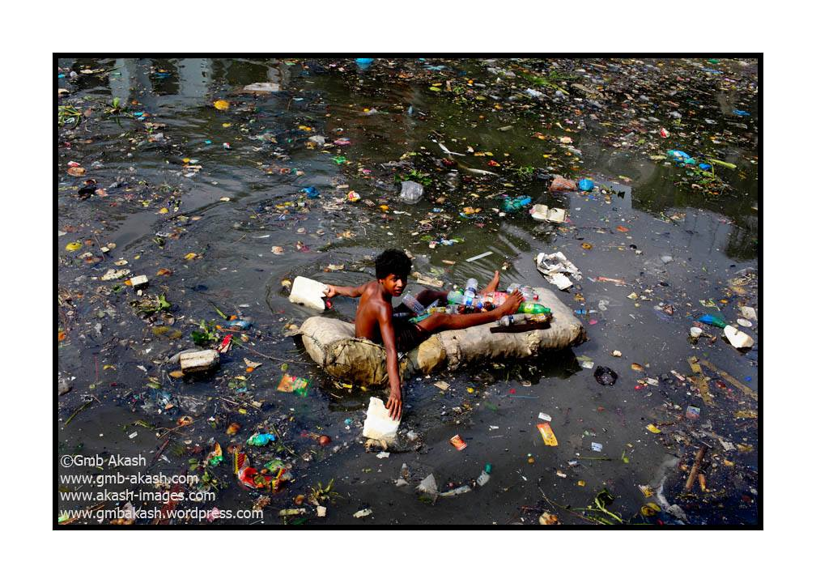

Slide 20
