Slide 1
Committed to Our Coast
Shrimp Task Force – Draft Plan
Bren Haase | February 8, 2017

Slide 2
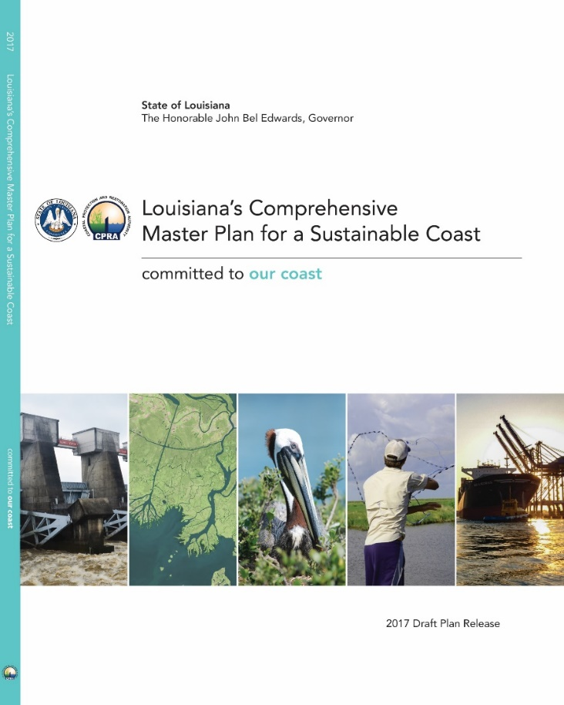
What is the Coastal Master Plan?
A framework to make decisions and guide our efforts to protect and restore coastal Louisiana
A list of projects that we think can do the most good given limited resources

Slide 3
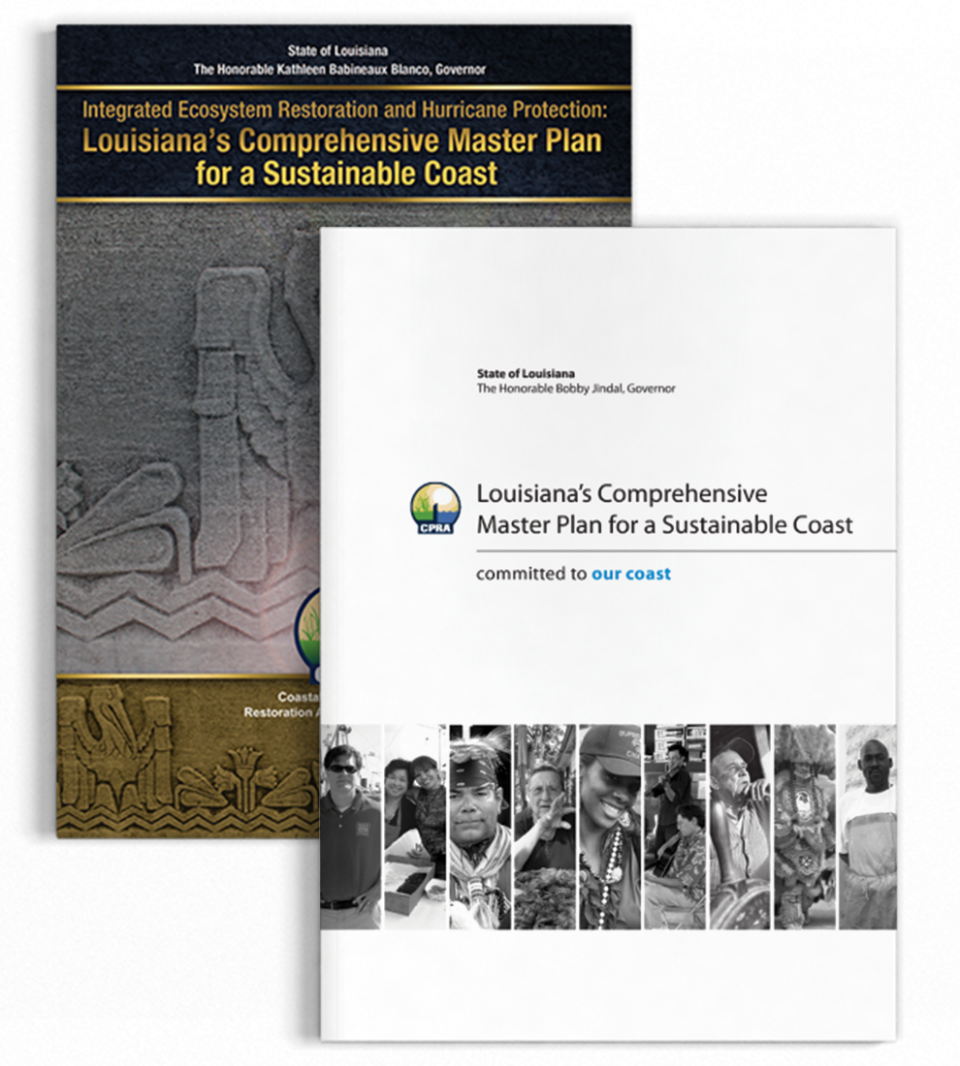
SO WHY ANOTHER PLAN?
It’s required by law to be updated every five years
Allows the state to respond to changes on the ground and public input as well as innovations in science, engineering, and policy
Advances a comprehensive and integrated approach to protecting and restoring the communities of Coastal Louisiana
Notes:
When we visit local communities, one of the most common questions is “So why are you doing another plan?” It’s certainly a valid question.
Louisiana law requires that the Coastal Master Plan be updated every five years and approved by the legislature so the state can respond to changes on the ground as well as innovations in science, engineering, and policy.
The 2017 Coastal Master Plan is the third installment in what will be a series of Coastal Master Plans, each one improving on work done before and helping to establish clear priorities for the future.
The 2017 Coastal Master Plan will carry the planning efforts from 2007 and 2012 forward by advancing a comprehensive and integrated approach to protecting and restoring the communities of coastal Louisiana.
Yearly implementation of the Coastal Master Plan is outlined in a document called CPRA’s Annual Plan.

Slide 4
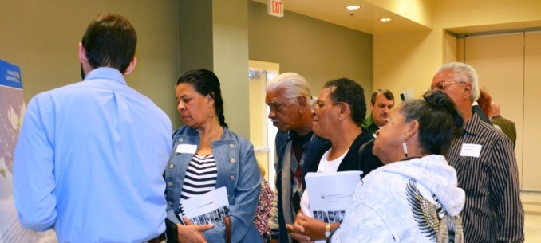
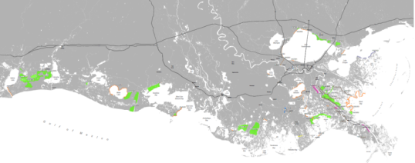
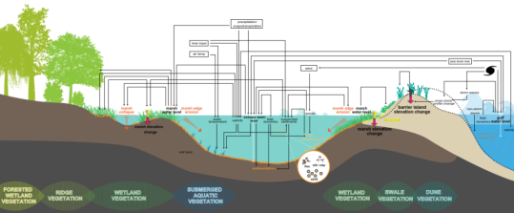
WHAT’s DIFFERENT ABOUT THE 2017 COASTAL MASTER PLAN?
Improved science and technical analysis
New ideas and information
Focus on flood risk reduction and resilience
Emphasis on communities
Expanded outreach and public engagement
Earlier funding
Notes:
The 2017 Coastal Master Plan will build on previous successes, but includes a number of key advancements.
CPRA will continue to focus on flood risk reduction and resilience.
We need to use all of the tools available to reduce communities’ flood risk and, as such, we are exploring different types of nonstructural options and refining policies to help communities become more resilient.
The 2017 Coastal Master Plan will present a much more detailed path forward for nonstructural project recommendations, funding sources, and grant procedures.
In addition, we are also expanding outreach through the creation of a new, interactive web-based tool to help residents better understand their flood risk now and in the future.
To view the tool, visit the “Flood Risk and Resilience Viewer” at cims.coastal.la.gov/floodrisk.
There will also an emphasis on communities and possible ways to integrate socio-economics into the analysis.
We know coastal restoration and protection goals ultimately intend to support the people who live and work in coastal Louisiana, and the 2017 Coastal Master Plan will place a greater focus on these communities.
CPRA appreciates the importance of understanding the cost of continued land loss as well as potential effects for all specific project actions on our culture and our local, regional, and national economy.
This information will be quantified and included in our analysis and decision making process.
CPRA is incorporating new ideas and information.
The 2017 Coastal Master Plan considers an array of new project ideas not modeled in 2012; these new project ideas were submitted from across the coast by stakeholders and members of the public.
Additionally, we will see significant advancements and improving the models based on the best available science.
The 2012 Coastal Master Plan was founded on state-of-the-art science and analysis, and the 2017 effort builds upon this further.
The modeling process provides a deeper understanding of our coastal environment today, as well as the changes we can expect over the next 50 years.
Recent updates include advancing modeling tools, incorporating a larger geographic area, and increasing spatial detail of land loss and flood risk.

Slide 5
OBJECTIVES OF THE COASTAL MASTER PLAN
Notes:
The Coastal Master Plan is designed to provide the direction and path forward needed to save our coast.
These objectives reflect the key issues affecting people in and around Louisiana’s coast, seeking to improve flood protection for families and businesses, recreate the natural processes that built Louisiana’s delta, sustain our unique cultural heritage, and ensure that our coast continues to be both a Sportsman’s Paradise and a hub for commerce and industry.

Slide 6
Developing the Coastal Master Plan

Slide 7
Developing the Coastal Master Plan

Slide 8
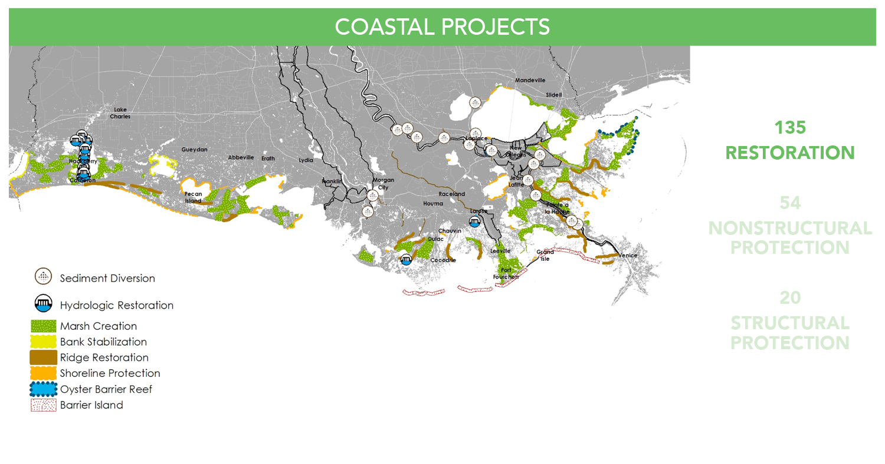
Projects Considered Restoration

Slide 9
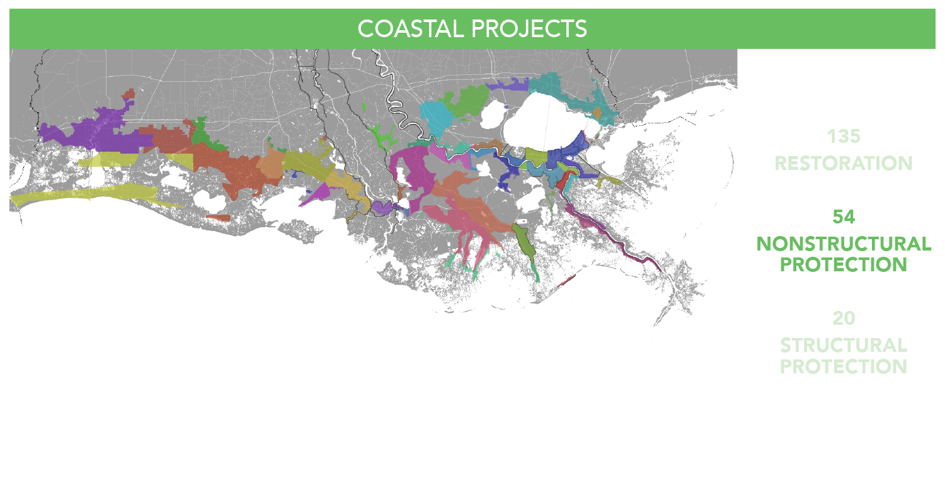
Projects Considered Nonstructural Protection

Slide 10
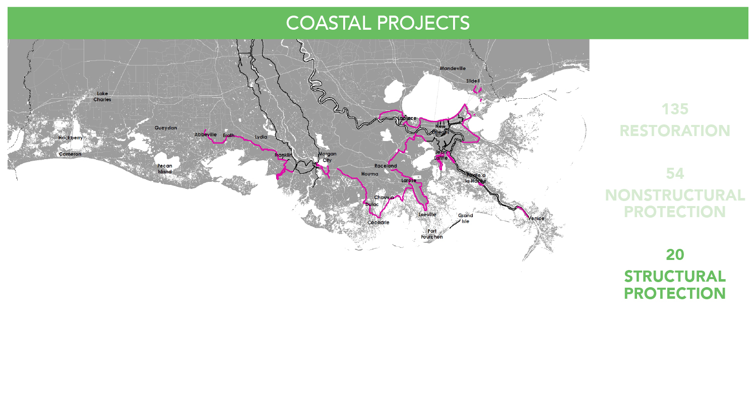
Projects Considered structural Protection

Slide 11
Developing the Coastal Master Plan

Slide 12
Envisioning Our Future Coast

Slide 13
Developing the Coastal Master Plan

Slide 14
Decision Drivers For Project Selection

Slide 15
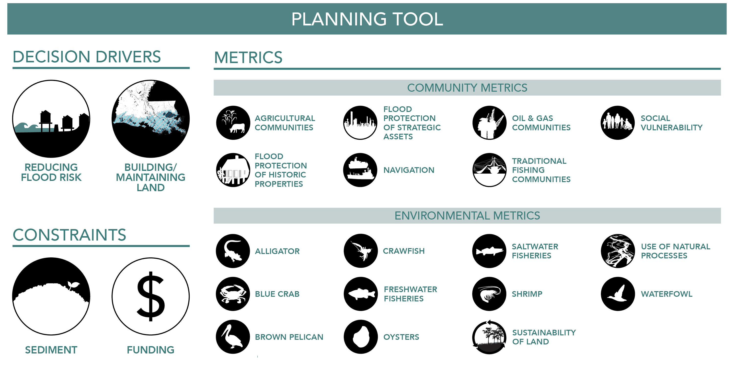
A Plan Built ON The Best Available Science…

Slide 16
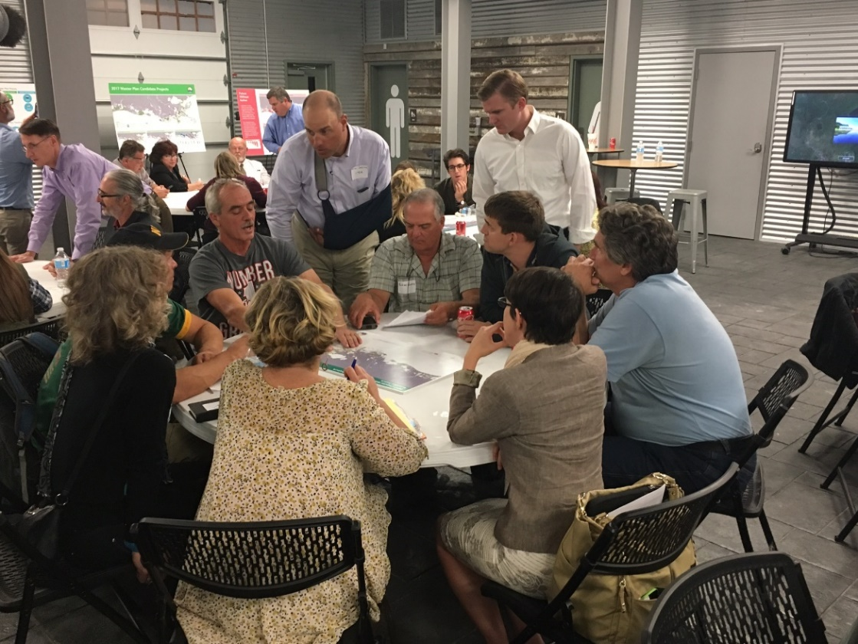
…But Responsive to the Needs of Our Communities

Slide 17
Unprecedented Outreach Before and During the Draft Plan

Slide 18
Unprecedented Outreach Official Public Hearings

Slide 19
Key Decision Points
Overall Funding: $50 Billion, earlier funding
Funding Split: An equal split of $25 billion each for restoration and risk reduction
Scenario: Plan for the worst conditions and hope for the best
Near-term/Long-term Results: Equal emphasis was placed on the near term and the long term
A Plan Based on Science, But Responsive to the Needs of Our Communities

Slide 20
2017 Draft Coastal Master Plan

Slide 21
Louisiana’s 2017 Draft Coastal Master Plan

Slide 22
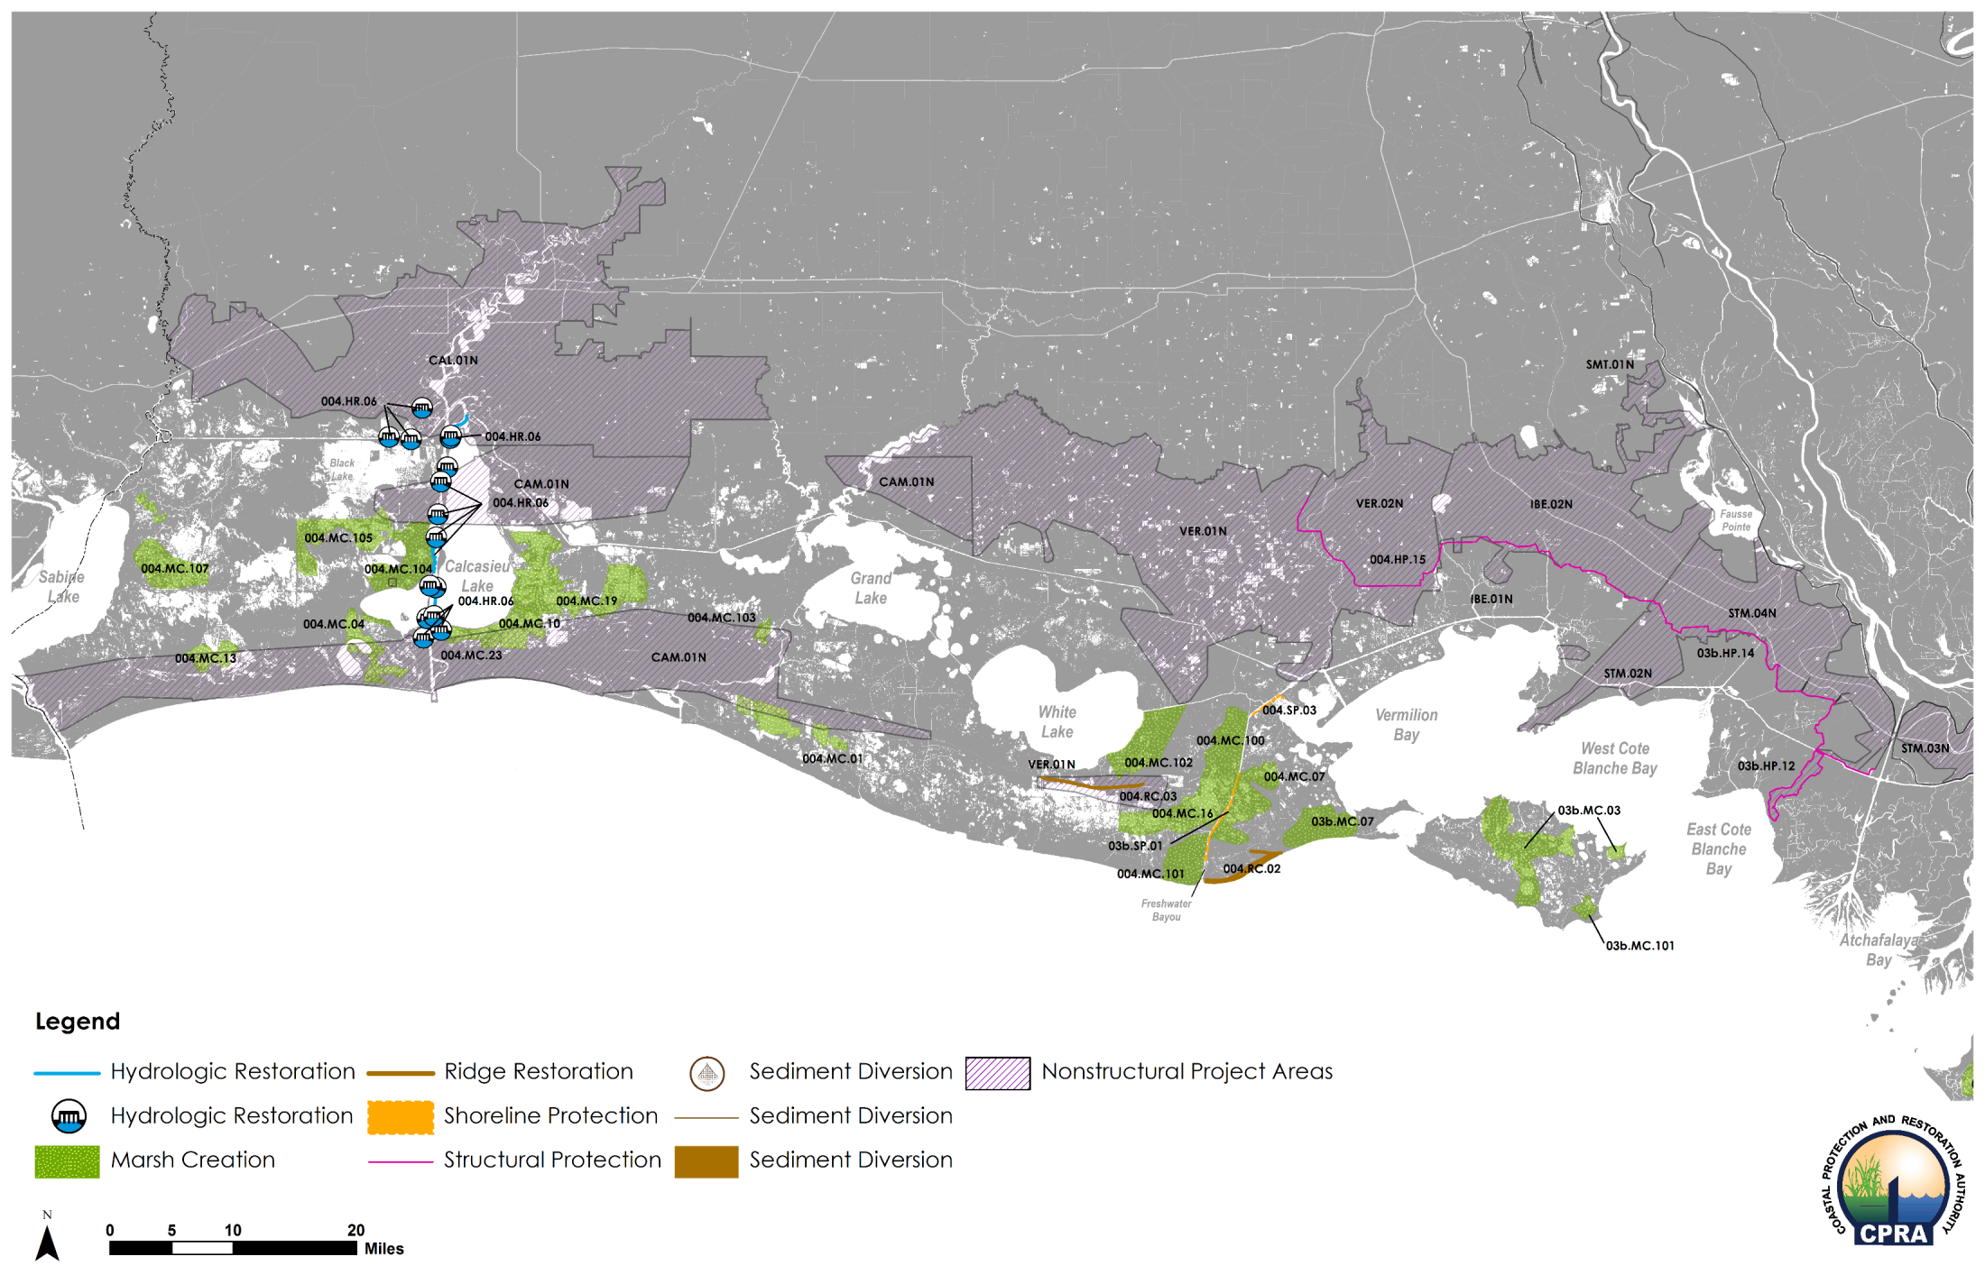
A Closer Look: WEST

Slide 23
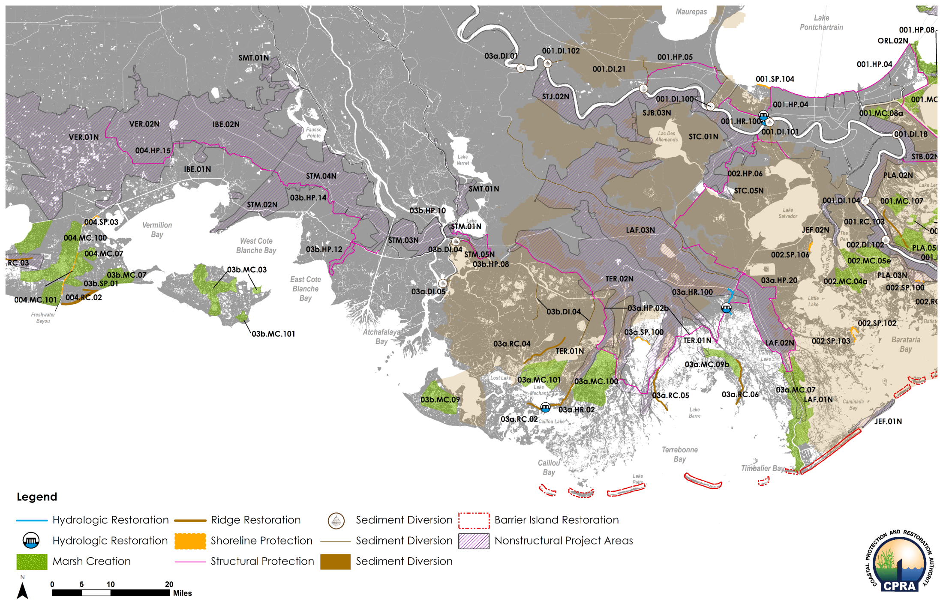
A closer Look: Central

Slide 24
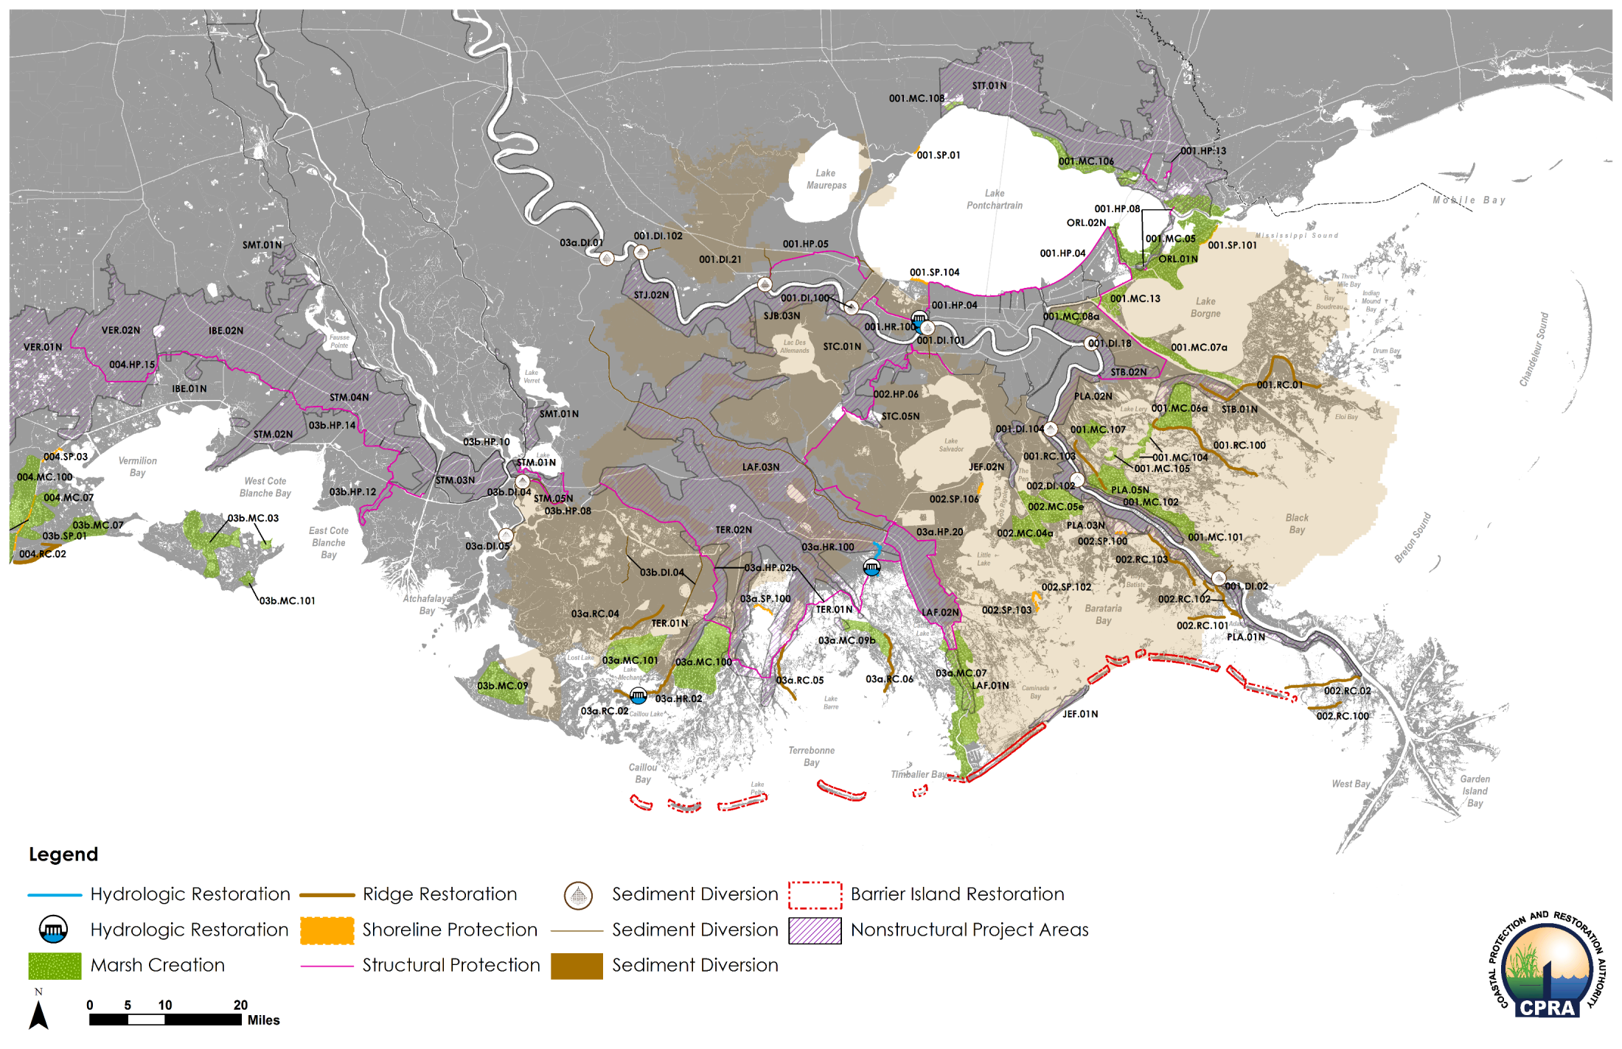
A closer Look: East

Slide 25
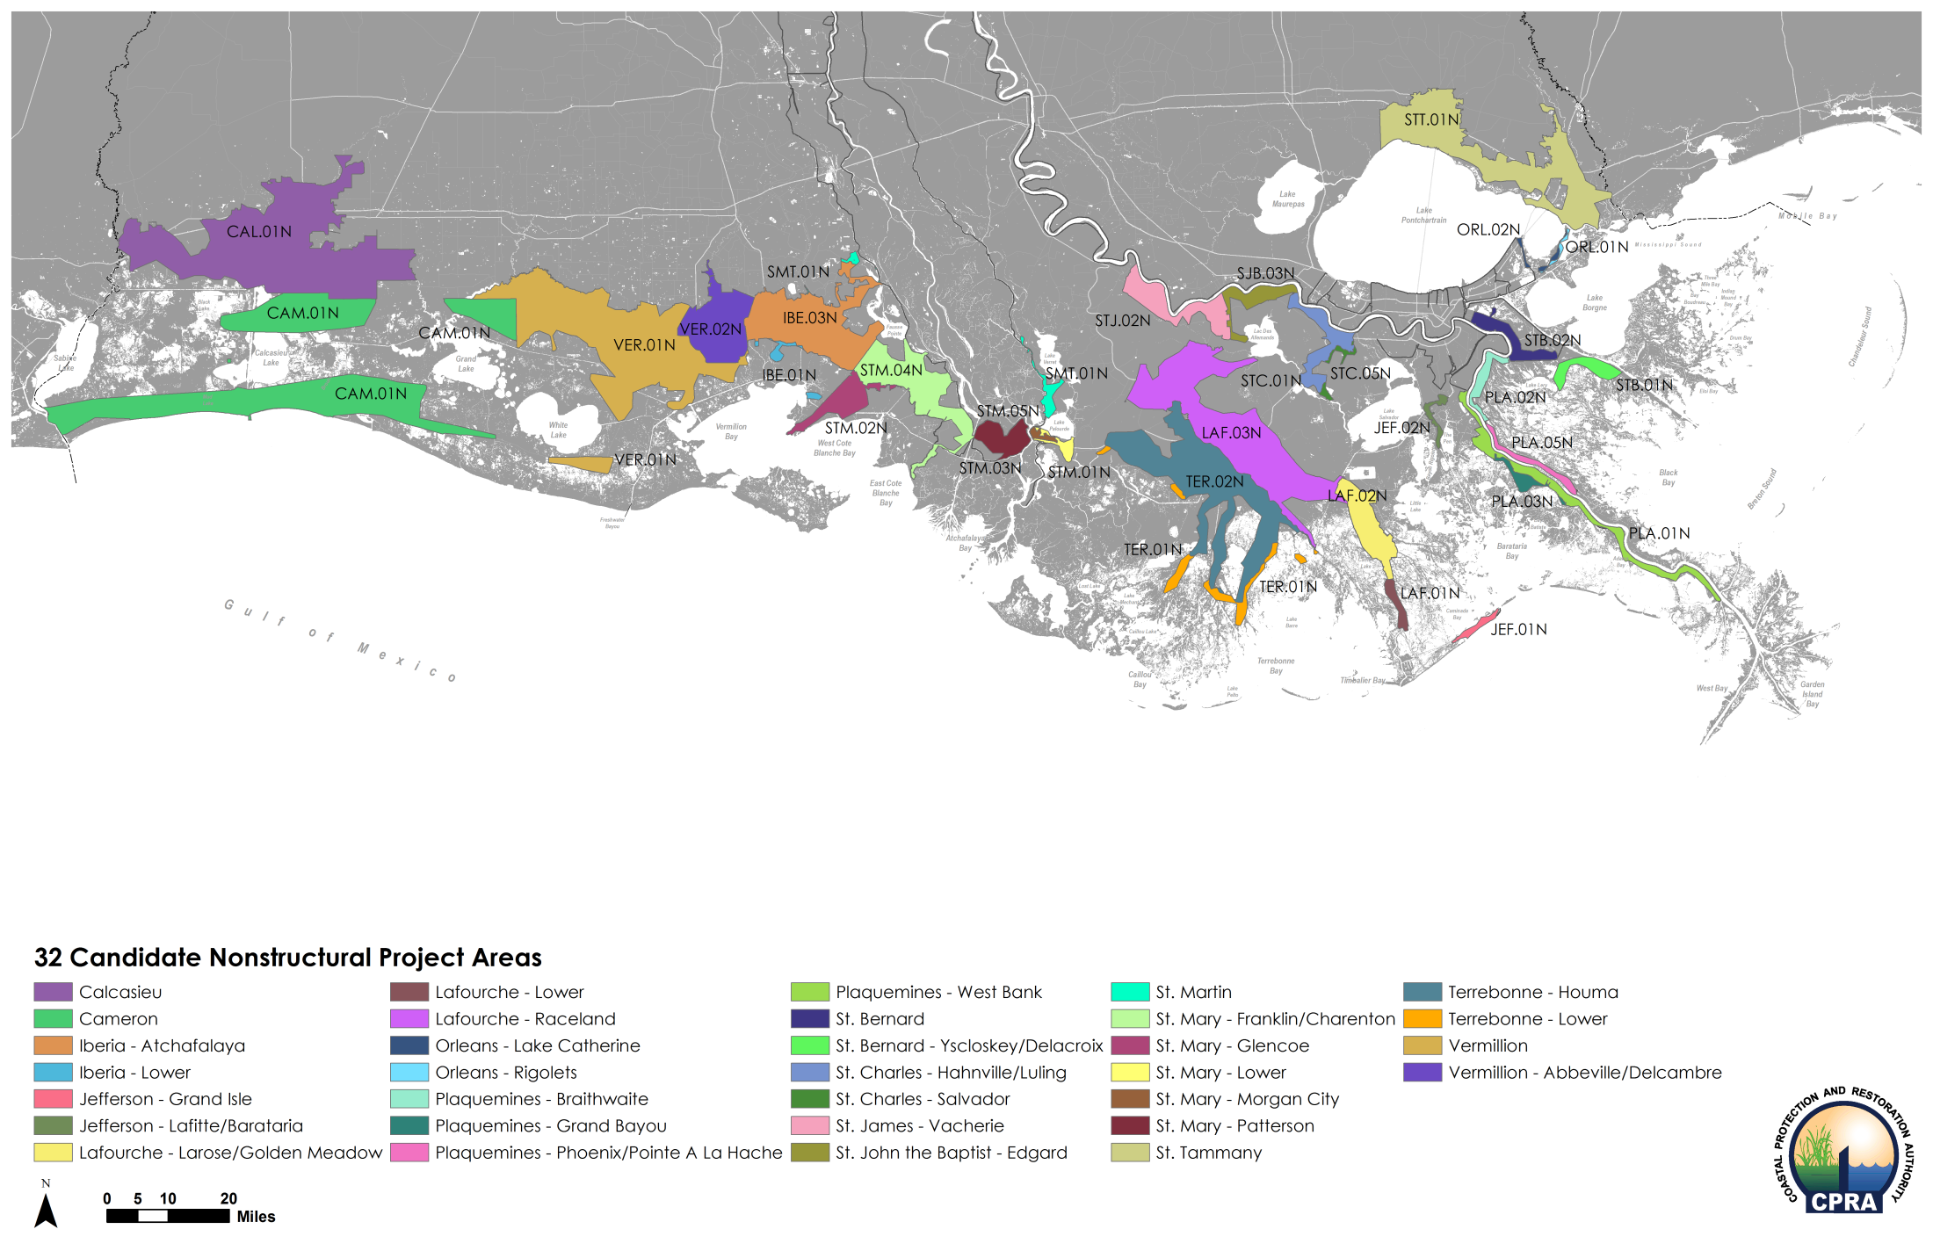
A Closer Look: Nonstructural Projects ~26,000 structures mitigated for $6.1B over next 50 years

Slide 26
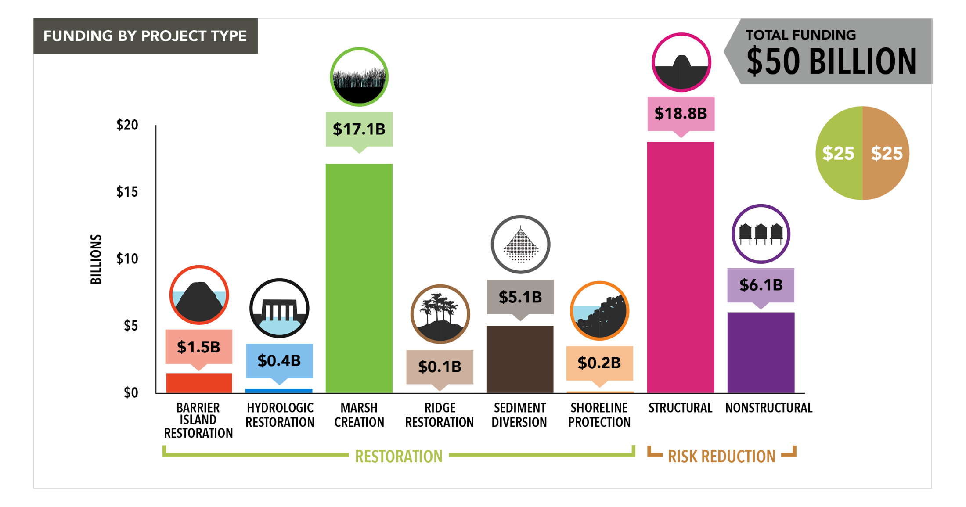
Funding by Project Type

Slide 27
Future Without Action Medium Scenario | Year 30

Slide 28
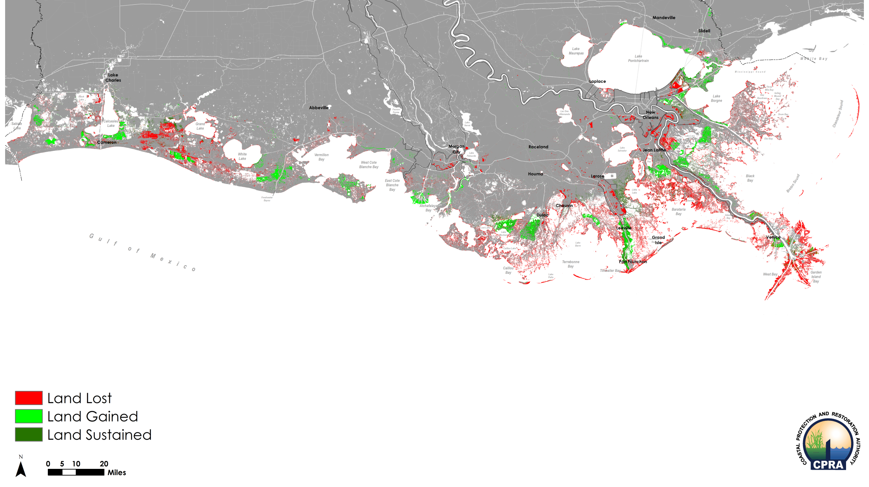
What The Plan Delivers: Land Change Medium Scenario | Year 30

Slide 29
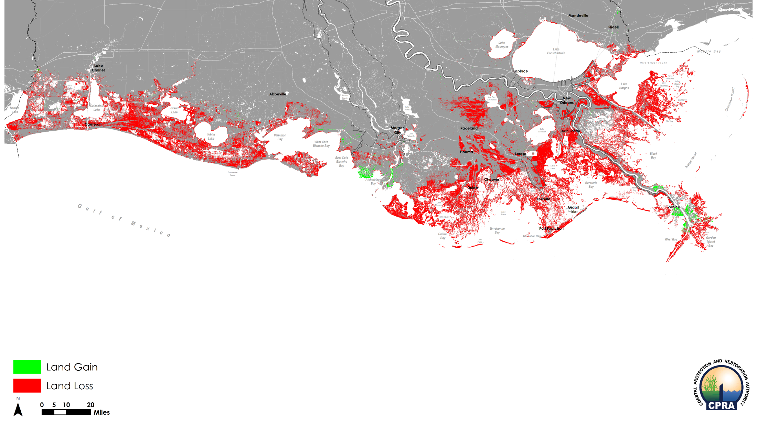
Future Without Action Medium Scenario | Year 50

Slide 30
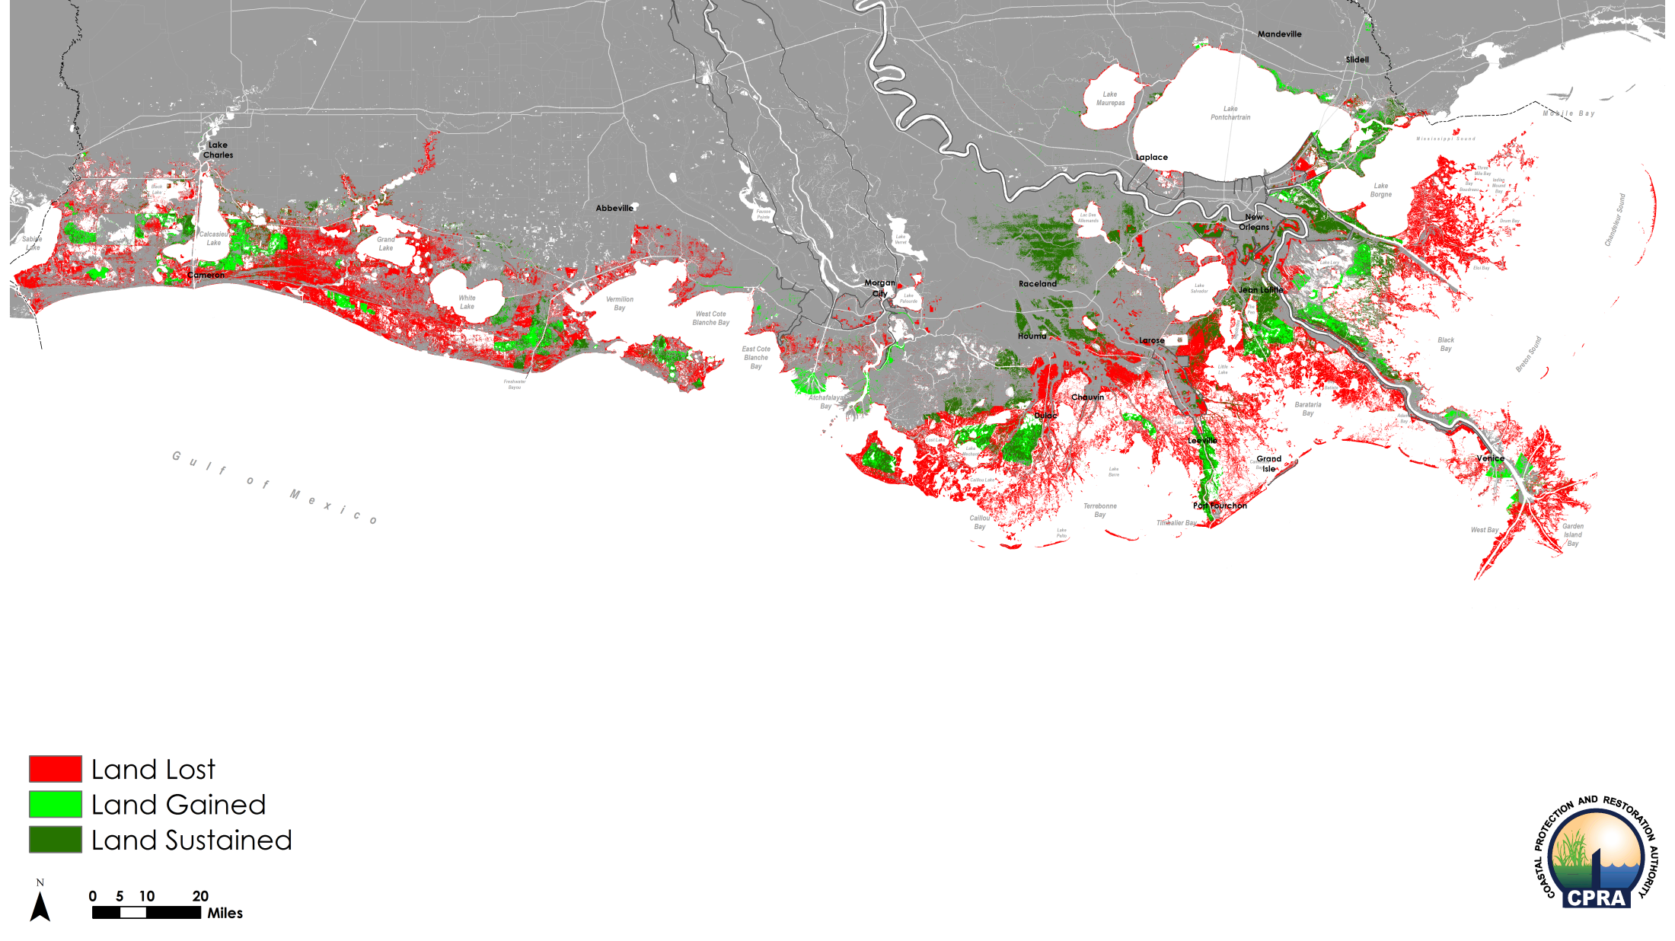
What The Plan Delivers: Land Change Medium Scenario | Year 50

Slide 31
What The Plan Delivers Land Gained/Sustained

Slide 32
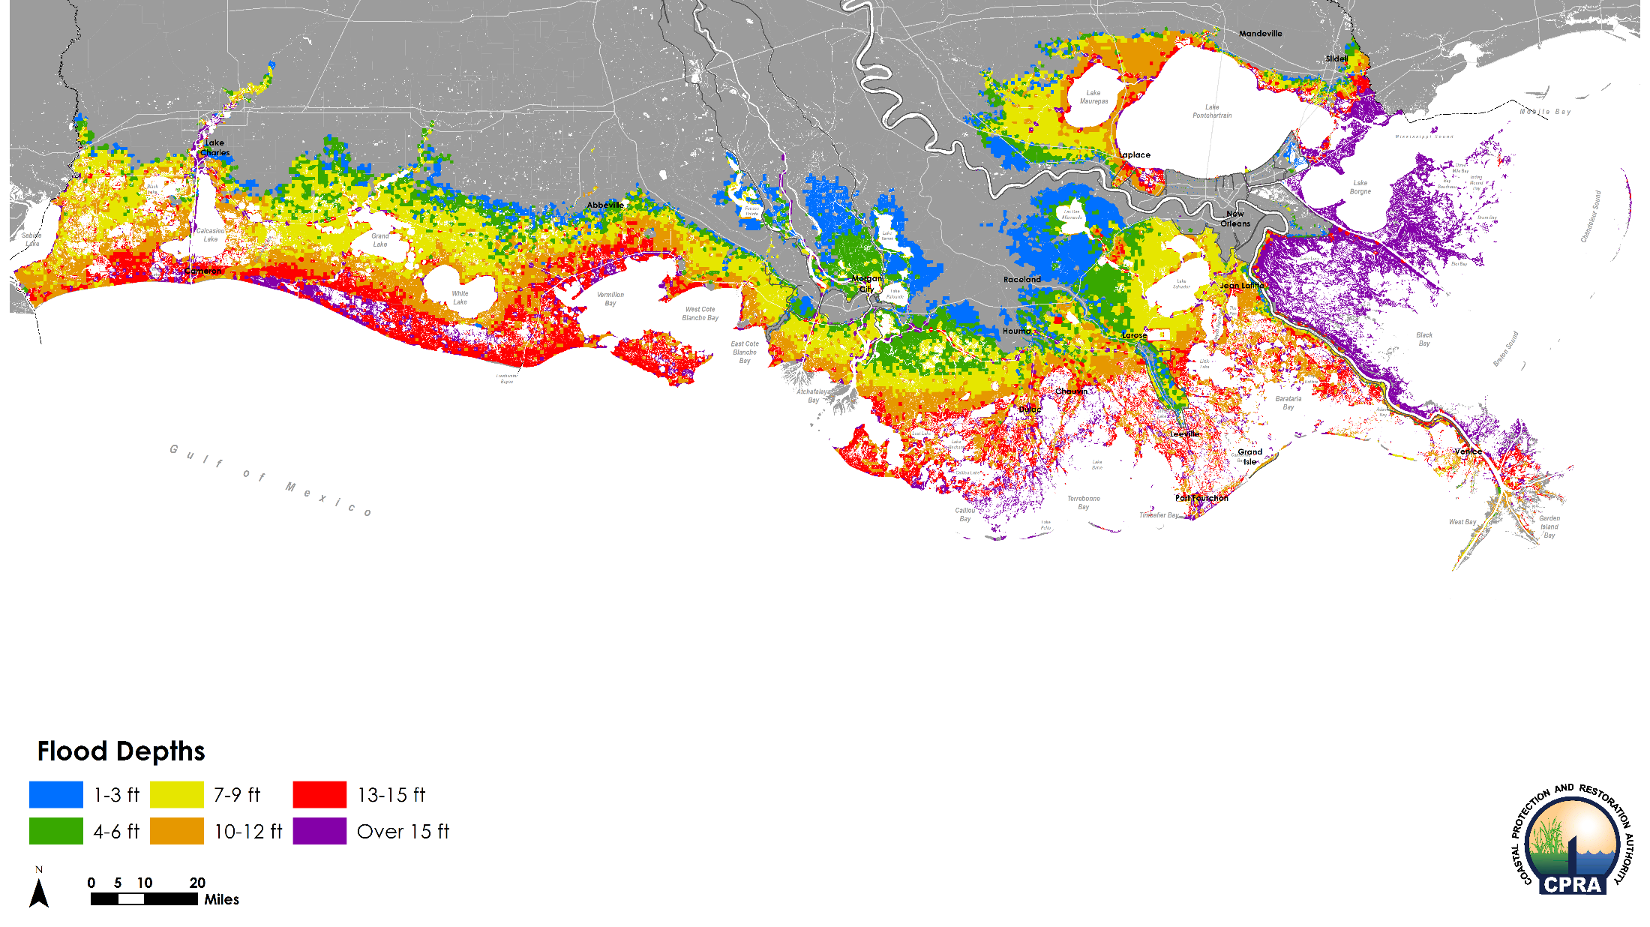
Future Without Action: Flood Depths Medium Scenario | Year 25 | 100-Year Event

Slide 33
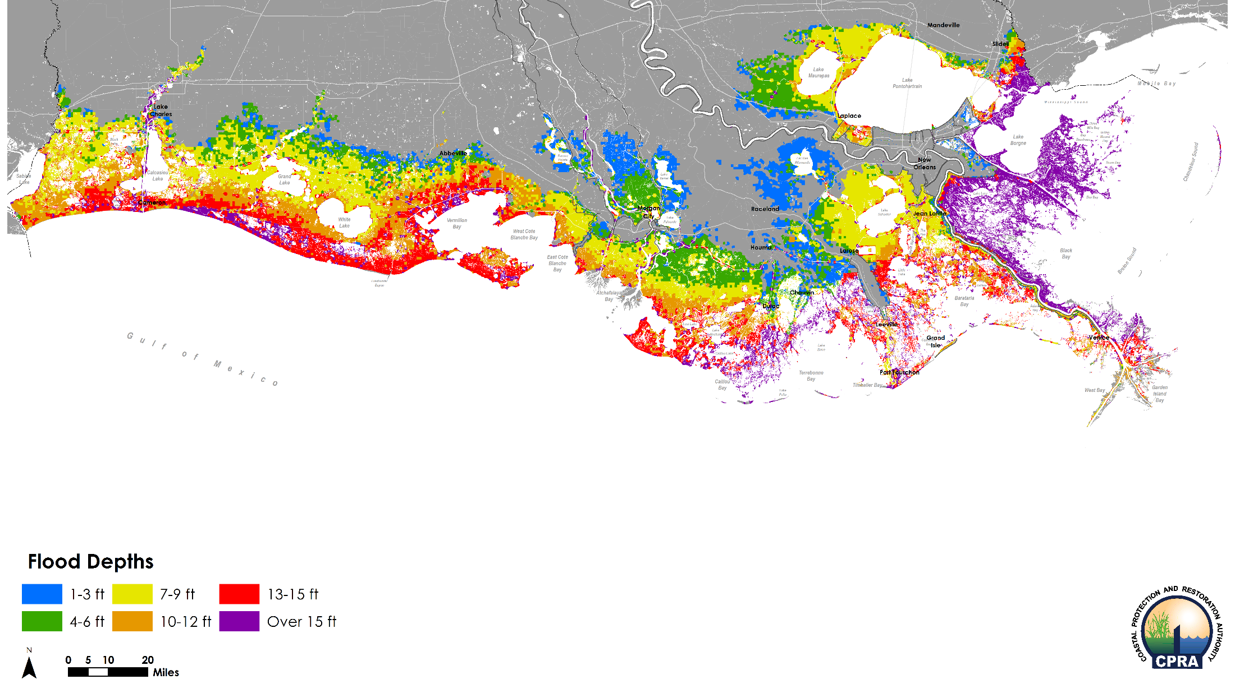
What The Plan Delivers: Flood Depths Medium Scenario | Year 25 | 100-Year Event

Slide 34
What The Plan Delivers: Flood Depth Difference Medium Scenario | Year 25 | 100-Year Event

Slide 35
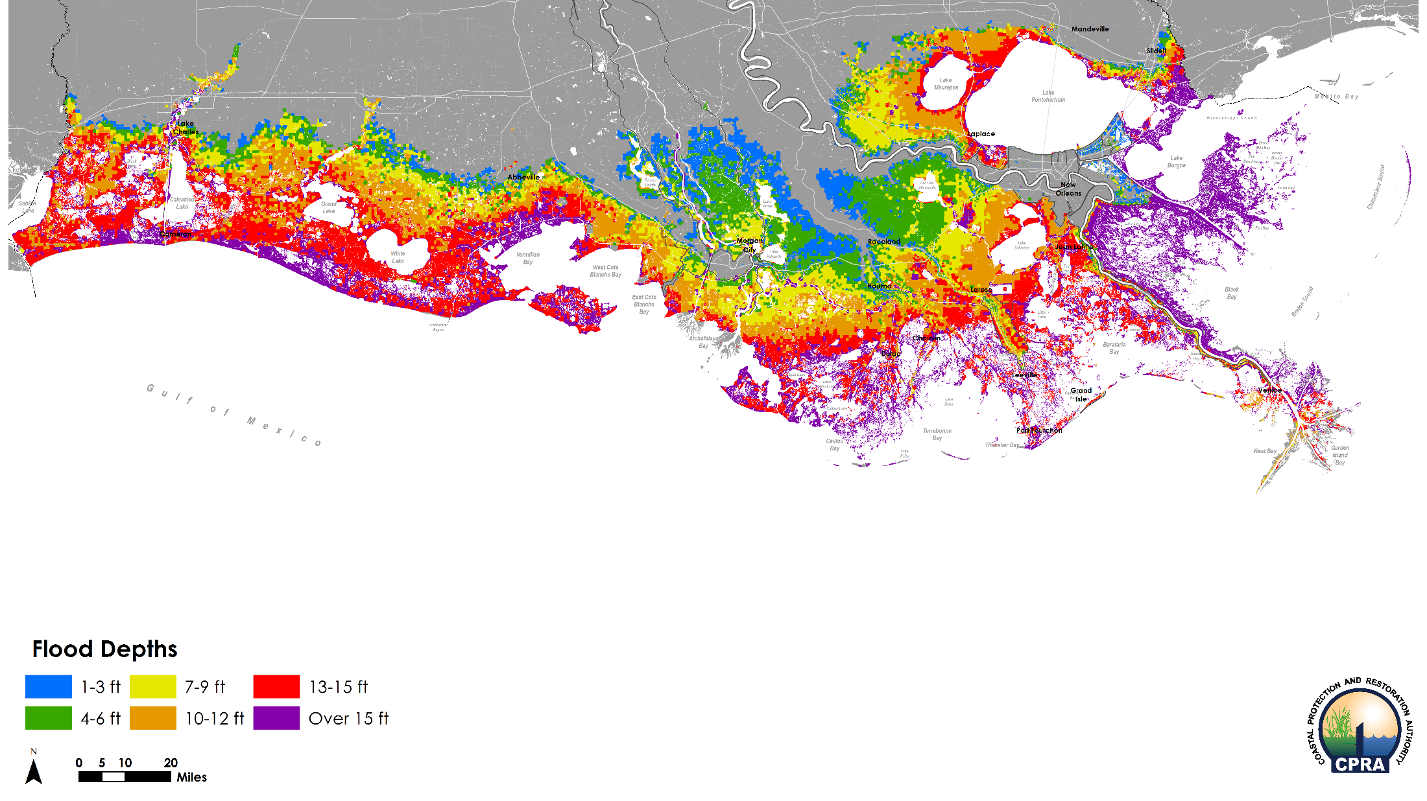
Future Without Action: Flood Depths Medium Scenario | Year 50 | 100-Year Event

Slide 36
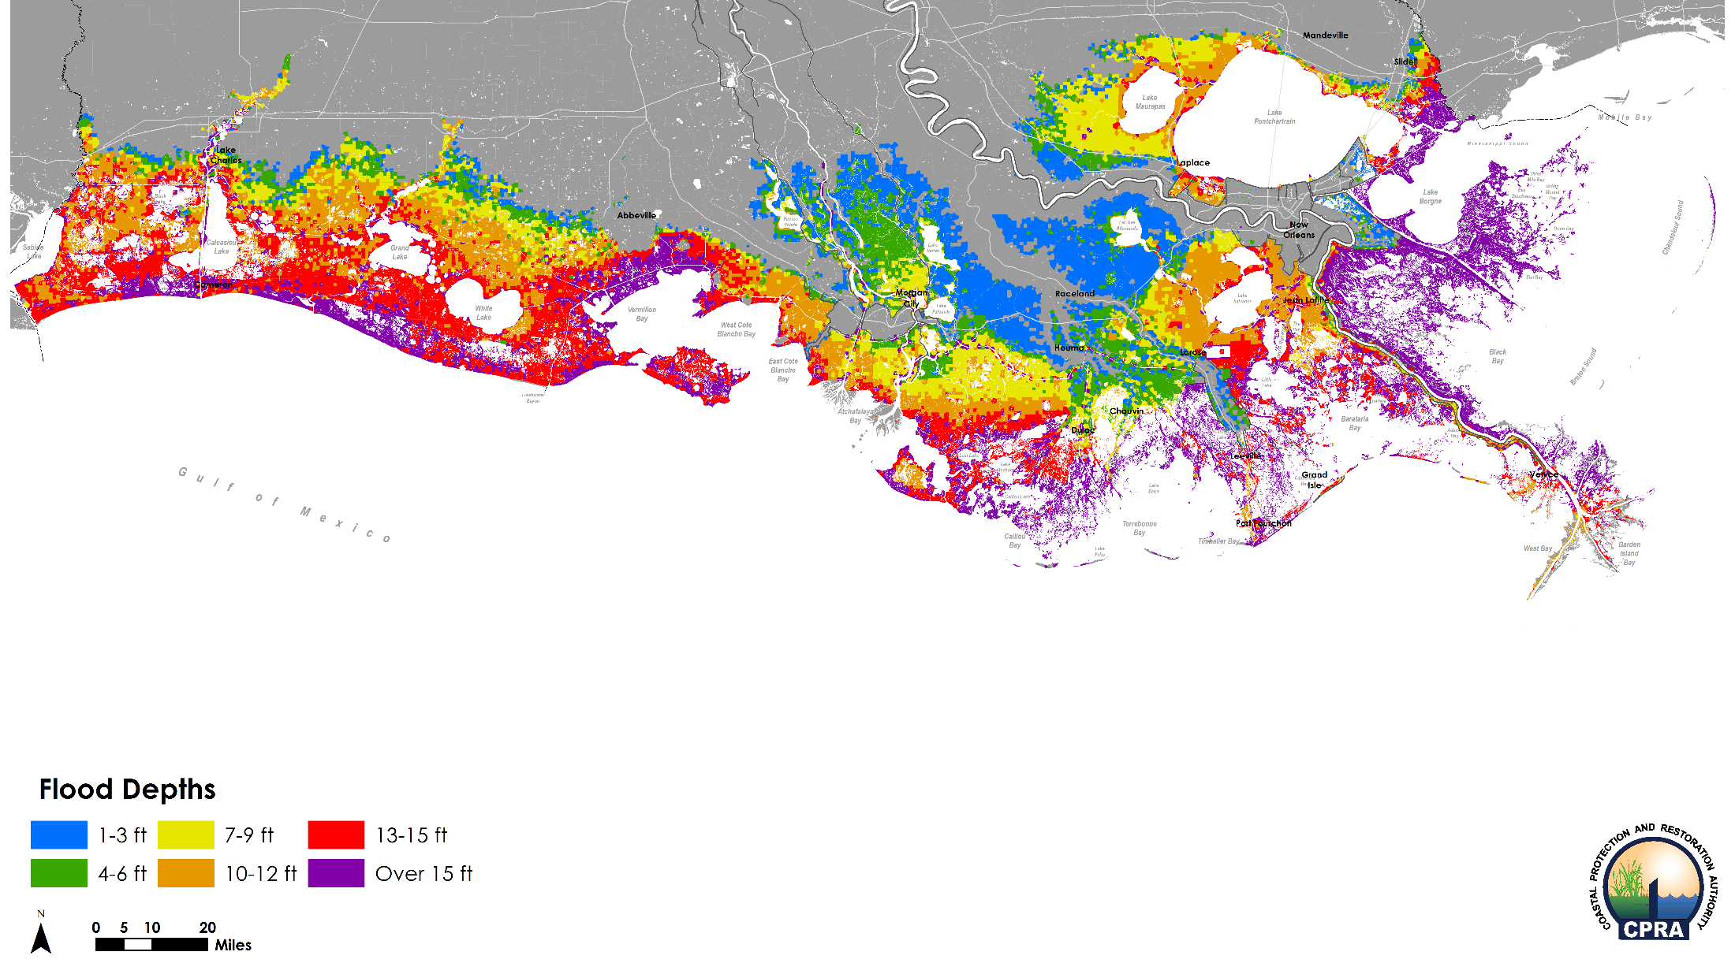
What The Plan Delivers: Flood Depths Medium Scenario | Year 50 | 100-Year Event

Slide 37
What The Plan Delivers: Flood Depth Difference Medium Scenario | Year 50 | 100-Year Event

Slide 38
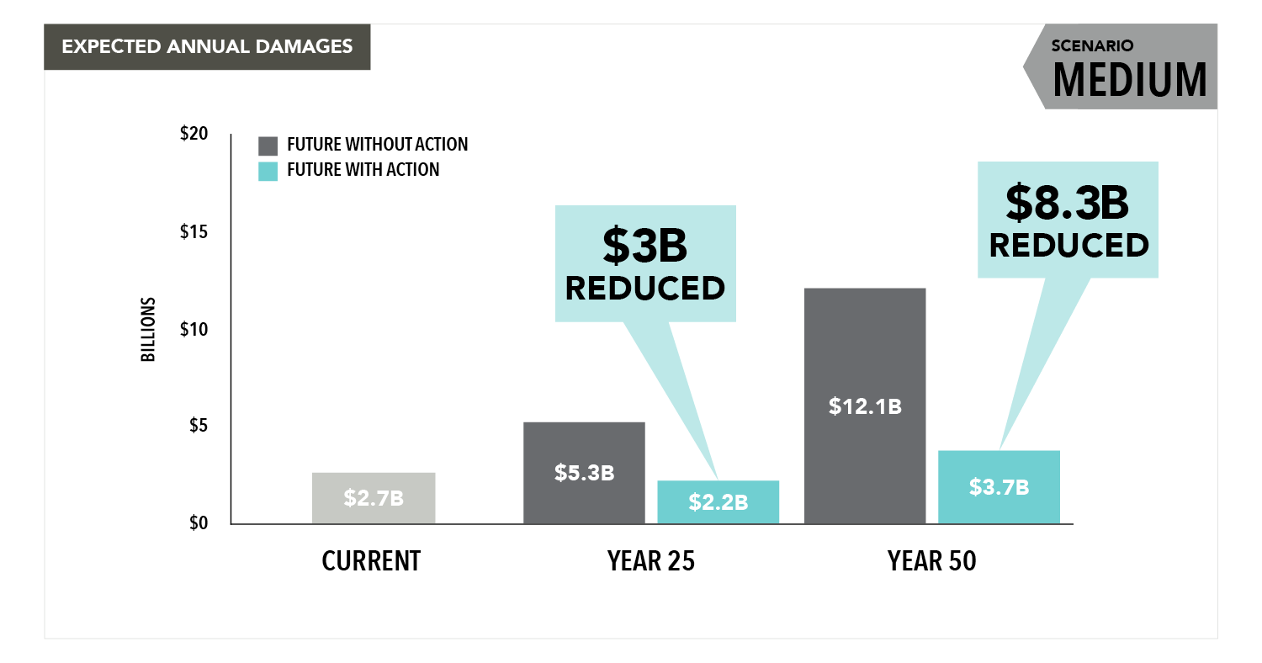
What The Plan Delivers Reduction in Expected Annual Damages

Slide 39
What The Plan Delivers

Slide 40
Key Questions:
Diversions and Water Levels
Lafitte
GIWW
Cumulative Effect
Diversions and Fisheries
Oysters/Shrimp Barataria Bay
Diversion Operation
Base flow
Mid Barataria
MB performance and land gain vs maintain
Diversion Location
Ama
Cost/performance
Other
Bayou Lafourche
MC negatives
Project overlap
High/Low reporting

Slide 41
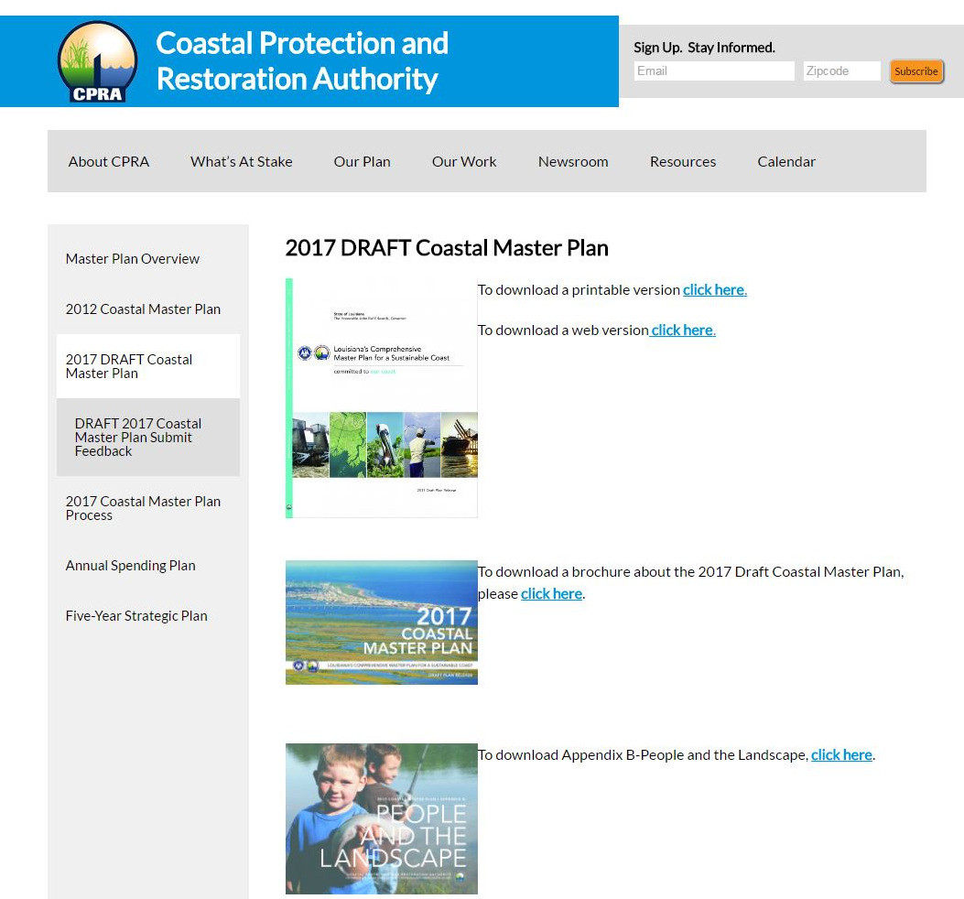
Master Plan website 2017 draft plan & Appendices
coastal.la.gov

Slide 42
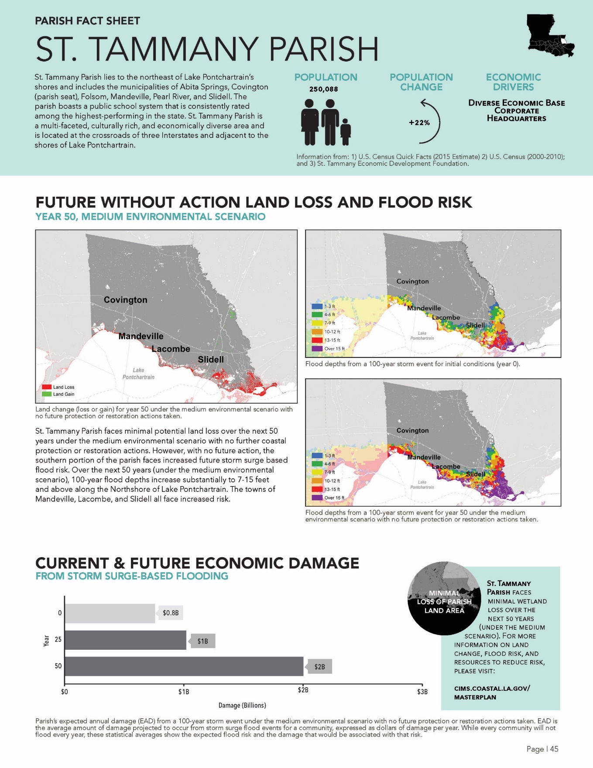
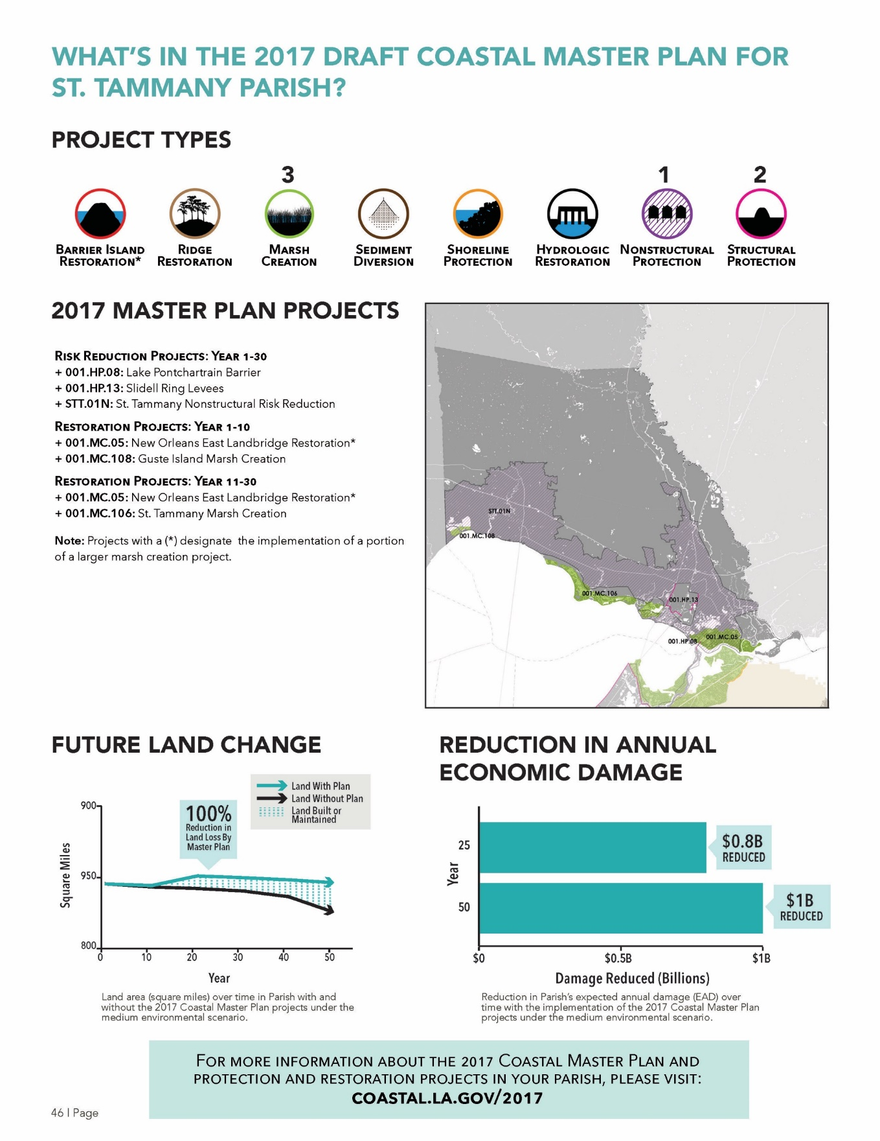
Parish Factsheets
Notes:
Parish Fact Sheets will show information on:
Predicted future without action land loss maps
Current and future without action flood risk maps
Future without action economic damages
2017 Coastal Master Plan projects within the parish
By phase
Depicted in a map
Reduction in estimated economic damages due to projects implementation
Expected future land change due to projects implementation

Slide 43
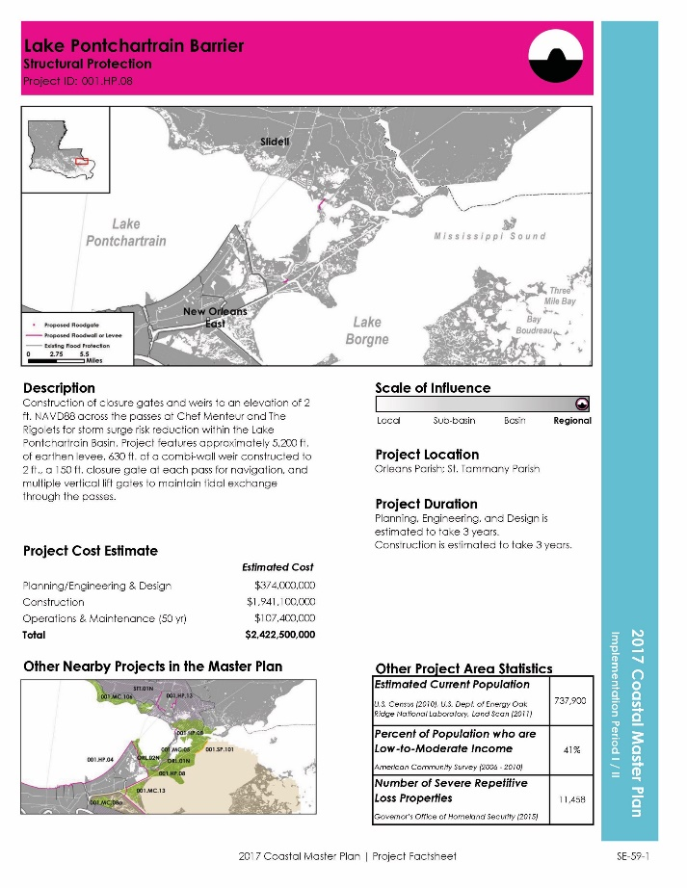
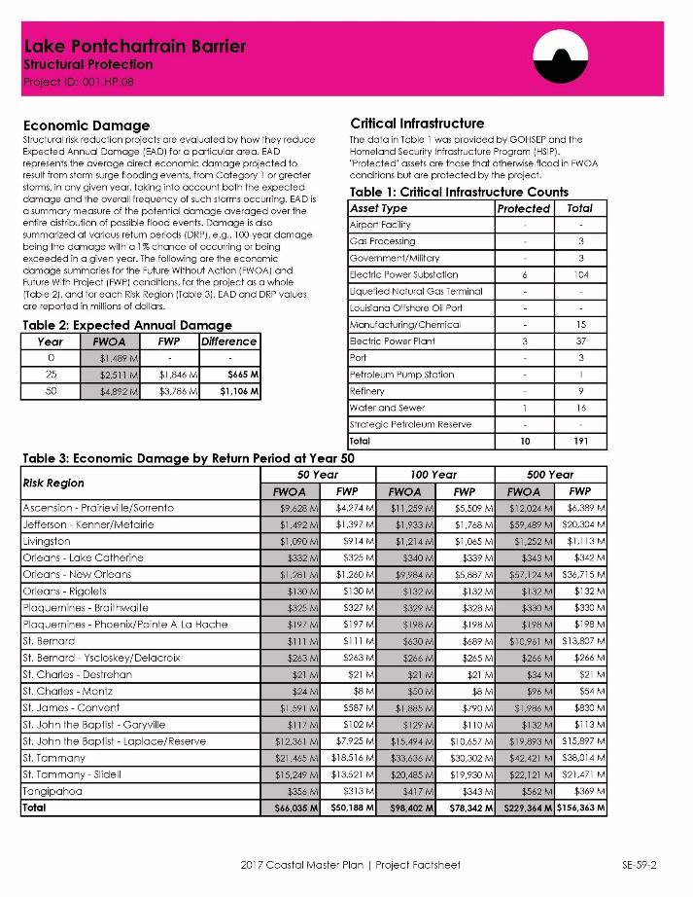
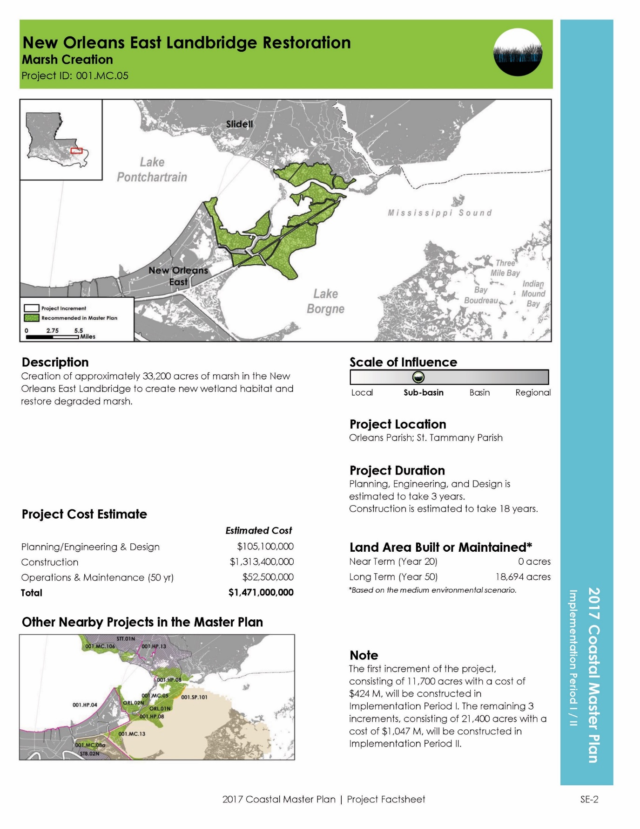
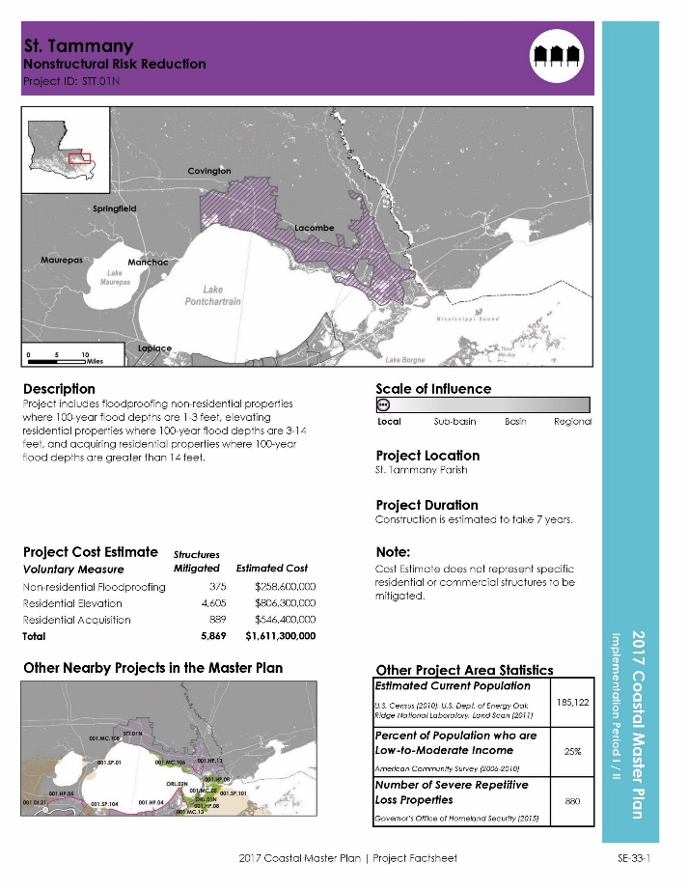
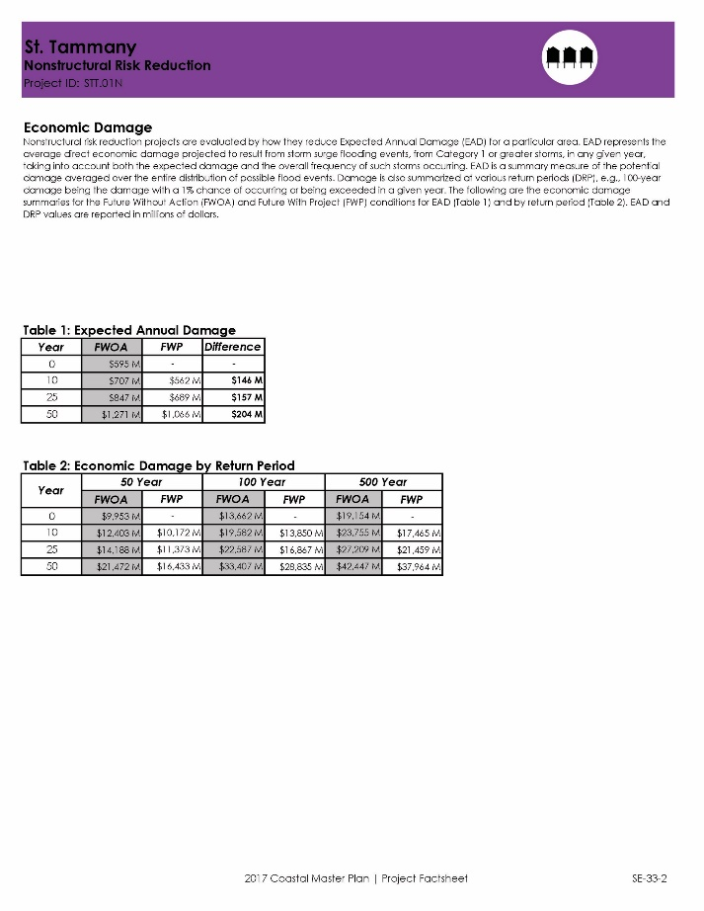
project fact sheets

Slide 44
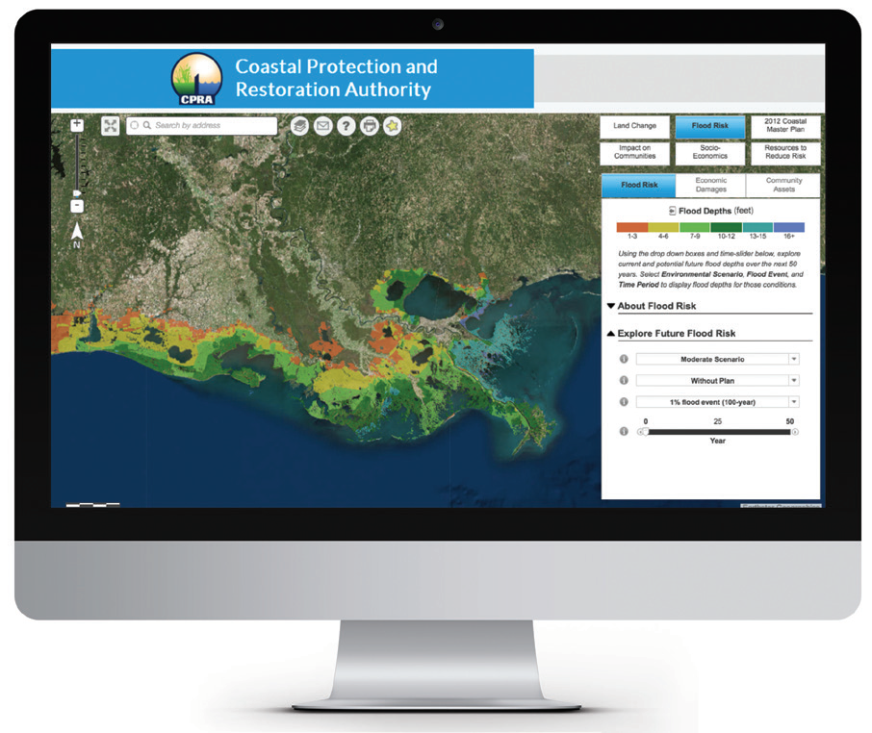
Master Plan Data Viewer
Learn more about how flood risk impacts communities today and in the future, as well as how to make your community safer and more resilient.
Visit the Master Plan Data Viewer at http://cims.coastal.la.gov/masterplan/

Slide 45
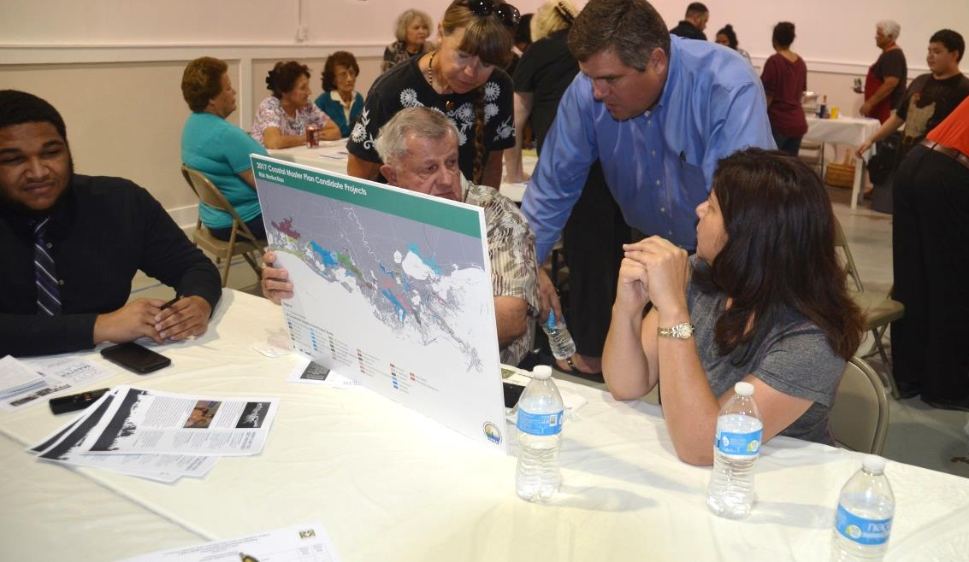
From Draft Plan to Final Plan
January 3: Draft Plan Posted
January 17, 18, 24, 25: Official Public Hearings
March 26: Comment Period Ends
April 19: Present Final Plan to CPRA Board
April 25: Submit Final Plan to Legislature

