Slide 1
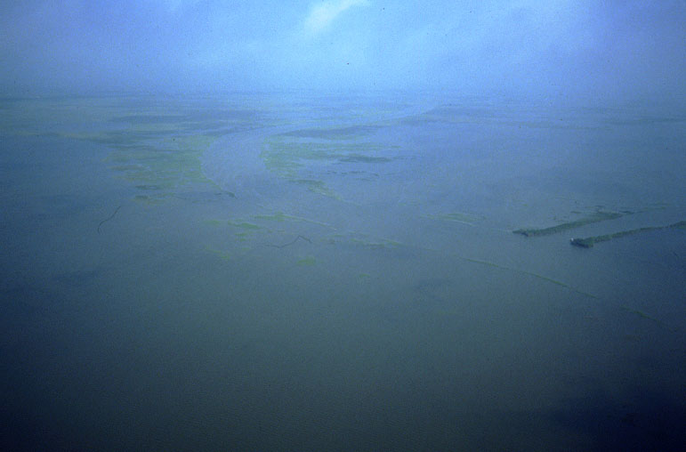
Is coastal Louisiana sustainable?
Torbjörn Törnqvist, Liz Chamberlain, Chris Esposito, Krista Jankowski, Zhixiong Shen
Department of Earth and Environmental Sciences
www.tulane.edu/~tor/

Slide 2
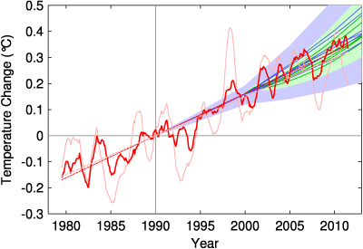
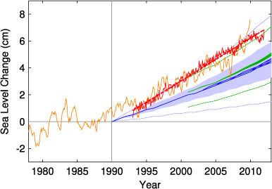
IPCC predictions
too conservative???
Rahmstorf et al. (2012)

Slide 3
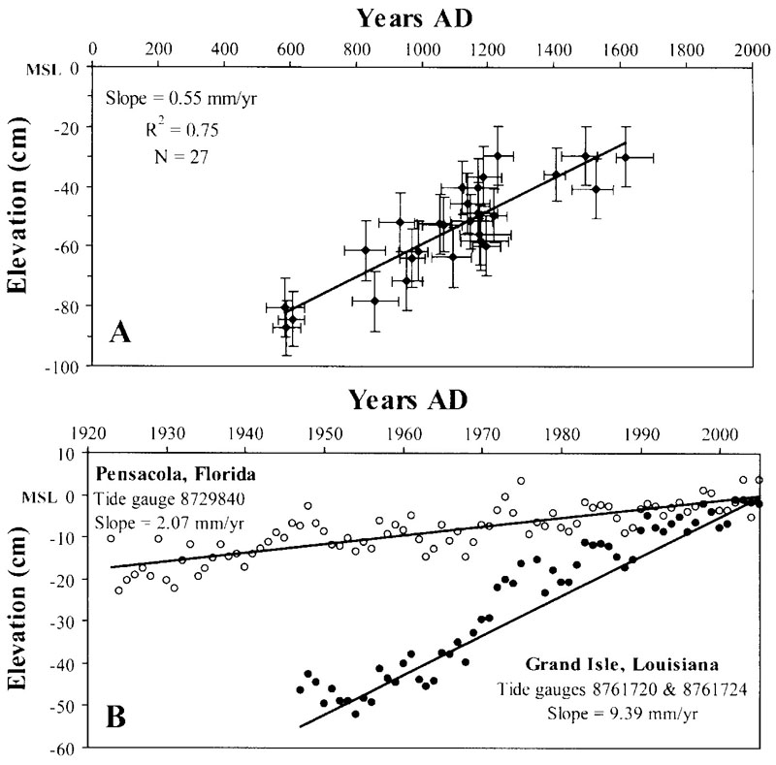
González & Törnqvist (2006)

Slide 4
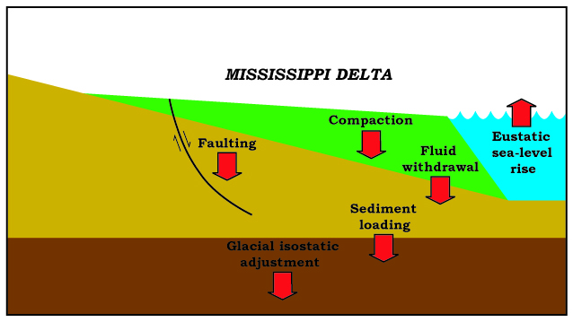

Slide 5
Coastal subsidence is a 4-dimensional problem…
Subsidence rates vary in space, potentially over very short distances (e.g., tens of meters)
Subsidence rates vary as a function of depth; the nature of this function can vary substantially across space (rates are always highest at the surface!)
Subsidence rates can vary through time, depending on the driving processes

Slide 6
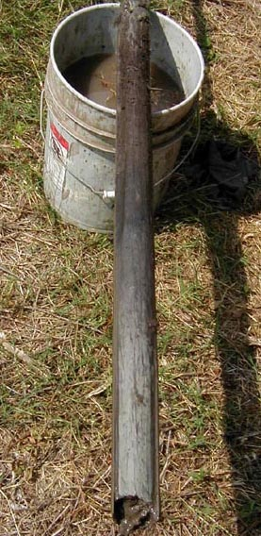
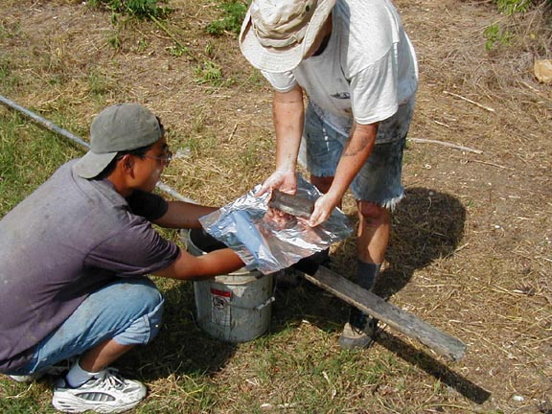

Slide 7
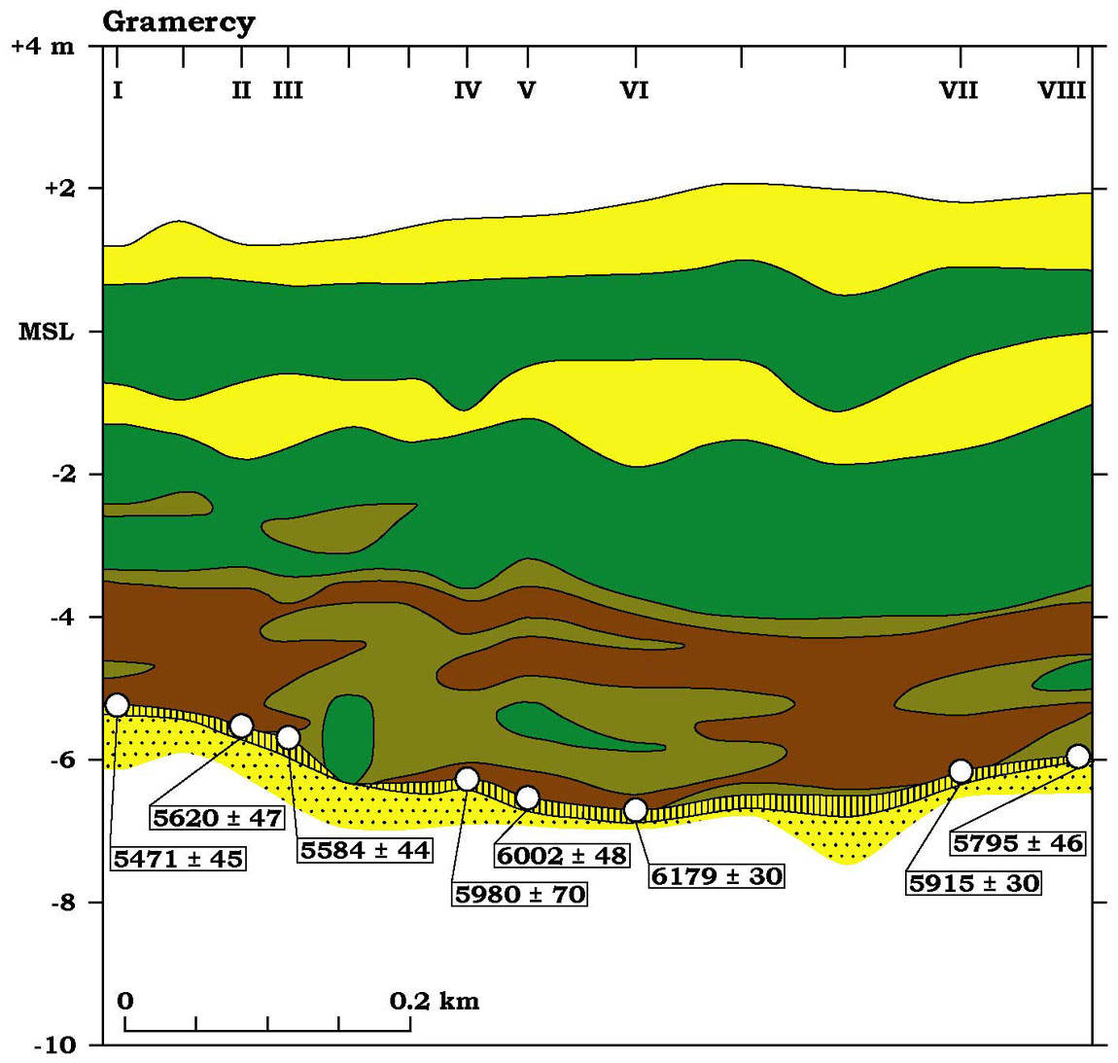

Slide 8
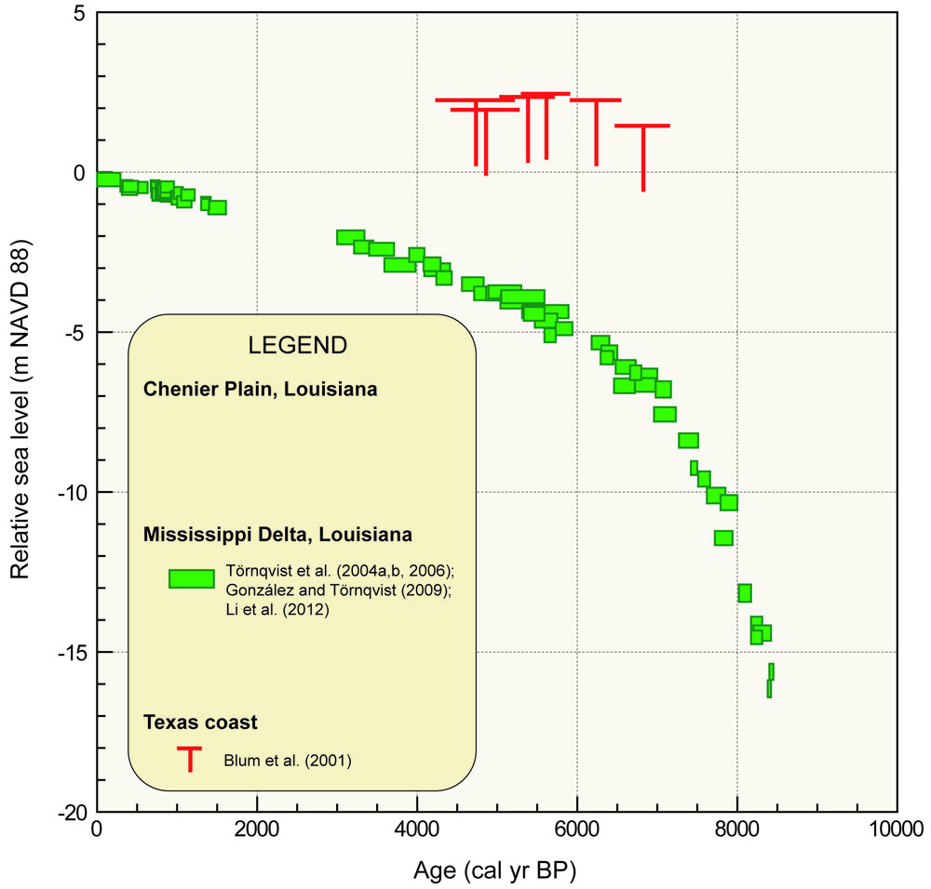
Yu et al. (2012)

Slide 9
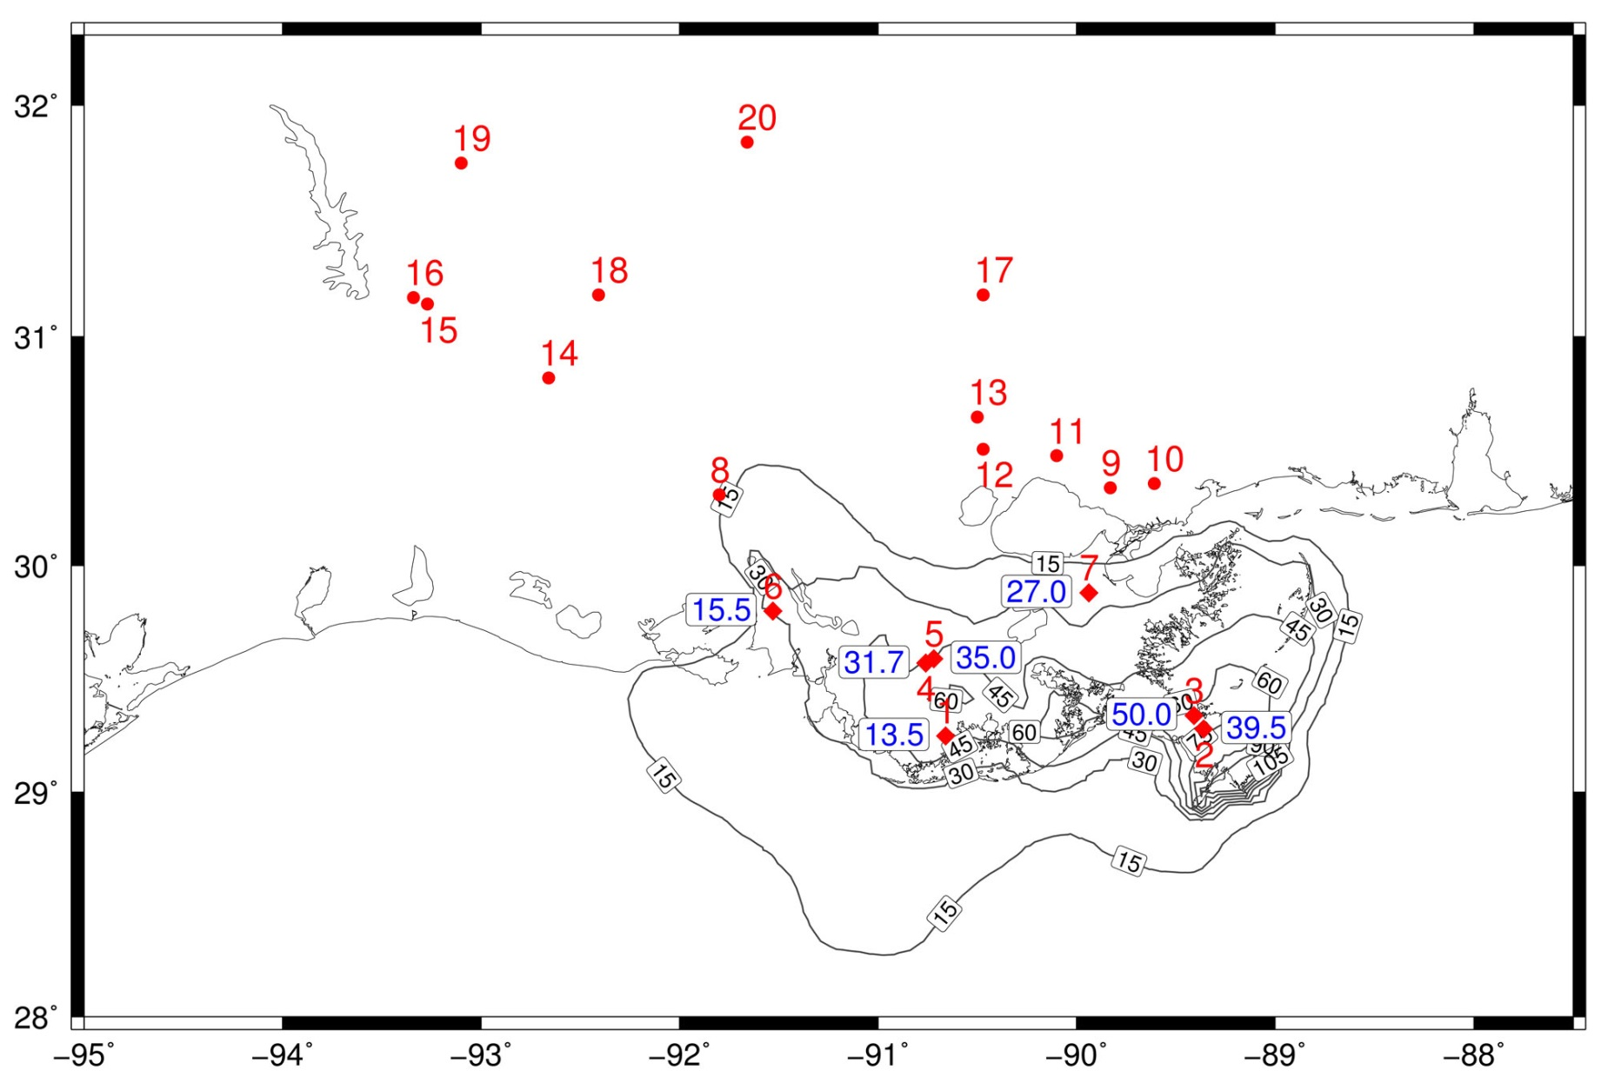
Wolstencroft et al. (2014)

Slide 10
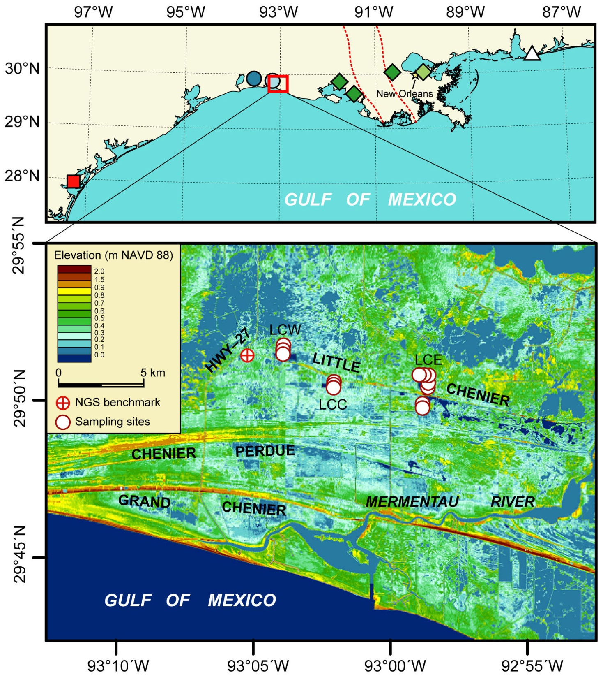
Yu et al. (2012)

Slide 11
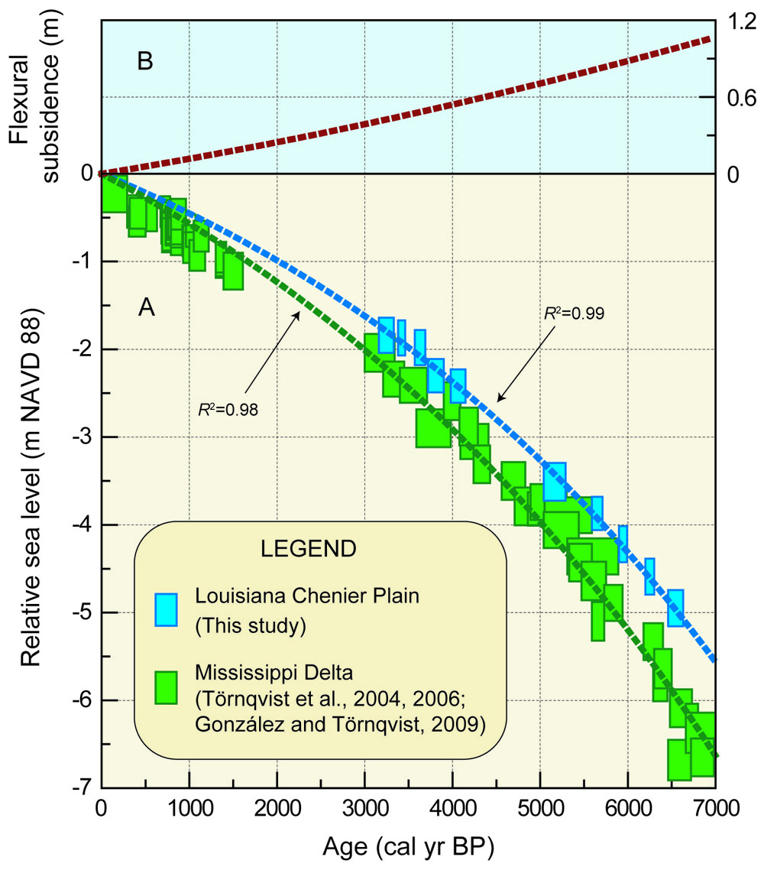
0.15 ± 0.07 mm/yr
Yu et al. (2012)

Slide 12
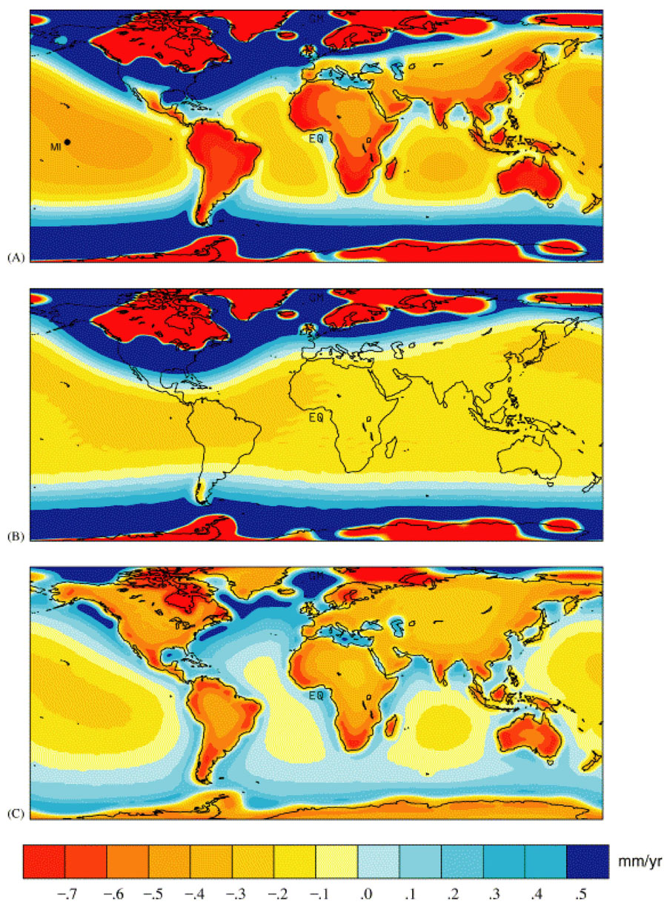
Mitrovica & Milne (2002)

Slide 13
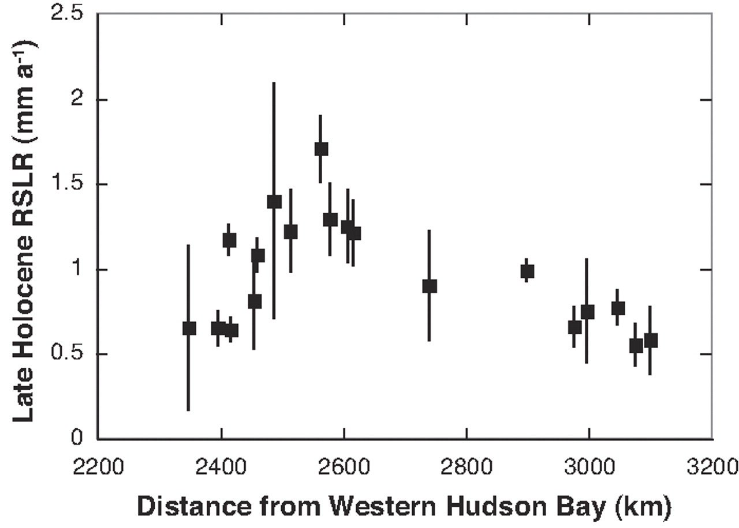
Delaware
Maine
South Carolina
Louisiana
Engelhart et al. (2009)

Slide 14
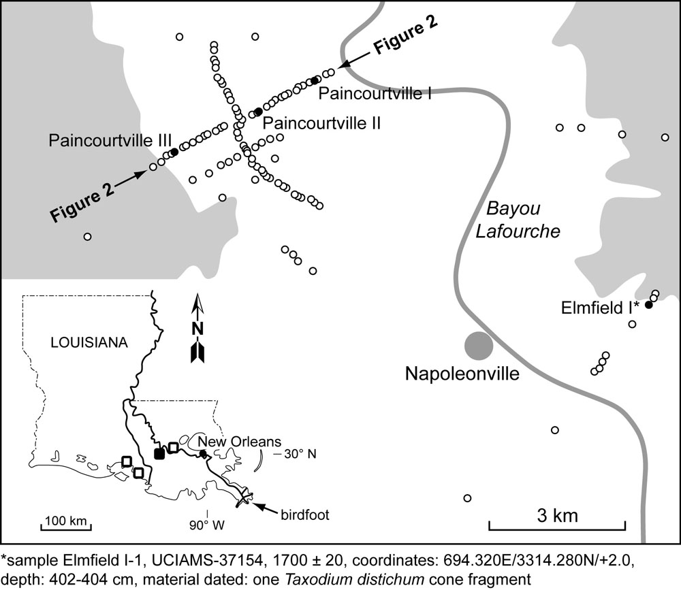
Törnqvist et al. (2008)

Slide 15
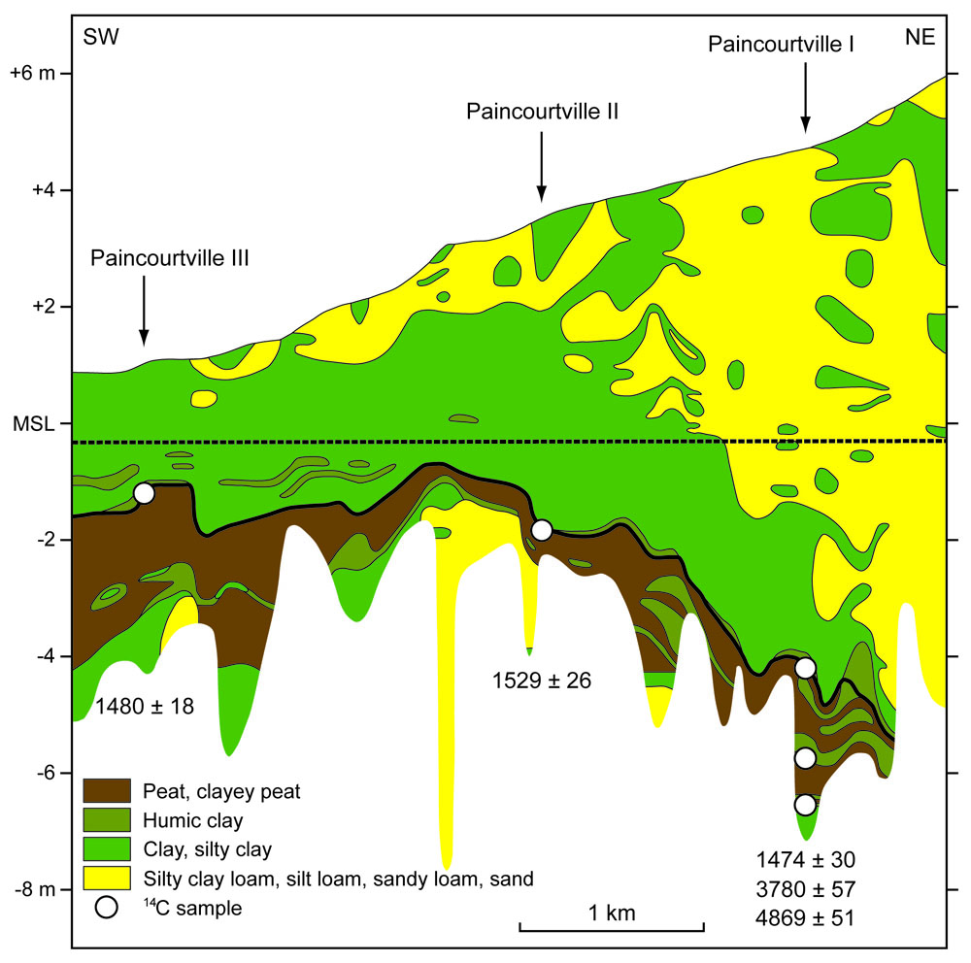
Törnqvist et al. (2008)

Slide 16
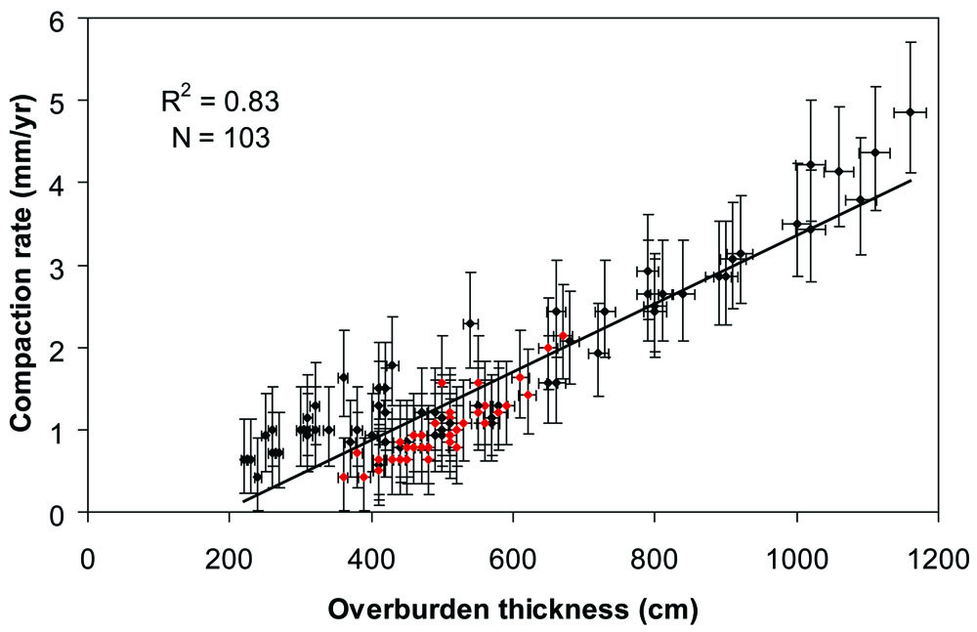
Törnqvist et al. (2008)

Slide 17
Published findings…
Regional processes deeper in the Earth’s crust generally contribute relatively little to land-surface subsidence rates (typically <1 mm/yr in aggregate)
Deltaic sediment loading leads to lithospheric subsidence rates in key portions of the Mississippi Delta of ~0.15 ± 0.07 mm/yr relative to the Chenier Plain
The common, long-term process that drives lithospheric subsidence throughout the Gulf of Mexico is glacial isostatic adjustment (likely within the 0.5-1.0 mm/yr range along the central US Gulf Coast)

Slide 18
Published findings…
Regional processes deeper in the Earth’s crust generally contribute relatively little to land-surface subsidence rates (typically <1 mm/yr in aggregate)
Deltaic sediment loading leads to lithospheric subsidence rates in key portions of the Mississippi Delta of ~0.15 ± 0.07 mm/yr relative to the Chenier Plain
The common, long-term process that drives lithospheric subsidence throughout the Gulf of Mexico is glacial isostatic adjustment (likely within the 0.5-1.0 mm/yr range along the central US Gulf Coast)
Compaction of Holocene strata is likely a dominant contributor to subsidence, with millennial-scale rates up to 5 mm/yr
Fluid extraction and growth faulting are potentially significant factors at the local scale and in need of major research efforts

Slide 19
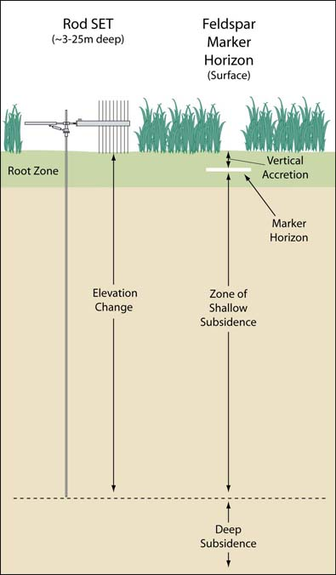
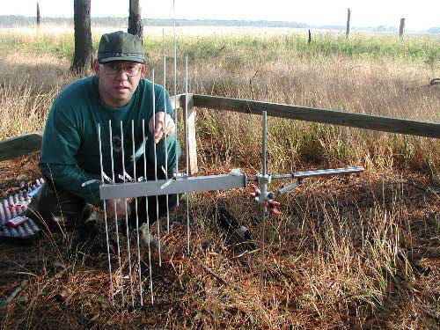
Rod surface-elevation table –
marker horizon method
(RSET-MH)

Slide 20
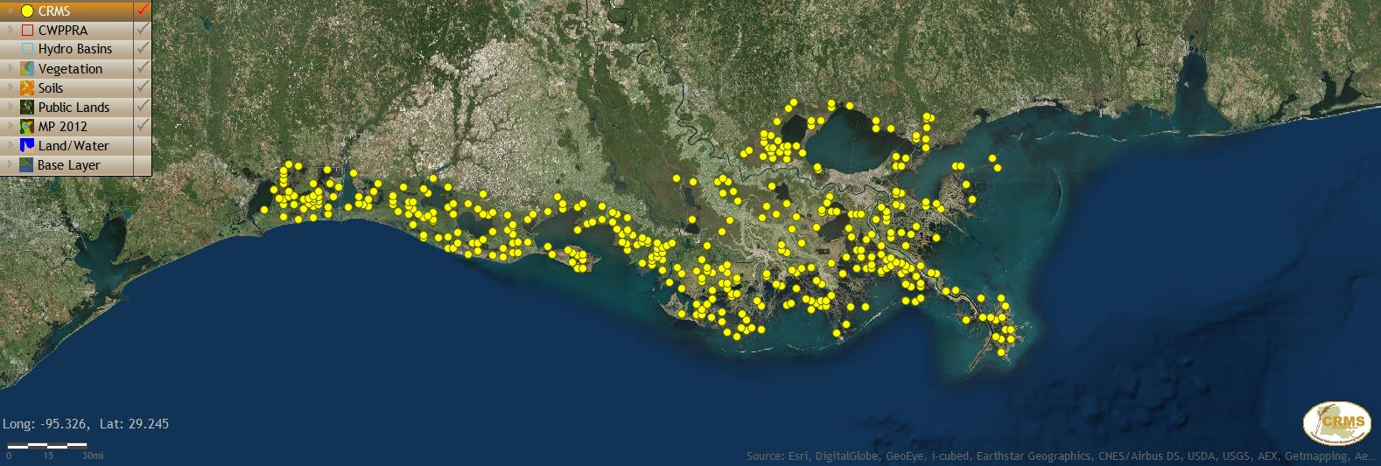

Slide 21
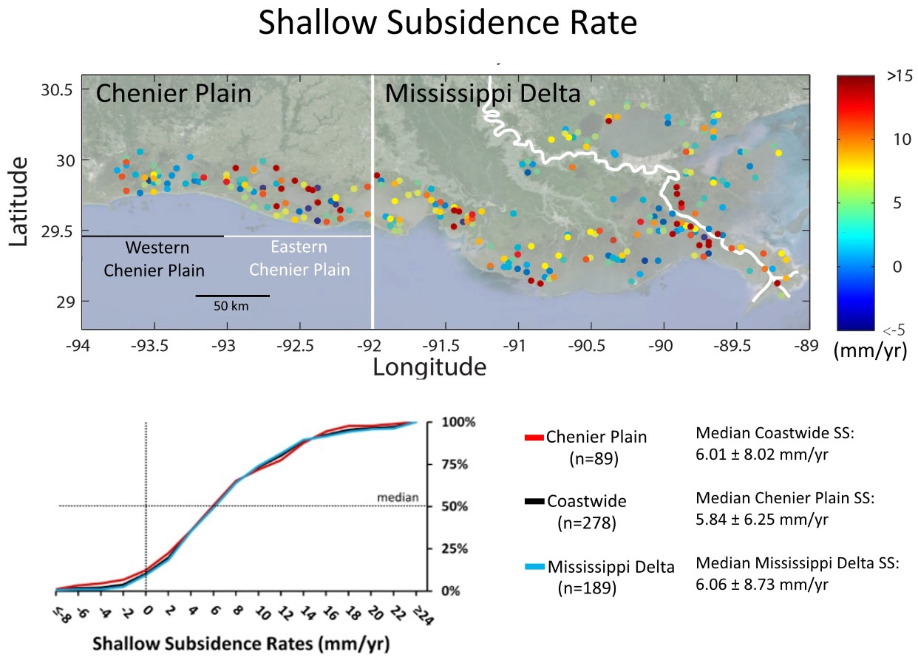
7 ± 8 mm yr⁻¹

Slide 22
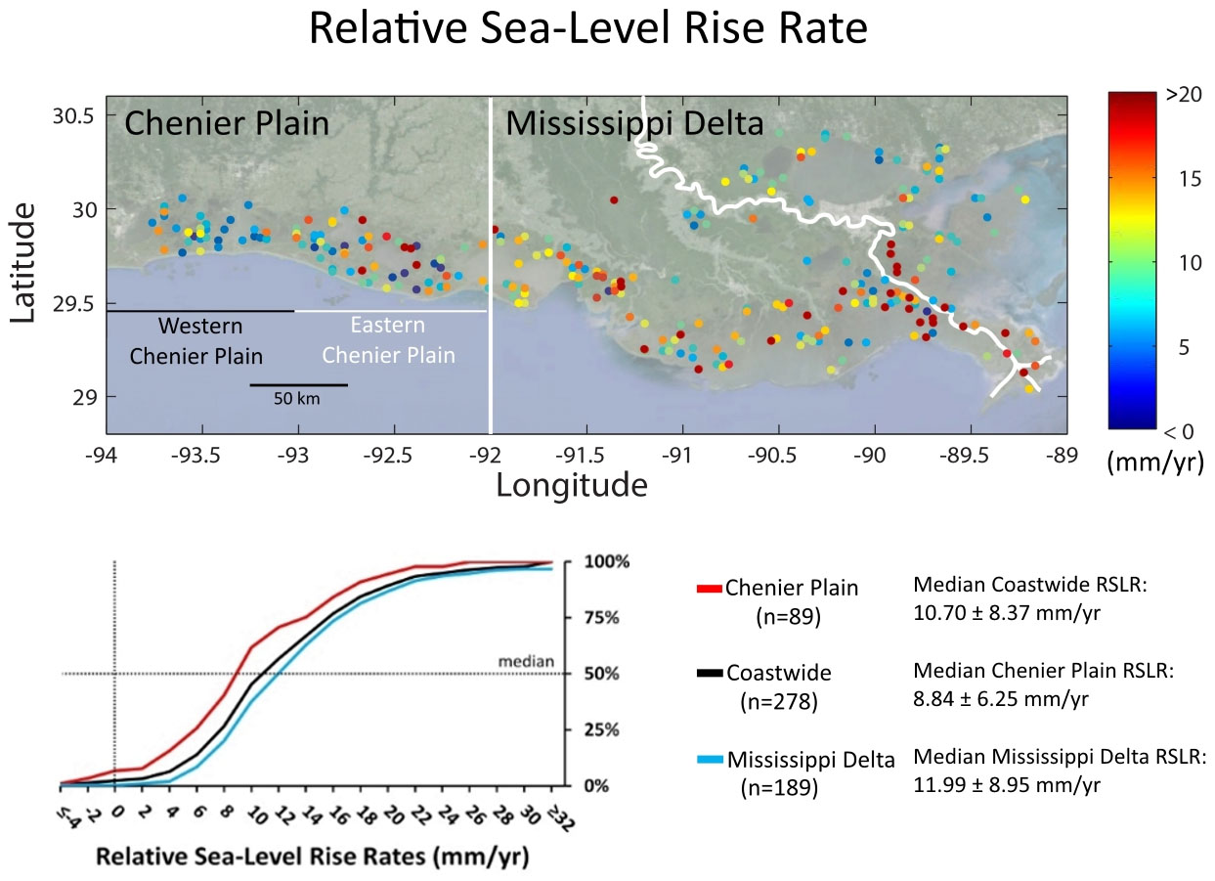
12 ± 8 mm yr⁻¹

Slide 23
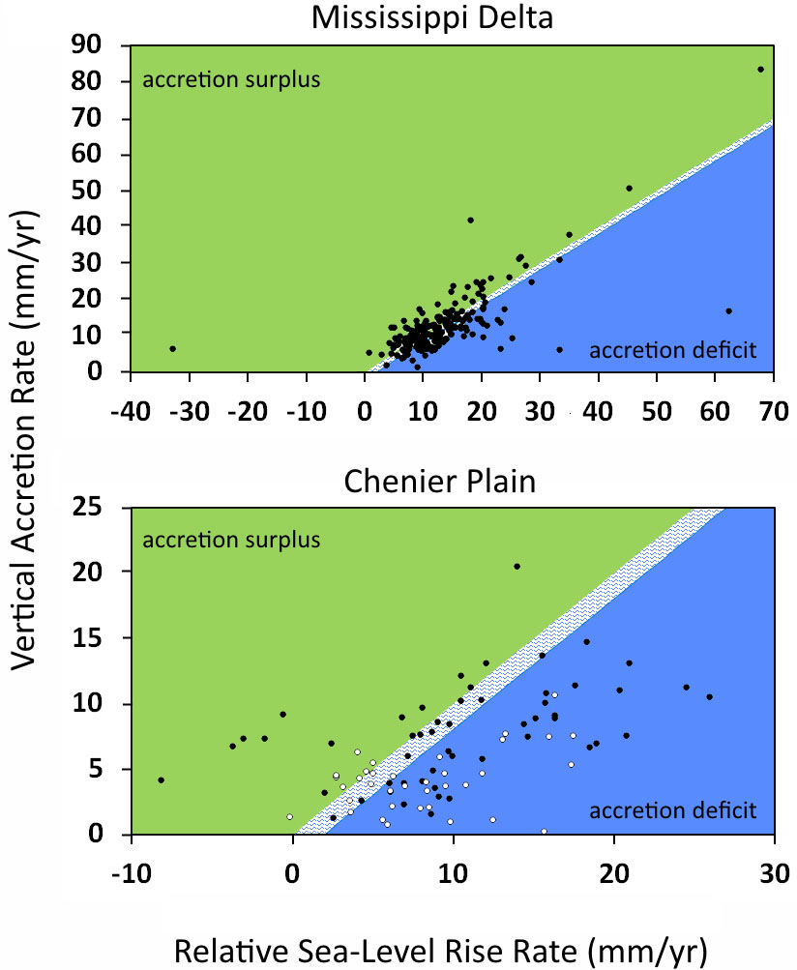
Mississippi Delta:
36% accretion deficit
Chenier Plain:
58% accretion deficit
Western Chenier Plain:
68% accretion deficit

Slide 24
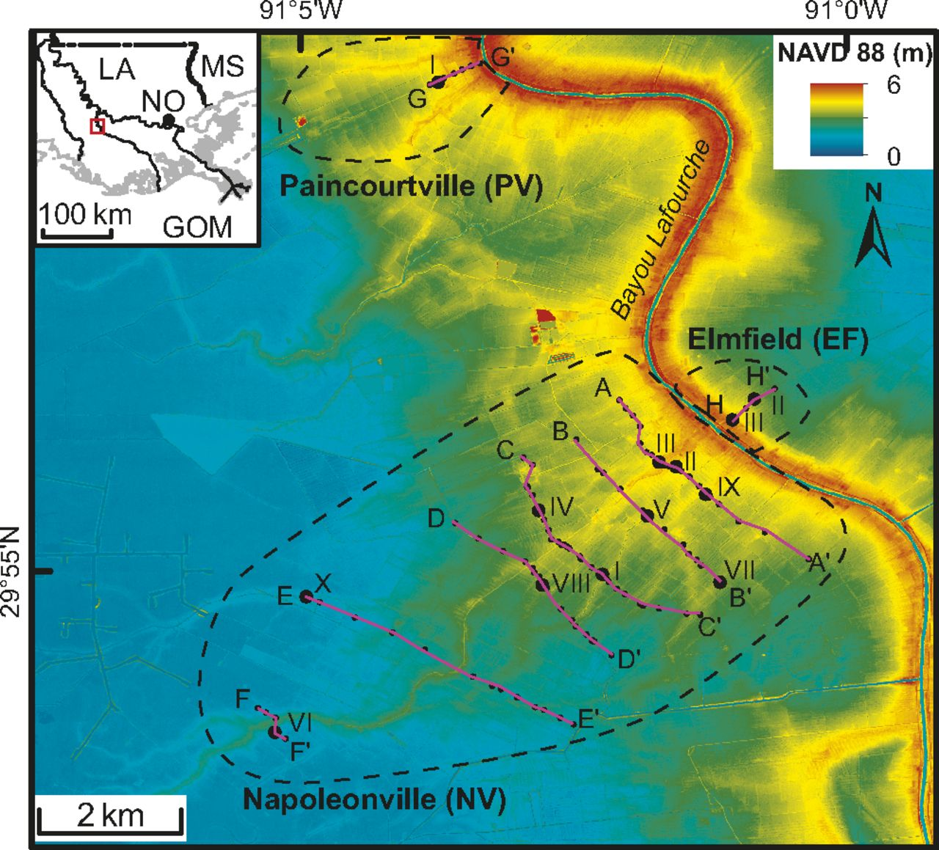

Slide 25
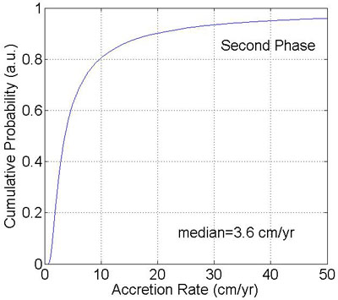
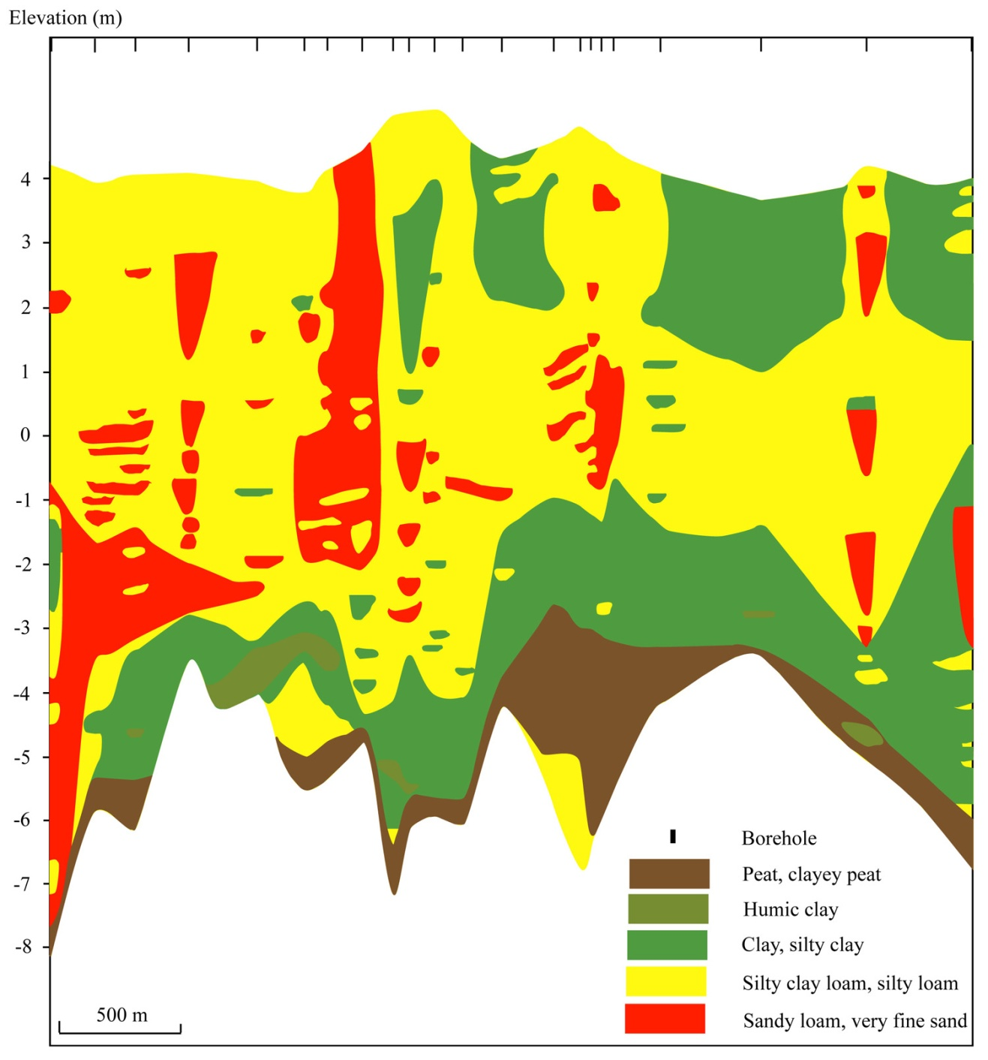
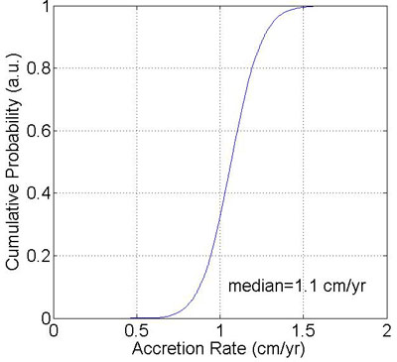
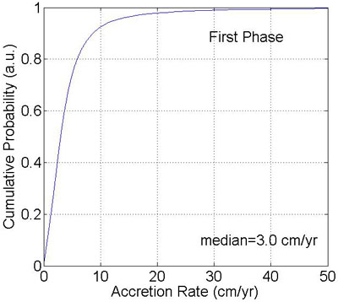
680 ± 30
650 ± 40
640 ± 30
1120 ± 50
1090 ± 60
1130 ± 60
1120 ± 40
990 ± 50
1100 ± 70

Slide 26
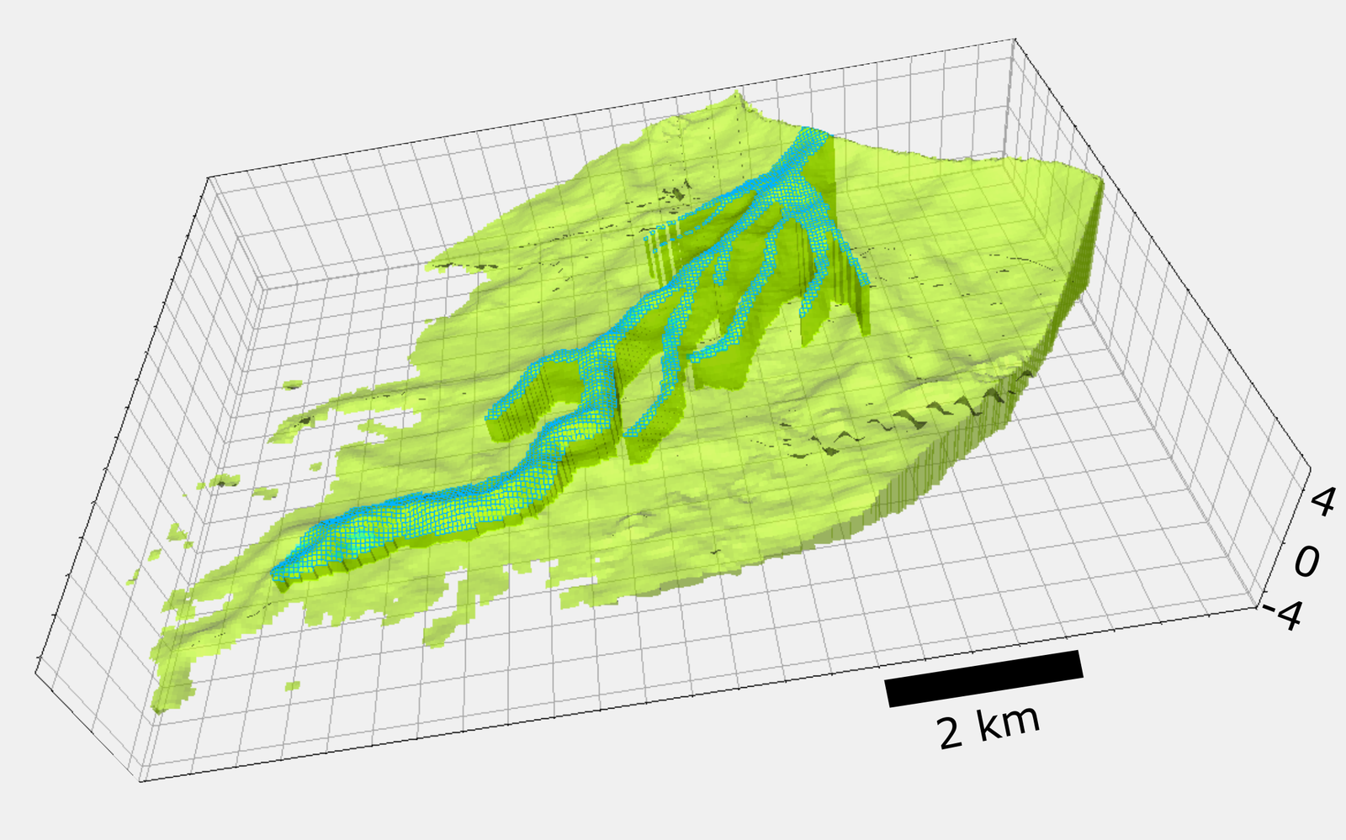
Attakapas Crevasse Splay

Slide 27
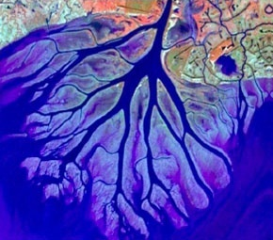
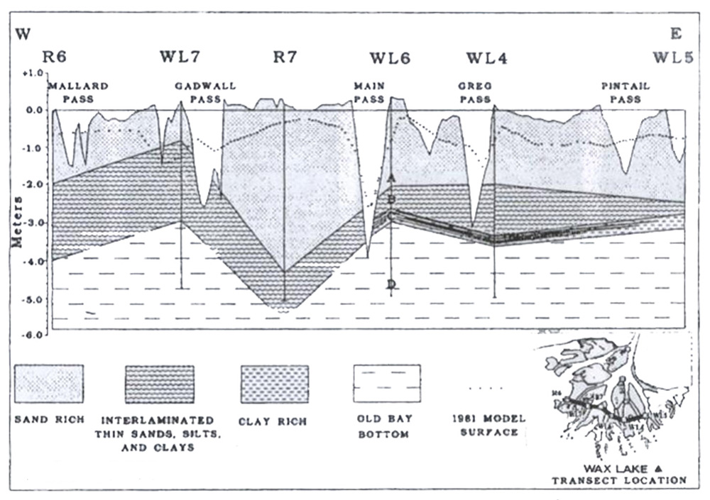
Wax Lake Delta
Sandy deposits account for ~70%
Proportion of sand in feeder channel ~20%
Retention rate 20-40%
Roberts (2003)

Slide 28
Attakapas Crevasse Splay
Sand accounts for ~5%
Proportion of sand from feeder channel ~5%
Retention rate >75%

Slide 29
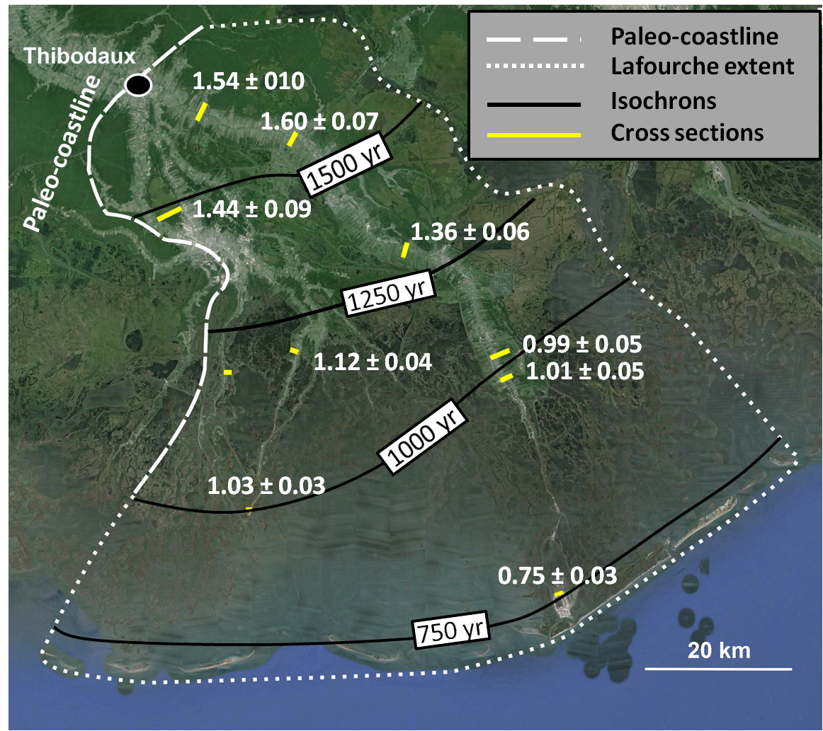
Total land area: 6000 km²
Period of activity: 1.6 – 0.6 ka
Mean land area production rate: ~6 km²/yr
(or ~0.13 football fields/hr)
Progradation rate: 120 – 150 m/yr

Slide 30
Emerging findings…
The present-day rate of relative sea-level rise at the land surface is 12 ± 8 mm/yr
Shallow subsidence (likely within the uppermost 5-10 m) contributes ~60-85% to total subsidence in coastal Louisiana
Mississippi Delta wetlands may keep up with relative sea-level rise (but note some caveats!) while the western Chenier Plain is in particular trouble

Slide 31
Emerging findings…
The present-day rate of relative sea-level rise at the land surface is 12 ± 8 mm/yr
Shallow subsidence (likely within the uppermost 5-10 m) contributes ~60-85% to total subsidence in coastal Louisiana
Mississippi Delta wetlands may keep up with relative sea-level rise (but note some caveats!) while the western Chenier Plain is in particular trouble
Delta-plain progradation over centennial to millennial timescales has built land at rates of ~6 km²/yr
Crevasse splays along Mississippi Delta distributaries can sustain accretion rates of 1-4 cm/yr over decadal to centennial timescales
Sediment retention efficiency is particularly high in these inland, vegetated settings and conservatively estimated at >75%

Slide 32
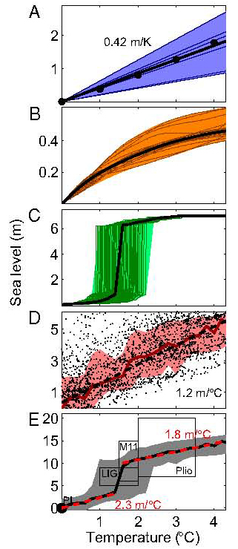
Levermann et al. (2013)
Notes:
Crisis = danger + opportunity

Slide 33
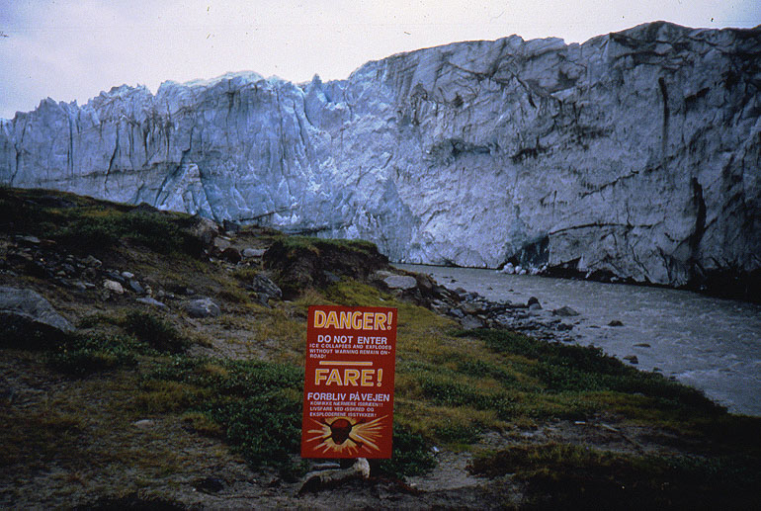

Slide 35
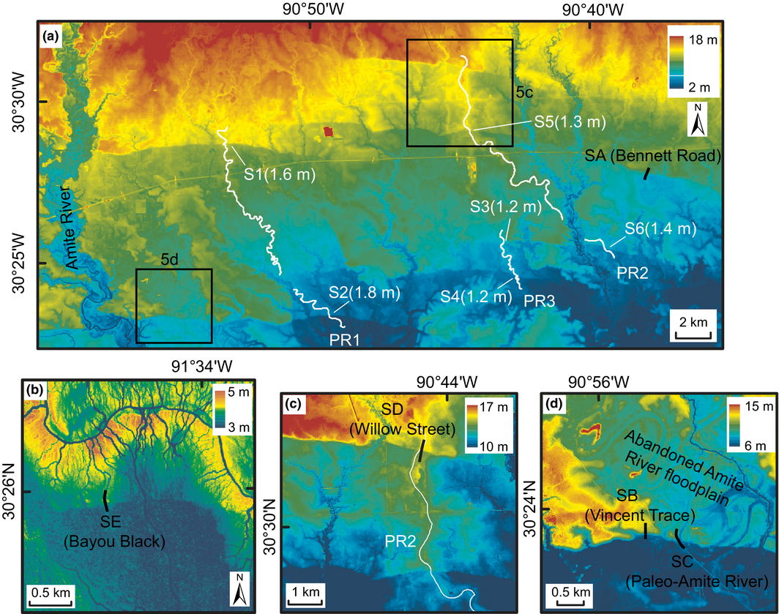
Shen et al. (2017)

Slide 36
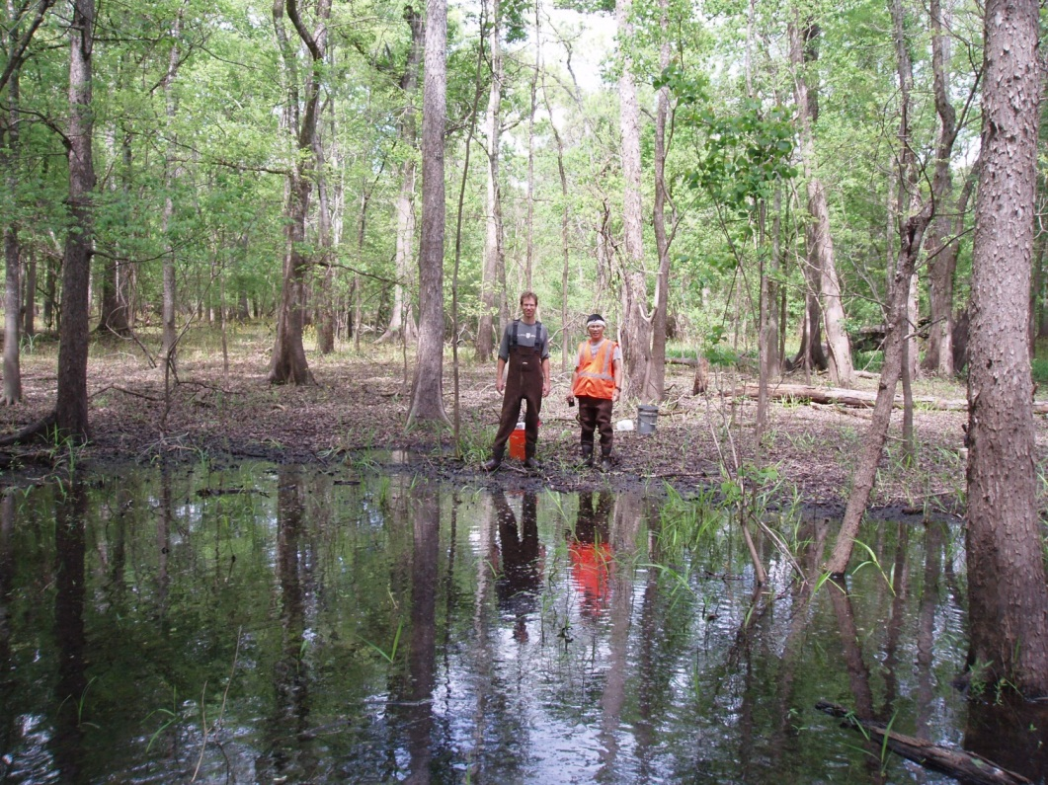
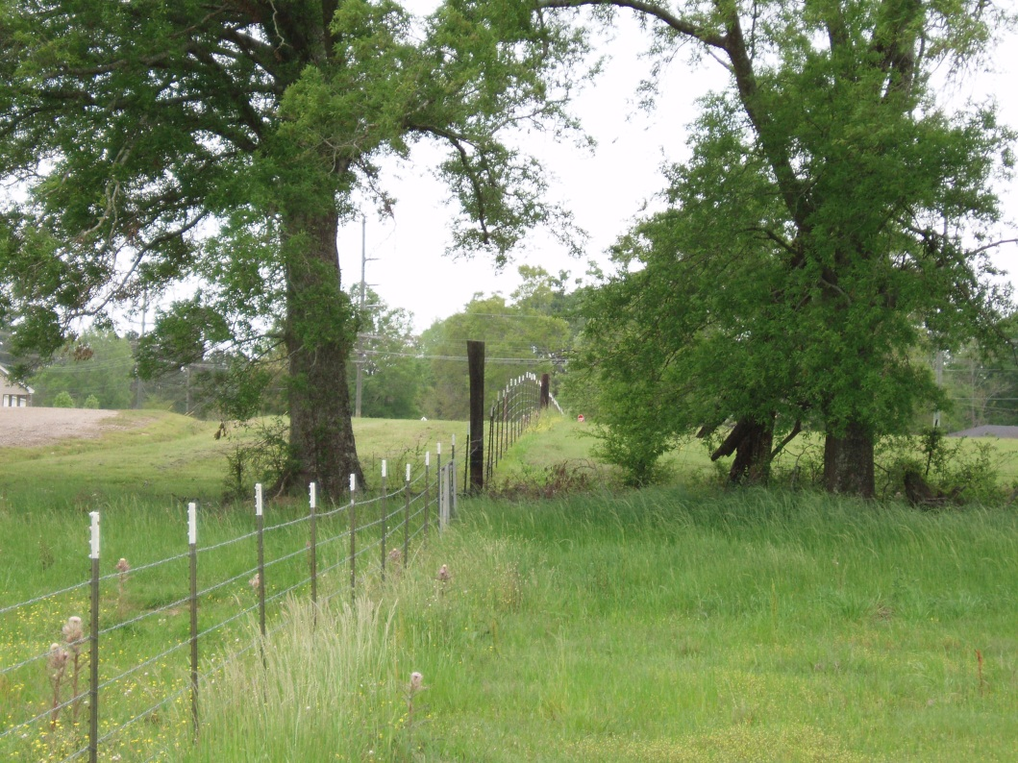
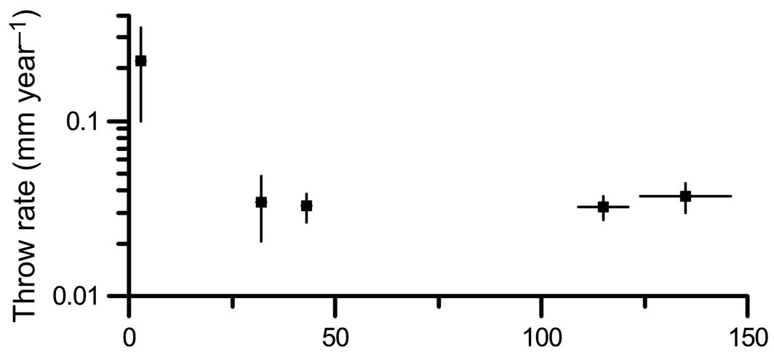
Shen et al. (2017)

Slide 37
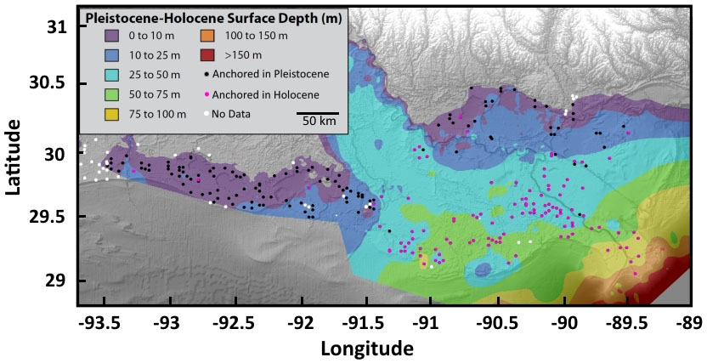
Base map from Louisiana Geological Survey

Slide 38
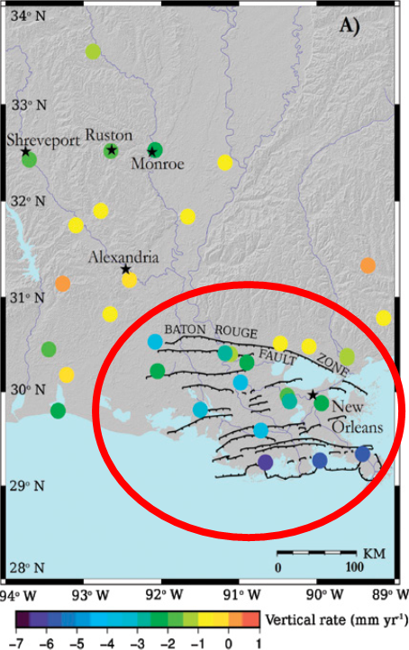
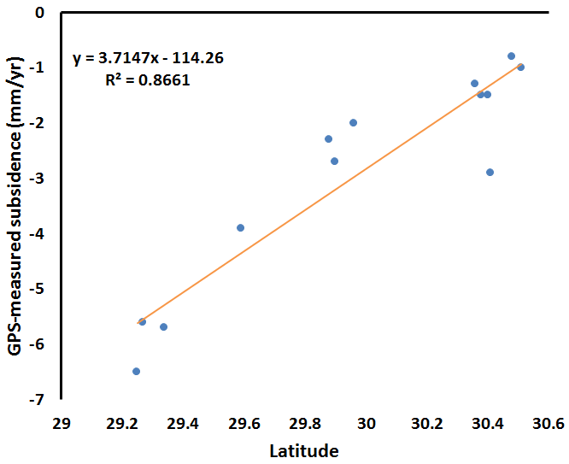
Deep subsidence rates from GPS-records ≥5 years in length
Karegar et al. (2015)

Slide 39
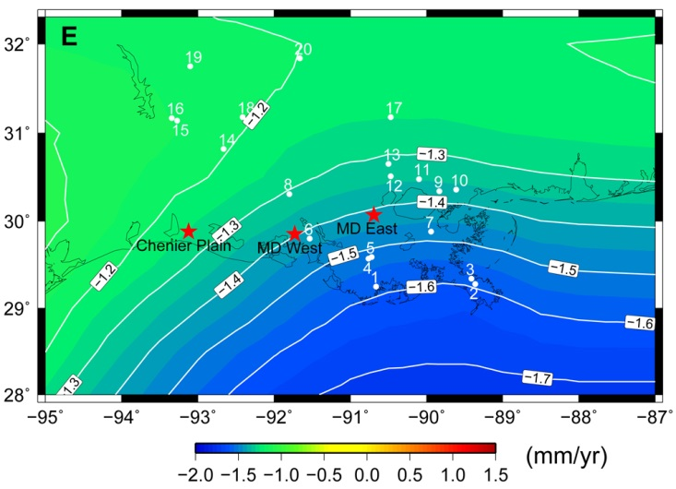
Lithosphere elastic thickness: 96 km
Upper mantle viscosity: 1x10²¹ Pa s
Lower mantle viscosity: 1x10²² Pa s
Wolstencroft et al. (2014)

Slide 40
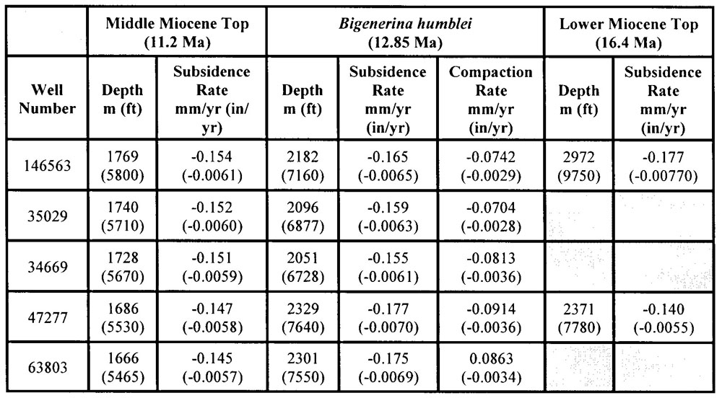
Long-term subsidence rates in New Orleans East
Edrington et al. (2008)

Slide 41
RSET-MH records ≥5 years in length

Slide 42
~6 mm yr⁻¹

Slide 43
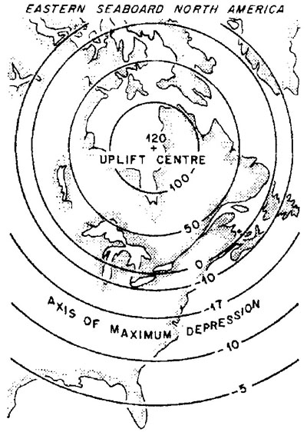
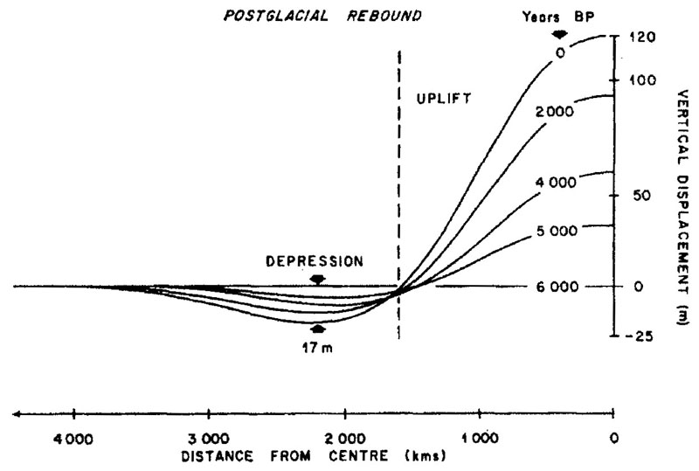
Walcott (1972)

