Slide 1
Building on Our Commitment to Protect and Restore Our Coast
BTNEP Management Conference
July 28, 2016

Slide 2
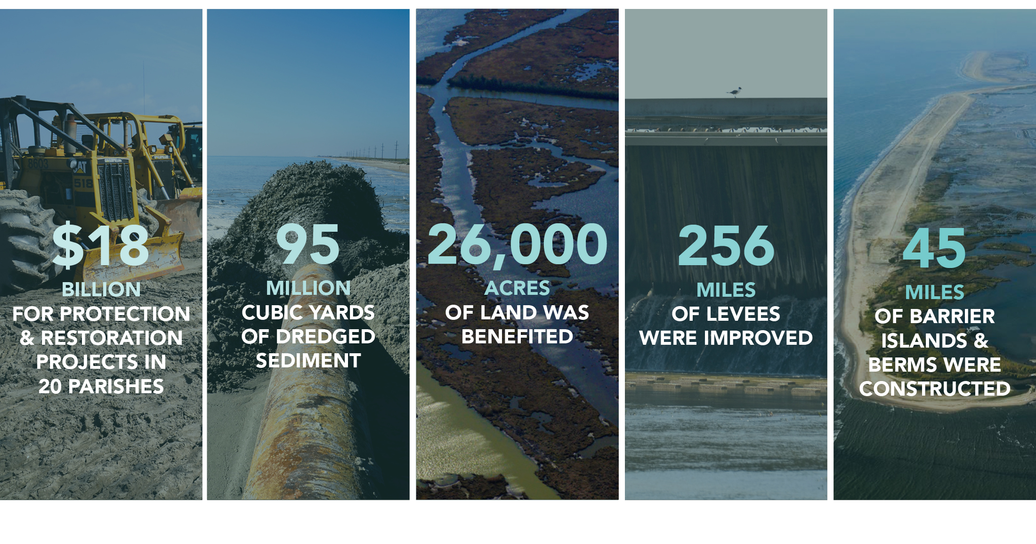
RESPONDING TO THE CRISIS: LOUISIANA’S COASTAL PROGRAM SINCE 2007
Notes:
Since 2007, we have made great strides in restoring and protecting our coast.
In these few short years, CPRA has worked with federal, state, and local partners to commit approximately $18 billion for protection and restoration projects in 20 parishes.
Ninety-five million cubic yards of dredged sediment has been placed in our wetlands; we’ve benefited more than 26,000 acres of coastal lands, improved 256 miles of levees, and constructed 45 miles of barrier islands and berms providing our coast with a crucial first line of defense.
We are proud of our successes to date, and more is to come.

Slide 3
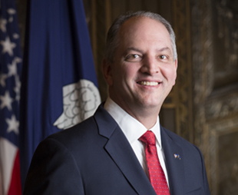
Executive Order
Signed into action by Governor John Bel Edwards on April 4, 2016
Requires all State agencies to administer their regulatory practices, programs, projects, contracts, grants, and all other functions vested in them in a manner consistent with Coastal Master Plan

Slide 4
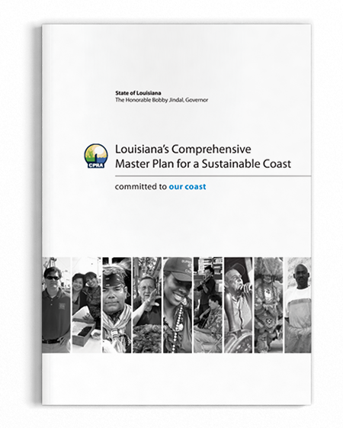
2012 COASTAL MASTER PLAN
Built on world class science and engineering
Evaluated hundreds of existing project concepts
Incorporated extensive public input and review
Resource constrained
Funding, water, sediment
Identified investments that will pay off, not just for us, but for our children and grandchildren
Notes:
The 2012 Coastal Master Plan provides the information Louisiana’s coastal citizens need as they seek to take care of their families, manage businesses, and plan for the future.
The technical decisions made as part of the 2012 Coastal Master Plan were done so utilizing world class science and engineering. As such, CPRA evaluated hundreds of existing project concepts to determine which projects represented the best investment. While the plan is based on science, it also incorporates extensive public input and review.
Unlike many previous plans, the projects included are resource constrained, meaning that our decisions accounted for the fact that we have limited funding, fresh water, and sediment.
Lastly, the plan identified investments that will pay off, not just for us but for our children and grandchildren.

Slide 5
OBJECTIVES OF THE COASTAL MASTER PLAN
Notes:
The Coastal Master Plan is designed to provide the direction and path forward needed to save our coast.
These objectives reflect the key issues affecting people in and around Louisiana’s coast, seeking to improve flood protection for families and businesses, recreate the natural processes that built Louisiana’s delta, sustain our unique cultural heritage, and ensure that our coast continues to be both a Sportsman’s Paradise and a hub for commerce and industry.

Slide 6
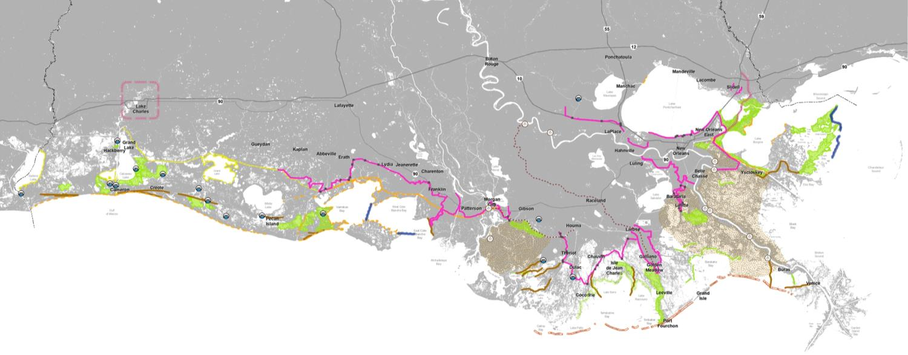
LOUISIANA’S 2012 COMPREHENSIVE MASTER PLAN FOR A SUSTAINABLE COAST
Nonstructural Measures
Notes:
As I mentioned previously, the 2012 Coastal Master Plan was developed through a groundbreaking technical effort and extensive public outreach.
Through this effort, identified the projects shown here. These projects will substantially increase protection for communities and make great strides toward achieving a sustainable coast. They include a diverse mix of projects throughout the coast, from the Chenier Plain to the Mississippi border.
The projects strike a balance between providing immediate relief to hard-hit areas and laying groundwork for the large-scale efforts that are essential if we are to protect communities and sustain our landscape. Building on this path forward is our commitment to the coast.
The overall goals of these projects are to use a combination of restoration, nonstructural, and targeted structural measures to provide increased flood protection for communities and to use an integrated systems approach to ensure a sustainable and resilient coastal landscape.

Slide 7
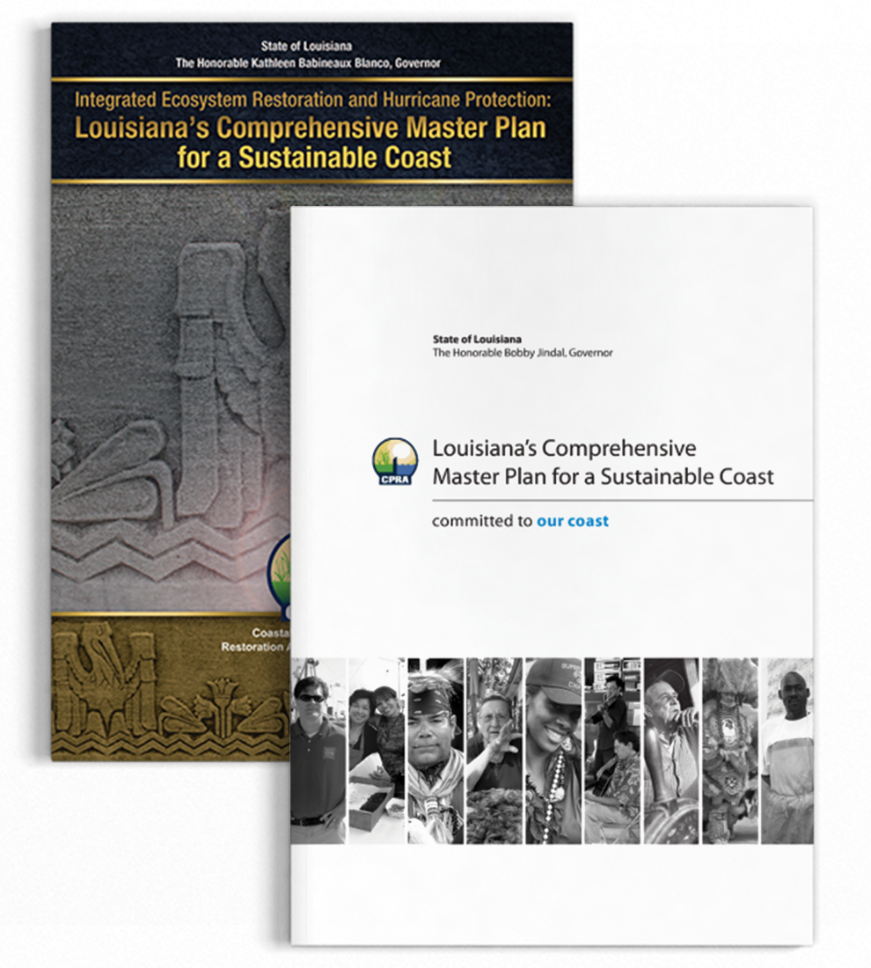
SO WHY ANOTHER PLAN?
It’s required by law to be updated every five years
Allows the state to respond to changes on the ground and public input as well as innovations in science, engineering, and policy
Advances a comprehensive and integrated approach to protecting and restoring the communities of Coastal Louisiana
Notes:
When we visit local communities, one of the most common questions is “So why are you doing another plan?” It’s certainly a valid question.
Louisiana law requires that the Coastal Master Plan be updated every five years and approved by the legislature so the state can respond to changes on the ground as well as innovations in science, engineering, and policy.
The 2017 Coastal Master Plan is the third installment in what will be a series of Coastal Master Plans, each one improving on work done before and helping to establish clear priorities for the future.
The 2017 Coastal Master Plan will carry the planning efforts from 2007 and 2012 forward by advancing a comprehensive and integrated approach to protecting and restoring the communities of coastal Louisiana.
Yearly implementation of the Coastal Master Plan is outlined in a document called CPRA’s Annual Plan.

Slide 8
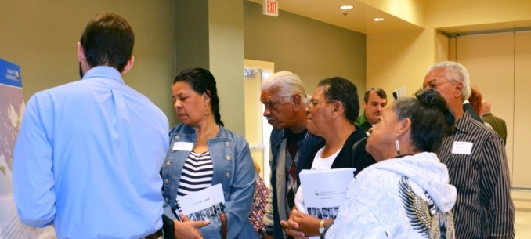
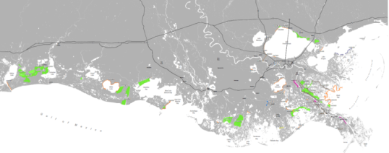
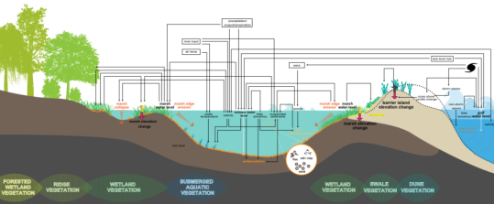
WHAT WILL BE DIFFERENT ABOUT THE 2017 COASTAL MASTER PLAN?
Improved science and technical analysis
Incorporating new ideas and information
Focus on flood risk reduction and resilience
Emphasis on communities
Notes:
The 2017 Coastal Master Plan will build on previous successes, but includes a number of key advancements.
CPRA will continue to focus on flood risk reduction and resilience.
We need to use all of the tools available to reduce communities’ flood risk and, as such, we are exploring different types of nonstructural options and refining policies to help communities become more resilient.
The 2017 Coastal Master Plan will present a much more detailed path forward for nonstructural project recommendations, funding sources, and grant procedures.
In addition, we are also expanding outreach through the creation of a new, interactive web-based tool to help residents better understand their flood risk now and in the future.
To view the tool, visit the “Flood Risk and Resilience Viewer” at cims.coastal.la.gov/floodrisk.
There will also an emphasis on communities and possible ways to integrate socio-economics into the analysis.
We know coastal restoration and protection goals ultimately intend to support the people who live and work in coastal Louisiana, and the 2017 Coastal Master Plan will place a greater focus on these communities.
CPRA appreciates the importance of understanding the cost of continued land loss as well as potential effects for all specific project actions on our culture and our local, regional, and national economy.
This information will be quantified and included in our analysis and decision making process.
CPRA is incorporating new ideas and information.
The 2017 Coastal Master Plan considers an array of new project ideas not modeled in 2012; these new project ideas were submitted from across the coast by stakeholders and members of the public.
Additionally, we will see significant advancements and improving the models based on the best available science.
The 2012 Coastal Master Plan was founded on state-of-the-art science and analysis, and the 2017 effort builds upon this further.
The modeling process provides a deeper understanding of our coastal environment today, as well as the changes we can expect over the next 50 years.
Recent updates include advancing modeling tools, incorporating a larger geographic area, and increasing spatial detail of land loss and flood risk.

Slide 9
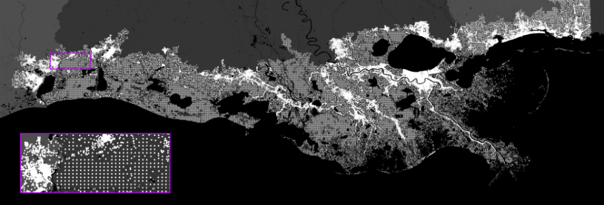
IMPROVED SCIENCE AND TECHNICAL ANALYSIS
Major Improvements
Integrated Compartment Model
Spatial resolution/extent
Incorporation of additional landscape and ecosystem processes
Enhanced fish/shellfish modeling
Primary Model Components
Landscape
Ecosystem
Risk reduction
Notes:
For the 2017 Coastal Master Plan, CPRA is making significant advancements and improving the models based on the best available science.
While the 2012 Coastal Master Plan was founded on state-of-the-art science and analysis, the 2017 effort builds upon this further in terms of both these major improvements and primary model components.
Recent updates include advancing modeling tools, incorporating a larger geographic area, and increasing spatial detail of land loss and flood risk, as well as improvements to primary model components, such as landscape, ecosystem and risk reduction.
Through these improvements, the modeling process can provide a deeper understanding of our coastal environment today, as well as the changes we can expect over the next 50 years.

Slide 10
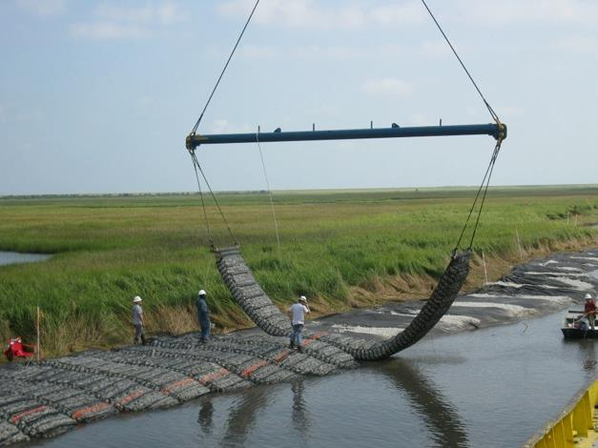
INCORPORATING NEW IDEAS AND INFORMATION
2012 Coastal Master Plan considered projects that were previously proposed and included in prior planning efforts
In order to capture new project ideas, CPRA created the New Project Development Program
The Program encouraged individuals and organizations to submit new projects for consideration
150 projects submitted
Projects that met required criteria are being evaluated for the 2017 Coastal Master Plan
Notes:
For the 2012 Coastal Master Plan, CPRA considered projects that were previously proposed and included in prior planning efforts.
The 2017 Coastal Master Plan considers an array of new project ideas not modeled in 2012; these new project ideas were submitted from across the coast by stakeholders and members of the public.
Due to a high level of interest and the large volume of project proposals received to date, CPRA issued two requests for proposals, which yielded about 150 new project ideas that are being evaluated for inclusion in the 2017 Coastal Master Plan.
These proposals included projects that:
Build and/or sustain land;
Provide significant flood risk reduction;
Address radical shifts in the coastal landscape; and
Confront future uncertainty challenges.

Slide 11
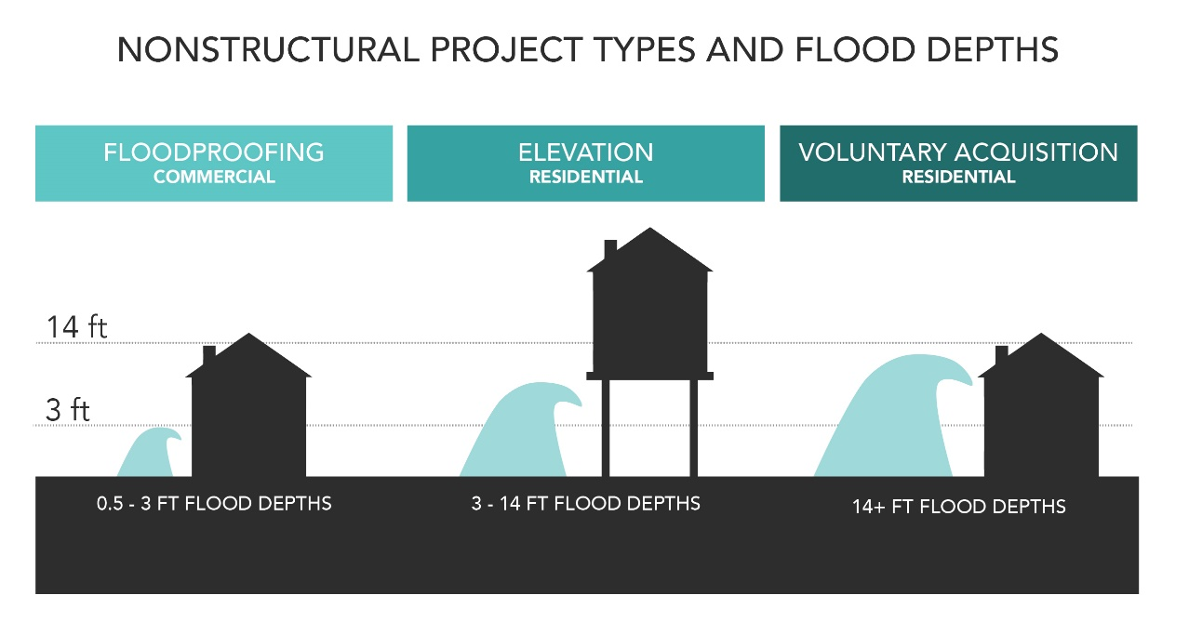
FOCUS ON FLOOD RISK REDUCTION AND RESILIENCE
CPRA is developing a framework to implement both nonstructural projects and programmatic measures to provide a comprehensive approach to flood risk reduction for homes, businesses, and community assets.
Program Framework
Develop Data and Tools
Provide Information
Provide Options
Create Platforms for Collaboration and Action
Notes:
With a focus on flood risk reduction and resilience, CPRA aims to both advance the recommendations in the 2012 Master Plan by providing a more specific strategy for implementing nonstructural projects in communities, as well as coordinate resources and expand citizens access to information and tools that can help guide individual and local community decisions to reduce flood risk
The program framework for these goals includes:
Developing data and tools: CPRA is working to develop integrated databases on flood risk, vulnerability, and socio-economic trends to determine the most effective resilience measures.
Providing information: This involves increasing public awareness of current and future flood risks due to climate change and provide clear mapping and visualization tools for coastal communities.
Providing options: It is critical to maximize choices of flood risk reduction measures and clearly communicate options to individuals and communities.
Creating platforms for collaboration and action: One of the most important parts to flood risk reduction and resilience is to create networks of coastal stakeholders and diverse community participants to partner in program development and implement solutions.

Slide 12
EMPHASIS ON COMMUNITIES
Reviewing long-term shifts in population
Understanding the impacts of coastal land loss and flood risk on communities and resources
Developing metrics to understand social vulnerability, flood protection of historic properties, and how best to support and maintain our traditional fishing, agricultural, and oil and gas communities
Notes:
CPRA appreciates the importance of understanding the cost of continued land loss as well as potential effects for all specific project actions on our culture and our local, regional, and national economy.
CPRA also knows that coastal restoration and protection goals ultimately intend to support the people who live and work in coastal Louisiana, and the 2017 Coastal Master Plan will place a greater focus on these communities.
To do this, CPRA will review long-term shifts in population and develop a better understanding of the impacts of coastal land loss and flood risk on our coastal communities and resources.
CPRA will also develop criteria to understand the distribution of flood risk across socio-economic groups, flood protection of historic properties, and how best to support and maintain the unique cultural heritage of our coastal communities.
This information will be quantified and included in the 2017 Coastal Master Plan’s analysis and decision making process.

Slide 13
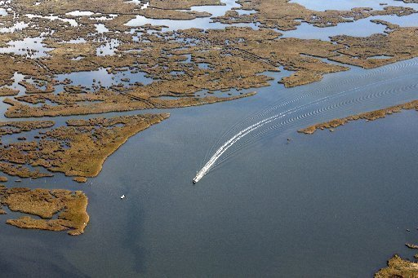
National Significance
Plan to highlight the national significance of Louisiana’s industries in the master plan
Need input from representatives and stakeholders to ensure accurate portrayal
Point us to key reports, websites, etc. that highlight this information

Slide 14
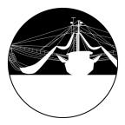
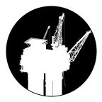
Appendix H - People & the Landscape
Maps showing the people/community, industry, infrastructure links in the coastal area
Info/data on community metrics from the 2017 Master Plan
Social vulnerability index metric results and report
Other community metrics: Traditional Fishing Communities, Support for Oil and Gas Activities and Communities, Support for Agricultural Communities, Flood Protection of Strategic Assets, and Flood Protection of Historic Properties

Slide 15
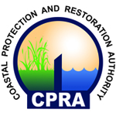
PLANNING TEAM
Karim Belhadjali
Bren Haase
Mandy Green
Melanie Saucier
Ashley Cobb
Andrea Galinski
Zach Rosen
SUPPORTED BY:
Notes:
While the Coastal Master Plan is the state’s plan, the legislature has directed CPRA to lead the development and implementation.
The Coastal Master Plan team is led by individuals from CPRA, and supported by The Water Institute of the Gulf, The RAND Corporation, Arcadis, and Emergent Method.

Slide 16
TECHNICAL TEAM COLLABORATIVE TEAM OF OVER 70 EXPERTS
Notes:
When all is said and done, this is a Louisiana plan for Louisiana people.
That’s why the primary data gathering and modeling efforts are being led by those who know the coast firsthand.
They know exactly how urgently we need solutions for our coast because they see the land loss and live with the flooding and hurricanes that affect us all.
The technical team includes 70 experts from a wide range of organizations who have developed and revised models and provided technical guidance to support the 2017 Coastal Master Plan.

Slide 17
A Framework to Make Decisions
THE ANALYTICAL CHALLENGE
VARIETY OF VIEW POINTS
Complex Coastal Environment
50 Year Planning Horizon
Uncertain Future Scenarios
Multiple Project Types
Diverse Community Needs
Risk Reduction (Structural or Nonstructural) vs. Restoration
Near-Term Benefits vs. Long-Term Sustainability
Different Stakeholder Preferences

Slide 18
Developing the Coastal Master Plan

Slide 19
Developing the Coastal Master Plan

Slide 20
Planning Framework

Slide 21
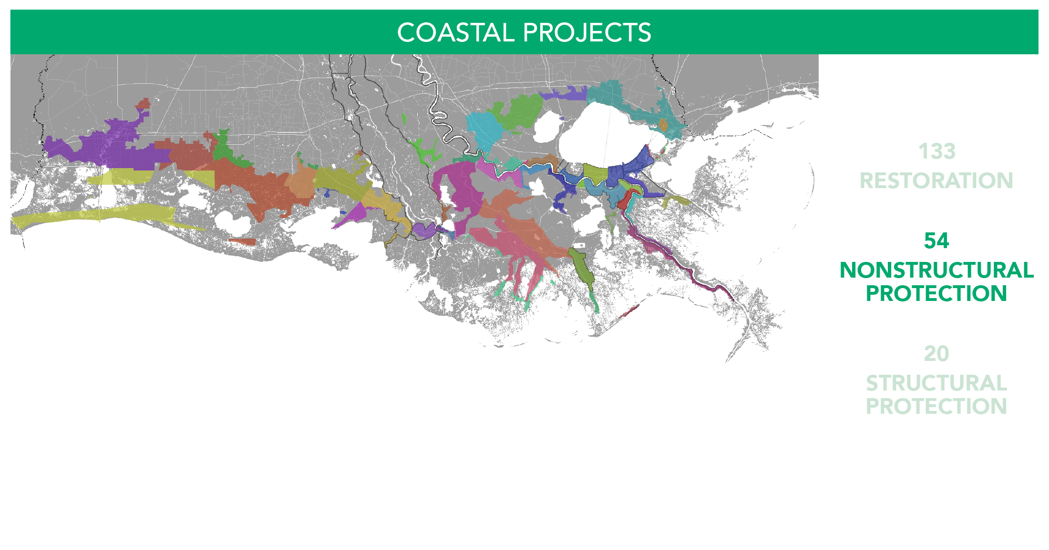
Planning Framework

Slide 22
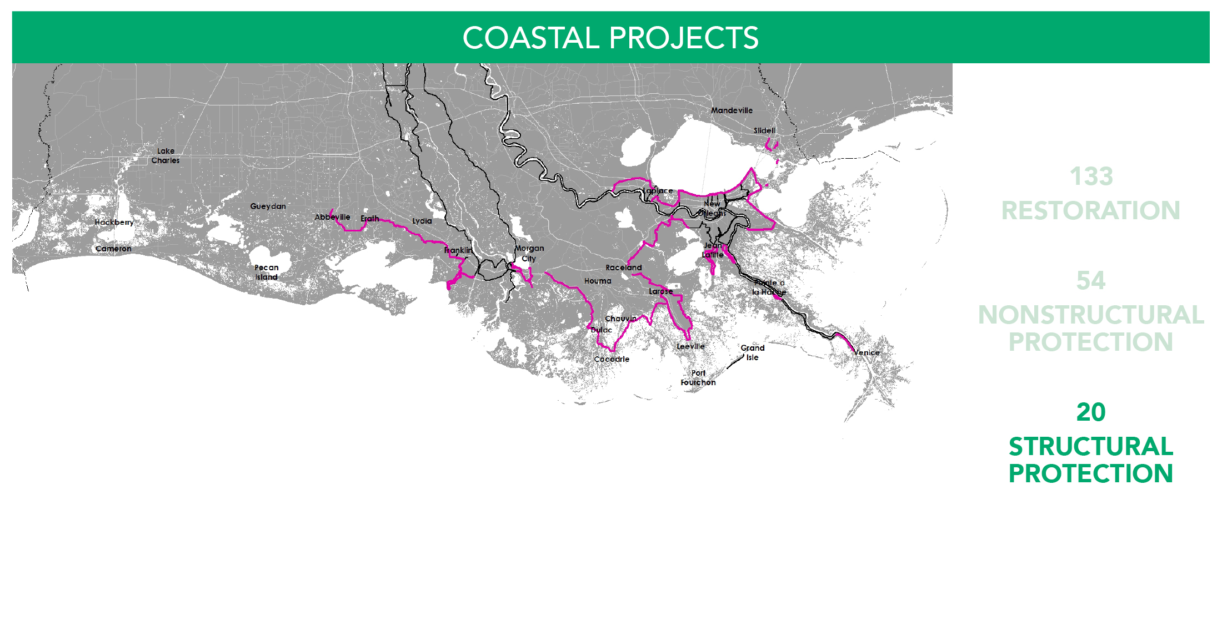
Planning Framework

Slide 23
Developing the Coastal Master Plan

Slide 24
Planning Framework

Slide 25
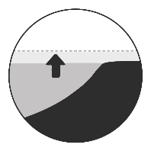
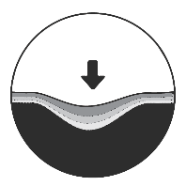
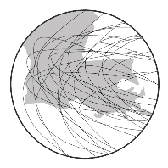
Environmental Scenarios
SCENARIO | PRECIP | ET | SEA LEVEL RISE | SUBSIDENCE | STORM FREQUENCY | AVG. STORM INTENSITY
2017 COASTAL MASTER PLAN
LOW | >HISTORICAL | <HISTORICAL | 1.41’ | 20% OF RANGE | -28% | +10.0%
MEDIUM | >HISTORICAL | HISTORICAL | 2.07' | 20% OF RANGE | -14% | +12.5%
HIGH | HISTORICAL | HISTORICAL | 2.72’ | 50% OF RANGE | 0% | +15.0%
COMPARED TO 2012 COASTAL MASTER PLAN
MODERATE | >HISTORICAL | HISTORICAL | 0.89’ | 20% OF RANGE | 0% | +10.0%
LESS OPTIMISTIC | HISTORICAL | >HISTORICAL | 1.48’ | 50% OF RANGE | +2.5% | +20.0%
 |  |  | (FEET/50 YEARS)

Slide 26
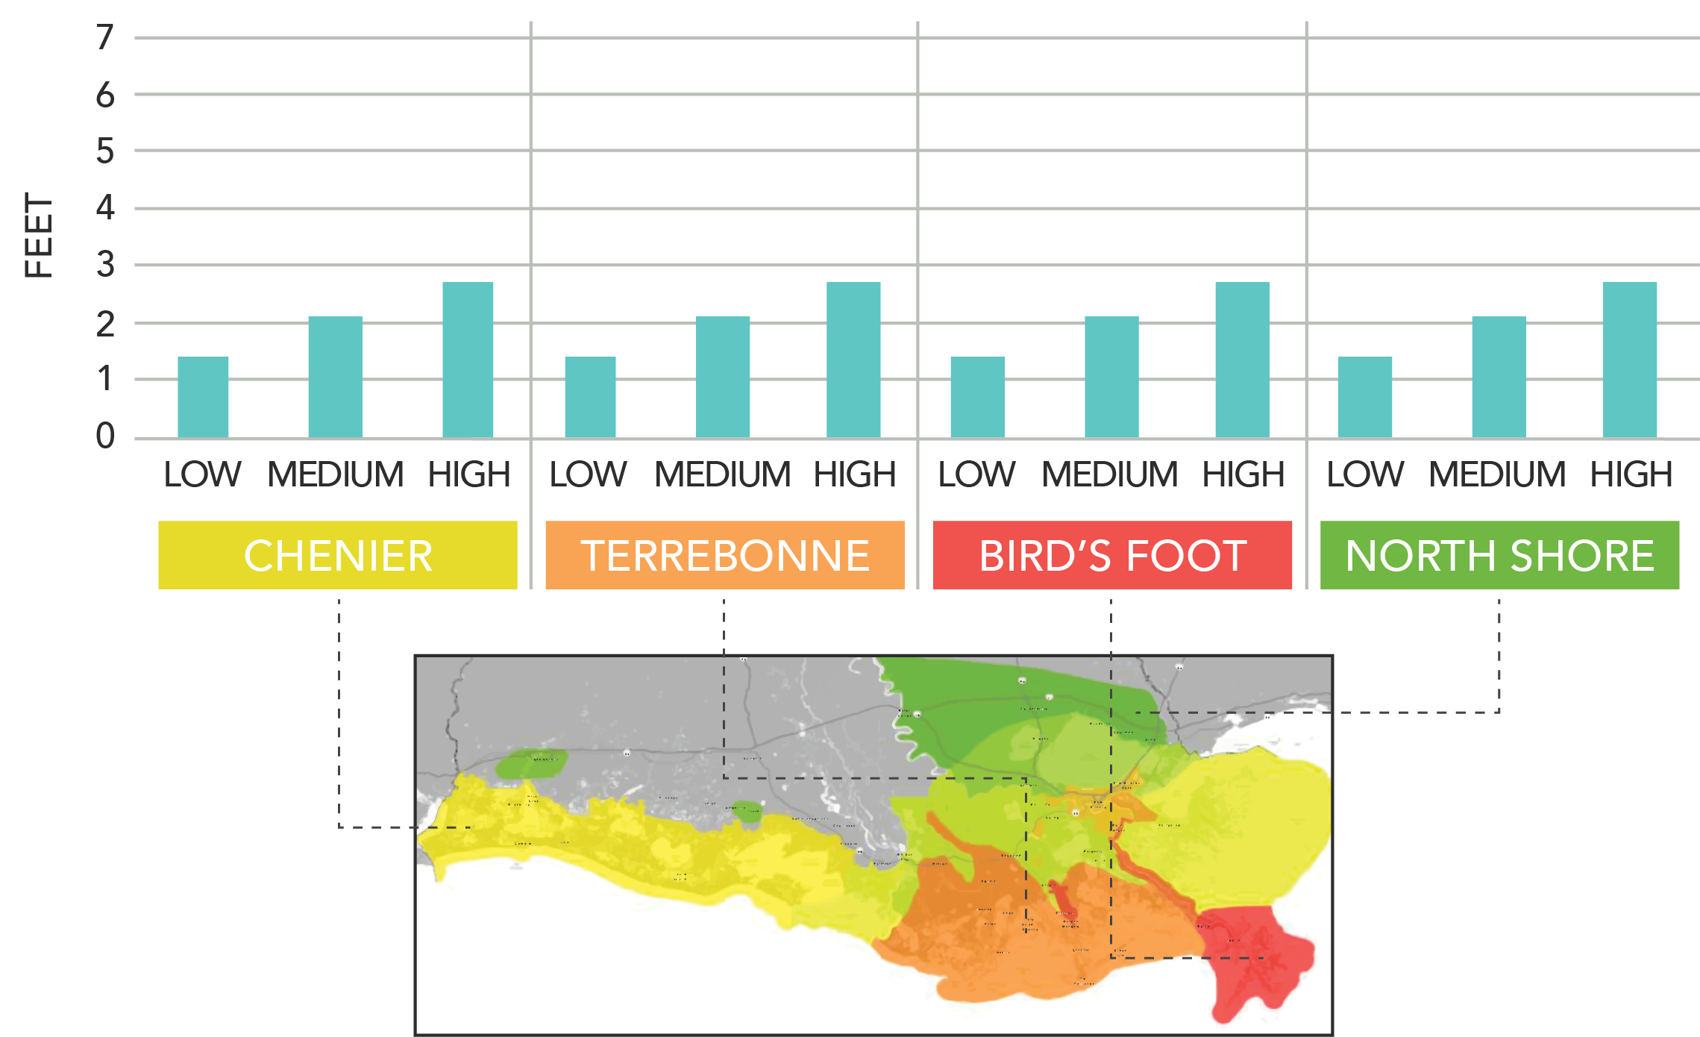
Relative Sea Level Rise Over 50 Years Sea Level Rise

Slide 27
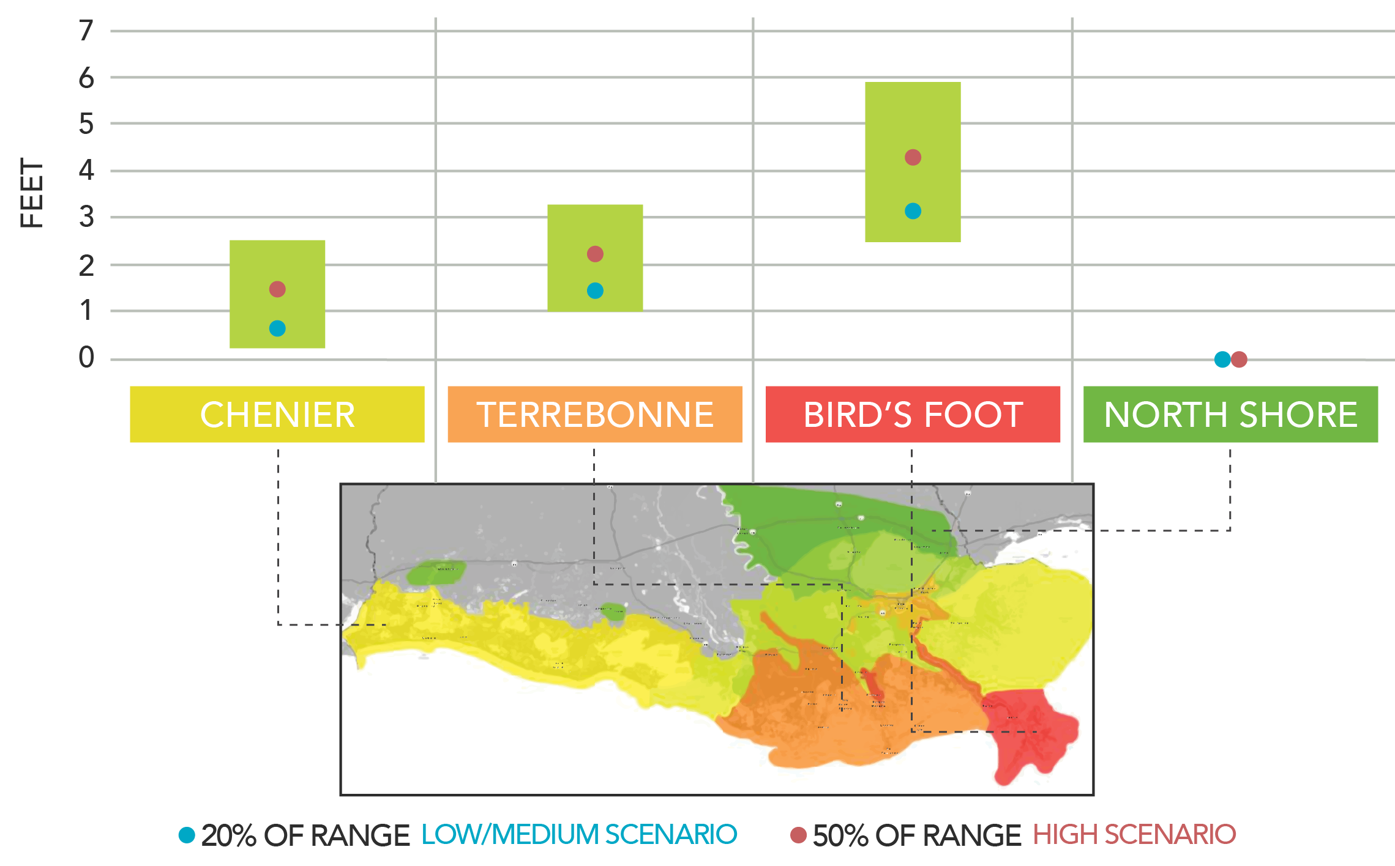
SUBSIDENCE RANGES

Slide 28
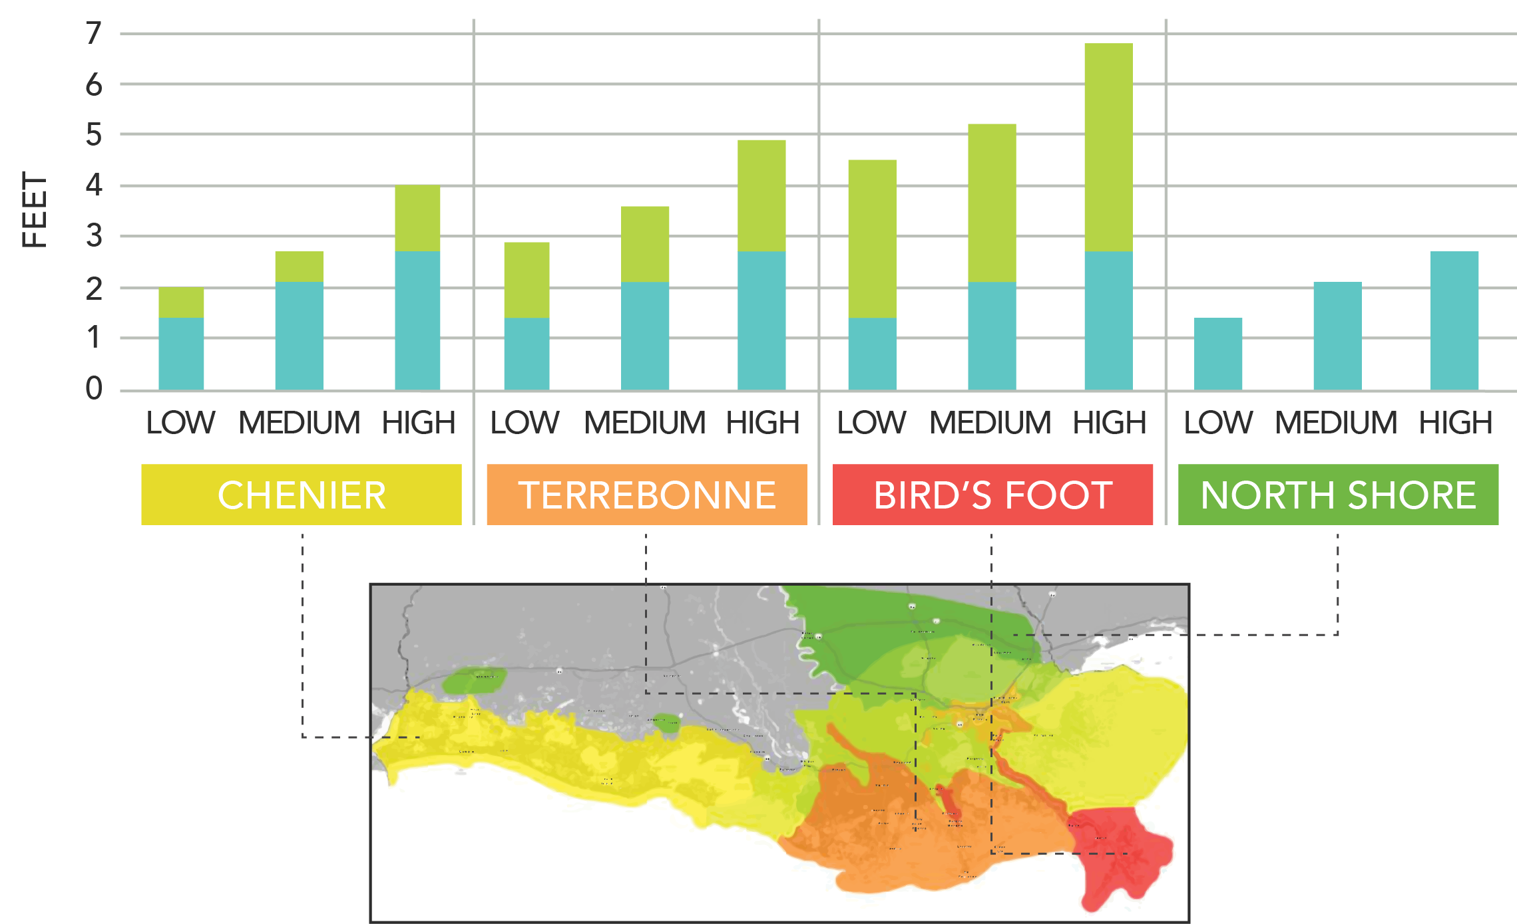
Relative Sea Level Rise Over 50 Years Sea Level Rise + Subsidence

Slide 29
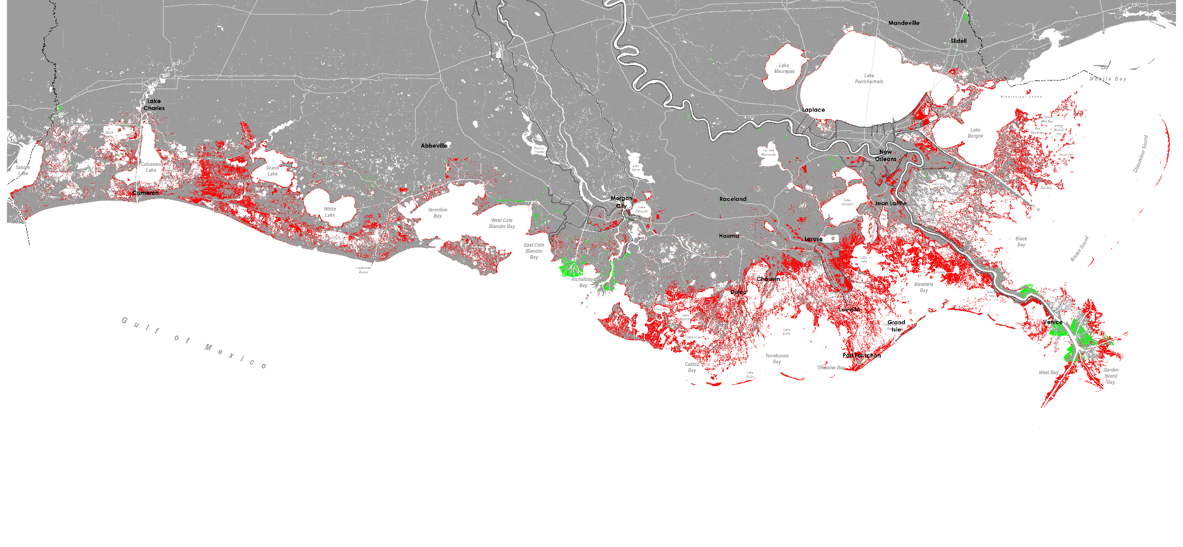
Predicted Land Change Future Without Action Year 50, Low Scenario
DRAFT

Slide 30
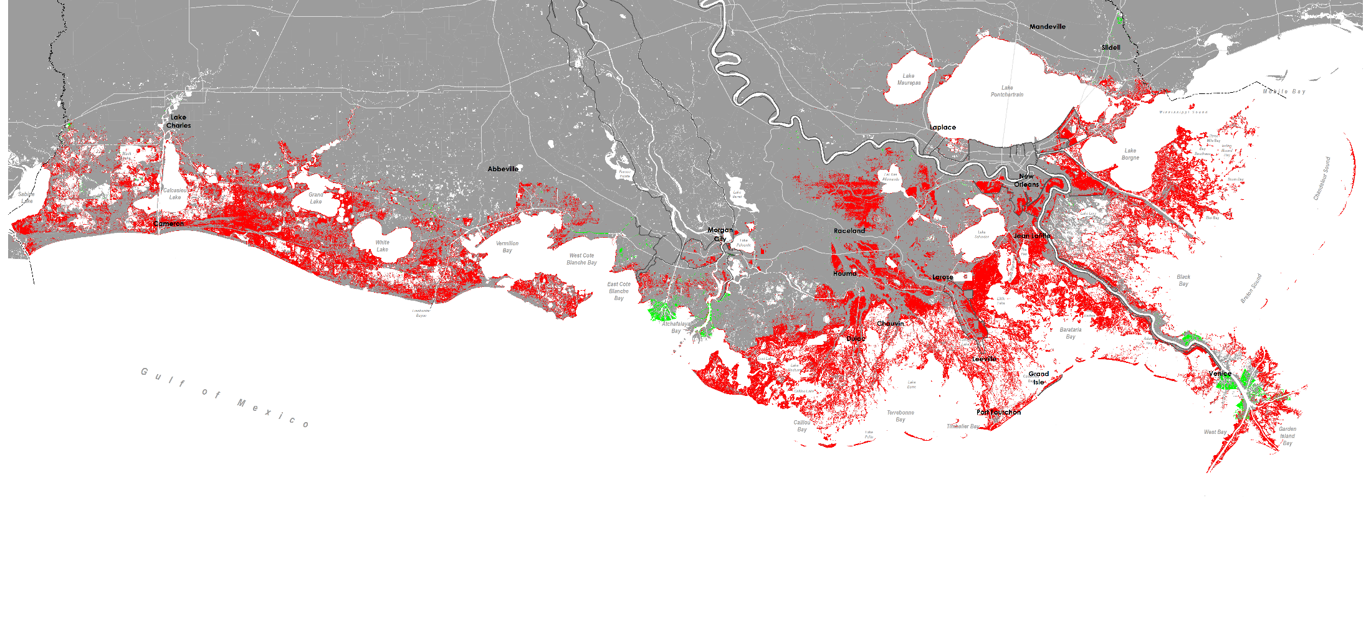
Predicted Land Change Future Without Action Year 50, Medium Scenario
DRAFT

Slide 31
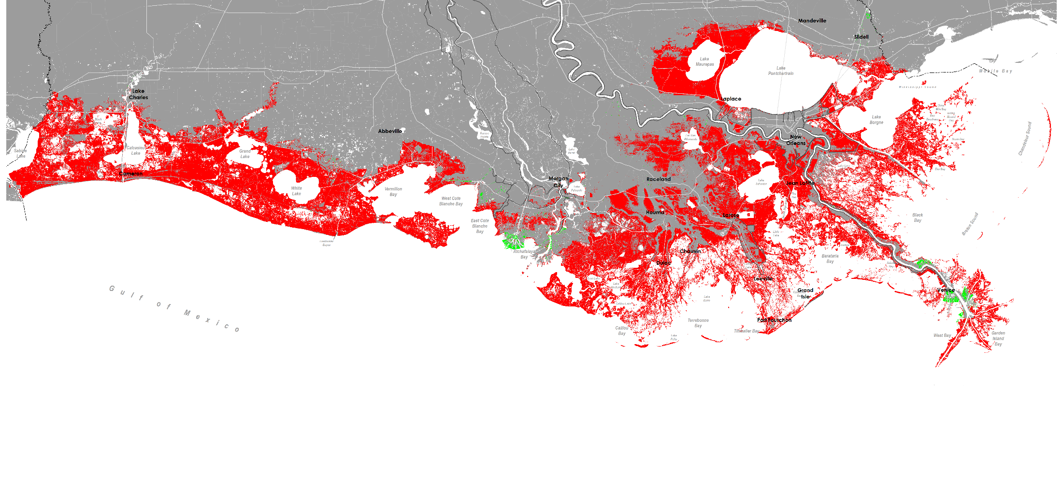
Predicted Land Change Future Without Action Year 50, High Scenario
DRAFT

Slide 32
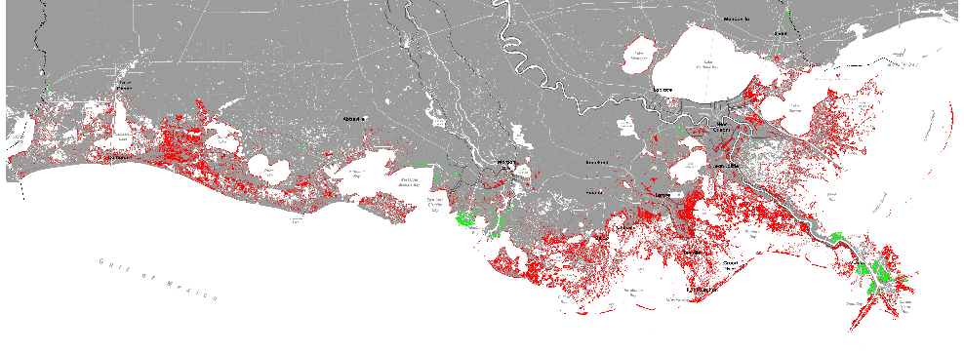
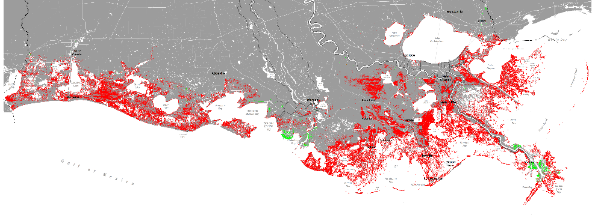
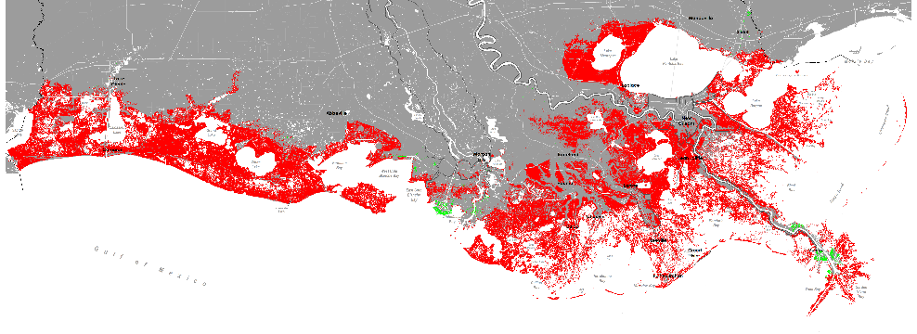
Predicted Land Change Future Without Action Year 50
LOW
DRAFT
MEDIUM
HIGH

Slide 33
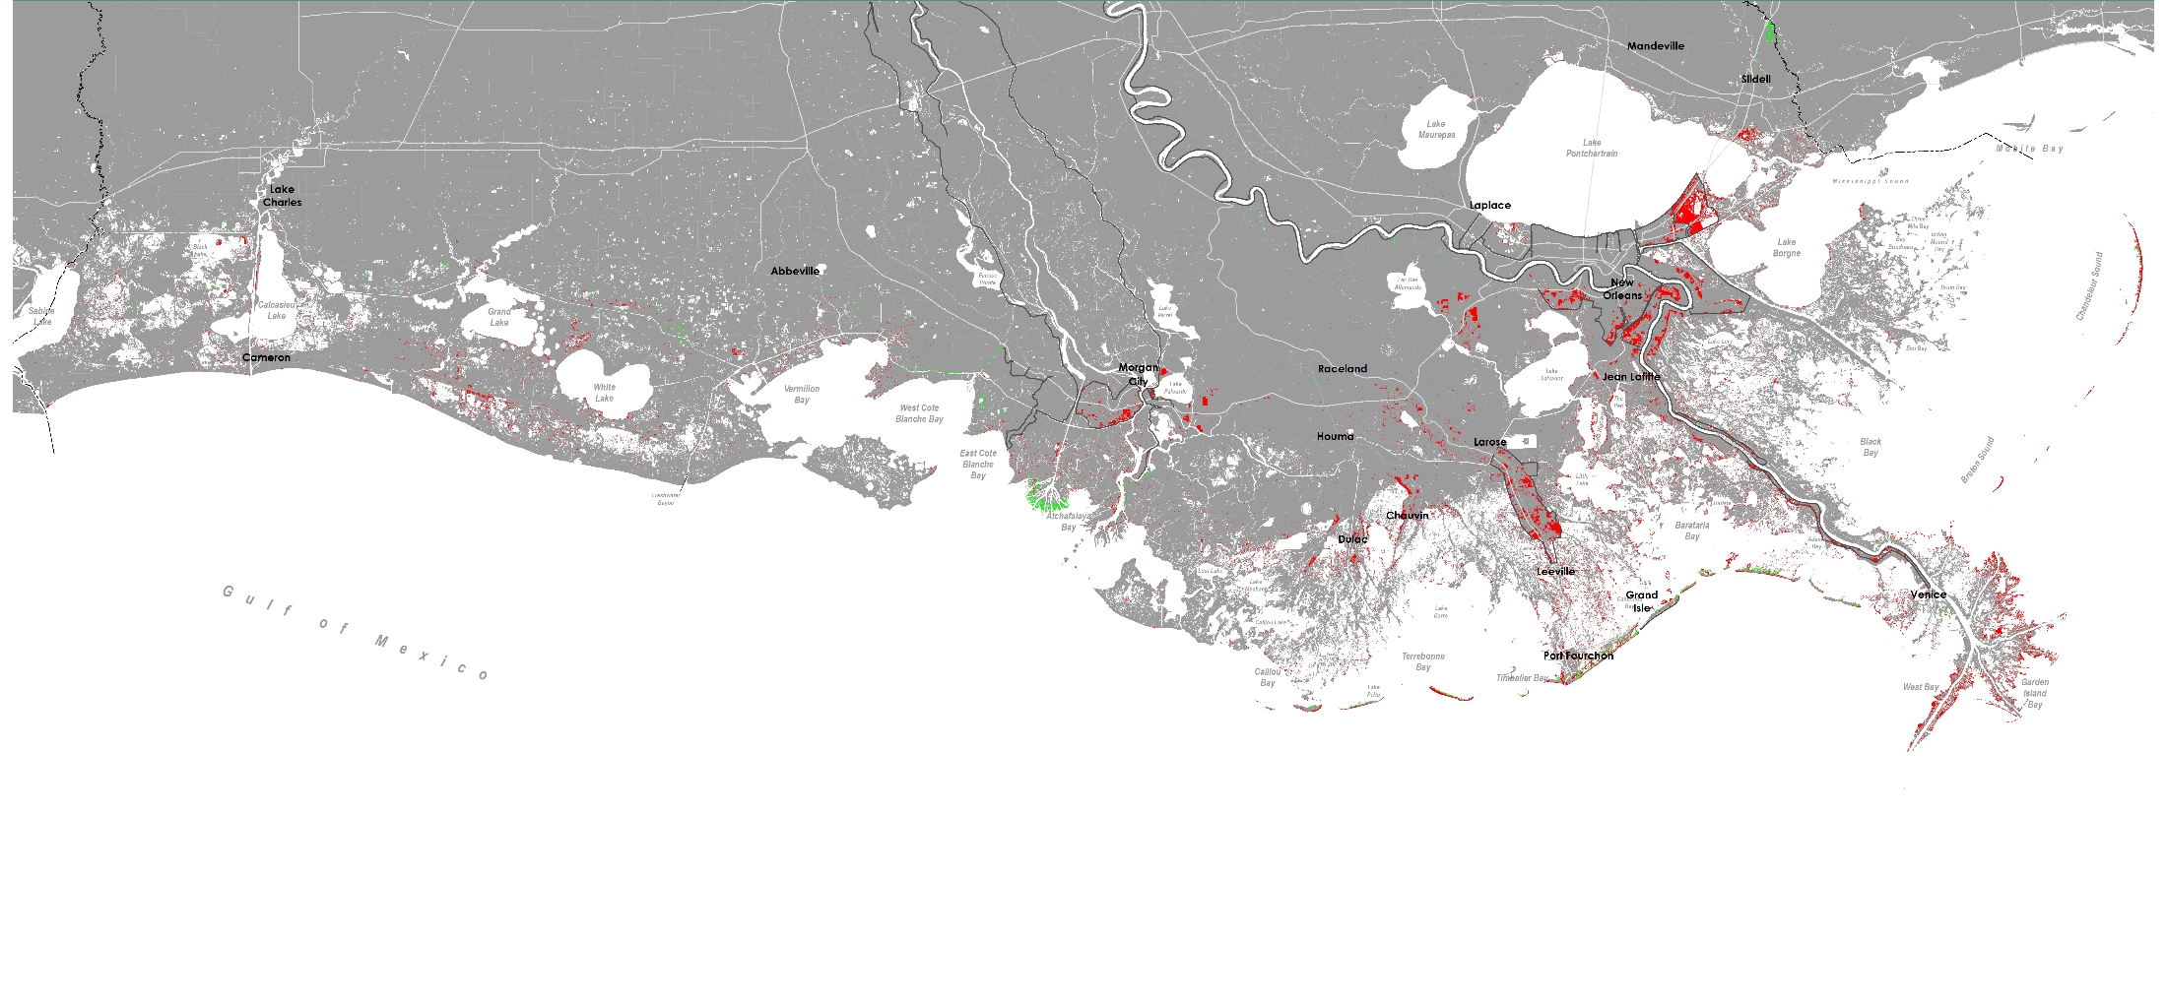
Predicted Land Change Future Without Action Year 10, High Scenario
DRAFT

Slide 34
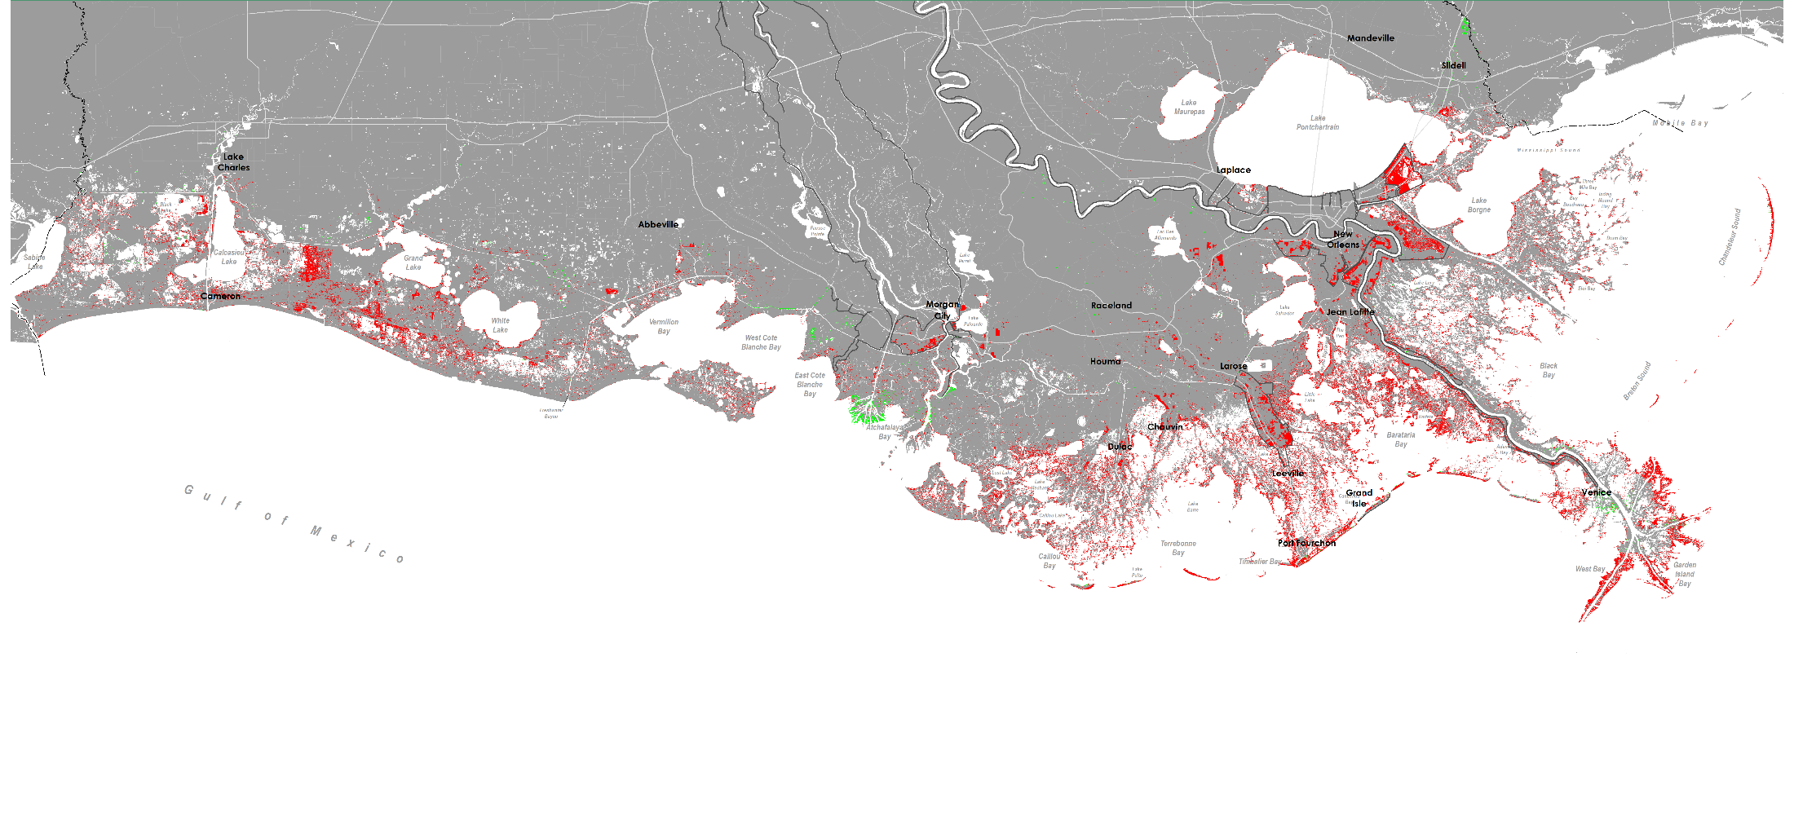
Predicted Land Change Future Without Action Year 20, High Scenario
DRAFT

Slide 35
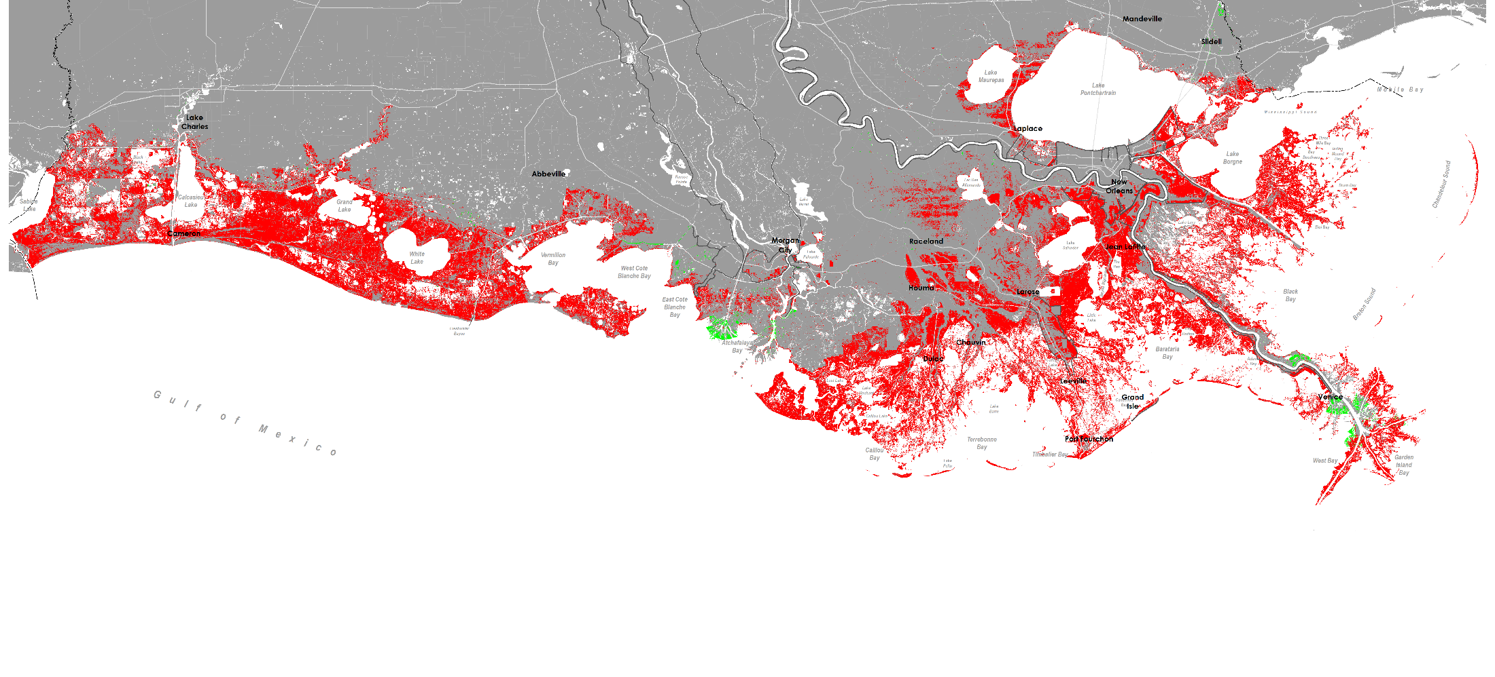
Predicted Land Change Future Without Action Year 30, High Scenario
DRAFT

Slide 36
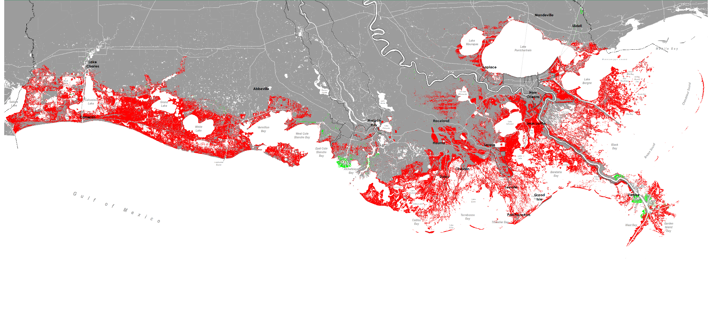
Predicted Land Change Future Without Action Year 40, High Scenario
DRAFT

Slide 37
Predicted Land Change Future Without Action Year 50, High Scenario
DRAFT

Slide 38
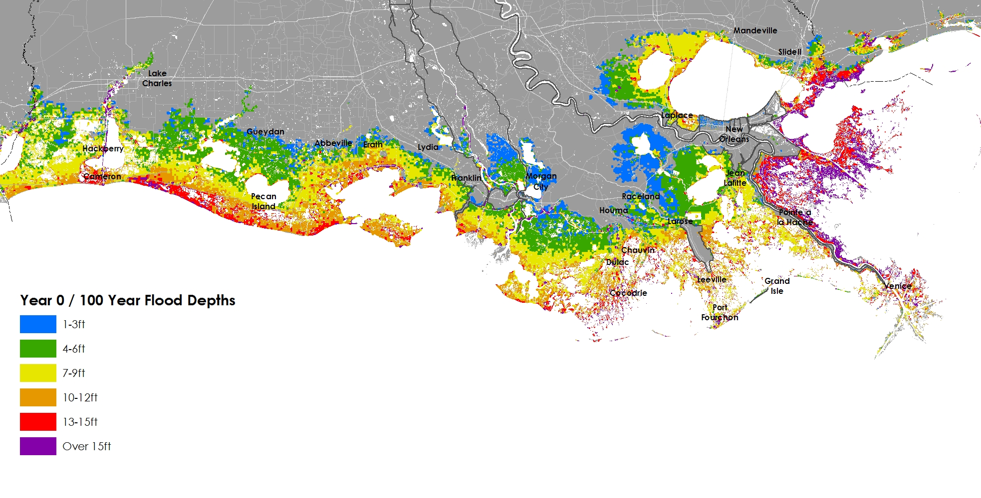
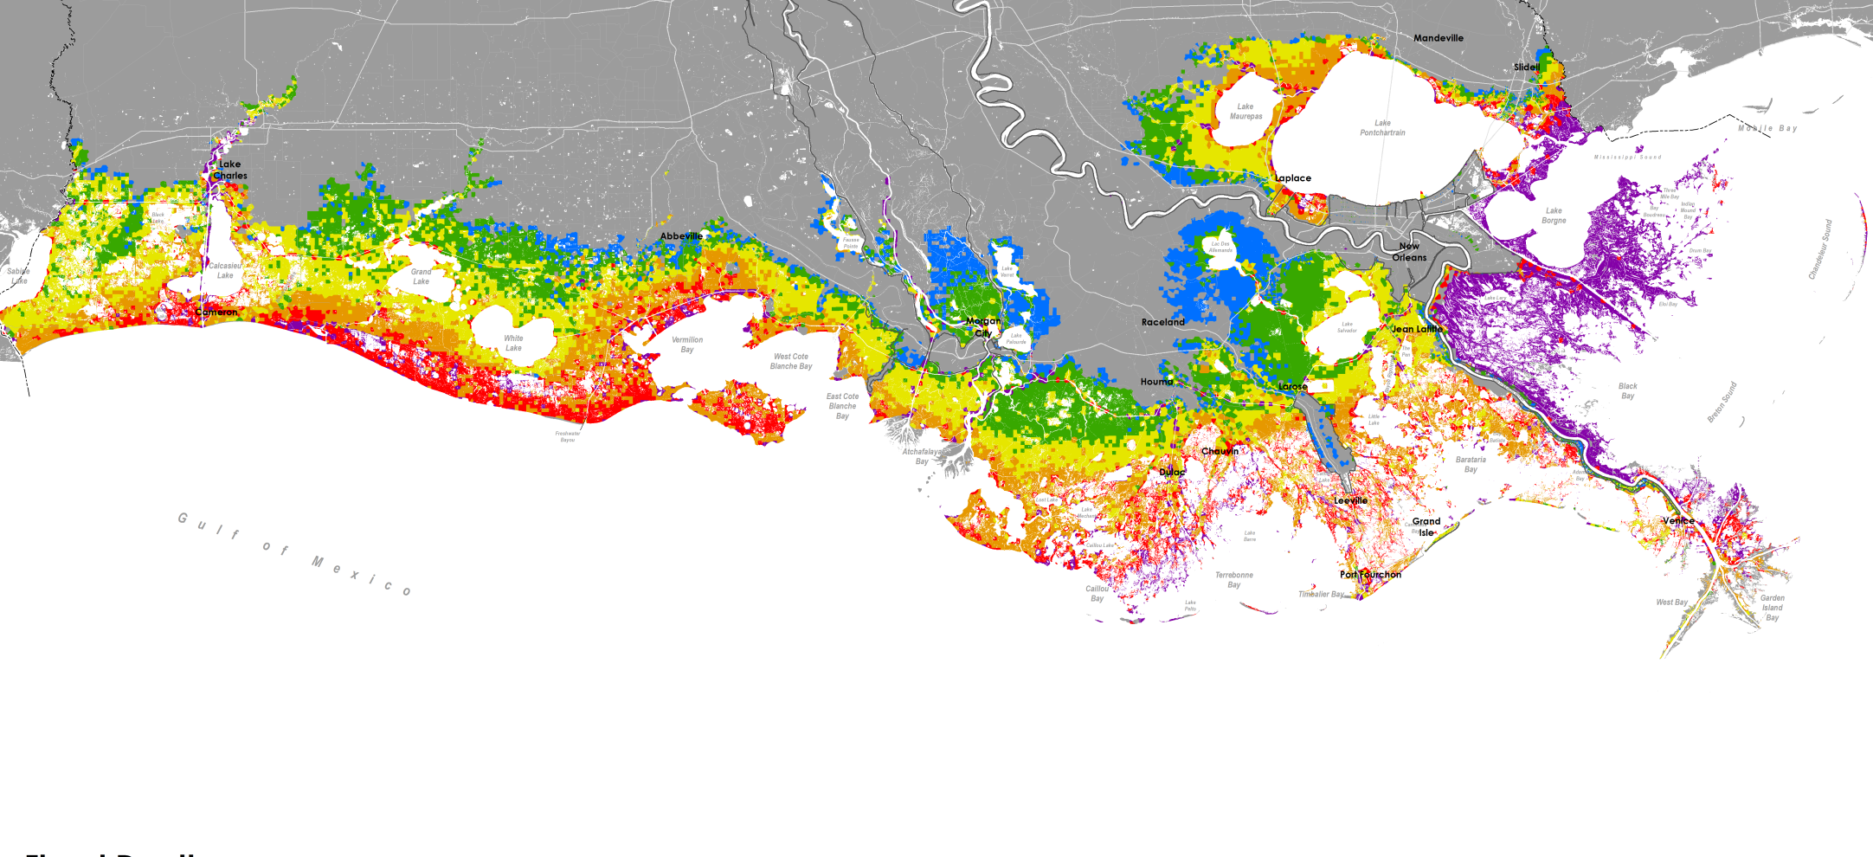
Predicted Flood Depths Future Without Action Year 10, Low Scenario, 100-Year Event
v
LOW / YEAR 25 / 100 YEAR FLOOD DEPTHS
1' - 3'
4' - 6'
7' - 9'
10' - 12'
13' - 15'
Over 15'

Slide 39
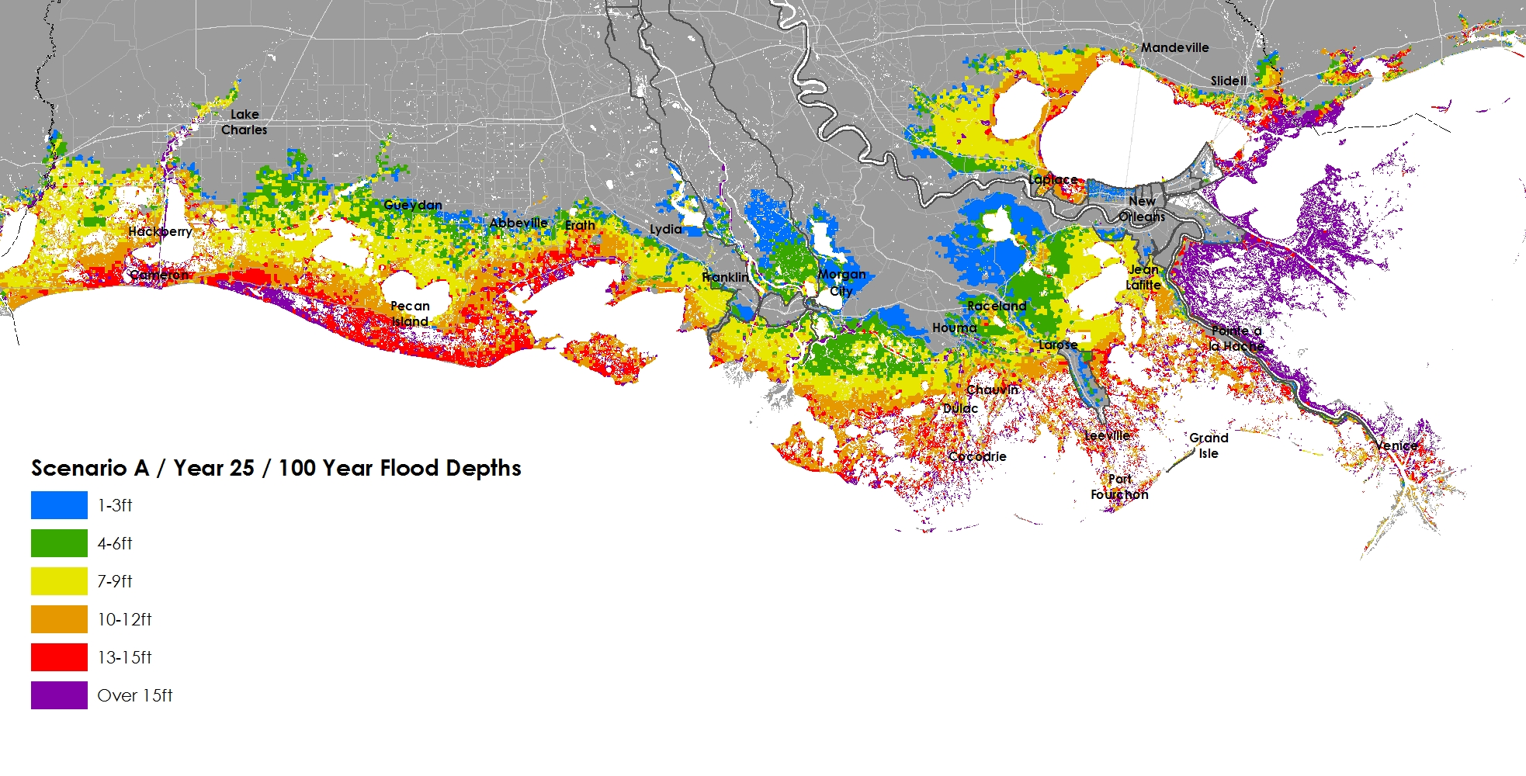
Predicted Flood Depths Future Without Action Year 25, Low Scenario, 100-Year Event
v
LOW / YEAR 25 / 100 YEAR FLOOD DEPTHS
1' - 3'
4' - 6'
7' - 9'
10' - 12'
13' - 15'
Over 15'

Slide 40
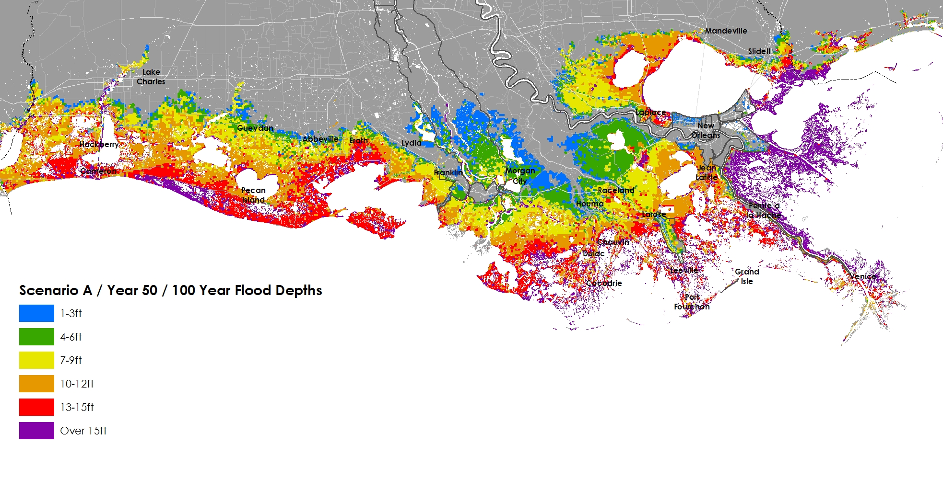
Predicted Flood Depths Future Without Action Year 50, Low Scenario, 100-Year Event
v
LOW / YEAR 50 / 100 YEAR FLOOD DEPTHS
1' - 3'
4' - 6'
7' - 9'
10' - 12'
13' - 15'
Over 15'

Slide 41
Developing the Coastal Master Plan

Slide 42
Planning Framework

Slide 43
Developing the Coastal Master Plan

Slide 44
Outreach & Engagement

Slide 45
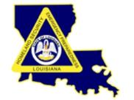
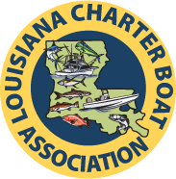
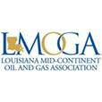
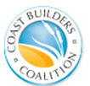
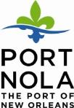
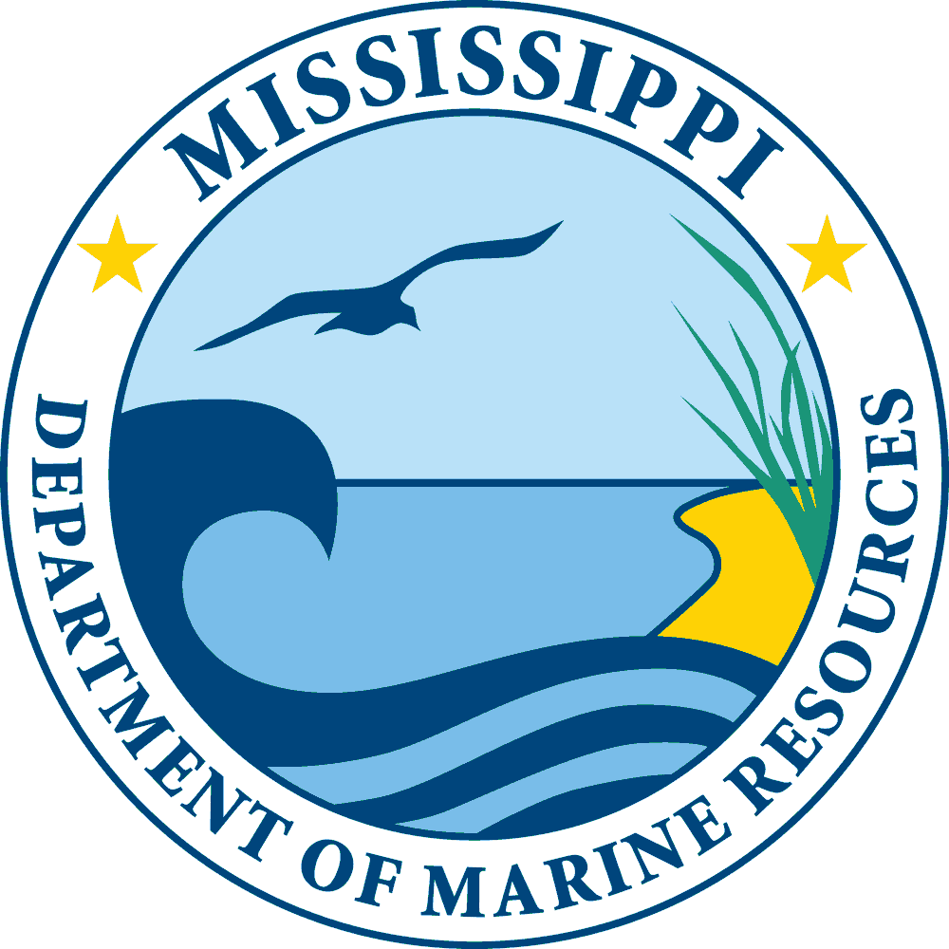
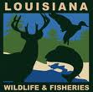
FRAMEWORK DEVELOPMENT TEAM
Notes:
The Framework Development Team is made up of individuals representing a variety of key stakeholder groups. This group was part of the 2012 effort, and it will continue to be utilized as CPRA seeks input for the 2017 Coastal Master Plan.
This team includes representation from local parishes, state and federal agencies, academia, and non-profits, as well as industry.
This is a group CPRA works with to make sure that a wide variety of viewpoints are heard and incorporated into the ideas and recommendations that will influence the 2017 Coastal Master Plan.
The FDT also functions as a communications conduit by allowing representatives to share what we’re working on with their stakeholders, and then share stakeholder thoughts back with CPRA as well. This process has been very beneficial in thinking through a lot of issues that may not have been on CPRA’s radar before.
You can visit CPRA’s website for a complete list of FDT members, as well as members of all of the groups involved throughout the 2017 Coastal Master Plan effort.

Slide 46
FOCUS GROUPS
Key industries or stakeholder groups that are impacted by land loss and large scale protection and restoration efforts
Focus Groups:
Community
Energy and Industry
Fisheries
Landowners
Navigation

Slide 47
SCIENCE AND ENGINEERING BOARD
NAME | ORGANIZATION | EXPERTISE
Carl Friedrichs | VIMS, William & Mary | Coastal Geoscience
Dan Childers | Arizona State University | Wetlands
Ed Houde | University of Maryland | Fisheries
Jen Irish | Virginia Tech | Risk
Len Shabman | Resources for the Future | Economics
Margaret Davidson |  | Natural Resource/Economic Policies
Marius Sokolewicz | Royal Haskoning | Coastal Modeling
Michael Orbach | Duke University | Socio-Economics
Sandra Knight | WaterWonks, LLC | Water Resources
William Fulton | Rice University | Urban Planning

Slide 48
TECHNICAL ADVISORY COMMITTEES
PREDICTIVE MODELS
John Callaway, University of San Francisco
Scott Hagen, Louisiana State University
Courtney Harris, Virginia Institute of Marine Sciences
Wim Kimmerer, San Francisco State University
Mike Waldon, US Fish and Wildlife Services (retired)
RESILIENCY
Daniel Aldrich, Northeastern University
Diane Austin, University of Arizona
Gavin Smith, University of North Carolina
Dan Zarrilli, City of New York, Mayor’s Office of Recovery & Resiliency
Notes:
Technical Advisory Committees (TACs) are small advisory groups made up of nationally known scientists and engineers.
For the 2017 Coastal Master Plan, a Predictive Models TAC has been established to advise the technical team working to implement the Model Improvement Plan.
In addition, a Resiliency TAC was established to offer working-level guidance and recommendations to CPRA on programmatic and policy measures needed to implement a comprehensive flood risk and resilience program. The Resiliency TAC is composed of experts in the areas of socio-economics, social capital, social vulnerability, and hazard mitigation/disaster planning.

Slide 49
Citizen Engagement Early Fall 2016
Host 4 community meetings across coastal Louisiana
Partner with local organizations when possible
Focus on receiving feedback on draft lists of potential projects at the basin scale
Use information from project modeling and alternative formulation to inform facilitated discussions
Use feedback to inform development of the draft plan

Slide 50
Parish Engagement
Roundtable format in multiple locations
Targeted attendees
Parish Presidents
Chief Administrative Officers
Floodplain Managers
Coastal Zone Managers
Public Works Directors
Levee Districts
Schedule:
Round 1: May 25 and 26, 2016
Round 2: October 2016
Round 3: January 2017

Slide 51
Website and Social Media
Planning and Technical Teams
Working Together
Technical Analysis
Learn More
Get Involved

Slide 52
Online Resources
2017 Coastal Master Plan brochure
2017 Coastal Master Plan videos in English and Vietnamese
Frequently asked questions

Slide 53
Interactive Education and Engagement
Visualization Tools: Model Output
www.cims.coastal.la.gov/floodrisk
Visualization Tools: Planning Tool Output

Slide 54
Parish Factsheets

Slide 55
HOW TO GET INVOLVED?
Visit our website: coastal.la.gov
Request a presentation or meeting: masterplan@la.gov
Attend public and community meetings

Slide 56
Timeline

Slide 57
Karim Belhadjali | karim.belhadjali@la.gov

